Slide 1



Tokyo .NET Developers Meetup #39
ANTONIO PEREZ
Antonyo

Slide 2

AGENDA
Introduction to BLAZOR
How to get started
Practical example
Debrief

Slide 3
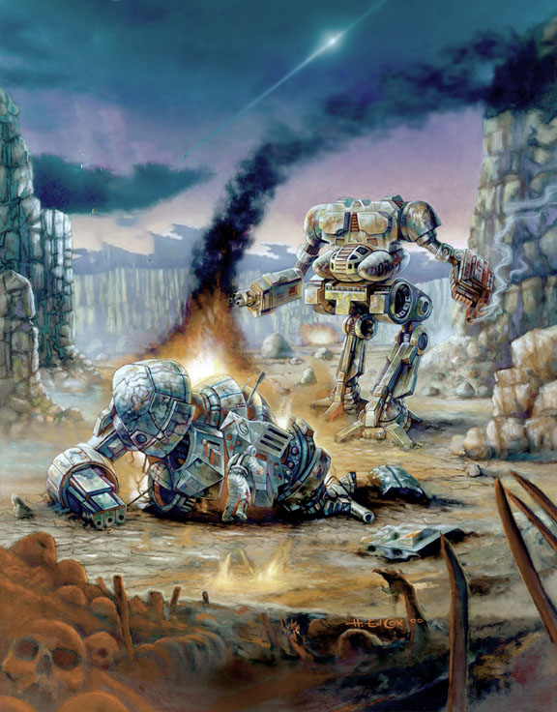



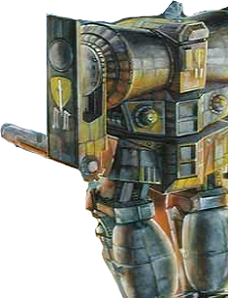

1. WHAT IS BLAZOR

Slide 4



Slide 5
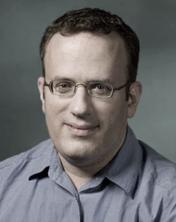
1975
Javascript
Brendan Eich

Slide 6

2015
ONLY

Slide 7

2017

Slide 8
JS
PARSED
COMPILED (JIT)
OPTIMIZED
HTTP
Executed
WASM
DECODED
COMPILED

Slide 9
Browser JS Engine
JS
JS
JS
WASM
WASM
WASM

Slide 10

C/C++
C#
Rust
Browser JS Engine
JS
WASM
Python
JAVASCRIPT (javascript can be compiled into wasm and then executed by javascript just for fun)

Slide 11
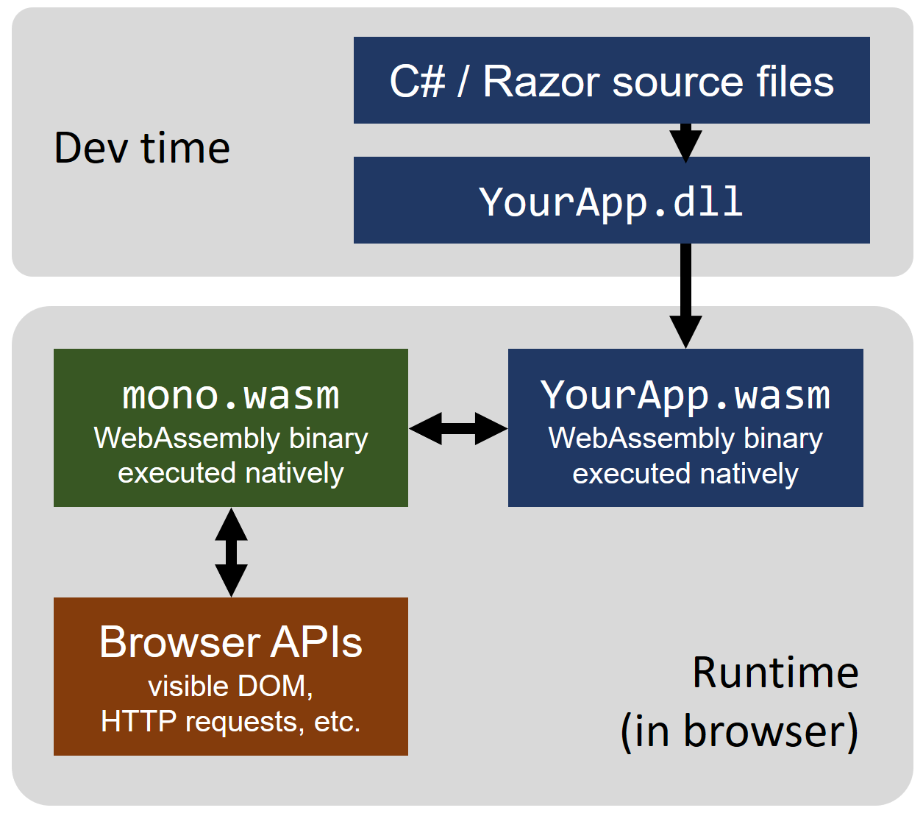
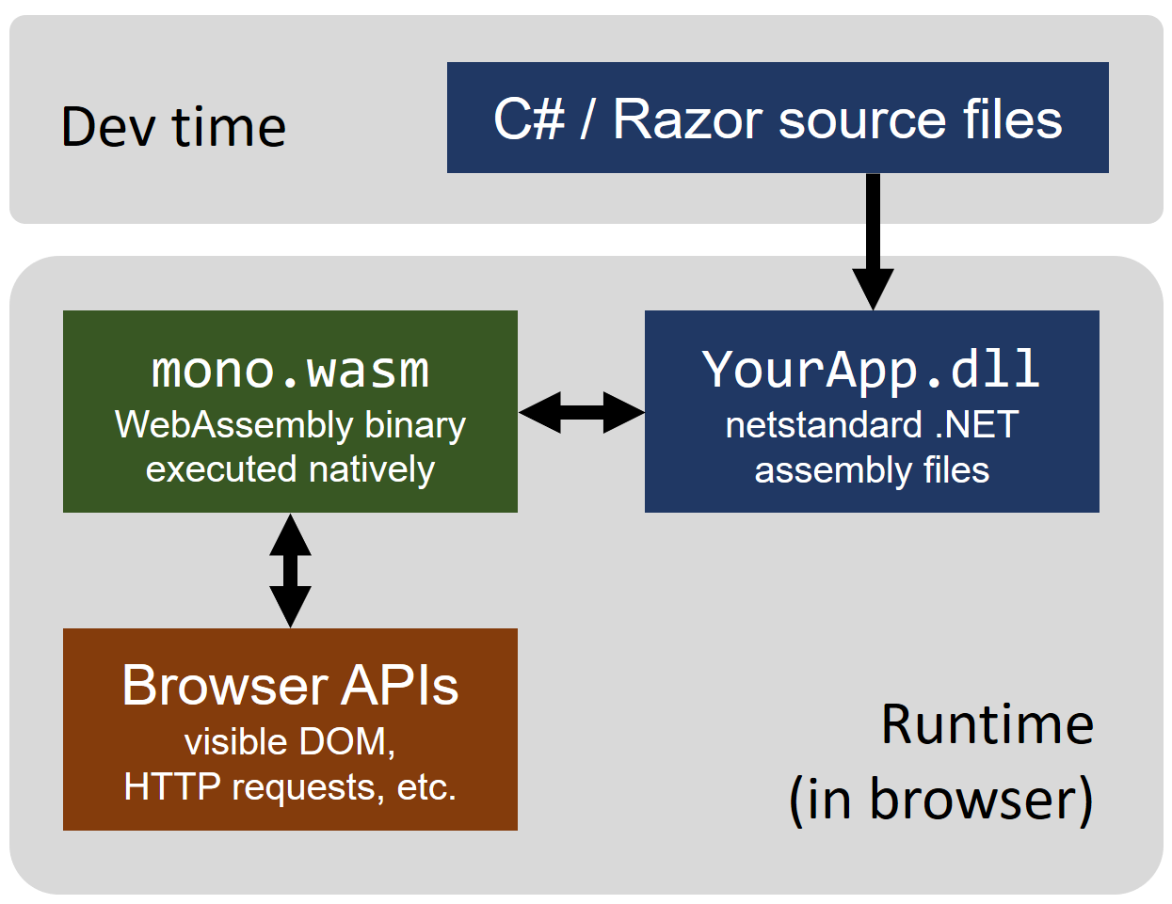

Slide 12
WHAT IS BLAZOR
It’s (another) a SPA Framework
Inspired by other SPA frameworks like React, Angular
Similar syntax to Razor
Runs on ASP.Net Core
Components
Layouts
Dependency Injection
Routing
Javascript Interop
And more to come…

Slide 13
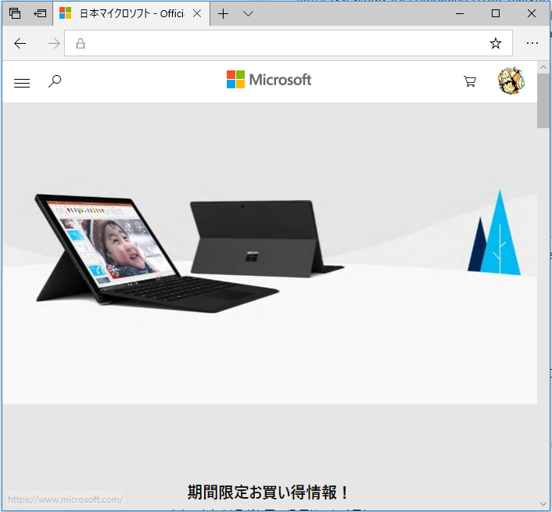
COMPONENTS
Client List
http://www.contoso.com/users
http://www.contoso.com
Client Info
Client List
Client Info
Client List from Japan
Client Info
Client Info
Client Info
Client Info
Client Info
Client List from UK
Client Info

Slide 14
2. Get Started
https://blazor.net/docs/get-started.html

Slide 15
3. Practical Example
Small website that manage Meetup users and their attendance to events.

Slide 16
Component Lifecycle
Override the following methods inside a component
SetParameters
OnInit
OnInitAsync
OnParametersSet
OnParametersSetAsync
OnRender
OnRenderAsync
If component implements IDisposable
Dispose

Slide 17
4. Debrief
Resources
Official website: https://blazor.net/
Official Github: https://github.com/aspnet/blazor
Good article on WebAssembly: https://hacks.mozilla.org/category/code-cartoons/a-cartoon-intro-to-webassembly/
Many more resources: https://blazor.net/community.html
My Github: https://github.com/Antonyo/DotNetMeetup

Slide 18


