Slide 1
Strategy Pattern
Course Title: | Software Engineering & Information System Lab
Course Code: | CSE-3104
Assigned By: | Md. Samsuddoha Assistant Professor University of Barishal

Slide 2
Submitted by : Team Innovex
Team Members | Role | Cover Content
Afsana (ID-053) | Team Leader | Introduce the pattern & Intent
Sabiha Akter (ID-051) | Database Administrator | Problems & Solution
Tasnim Ahmed Arnob (ID-042) | Backend Engineer | Structure Examples/ Real Analogy Application
Shouvik Biswas (ID-24) | SQA Engineer & Business Analyst | Advantage & Disadvantage
Mahbubur Rahman Antor (ID-34) | UI/UX Designer and Fronted Developer | Coding

Slide 3
01 Introduce the pattern & Intent
TABLE OF CONTENTS
02 Problems
03 Solution
04 Structure
05 Examples & Real Analogy
06 Advantage & Disadvantage
07 Application
08 Coding

Slide 4
What is Design Pattern?
Design Pattern
A Design Pattern is a reusable and proven blueprint that provides a general solution to commonly occurring software design problems. It is not ready-made code but a customizable template that developers adapt according to their needs.
General Concept
Not actual code, just an idea or structure.
Customizable
Can be adapted to different programs

Slide 5
Why Should You Learn Design Patterns?
02.
04.
06.
Common Problems
Code Reusability
Common Language
01.
03.
05.
07.
Proven Solutions
OOP Principles
Better Communication
Save Time

Slide 6
What Does a Design Pattern Consist Of?
Briefly describes the problem and solution.
Shows the classes and their relationships.
Explains when and where to use the pattern.
Intent
Motivation
Structure
Code Example
Applicability
Explains why the pattern is needed and how it helps.
Demonstrates the pattern using sample code.

Slide 7
Classification of Design Patterns
Creational patterns
Structural patterns
Behavioral patterns

Slide 8
Design Patterns in different programming languages

Slide 9
What is Strategy Design Pattern?
Strategy Design Pattern
Strategy Design Pattern is a behavioral design pattern that allows you to define multiple algorithms (strategies), place each one in a separate class, and switch between them at runtime without changing the main code.
Example
A Navigator App can have different routing strategies:
Car Route
Walking Route
Cycling Route
Public Transport Route
Instead of writing all route logic inside one class, each route becomes a separate strategy and the app selects one when needed.

Slide 10
Walking
Public Transport
Problem Statement
Cycling
Tourist Routes
Navigator app initially supported car routes only. New routing options includes:
to provide directions for pedestrians.
to suggest travel using buses, trains, or similar services.
to recommend scenic or attraction-based paths.
to support bike-friendly navigation

Slide 11
Issue-2
Issue-1
Issues Faced
Issue-3
Diffult to maintain and modify
Class became large and complex
Issue-4
Higher risk of bugs
Frequent merge conflicts in team development

Slide 12
Solution
Extract each routing algorithm into a separate Strategy class.
Define a common interface: buildRoute(start, end)
Examples
CarRouteStrategy
CyclingRouteStrategy
WalkingRouteStrategy
Navigator – delegates route calculation to the selected strategy
PublicTranportStrategy
Strategies can be switched at runtime

Slide 13
✔ Better maintainability
✔ Easy to add new routing algorithms
Benefits
✔ Reduced code duplication and bugs
✔ Improved teamwork and scalability
✔ Follows the Open/Closed Principle

Slide 14
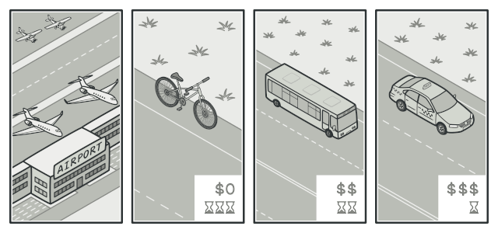
Getting to the Airport
Transportation strategies
Real Life AnalogY
Depending on factors

Slide 15
Structue - 4 Components
Context
CONCRETE STRATEGIES
Runs the strategy, never knows details
Each algorithm lives in its own class
CLIENT
STRATEGY INTERFACE
Chooses which strategy to use
all strategies must follow

Slide 16
Structure — Keywords
Structure
CLIENT
CONTEXT
«interface»
STRATEGY
uses
• Decides • Creates • Injects
injects
strategy: Strategy
setStrategy(s)
execute()
executeStrategy()
Common Contract
Delegates
Doesn't know HOW
Interchangeable
implements ↑
Concrete
Strategy A
Concrete
Strategy B
Concrete
Strategy C
Bus
Car/Cab
Bicycle
execute(bus)
execute(Car/cab)
execute(bicycle)

Slide 17
Real-Life Analogy
✈ Getting to the Airport
The Traveler
Client
sets strategy
THE TRIP
Context
«interface» Travel to the Airport
calls getThere()
🚌 BUS
🚕 Tourist route
🚲 BICYCLE
Cheap • Slow
Fast • Costly
Free • Distance
ConcreteBusStrategy
ConcreteTaxiStrategy
ConcreteBikeStrategy

Slide 18
Advantages
1. Runtime Flexibility
4. Code Reusability
2. Open / Closed Support
5. Less Conditional Logic
3. Easy Maintenance
6. Easy Testing
Insert your multimedia content here

Slide 19
Disadvantages
1. More Classes
4. Overengineering Risk
2. Extra Overhead
5. More Object Interaction
3. Strategy Selection Complexity
Insert your multimedia content here

Slide 20
When to Use ?
Multiple Solutions Exist
Dynamic Behavior Needed
Remove Complex Conditions
Need Scalability
Insert your multimedia content here
Apply SOLID Principles

Slide 21
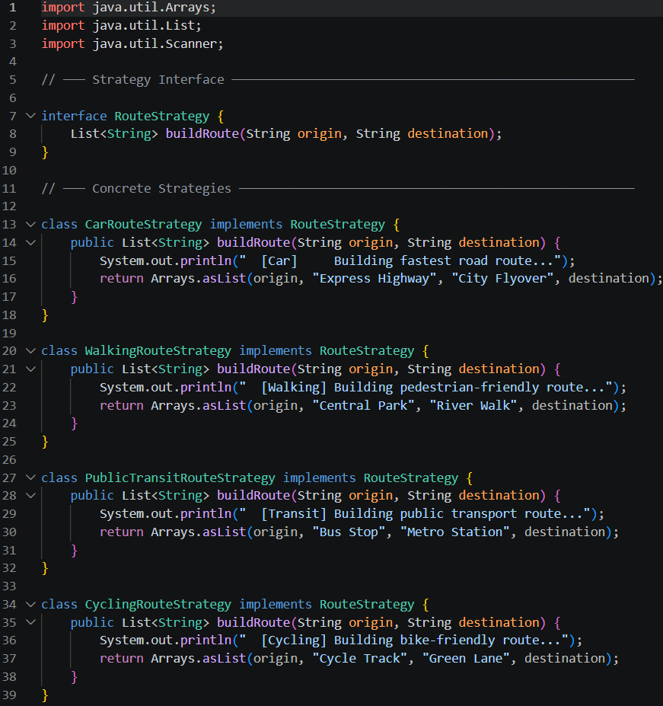
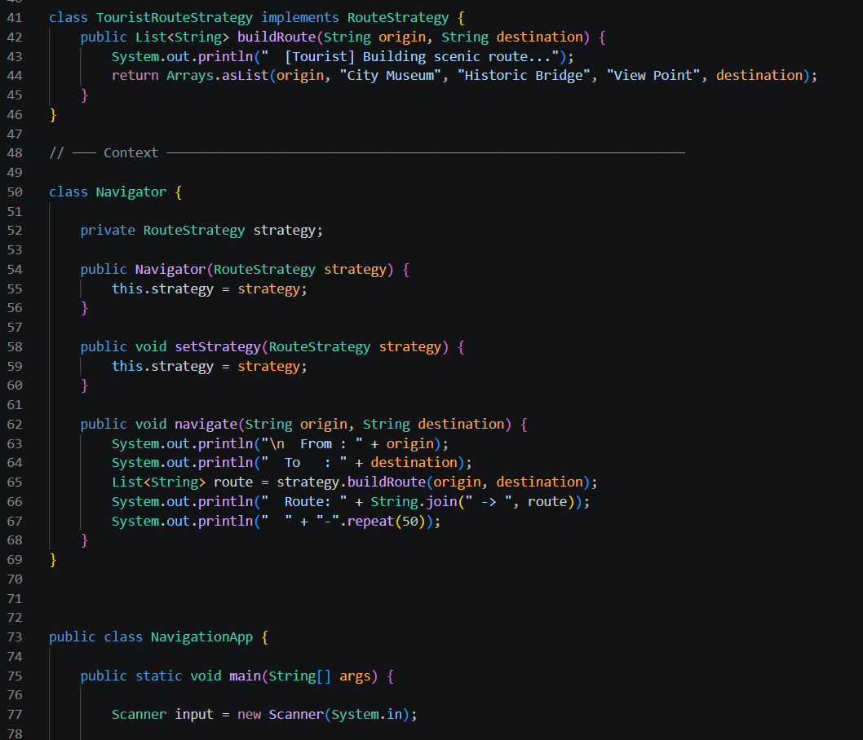
Code

Slide 22
