Slide 1

Agile Project Management Software
01

Slide 2
Agile Project Management Software
Presented By :
1. Md. Samim Sarkar (193015060)
2. Kazi Abrar Ahmed (193015056)
3. Sakhawat Hossain (193015069)
Supervised By :
Mr. Palash Roy
Lecturer , Dept of CSE.
Green University of Bangladesh
08-09-2022
02

Slide 3
Table of Contents
01
02
03
05
Introduction
Objectives
Motivation
Related works
Requirements
Software and Language Requirements
Use Case Diagram
Data Flow Diagram
Gantt Chart
Conclusion
04
03
08-09-2022

Slide 4
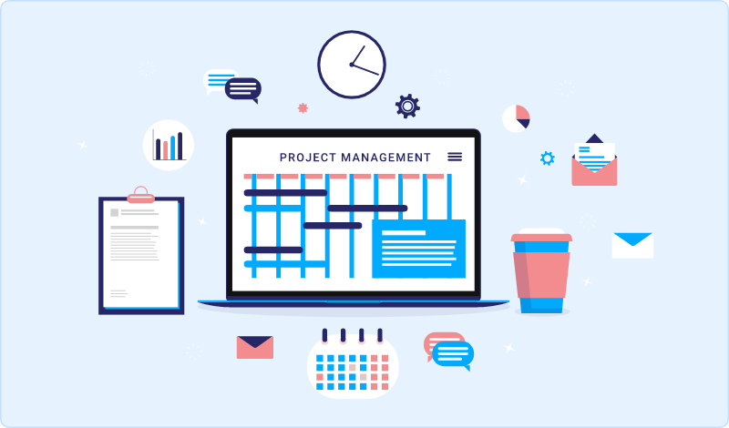
Introduction
Intrack is a cloud-based project management software
It allows businesses to manage, collaborate, communicate, and organize their tasks and projects
04
08-09-2022

Slide 5

OBJECTIVES
To help organizations to get quick feedback from the user’s experience to improve on the project accordingly.
Provide an excellent platform for increasing collaboration in a team.
Achieve organization-wide security, compliance, and planning.
08-09-2022
05

Slide 6
Motivation
01
Agile innovation methods have revolutionized information technology.
02
Over the past 25 to 30 years they have greatly increased success rates in software development
The spread of agile raises intriguing possibilities for other industries besides tech.
04
The existing project management tools are mainly built for engineering software development teams
03
06
08-09-2022

Slide 7
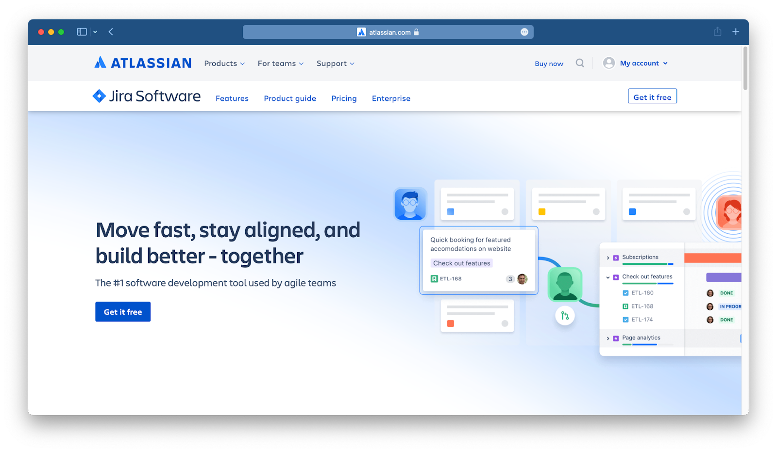
Related works
Jira is a software application used for issue tracking and project management.
Limitations:
It's complicated user interface can make managing tasks difficult.
It's mainly built for engineering and software development teams.
www.atlassian.com/software/jira
08-09-2022
07

Slide 8
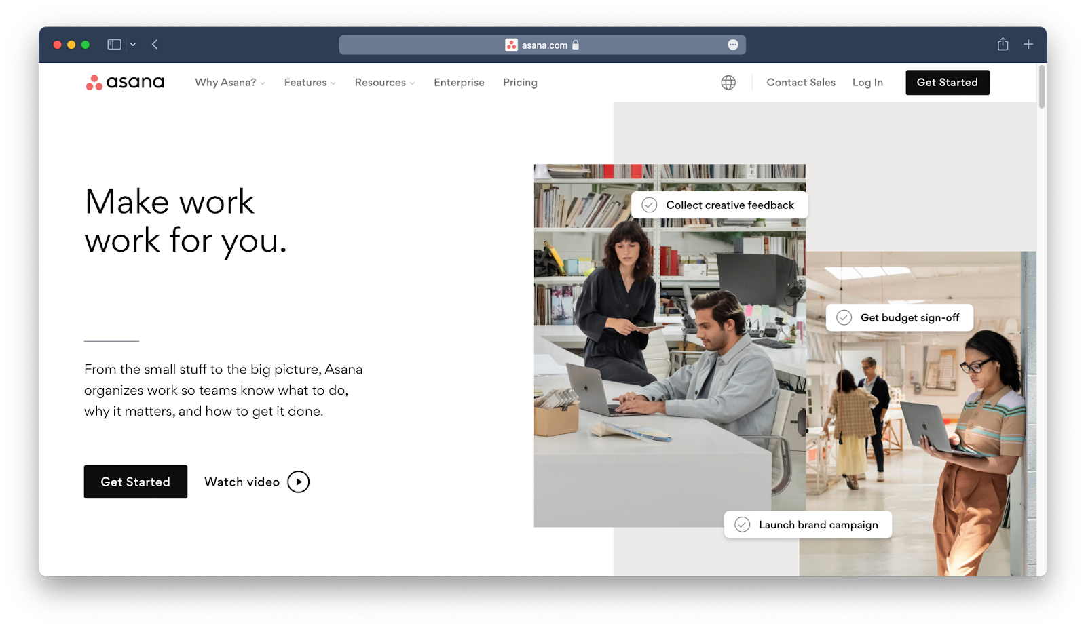
Related works
Asana is a web-based task management and collaboration software.
Limitations:
Limited features on the free version
Not meant for heavy project management
Not Very Friendly to New Users
www.asana.com
08-09-2022
08

Slide 9
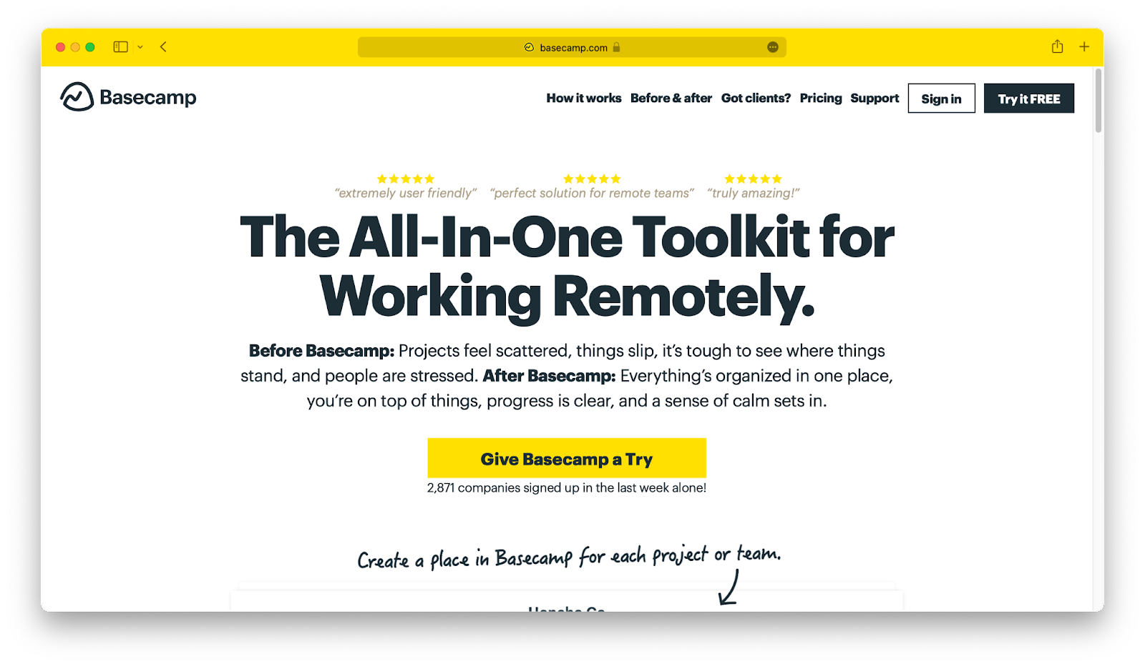
Related works
Basecamp is a collaborative project management software and daily task tracking application.
Limitations:
Extremely limited functionality.
The interface can be confusing to deal with.
Can’t customize task statuses.
Limited project tracking feature.
www.basecamp.com
08-09-2022
09

Slide 10
Requirements
Functional Requirements:
The manager should be able to create a project and invite team members to the project.
The manager can assign tasks to anyone in the team.
Members will view their assigned tasks and update task status.
Both manager and team members should be able to prioritize the task
A verification email is sent to user whenever the user registers for the first time on the system.
Users can visualize their tasks on a List or Board view.
10
08-09-2022

Slide 11
Requirements
Non-Functional Requirements:
Project members are not allowed to delete the project.
The software should be platform-independent. So moving from one OS to another OS will not create any problems.
The processing of each request should be done within 10 seconds
The system must perform without failure in 95 percent of use cases during a month.
11
08-09-2022

Slide 12
Software Requirements and Language Requirements
Software Requirements:
VS Code
Git
Github
Figma
Any Web browser
Language Requirements:
In addition, the following technologies
we’ll use while developing the platform:
Back End:
Node.js/Express
MongoDB
Redis
Docker
Front End:
React.js/Redux
GraphQL
Day 3
08-09-2022
12

Slide 13
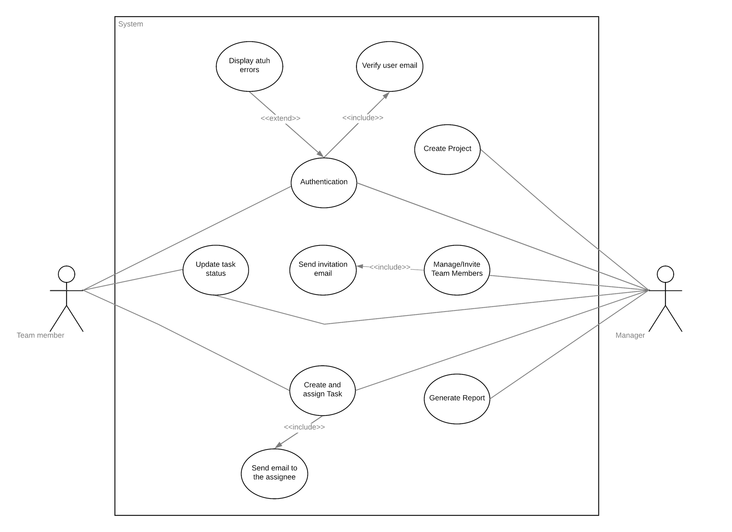
Use Case Diagram
13
08-09-2022

Slide 14
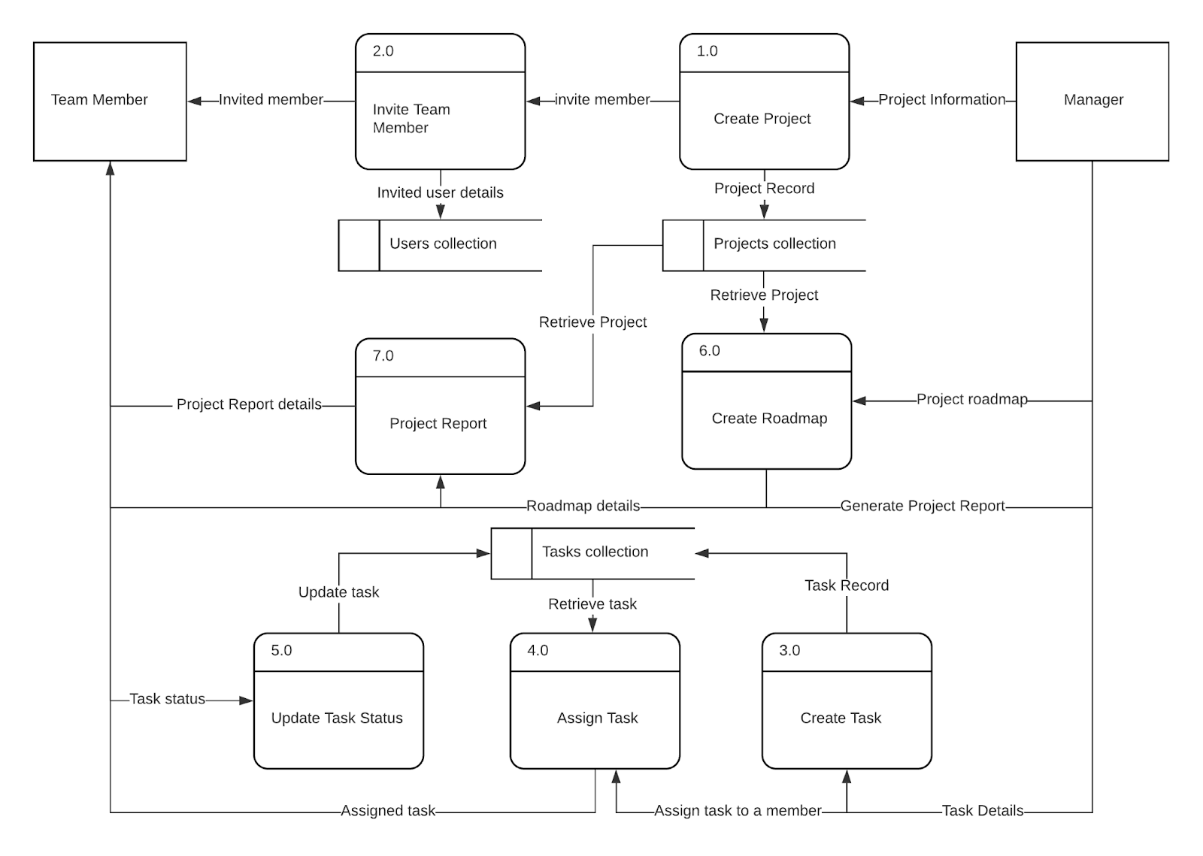
Data Flow Diagram
14
08-09-2022

Slide 15
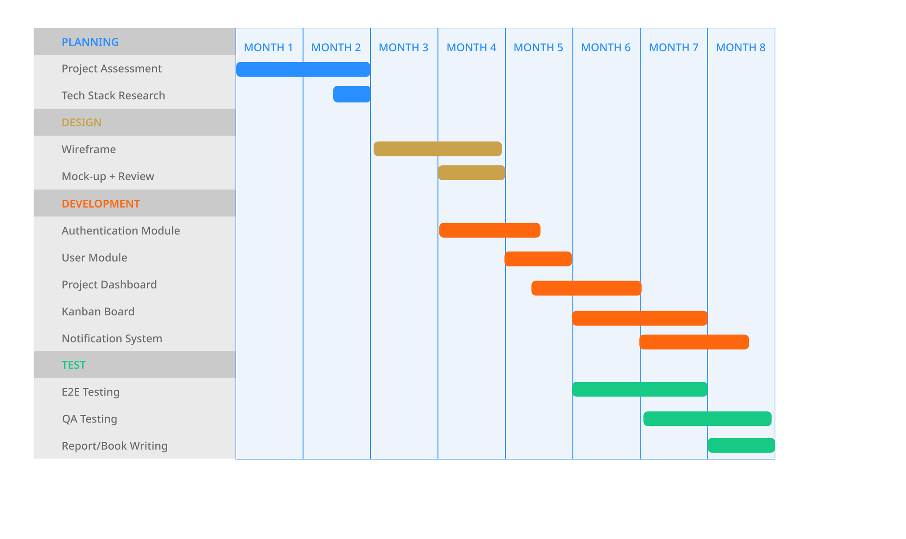
Gantt Chart
15
08-09-2022

Slide 16
Conclusion
This project has lot of scope to replace the existing system used by organizations. It will save time, increase productivity and provide better performance with well-designed and intuitive interface.
16
08-09-2022

Slide 17
References
Learning Agile: Understanding Scrum, XP, Lean, and Kanban.
Agile Practice Guide 1st Edition
www.atlassian.com/agile/project-management
www.atlassian.com/software/jira
www.basecamp.com
www.asana.com
17
08-09-2022

Slide 18

Have any Question?
18

Slide 19
Thanks!
19
08-09-2022

