Slide 1
Fire Alarm System
Asif Ikbal Antu
Nazia Tabassum
Dawan Minhajul Islam

Slide 2
What is a fire alarm system
Detect and warn people through visual and audio appliances.
Activated automatically from smoke detectors, and heat detectors
Alarms can be motorized bells or wall mountable sounders or horns.
Alarm sounders can be set to certain frequencies and different tones including low, medium and high.

Slide 3
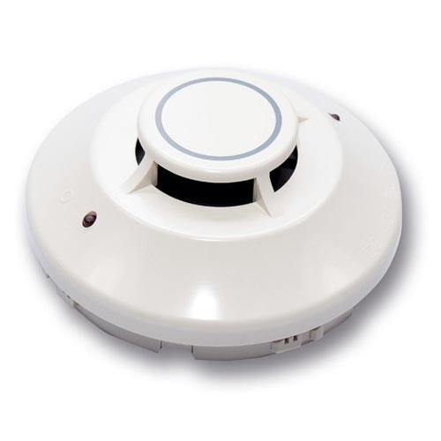
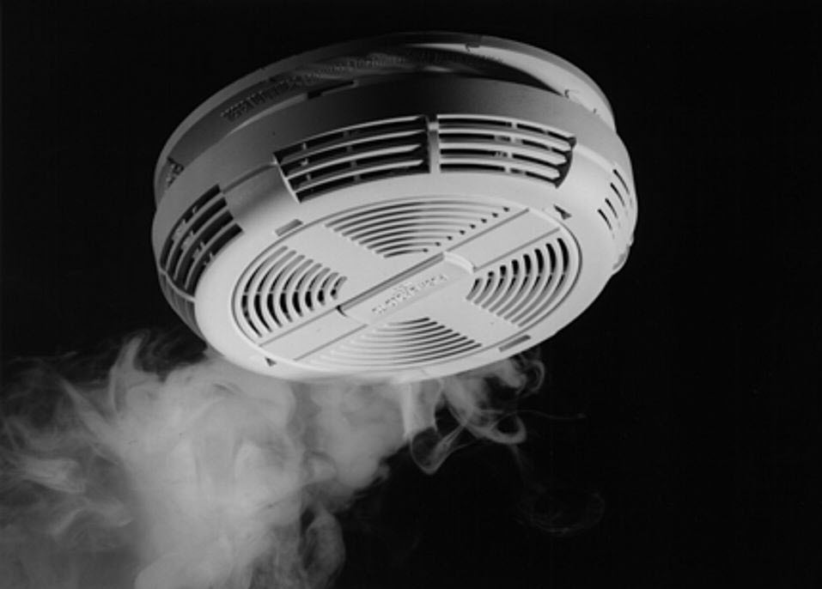
The types of fire alarm systems
Heat Detectors:
Smoke Alarms:

Slide 4
How does a fire alarm system work?
When smoke particles pass thru the chamber of the optical detector, it scatters light that triggers the alarm. In the ionization detector, if the smoke particle enters the chamber of the ionization detector it will reduce air ionization inside the chamber of the ionization detector and triggers the alarm.

Slide 5
Benefit & goals
Early Detection
We may avoid major damage or even worse, the complete destruction of the home.
Avoid Smoke Inhalation
This can save the life of anyone in the house at the time
Insurance Discounts
This can save you money on your house insurance.

Slide 6
Benefit & goals
24/7 Monitoring
A home fire alarm system gives the homeowner protection 24 hours a day, every day of the week
Easy & Affordable
Having a system is very reasonably priced.

Slide 7
Possible future amendments of the project
Fires continue to occur in modern architecture, the people's lives and property has brought huge losses. In order to reduce the fire in the building automatic fire alarm equipment placed into a necessity. We can use the fire alarm system for marketing purposes.

Slide 8

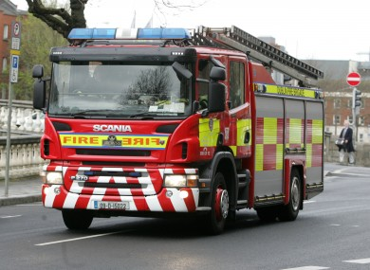
Possible future amendments of the project
Add mobile calling system to call ambulance and fire service when alarm is buzzed.

