Slide 1

AI Presentation
MathBangla: A Next-Gen Bengali NLP and Mathmatical Equation Generation AI
Prepared by:
Antor Hawlader
ID: 222071024
Tamim Chad Likhon ID: 222071045
Dept: CSE
Batch: 30th
8th Semester
Submit On: 16-07-2025
Submitted to:
Abdur Rab Dhruba, Lecturer,
Department of
CSE & CSIT SMUCT
Shanto Mariam University of Creative Technology
Department: CSE
Course Code: CSE-3311
Course Name: Artificial Intelligence

Slide 2

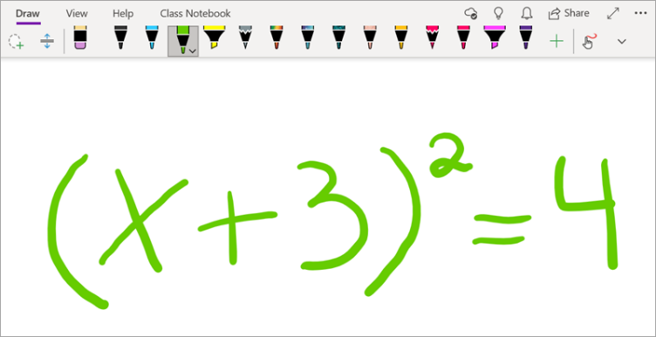
What is Math-Bangla?
MathBangla is a dual-purpose Bengali AI system designed for advanced language and mathematical understanding.
Objective 1: A next-gen Bengali NLP model that understands regional dialects, slangs, and informal structures.
Objective 2: A Bengali-language mathematical reasoning engine that transforms textual math problems into structured algebraic equations.

Slide 3


Two Core Objectives
All-in-One Bengali NLP Engine
Understands standard Bengali and all major dialects.
Can translate between dialects
(example: Dhakaiya → Barishali).
Bangla-to-Equation Converter
Understands and extracts logic from Bengali text-based math problems.
Produces algebraic equations in a clean and accurate format.

Slide 4
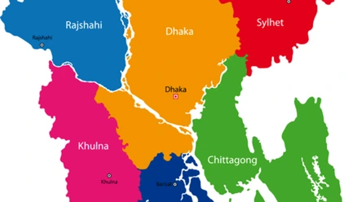

Unique Features
Supports dialects like Sylheti, Chittagonian, Rangpuri, etc.
Built-in dialect translator (useful for informal speech/text analysis).
End-to-end Bangla math problem solver with no English dependency.
Output: Equations only, no unnecessary explanation or English phrases.

Slide 5
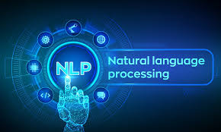

Why Bengali NLP?
Bengali is one of the top 6 languages globally, yet lacks AI tools for dialects.
Local dialects are underrepresented in NLP research and applications.
Tools like this can empower local voice tech, chatbots, and educational AI apps.

Slide 6
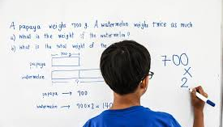
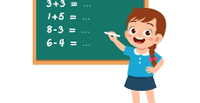
Why Math Conversion?
Most Bengali-medium students face difficulties in algebraic translation.
No AI tool exists that supports solving math in pure Bengali.
MathBangla enables faster understanding of complex word problems.

Slide 7
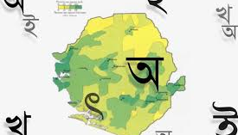

Why Our Approach Is Unique
Not just another Bengali POS tagger — it works on noisy, real-life dialects.
First-of-its-kind Bangla Equation Generator engine using natural language.
Two specialized modules fused together for deep understanding.

Slide 8
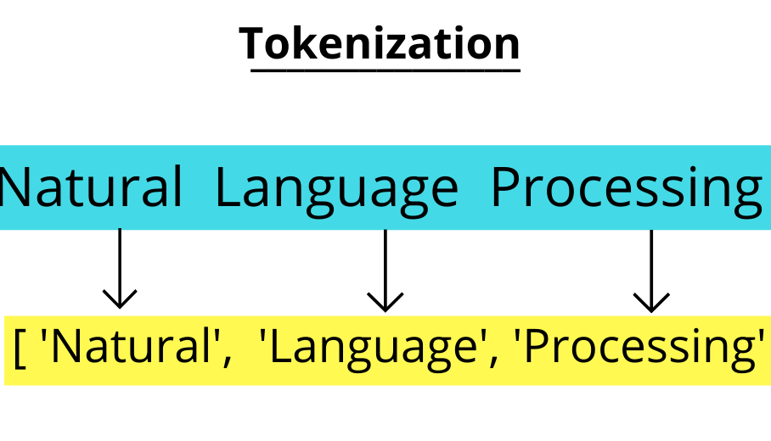
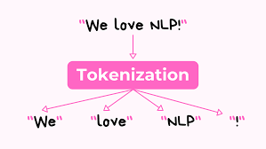
How It Works – Bengali NLP
Step 1: Input sentence tokenized with dialect recognition layer.
Step 2: POS tagging and syntax parsing (custom-trained on dialect corpora).
Step 3: Semantic intent recognition and dialect translation if needed.

Slide 9
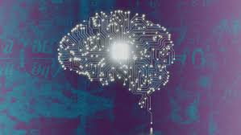
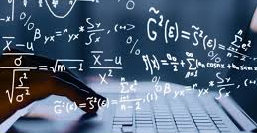
How It Works – Math Pattern Engine
Step 1: Extract numerical values, quantities, and math-specific keywords.
Step 2: Detect relationship logic (e.g., total, twice, difference, ratio).
Step 3: Generate symbolic equations with variables.

Slide 10
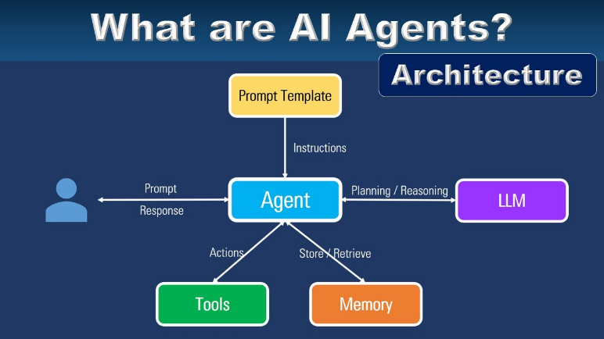
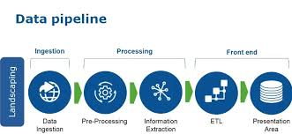
Integration Architecture
Pipeline:
Bengali NLP Module → Math Pattern Recognizer → Equation Builder
Interconnected modules handle translation, parsing, and expression generation.
Modular system allows reuse of Bengali NLP engine for other AI applications.

Slide 11


Applications – NLP Side
Bengali virtual assistants that can understand dialect speech.
Dialect-to-dialect machine translation system.
Chatbots for healthcare, agriculture, and education using regional dialects.

Slide 12
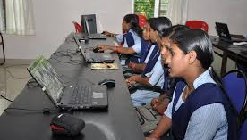

Applications – Math Side
Bengali EdTech platforms for JSC, SSC, HSC level math problem solving.
Exam prep apps that support math queries in Bengali language.
Assistive tools for low-income or rural students with no English background.

Slide 13

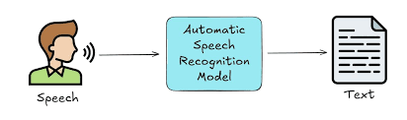
Future Extensions
Add voice input/output (Speech-to-Math)
Add OCR module for extracting math problems from printed textbooks.
Gamified learning using Bengali spoken input and instant equation generation.

Slide 14

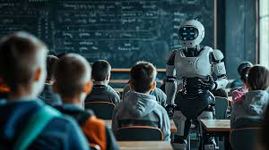
For Whom?
Students in Bengali medium (especially rural and underprivileged areas).
Teachers seeking to create AI-supported learning materials.
NLP researchers working with low-resource, underrepresented languages.

Slide 15


Who Else Benefits?
EdTech startups building smart Bengali learning tools.
NGOs working on digital education and literacy.
Government e-learning projects in national curriculum

Slide 16


Summary & Vision
MathBangla unites linguistic intelligence and logical reasoning in Bengali.
Solves a real problem: language-first math education.
Future: Expand to voice, OCR, cross-lingual education tools.

Slide 18
Component | Function | Technology
Dialect NLP | Understand dialects | Custom model
Math Logic | Convert to equation | Pattern matcher
UI/API | Integrate with EdTech | REST API

