Slide 1
Optimization of online store inventory management
Performer: student of group 10702319
Naumov A.M
Supervisor: Associate Professor Kovaleva I.L.

Slide 2


Introduction
E-commerce opens up new horizons for business development

Slide 3
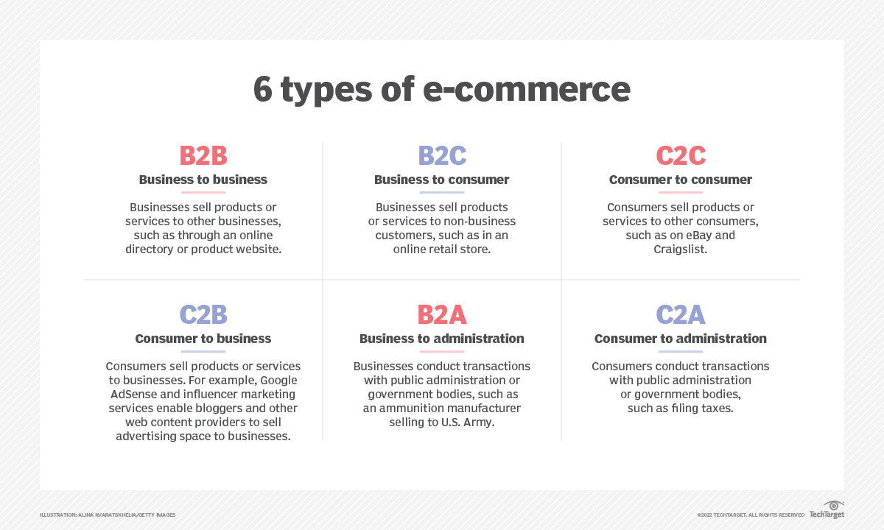
E-commerce

Slide 4
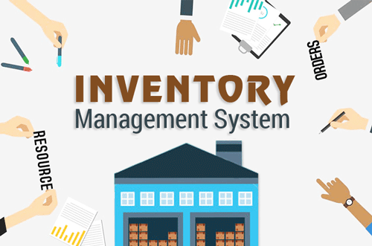
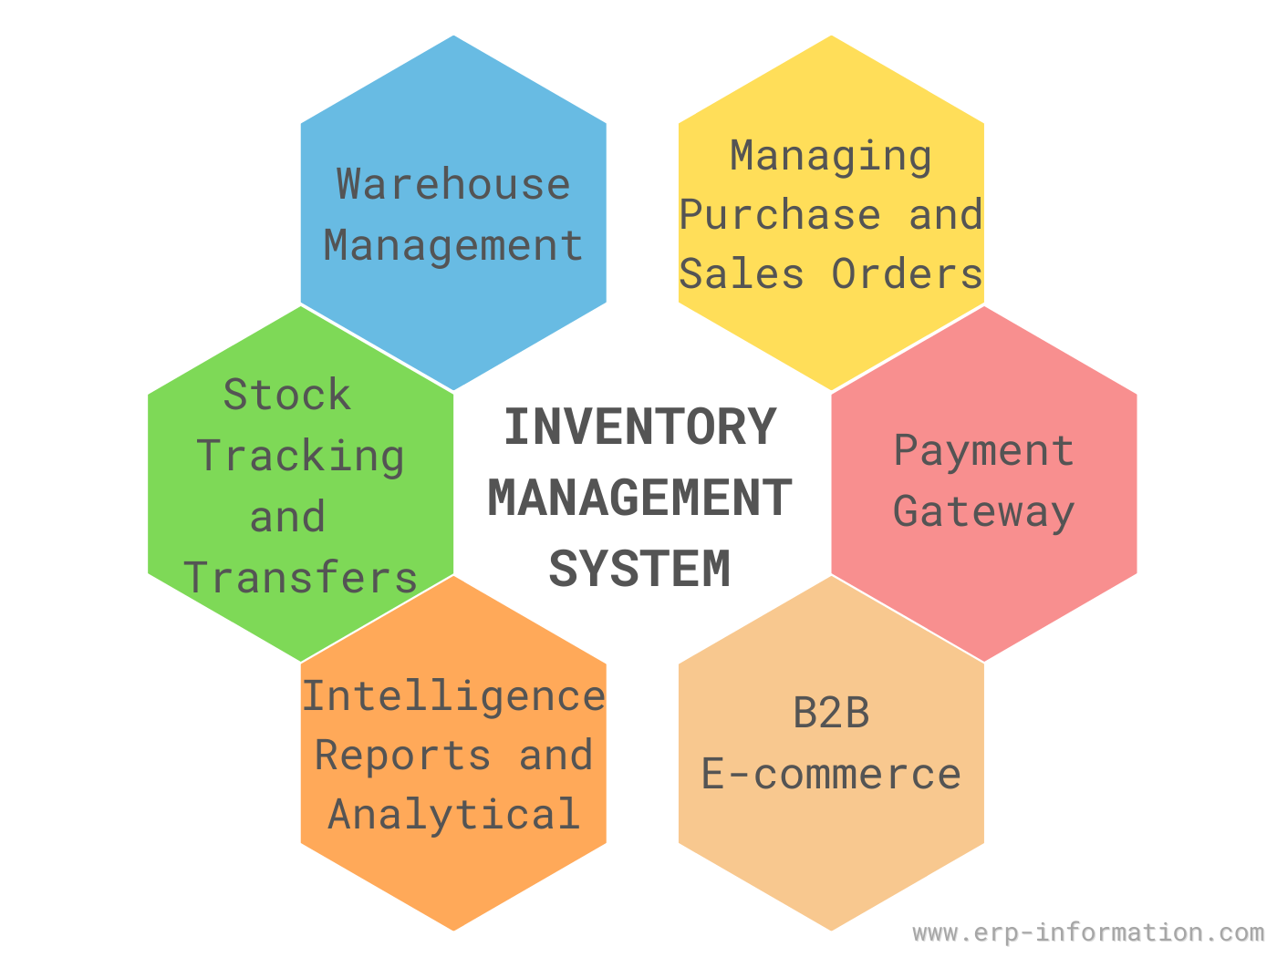
Inventory management is one of the main problems of managing a B2B solution
The inventory management system is a set of measures for the creation and replenishment of stocks, the organization of continuous monitoring and operational planning of supplies.

Slide 5
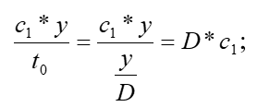
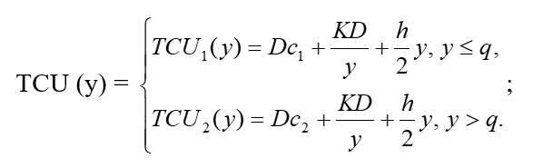
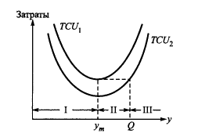
a single-product static model with "gaps" in inventory management prices with instant replenishment of inventory in the absence of a shortage.
Acquisition costs per unit of time: c - unit price, D - demand intensity.
Total costs per unit of time:
Graphs of these two functions:

Slide 6

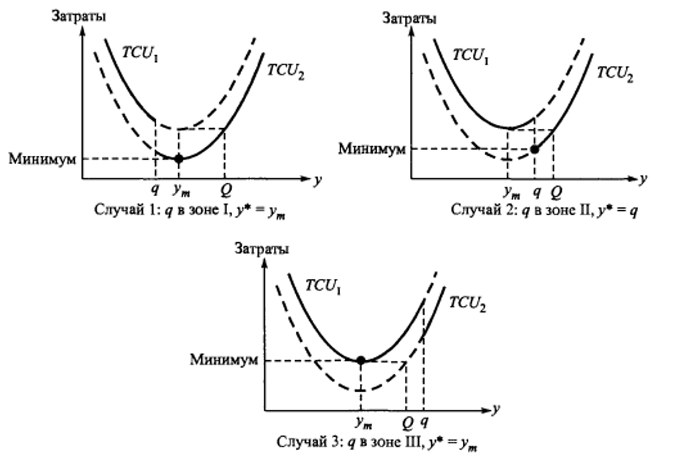
the order size at which the minimum values TCU1 and TCU2 are reached: D - demand intensity, K - the cost of making an order, h - the cost of storing an order unit.
From the type of cost function TCU1 and TCU2, it follows that the optimal order size y* depends on where the price gap point q is in relation to the three zones I, II and III shown in the figure.
Then the zones are defined as follows:
- I : 0<=q< y_{m}
- ii : y_{m}<= q< Q
- iii: q>= Q

Slide 7
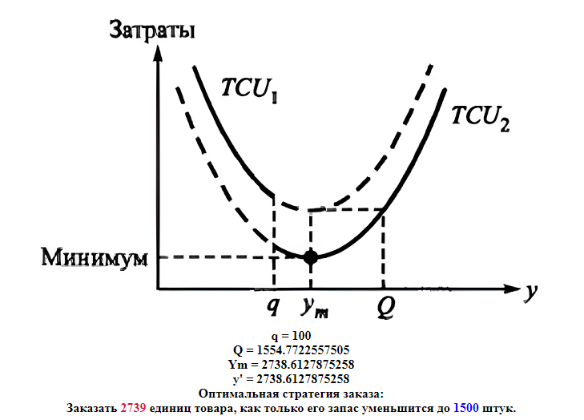
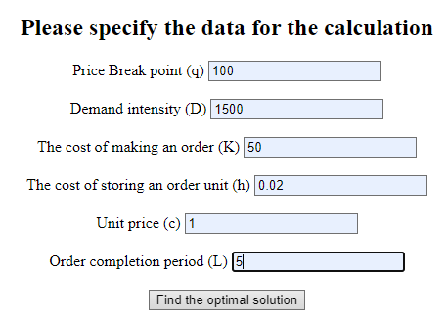
Software implementation

Slide 8

Conclusion
In this course project, current inventory management algorithms were considered and studied, which can be used as a component of the business process when managing a modern online store. The chosen algorithm of a single-product static model with "gaps" in prices has been adapted for software implementation. Subsequently, a software implementation of this algorithm was performed and testing was performed.

Slide 9
Thanks for your time!

