Slide 1
Image Classification using Dimensionality Reduction and Various Models
Anto Sujin A
antosujin.a@gmail.com
9487667488

Slide 2
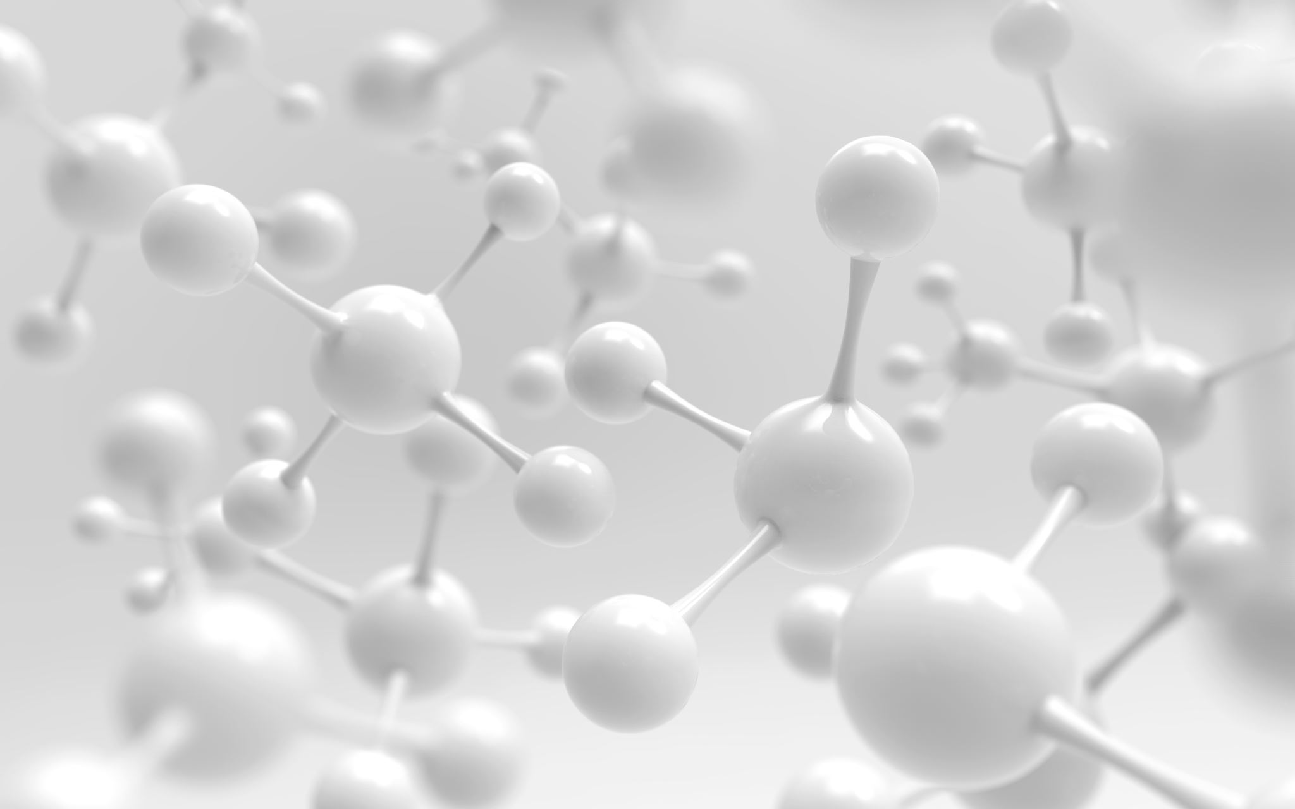
Introduction
Welcome to the presentation on "Image Classification using Dimensionality Reduction and Various Models.“
We will explore how dimensionality reduction techniques, specifically PCA, can improve image classification performance.
We will also apply several classification models to compare their performance on reduced dimensions.

Slide 3
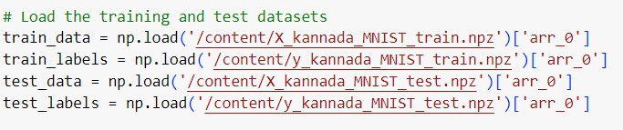
Dataset
The dataset consists of 60,000 images for training and 10,000 images for testing.
Each image has a size of 28x28 pixels.

Slide 4
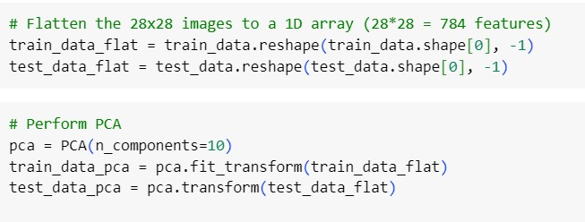
Dimensionality Reduction with PCA
PCA (Principal Component Analysis) reduces the dimensions of the images from 28x28 to 10 components.
This reduces computational complexity while retaining essential features.

Slide 5
Model 1 - Decision Trees
Decision Trees are a powerful non-linear classification model.
We will apply Decision Trees to the PCA-transformed images.

Slide 6
Model 2 - Random Forest
Random Forest is an ensemble learning method based on decision trees.
It combines multiple decision trees to improve accuracy and reduce overfitting.

Slide 7
Model 3 - Naive Bayes
Naive Bayes is a probabilistic classification model based on Bayes' theorem.
It is efficient and works well with high-dimensional data.

Slide 8
Model 4 - K-NN Classifier
K-NN (K-Nearest Neighbors) is a simple and effective classification algorithm.
It classifies data points based on the majority class among its k-nearest neighbors.

Slide 9
Model 5 - SVM (Support Vector Machine)
SVM is a powerful classification algorithm used for both linear and non-linear data.
It finds the optimal hyperplane that maximizes the margin between classes.

Slide 10
Metrics Evaluation
We will evaluate each model's performance using the following metrics:
Accuracy: Ratio of correct predictions by the total number of predictions.
Precision: Ratio of true positive predictions to the total predicted positive instances.
Recall: Ratio of true positive predictions to the total actual positive instances.
F1-Score: Harmonic mean of precision and recall, balancing false positives and false negatives.
Confusion Matrix: Visual representation of model performance across all classes.
RoC - AUC Curve: Receiver Operating Characteristic curve and Area Under the Curve.

Slide 11
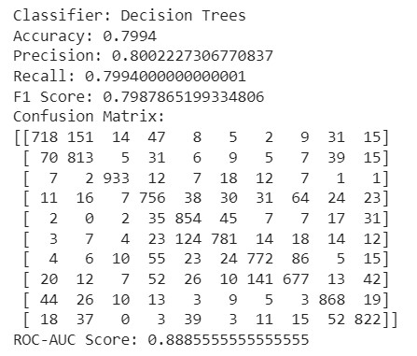
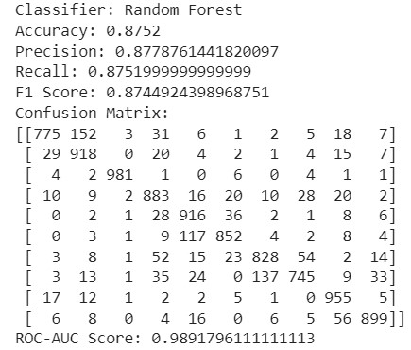
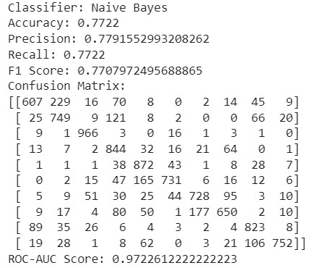
Experimental Results
The results for each model on the 10-component PCA data

Slide 12
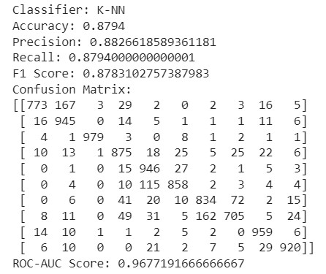
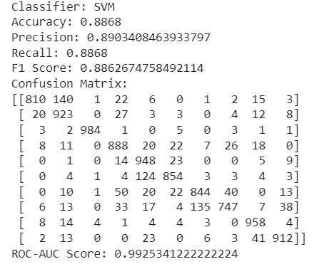
Experimental Results
The results for each model on the 10-component PCA data

Slide 13
Experiment with Different Component Sizes
Repeated the same experiment with PCA components of size 15, 20, 25, and 30.
Here we only shows the ROC_AUC value of all models varies on different PCA values.

Slide 14
Experiment with Different Component Sizes

Slide 15
code & REFERENCE
Code: https://colab.research.google.com/drive/1ThD-EtiCuPQiE9UhOzltW5ajh7uvo8jG?usp=sharing
Dataset can be downloaded from the link : https://www.kaggle.com/datasets/higgstachyon/ kannada-mnist

Slide 16
Conclusion
Except Decision Tree all other algorithms performs well while increase the PCA value.
Decision Tree’s maximum performance occurs at PCA = 15.
Comparatively SVM model is the best in all PCA values and attained it’s maximum performance at PCA = 30.

Slide 17

Questions & Answers

Slide 18


