Slide 1
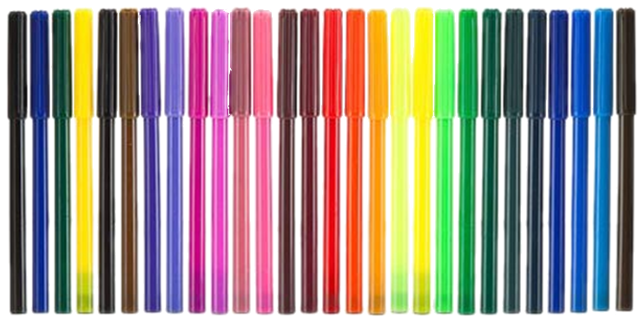
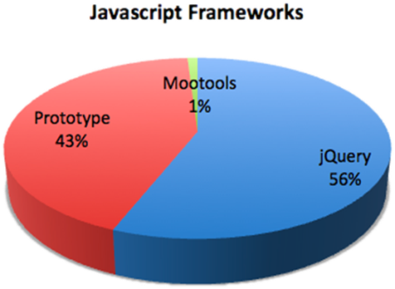

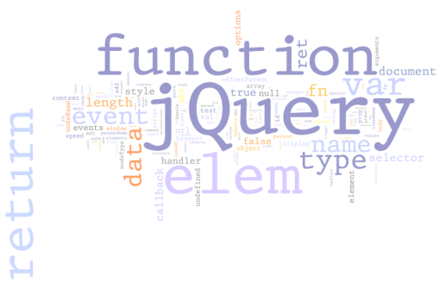


jQuery Overview
Unleash the Power of jQuery
Doncho Minkov
Technical Trainer
http://minkov.it
Telerik Software Academy
academy.telerik.com

Slide 2

Table of Contents
What is jQuery?
jQuery Fundamentals
Selectors
DOM Manipulation
DOM Altering
jQuery DOM elements
AJAX
jQuery AJAX Methods
Executing AJAX Requests

Slide 3
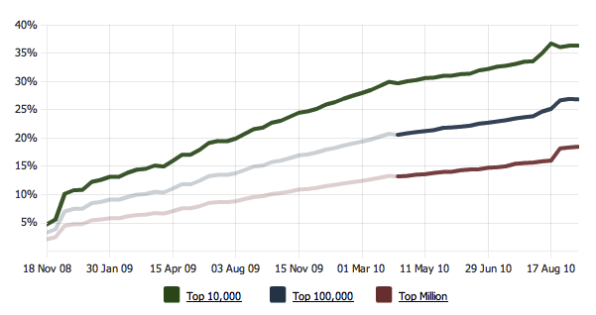
What is jQuery?
The world’s most popular JavaScript library

Slide 4
What is jQuery?
jQuery is a cross-browser JavaScript library
Designed to simplify the client-side scripting of HTML
The most popular JavaScript library in use today
Free, open source software
jQuery's syntax is designed to make it easier to
Navigate a document and select DOM elements
Create animations
Handle events
Develop AJAX applications

Slide 5
What is jQuery? (2)
jQuery also provides capabilities for developers to create plugins for
Low-level interaction and animation
Advanced effects and high-level, theme-able widgets
Creation of powerful and dynamic web pages
Microsoft adopted jQuery within Visual Studio
Uses in Microsoft's ASP.NET AJAX Framework and ASP.NET MVC Framework

Slide 6
Why jQuery is So Popular?
Easy to learn
Fluent programming style
Easy to extend
You create new jQuery plugins by creating new JavaScript functions
Powerful DOM Selection
Powered by CSS 3.0
Lightweight
Community Support
Large community of developers and geeks

Slide 7
How to Add jQuery to a Web Site?
Download jQuery files from
http://www.jquery.com
Self hosted
You can choose to self host the .js file
E.g. jquery-1.9.js or jquery-1.9.min.js
Use it from CDN (content delivery network)
Microsoft, jQuery, Google CDNs
e.g. http://code.jquery.com/jquery-1.9.1.min.js,
http://ajax.microsoft.com/ajax/jquery/jquery-1.9.1.min.js
Notes:
Talking Points:
You can choose to self host files - this is including jQuery in the scripts folder in Visual Studio.
Can also just include jQuery from a CDN - simply change the script reference to point to jQuery on the CDN
Can be faster loading and client browser may already have jQuery file cached
Be careful! If the CDN goes down your site may also go down.
Source version is human readable.
Always include the minified version for your production code.

Slide 8




Selectors and DOM Manipulation

Slide 9
Selectors
Selection of DOM elements in jQuery is much like as in pure JavaScript
Selection of elements using CSS selectors
Like querySelectorAll
$("selector")
//by tag
$("div") //document.querySelectorAll("div");
//by class
$(".menu-item")
//document.querySelectorAll(".menu-item");
//by id
$("#navigation")
//by combination of selectors
$("ul.menu li")

Slide 10
Selection with jQuery
Selecting items with jQuery
Almost always returns a collection of the items
Even if there is only one item
Can be stored in a variable or used right away
The usage of the elements is always the same, no matter whether a single or many elements
// select the item
$("#something").hide();
$(".widgets").fade(1);

Slide 11
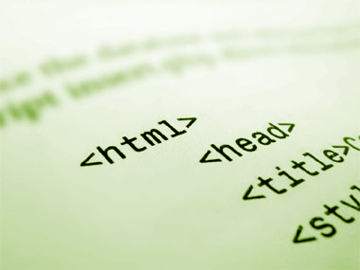
Selection with jQuery
Live Demo

Slide 12
DOM Traversal

Slide 13
DOM Traversal
As with plain JavaScript, the DOM can be traversed with jQuery
Properties for:
Next and previous siblings
Parents and children

Slide 14
DOM Traversal: Next and Previous
jQuery.next(), jQuery.prev()
Returns the next/prev sibling
Returns an HTML element
Not a [text] node
<ul>
<li>Item 1</li>
<li>Item 2</li>
<li>Item 3</li>
</ul>
var first = $("li").first();
log(first);
//logs "Item 1"
log(first.next());
//logs "Item 2"

Slide 15
Next/Prev Siblings
Live Demo

Slide 16
DOM Traversal: Parent
jQuery.parent()
Returns the parent of the element
jQuery.parents(selector)
Returns the first parent that matches the selector
<div id="wrapper">
<ul id="items-list">
<li>Item 1</li>
<li>Item 2</li>
<li class="special">Item 3</li>
<li>Item 4</li>
</ul>
</div>
var item = $(".special");
item.parent().attr("id"); //logs "items-list"
item.parents("div").attr("id");
//logs "wrapper"
item.parents("#wrapper") .attr("id");
/logs "wrapper"

Slide 17
Parent Element
Live Demo

Slide 18
Altering the DOM

Slide 19

Adding Elements
Adding elements can be done on the fly
Using jQuery.appendTo()/prependTo() and jQuery.append()/prepend()
$('<ul><li>Hello</li></ul>').appendTo('body');
$("body").prepend("<h1>header</h1>");

Slide 20
Adding Elements to the DOM
Live Demo

Slide 21
Removing Elements
You can also remove elements from the DOM
Just as easy
// Before
<div>
<p>Red</p>
<p>Green</p>
</div>
// Removing elements
$('p').remove();
// After
<div>
</div>

Slide 22

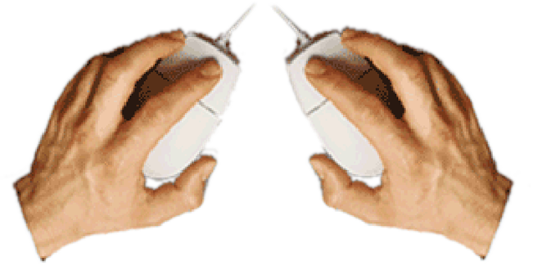

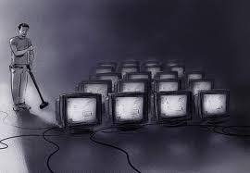
Removing Elements
Live Demo

Slide 23
jQuery Extended DOM Elements

Slide 24
jQuery Objects
Selected with jQuery DOM elements are not pure DOM elements
They are extended
Have additional properties and methods
addClass(), removeClass(), toogleClass
on, off, live for attaching events
animate, fade, etc…
//Parsing a regular DOM element to jQuery Element
var content = document.createElement("div");
var jContent = $(content);

Slide 25
Properties of jQuery Elements
jQuery elements extend regular DOM
asd elements
Methods for altering the elements
jQuery.css("color", "#f3f")
jQuery.html() returns the innerHTML
jQuery.html(content) sets the innerHTML
jQuery.text(content) sets the innerHTML, by escaping the content

Slide 26
Properties of jQuery Elements
Live Demo

Slide 27
Events

Slide 28
jQuery Events
jQuery has a convenient way for attaching and detaching events
Works cross-browser
Using methods on() and off()
function onButtonClick(){
$(".selected").removeClass("selected");
$(this).addClass("selected");
}
$("a.button").on("click", onButtonClick);

Slide 29

jQuery Event Handlers
Live Demo

Slide 30




jQuery AJAX

Slide 31
AJAX Fundamentals
AJAX is acronym of Asynchronous JavaScript and XML
Technique for background loading of dynamic content and data from the server side
Allows dynamic client-side changes
Two types of AJAX
Partial page rendering – loading of HTML fragment and showing it in a <div>
Web service – loading data and client-side processing it with JavaScript / jQuery
The data can be JSON, XML or string

Slide 32
jQuery Ajax
You can use jQuery Ajax to seamlessly integrate with server side functionality
jQuery makes simple the asynchronous server calls
jQuery.ajax(…)
The core method for using AJAX functionality
The shortcut methods use it 'under the hood'
Thus it can do everything
$.get(…) and $.post(…)
Executes a server-side request and returns a result
The HTTP action that will occur is POST or GET

Slide 33
jQuery Ajax (2)
$.getJSON(<url>)
Uses the GET HTTP action and inform the server to send back JSON-serialized data
$(…).load(<url>)
Gets HTML from the server and loads it into whatever you have selected (e.g. a <div>)
Note that jQuery AJAX does not use a selection (except for .load(…) method)
With certain jQuery methods there is not a logical reason to make a selection first
Most AJAX methods fall into that category

Slide 34
jQuery Ajax – $(…).load()
Example of dynamically loaded AJAX content:
$(…).load(<url>)
Gets an HTML fragment from the server and load it into whatever you have selected
Data could come from a PHP script, a static resource or an ASP.NET page
Note that the server should return a page fragment
If it returns a whole HTML page, then we are going to have some invalid HTML!
$('#myContainer').load('home/myHtmlSnippet.html');

Slide 35
jQuery Ajax – Example
<button>Perform AJAX Request</button>
<script type="text/javascript">
$("button").on("click", function() {
$.ajax({
url: "data.html",
success: function(data){
$('#resultDiv').text(data);
}
});
});
</script>
<div id="resultDiv">Result will be shown here</div>
Note that data.html will not be loaded unless the script comes from a Web server
AJAX URL should reside on the same Web server

Slide 36

jQuery AJAX: JSON-Style AJAX and Partial Rendering
Live Demo

Slide 37
jQuery Overview
?
?
?
?
?
Questions?
?
?
?
?
?
?

Slide 38
Homework
Create a slider control using jQuery
The slider can have many slides
Only one slide is visible at a time
Each slide contains HTML code
i.e. it can contain images, forms, divs, headers, links, etc…
Implement functionality for changing the visible slide after 5 seconds
Create buttons for next and previous slide

Slide 39
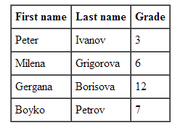
Homework (2)
Using jQuery implement functionality to insert a DOM element before or after another element
By given an array of students, generate a table that represents these students
Each student has first name, last name and grade
Use jQuery
Implement functionality to change the background color of a web page
i.e. select a color from a color picker and set this color as the background color of the page

Slide 40
Homework (3)
*Implement a GridView control
Rows can be added dynamically
A header row can be added dynamically
Each GridView can have at most one header row
Each row can have a nested GridView
Each GridView can have at most one nested GridView

Slide 41
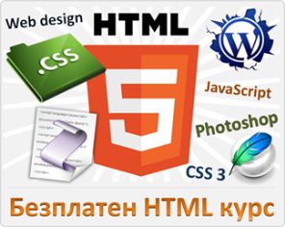


Free Trainings @ Telerik Academy
"Web Design with HTML 5, CSS 3 and JavaScript" course @ Telerik Academy
html5course.telerik.com
Telerik Software Academy
academy.telerik.com
Telerik Academy @ Facebook
facebook.com/TelerikAcademy
Telerik Software Academy Forums
forums.academy.telerik.com

