Slide 1
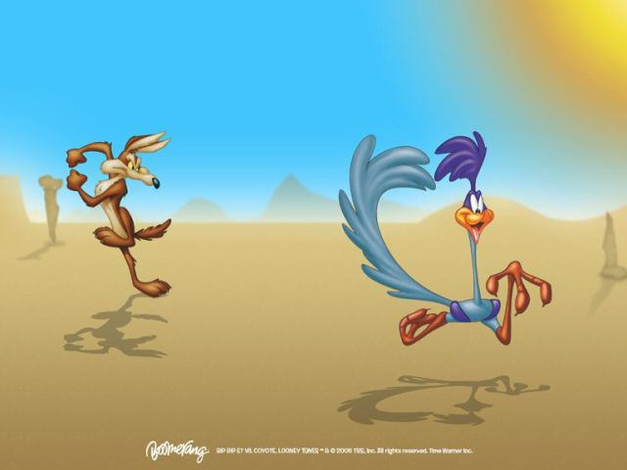
Team Wile E. Coyote

Slide 2
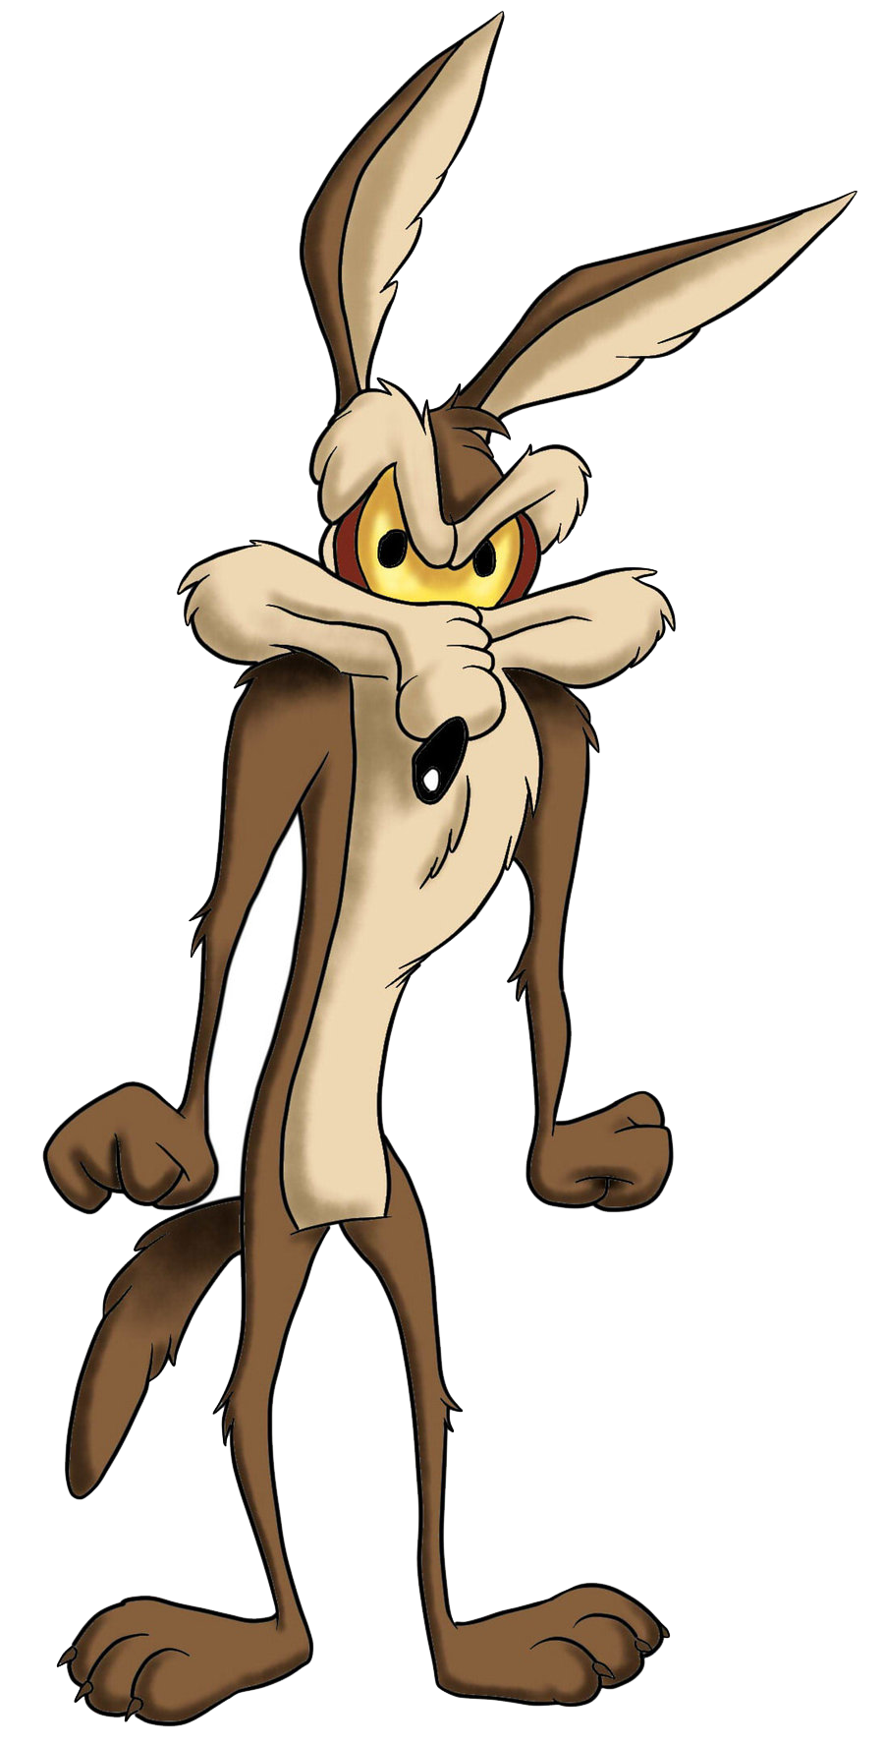
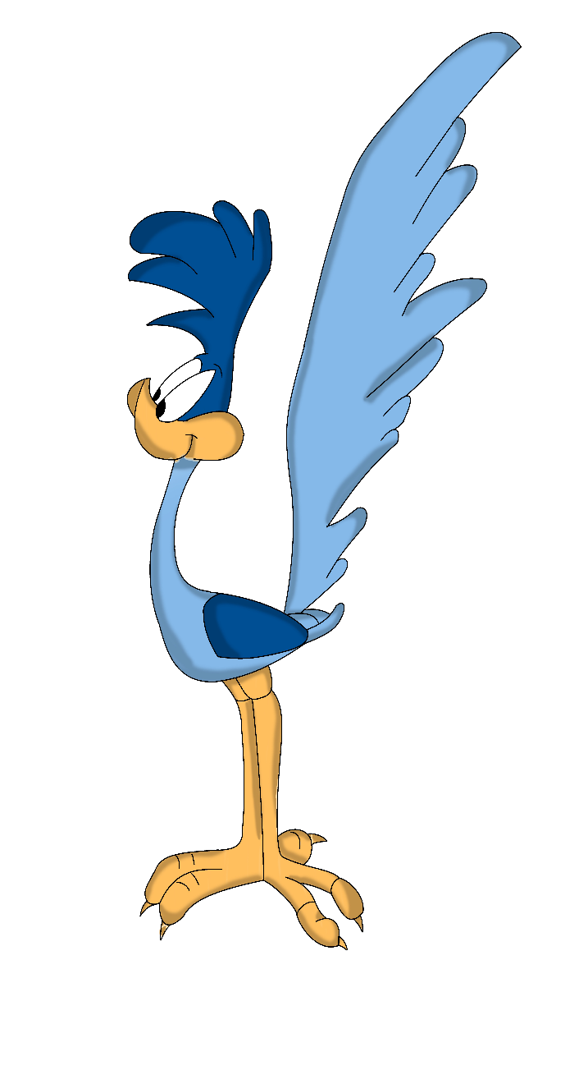
The Game
Overview
Notes:
(c) 2006 National Academy for Software Development - http://academy.devbg.org*
2##

Slide 3
Game States
Menu
Single Player
Multi Player
Game Over
3

Slide 4
Object oriented assets
Interfaces: IMovable, IDrawable
Classes: JustCoyote, Player, PlayingState, Menu, Wall, RunnerAI
Abstract Class: Actor
Static Class: Wall
Structure: WallSegment, Direction
Enumeration: GameState, DirectionEnum

Slide 5
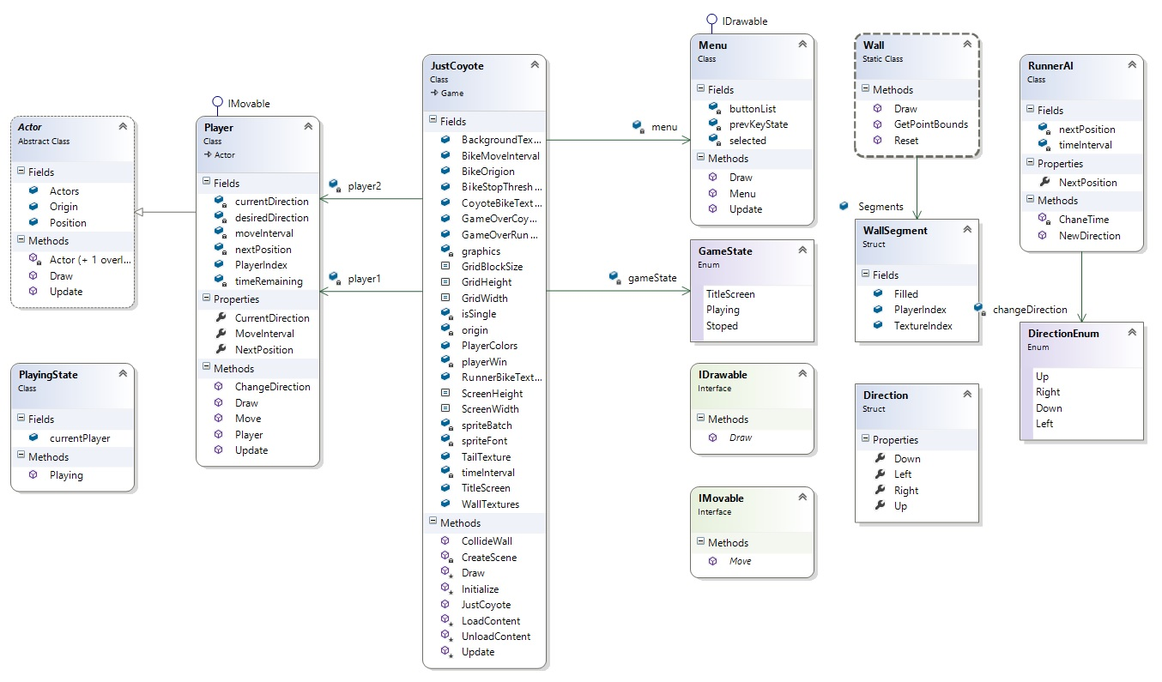
Class Diagram
Notes:
(c) 2006 National Academy for Software Development - http://academy.devbg.org*
5##

Slide 6
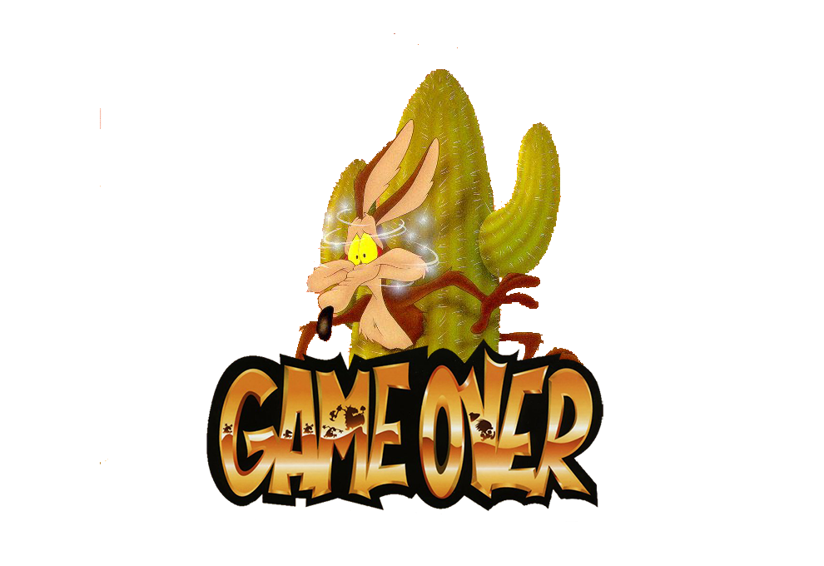
Game Over
Notes:
(c) 2006 National Academy for Software Development - http://academy.devbg.org*
6##

