Slide 1
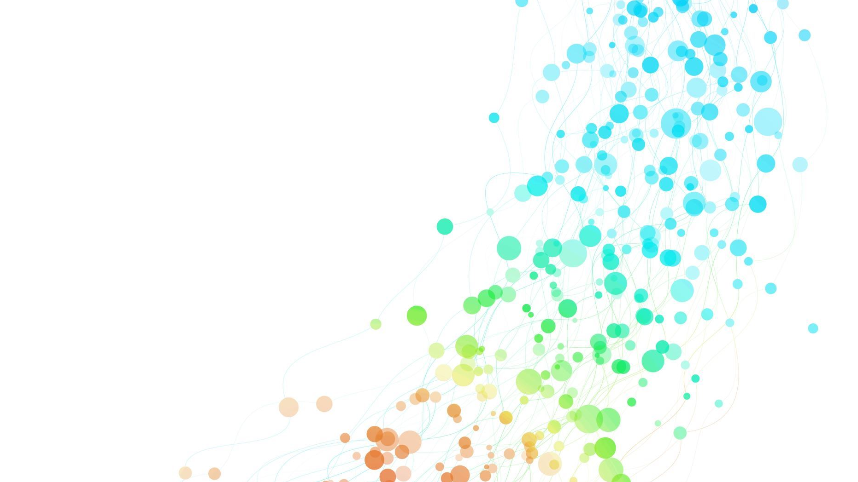
Gesture Recognizer
Antonio Querci and Alessando Trusendi

Slide 2
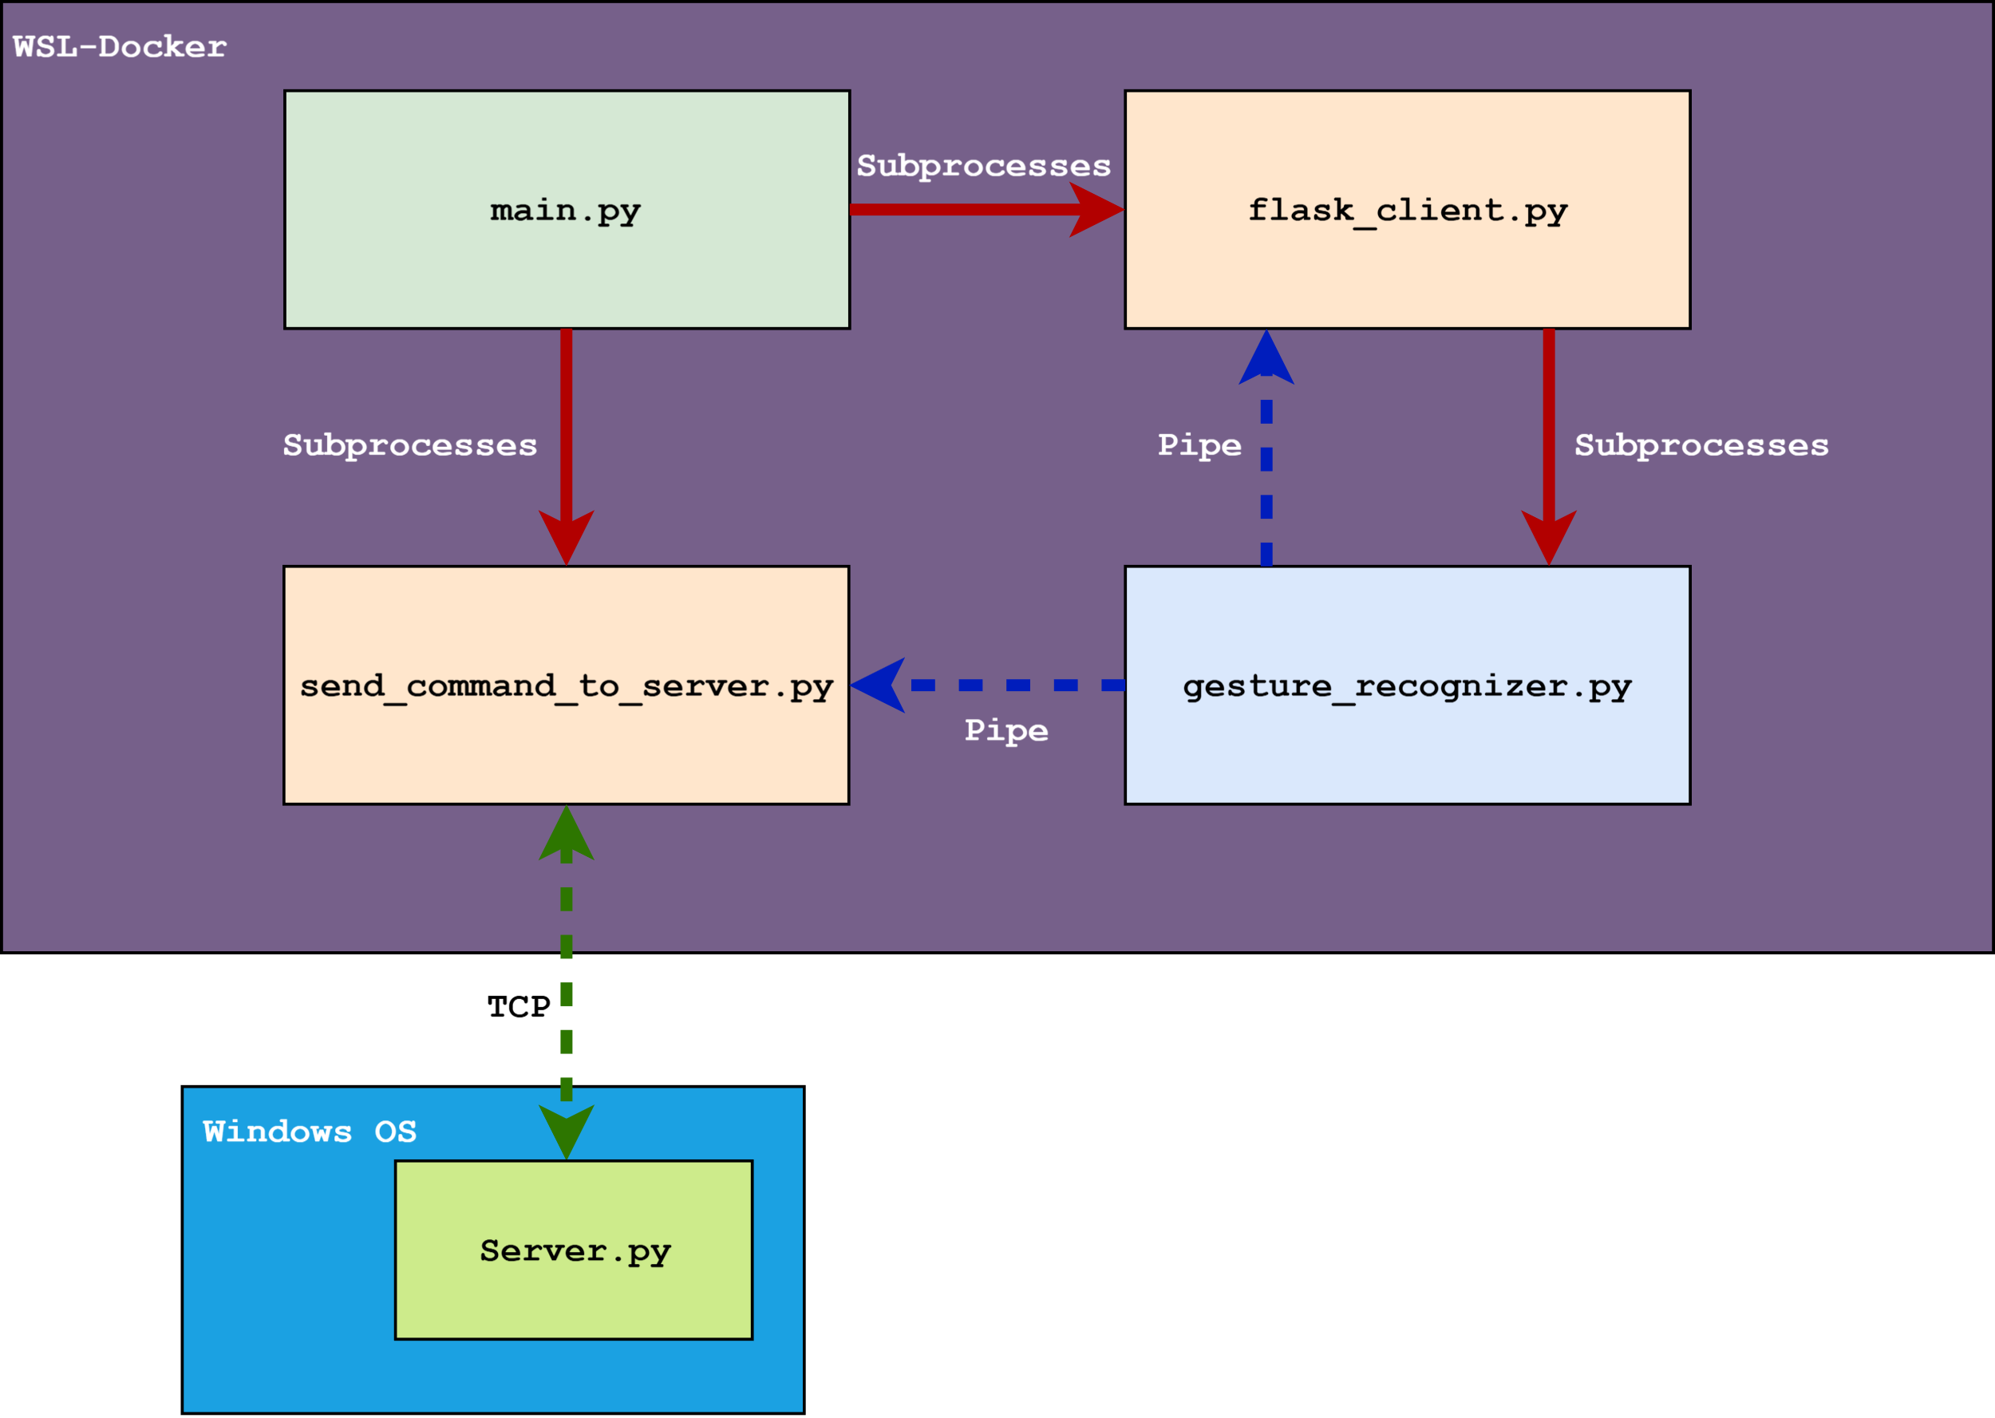
Application architetture

Slide 3
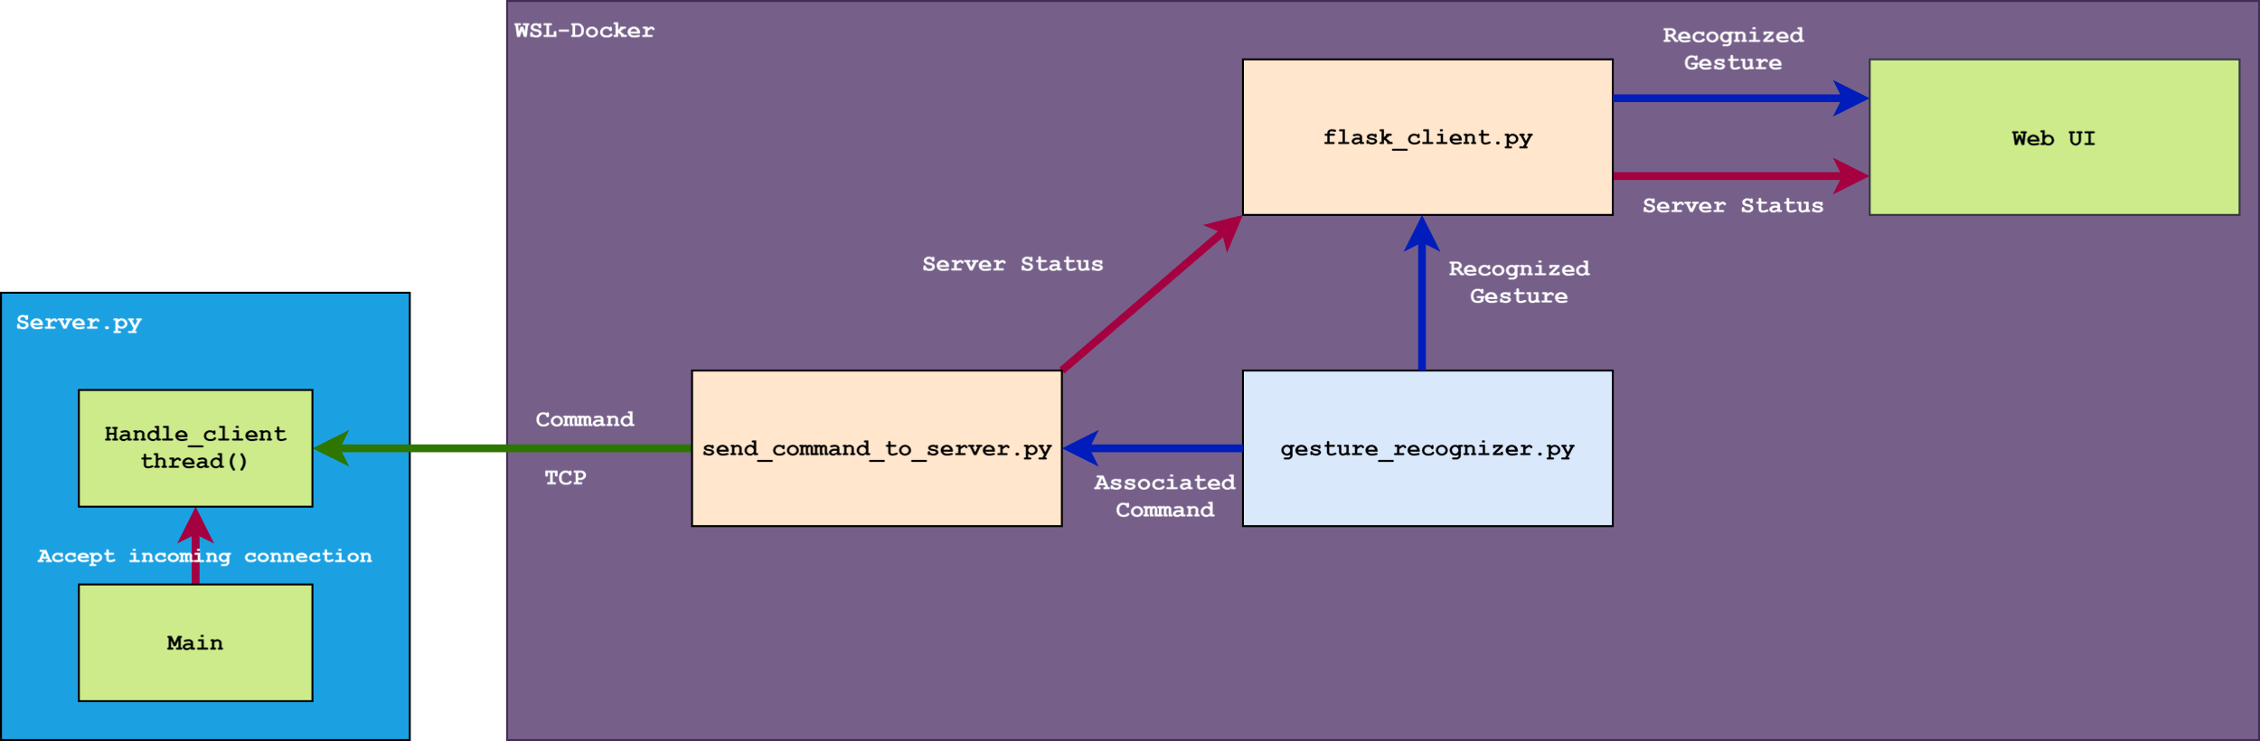
Client – Server Communication

Slide 4
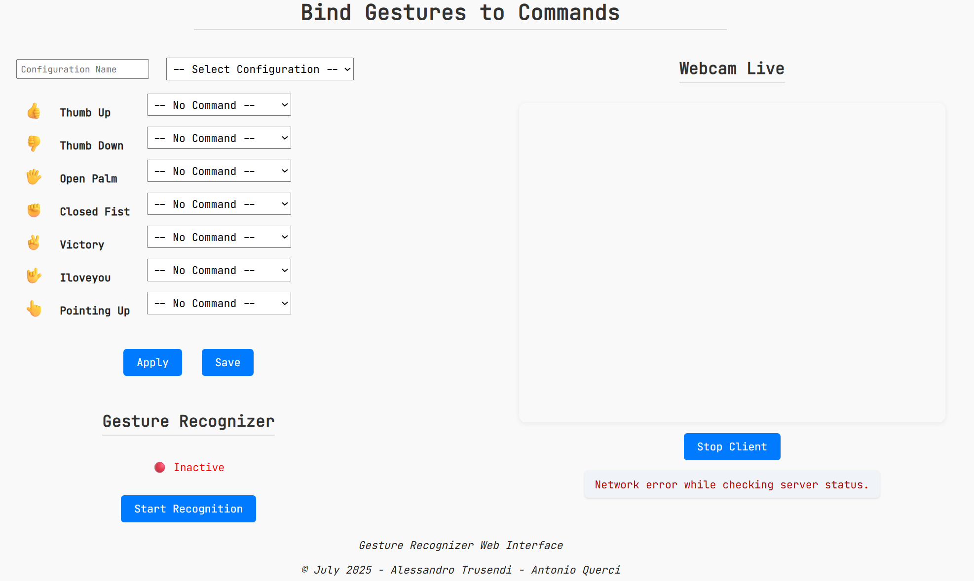
Graphical Interface

Slide 5
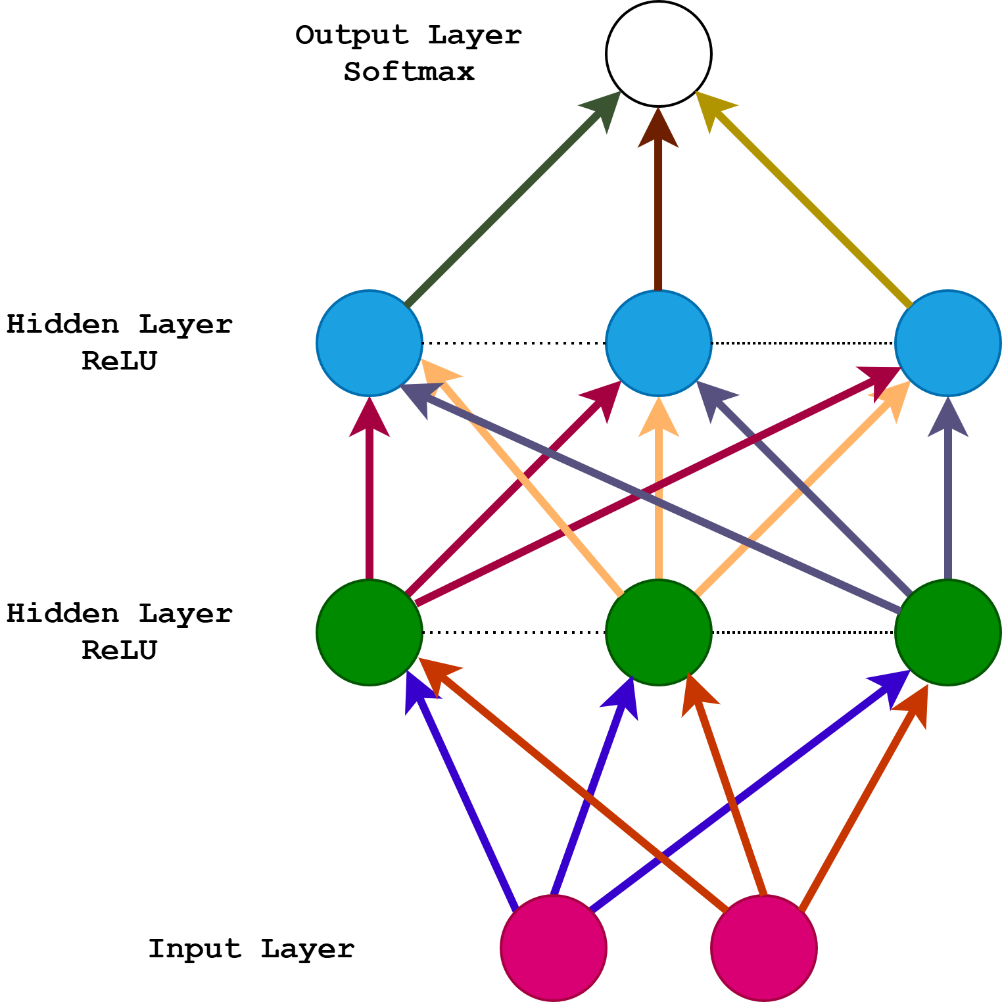
Custom DNN Model
Input size: 21 x 3 x 2
Two hands → 21 Landmarks x 3 coords x 2 = 126 inputs
Hidden layer size: 128
Number of classes = 19
18 + 1 (+1 for unrecognized gestures)

Slide 6
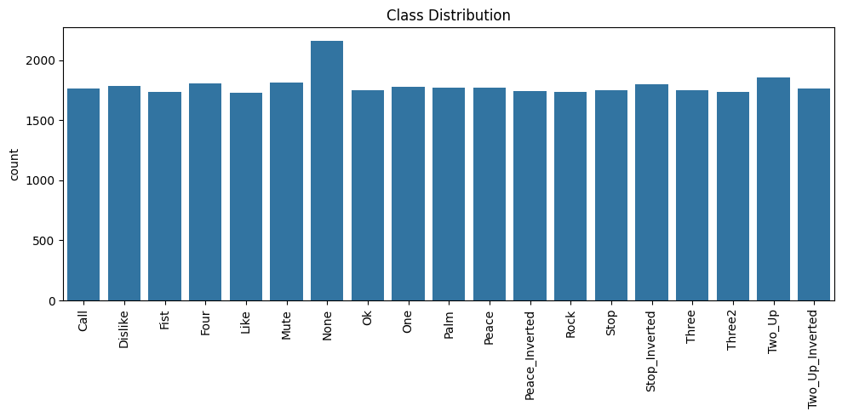
Dataset Class Distribution

Slide 7
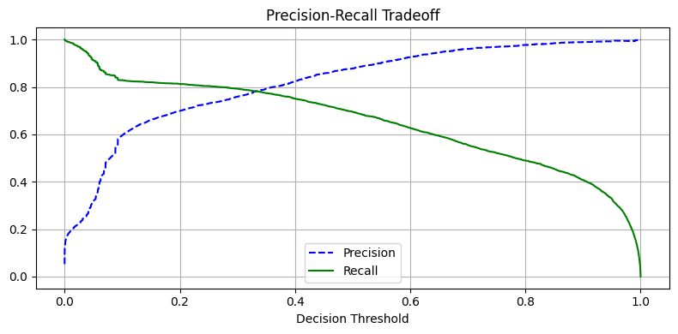
Precision-Recall Tradeoff

Slide 8
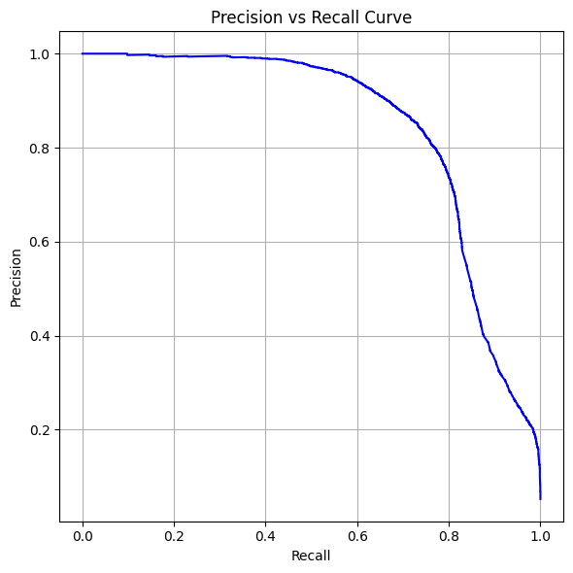
Precision vs Recall

Slide 9
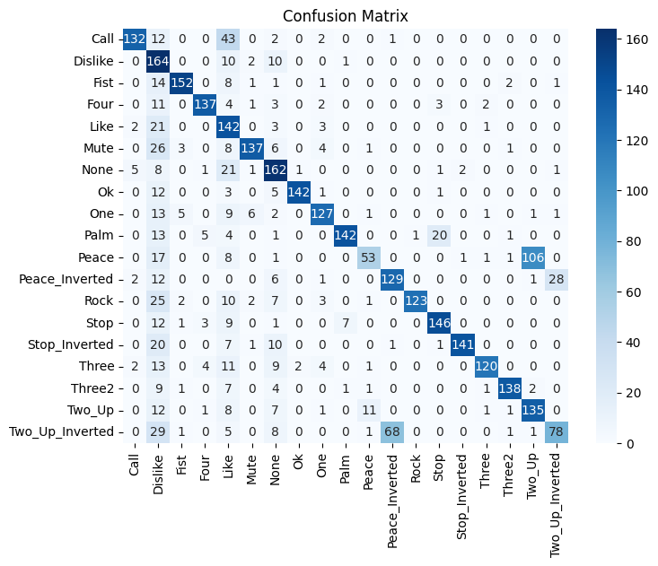
Confusion Matrix

