Slide 1
Tether
compiler-design / project-review-2
Review 2: 75% implementation (milestones 3–6)
maps back to fib.tth 3:4
function fib(n) {
the generated JavaScript now knows where every token came from
Antra
24BDS0066 · Compiler Design
Notes:
Good morning. This is Review 2 of Tether, the source-mapped transpiler. At Review 1 the front end was done, 25 percent. Today the compiler is at 75 percent: it type-checks, generates JavaScript, and writes a source map, which an independent decoder agrees with completely. The line on the slide is real output: the function name fib in the generated JavaScript maps back to line 3, column 4 of fib.tth.

Slide 2
From 25% to 75%
tether / recap
At Review 1
Since then
Frozen grammar (BNF)
Lexer with a span on every token
Recursive-descent parser, 21 node kinds
Panic-mode recovery, caret diagnostics
Playground; 63 tests
Type checker with a scoped symbol table
Lowering: for, +=, && and || removed
JavaScript emitter that records a mapping table
Base64 VLQ encoder
Source Map v3, checked by an independent decoder
151 tests
Notes:
A quick reminder of where Review 1 ended: the front end, meaning grammar, lexer, parser, error recovery and the playground. Since then I built the rest of the compiler up to the source map: the type checker, lowering, the JavaScript emitter, the VLQ encoder, and the source map writer with independent verification.

Slide 3
Six of eight milestones complete
tether / progress
75%
Acceptance criterion | Status
AC-1 benchmarks print exactly their expected output | met
AC-3 every mapping round-trips through a decoder | met
AC-4 five semantic errors reported in one run | met (8)
AC-2, AC-5 browser breakpoints, stack traces | M7
AC-6 fidelity figures at -O0 and -O1 | M8
of the planned work
M1
M2
M3
M4
M5
M6
M7
M8
Grammar, lexer
Parser, AST
Type checker
Lowering, JS
VLQ encoder
Source map
Browser proof
-O1, report
Notes:
Six of eight weekly milestones are complete, which is 75 percent. Three acceptance criteria are now met: the four benchmarks print exactly the right output, every mapping round-trips through an independent decoder, and the semantic-error fixture reports eight errors in one run. Browser verification and optimisation are milestones 7 and 8.

Slide 4
The whole pipeline now runs
tether / architecture
program.tth
program.js + program.js.map
Lexer
M1
Parser
M2
Type checker
M3 · new
Lowering
M4 · new
JS emitter
M4 · new
Source map
M5–6 · new
diagnostics.js every phase reports here; code generation runs only if there are no errors (FR-S4)
New modules (lines)
checker.js 401 · lower.js 104 · emit.js 250 · vlq.js 47 · sourcemap.js 87
Still no third-party dependencies (NFR-1). A full compile takes under 0.1 ms per benchmark.
Notes:
Every stage of the pipeline now exists. Each is still its own module with its own tests, and there are still no third-party dependencies. The diagnostics module is shared: code generation only runs when there are no errors.

Slide 5
Type checker: every error, one run
tether / 03-checker · milestone 3
$ tether build semantic-errors.tth
9:4: error: function 'sign' does not
return a value on every path
9 | fn sign(n: int): int {
| ^^^^
9:18: note: its return type is 'int'
16:5: error: 'x' is already declared
15:5: note: previous declaration of 'x'
20:7: error: 'add' expects 2 arguments,
but got 1
…
8 errors; no output written
Scoped symbol table
shadowing in a block is legal; redeclaring in one scope is an error
Five FR-S2 checks
operands, conditions, argument count and type, missing return
Notes point back
e.g. to the first declaration of 'x'
No cascades
a broken expression gets an error type that is accepted everywhere
Notes:
This is real output for the semantic-error fixture, which has eight independent mistakes. All eight are reported in one run, each with a caret, and notes point back to related code, like the first declaration of x. A broken expression gets a special error type that is accepted everywhere, so one mistake gives one message. That meets AC-4, which asks for five.

Slide 6
Scopes, and one subtle bug avoided
tether / 03-checker
global
every function, collected first
Tether
let x = 1;
{ let x = x + 1; }
main
top-level let
fn f
parameters and locals
JavaScript Tether emits
let x = 1;
{ let x$1 = x + 1; }
blocks
nested scopes
blocks
nested scopes
Copying the code literally would crash JavaScript's temporal dead zone. The shadowing name is renamed instead; '$' cannot appear in Tether names.
Functions see other functions, their parameters and their own locals, not top-level variables: no closures.
Notes:
The scopes form a tree: functions are collected into a global scope first, so they can be called before they are declared. Top-level code and each function have their own scope. One subtle case: in Tether, let x = x + 1 inside a block reads the outer x. Copied literally into JavaScript, that throws an error because of the temporal dead zone. So the checker gives every shadowing declaration a new JavaScript name, like x$1. A dollar sign cannot appear in a Tether identifier, so the new name can never clash.

Slide 7
Lowering: a smaller language, same spans
tether / 04-lower · milestone 4
Tether | Core form after lowering
for (i; c; u) B | { i; while (c) { B; u; } }
x += e | x = x + e
a && b | a ? b : false
a || b | a ? true : b
$ tether build fib.tth --dump-core
Block @13:3+83 [lowered]
Let @13:8+9
While @13:3+83 [lowered]
cond: Binary < @13:19+5
body: Block @13:34+52
Let @14:5+17
Assign = @15:5+6
Assign = @16:5+9
Assign = @13:26+6 [lowered]
Binary + @13:26+6 [lowered]
Every new node keeps the span of the code that caused it (FR-M2), so stepping through it still lands on the right line.
Notes:
Lowering rewrites the checked tree into a smaller core language, so the emitter has fewer cases. A for loop becomes a while loop inside a block, compound assignment becomes a normal assignment, and && and || become conditional expressions that keep short-circuiting. The dump on the right is real: nodes marked lowered were created by this pass, and each carries the span of the for statement or the i += 1 that caused it, so the source map still points to the right code.

Slide 8
Readable JavaScript, written through one path
tether / 04-emit · milestone 4
"use strict";
function fizzbuzz(n) {
let var$ = "";
if (divides(3, n) ? divides(5, n)
: false) {
var$ = "FizzBuzz";
} else if (divides(3, n)) {
var$ = "Fizz";
}
return var$;
}
//# sourceMappingURL=fizzbuzz.js.map
One write path (FR-G2)
every write updates the line and column; checked against the final text
Reserved words renamed (FR-G3)
var becomes var$; the map keeps the name var
Tether semantics kept
/ becomes Math.trunc(a / b); == becomes ===
AC-1 met
all four benchmarks print exactly their expected output
Notes:
The emitter writes plain ES2015 that a person can read. Everything goes through one write function that tracks the line and column, so each mapping records exactly where its text starts; after each compile the counters are checked against the final text. The variable var is a reserved word in JavaScript, so it becomes var$, while the source map keeps the original name. Integer division becomes Math.trunc. All four benchmarks print exactly their expected output, which was computed by a separate plain JavaScript implementation.

Slide 9
Base64 VLQ, the number format inside a map
tether / 05-vlq · milestone 5
1
Sign into the lowest bit
Value | After step 1 | VLQ
0 | 0 | A
1 | 2 | C
−1 | 3 | D
15 | 30 | e
16 | 32 → 0+32, 1 | gB
−5 | 11 | L
n ≥ 0 becomes 2n; n < 0 becomes 2|n| + 1
2
Split into 5-bit groups
least significant group first
3
Continuation bit
add 32 to every group except the last
4
Base64 digit per group
A–Z, a–z, 0–9, +, /
Tested on these vectors, 5,000 random values, and cross-checked with Node’s own decoder.
Notes:
Source maps store numbers as Base64 VLQ. The encoder moves the sign into the lowest bit, splits the value into 5-bit groups, sets a continuation bit on all but the last group, and writes each group as one Base64 character. For example 16 becomes gB. The encoder is tested on these vectors, on five thousand random values, and against Node’s built-in decoder, which I did not write.

Slide 10
The source map file
tether / 06-sourcemap · milestone 6
{
"version": 3,
"file": "fib.js",
"sources": ["../examples/fib.tth"],
"sourcesContent": ["// Fibonacci…"],
"names": ["fib","n","fibIter",…],
"mappings": ";AAEA,SAAGA,IAAIC;EACL…"
}
Delta encoding (FR-X3)
the generated column restarts each line; the other fields carry on across the file
Names (FR-G3)
identifier segments carry the original name, so var$ shows as var
Self-contained (FR-X5)
sourcesContent embeds the original text
out/fib.js.map (shortened)
AAEA,SAAGA,IAAIC is exactly the example worked out by hand in the Review 1 report, and a test checks it.
Notes:
Here is the real map for fib. It has the six fields Source Map version 3 requires. The mappings string is delta-encoded: the generated column restarts on each line, the other fields carry on across the file. Its first segments, AAEA, SAAGA, IAAIC, are exactly the example I worked out by hand in the Review 1 report, and a test checks that.

Slide 11
An independent decoder agrees 100%
tether / 06-verify
186/186
Also checked for every benchmark
Every segment has 4 or 5 fields
Every segment points at a real source position
Every name index is inside names
Every statement and identifier has a mapping (FR-X4)
sourceMappingURL and sources resolve on disk
Output is byte-identical between runs (NFR-2)
mapping entries across the four benchmarks, looked up in Node's built-in SourceMap decoder, give back the same original line, column and name (AC-3)
Why a separate decoder? A self-consistent encoder can still be wrong (NFR-4). Node’s decoder is not part of this project, so it is a real check, and it adds no dependency.
Notes:
This is the most important result of this review. Every one of the 186 mapping entries across the four benchmarks round-trips through Node’s built-in SourceMap class, a decoder I did not write. That matters because an encoder can be consistent with itself and still be wrong. The test suite also checks the conformance properties from section 7 of my PRD.

Slide 12
The payoff: errors point at the original source
tether / 06-payoff
Without the map
With the map
$ node out/stack-overflow.js
RangeError: Maximum call stack
at down (out/stack-overflow.js:3:10)
at down (out/stack-overflow.js:3:10)
$ node --enable-source-maps …
return down(n + 1) + 1;
RangeError: Maximum call stack
at down (stack-overflow.tth:6:10)
Line 6, column 10 is the exact recursive call in the .tth file, and Node even prints the original source line.
The same check in Chrome DevTools, with screenshots, is milestone 7.
Notes:
This is the whole point of the project, working end to end. A program that recurses forever crashes. Without the source map, the stack trace points at generated JavaScript. With the source map, Node reports line 6, column 10 of the original .tth file, the exact recursive call, and prints the original source line too. Milestone 7 will show the same in Chrome DevTools.

Slide 13
151 tests, all passing
tether / tests
88 new since Review 1
one test file per new phase
Golden files
generated .js, .js.map, core tree and mappings compared byte for byte
Expected output
computed by a separate plain JavaScript program, not by Tether
Notes:
The suite has grown from 63 to 151 tests, all passing. The biggest group compares the generated JavaScript, the source map, the core tree and the mapping table against golden files. The expected program output was computed by a separate plain JavaScript implementation, so the compiler is not checking itself.

Slide 14
28 of 31 functional requirements done
tether / requirements
Area | Requirements | Status
Lexing, parsing, diagnostics | FR-L1–L5, FR-P1–P4, FR-S3 | done
Scopes and types; no output on error | FR-S1, S2, S4 | done
Lowering and JavaScript emission | FR-M1–M3, FR-G1–G4 | done
Source map | FR-X1–X5 | done
Command line | FR-C1–C3 | done
-O1 and fidelity report | FR-O1–O3 | M8
Notes:
28 of the 31 functional requirements are done. The remaining three are the optimisation requirements, which are Could priority in my PRD and belong to milestone 8.

Slide 15
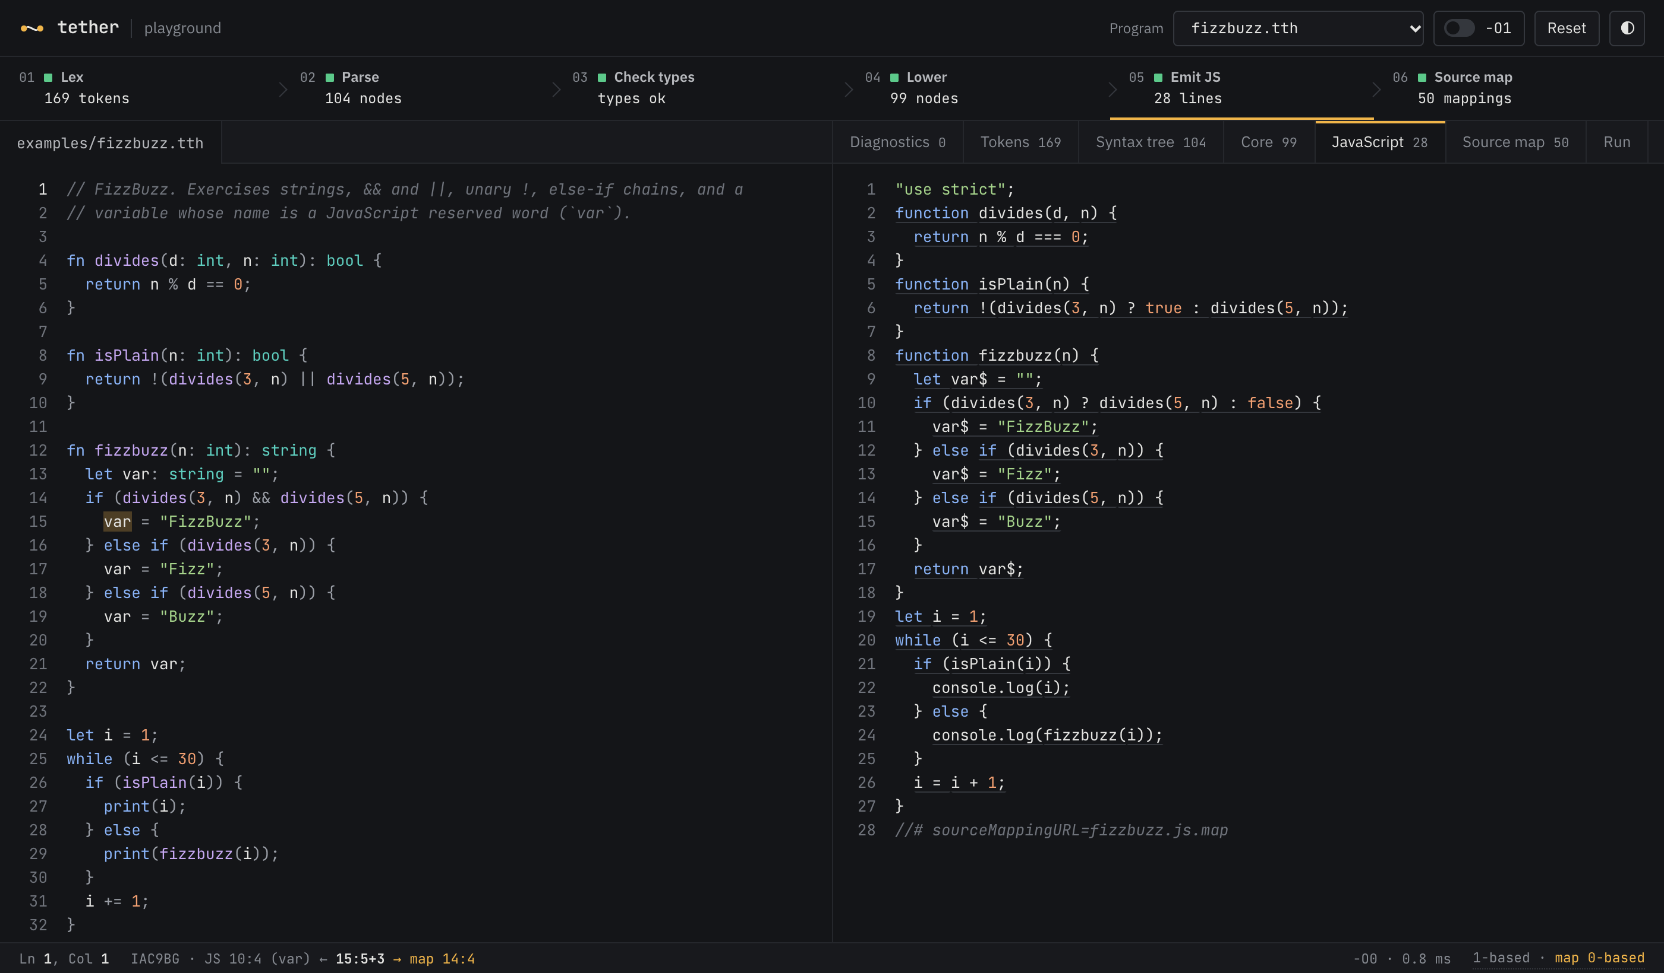
Playground: every phase, live
tether / playground
Six phases, one pipeline
click a phase to open what it produced
Hover a JS segment
var$ lights up var; the status bar shows both positions
Run
executes the generated program in a worker
Notes:
The playground now shows all six phases live. Under JavaScript, each underlined segment is one source-map entry: hovering it highlights the Tether code it came from. The Run tab executes the generated program. In the screenshot I am hovering var$ in the JavaScript: the Tether name var lights up, and the status bar shows both positions, 1-based in Tether and 0-based in the map.

Slide 16
The remaining 25%
tether / plan
M1
M2
M3
M4
M5
M6
M7
M8
Grammar, lexer
Parser, AST
Type checker
Lowering, JS
VLQ encoder
Source map
Browser proof
-O1, report
M7 Browser verification
M8 Optimisation and fidelity
Set breakpoints on at least ten .tth statements in Chrome DevTools and show each one halts there (AC-2)
Show a runtime stack trace naming the .tth file and line in the browser (AC-5)
Screenshots and a written walkthrough
-O1: constant folding and dead-code removal (FR-O1)
A folded expression keeps the span of what it replaced (FR-O2)
--map-report: statements that keep a mapping at -O0 and -O1, for all four benchmarks (FR-O3, AC-6)
Notes:
Two milestones remain. Milestone 7 proves breakpoints and stack traces in Chrome DevTools, with screenshots. Milestone 8 adds the -O1 optimiser and measures how many mappings it costs.

Slide 17
Live demo
tether / demo
# 1 compile and run
$ node bin/tether.js build examples/fib.tth && node out/fib.js
# 2 eight semantic errors in one run
$ node bin/tether.js build test/fixtures/semantic-errors.tth
# 3 the lowered tree and the mapping table
$ node bin/tether.js build examples/fib.tth --dump-core
# 4 a runtime error, reported in the original source
$ node --enable-source-maps out/stack-overflow.js
All commands are in REVIEW-DEMO.md.
Notes:
Now a short live demo, using the commands in REVIEW-DEMO.md: compiling and running a program, the semantic-error fixture, the lowered tree, and the source-mapped stack trace.

Slide 18
Questions?
tether / questions
Antra · 24BDS0066
1:7+11
print("thank you");
Notes:
Thank you. I am happy to take questions.

