Slide 1
Tether
compiler-design / project-review-3
Review 3: final implementation (100%)
Chrome DevTools paused here · fib.tth:14
let next = a + b;
a breakpoint on the original source, in a debugger that knows nothing about Tether
Antra
24BDS0066 · Compiler Design
Notes:
Good morning. This is the final review of Tether. All eight milestones are complete. The line on this slide is the headline result: I set a breakpoint on this line of my Tether source in Chrome DevTools, and Chrome stopped there, even though Chrome knows nothing about my language. Everything it needs comes from the source map Tether writes.

Slide 2
The project in one slide
tether / summary
01
02
03
Problem
Tether
Result
A program compiled to JavaScript is debugged as JavaScript: errors and breakpoints point at code nobody wrote.
A compiler for a small typed language that emits ES2015 plus a Source Map v3 file, carrying exact positions through every phase.
20 of 20 breakpoints set on .tth lines in Chrome DevTools stop there; runtime stack traces name the .tth file and line.
Source maps are not new. Treating positions as a verified, measured artifact through every phase is.
Notes:
In one slide: compiled code is normally debugged as generated code. Tether compiles a small typed language to JavaScript and writes a source map, carrying exact positions through every phase. The result is that breakpoints and stack traces in Chrome work on the original source. The novelty, as I said in Review 1, is not the source map format itself, but treating positions as something verified and measured.

Slide 3
All eight milestones complete
tether / progress
100%
31/31
6/6
6/6
functional requirements
non-functional requirements
acceptance criteria
of the plan in the PRD
M1
M2
M3
M4
M5
M6
M7
M8
Grammar, lexer
Parser, AST
Type checker
Lowering, JS
VLQ encoder
Source map
Browser proof
-O1, report
Notes:
All eight milestones are complete: every functional and non-functional requirement in my PRD, and all six acceptance criteria.

Slide 4
Acceptance criteria
tether / acceptance
 | Criterion | Result | Evidence
AC-1 | Benchmarks print exactly their expected output | 4 of 4 | test/cli.test.js
AC-2 | Breakpoints on ≥ 10 .tth statements halt there in Chrome DevTools | 20 of 20 | docs/browser-verification.md
AC-3 | Mapping table round-trips through an independent decoder | 100% | test/sourcemap.test.js
AC-4 | Five semantic errors reported in one run, with carets | 8 of 8 | semantic-errors.tth
AC-5 | Browser stack trace names the original file and line | stack-overflow.tth:6 | screenshot, DevTools console
AC-6 | Mapping retention recorded at -O0 and -O1 | 5 programs | docs/fidelity.md
Notes:
These are the six acceptance criteria from the PRD, each with its result and where the evidence is. AC-2 and AC-5, the browser criteria, and AC-6, the fidelity measurement, are new since Review 2.

Slide 5
Final architecture
tether / architecture
program.tth
program.js + program.js.map
Lexer
M1
Parser
M2
Checker
M3
Lowering
M4
Optimise
-O1 · M8
JS emitter
M4
Source map
M5–6
diagnostics.js errors from every phase, with carets and notes; no output after any error
2,155
0
< 0.1 ms
170
lines of compiler source
dependencies
full compile per benchmark
tests
Notes:
The final pipeline. The optimiser, drawn dashed, runs only with -O1. The whole compiler is about two thousand lines with no dependencies, and a full compile of a benchmark takes under a tenth of a millisecond.

Slide 6
Proving it in a real browser
tether / 07-browser · milestone 7
Chrome 1: the program
debug/index.html loads out/fib.js; Chrome fetches fib.js.map and shows fib.tth
Chrome 2: DevTools
its own DevTools UI, driven by keyboard: open fib.tth, go to line, toggle breakpoint
Verifier (Node)
reads where Chrome stopped and maps it back with an independent decoder
For each of 20 statements in the 4 benchmarks
1
A fresh tab and a fresh DevTools, so no breakpoint carries over
2
Set the breakpoint on the .tth line through the DevTools interface
3
Reload; Chrome pauses in out/<name>.js
4
Map the paused position back: it must be on the same .tth line
Notes:
To prove AC-2 honestly, the breakpoints are set the way a person sets them: through the DevTools user interface on the .tth file. A script runs two headless Chrome instances. The first runs the compiled program. The second shows Chrome’s own DevTools attached to the first, and the script types into it: open the file, go to the line, toggle a breakpoint. Then it reloads and records where Chrome stopped, and maps that position back with Node’s decoder. Each check gets a fresh tab, so no breakpoint leaks from one check into the next; that was a real bug in my first version of the script.

Slide 7
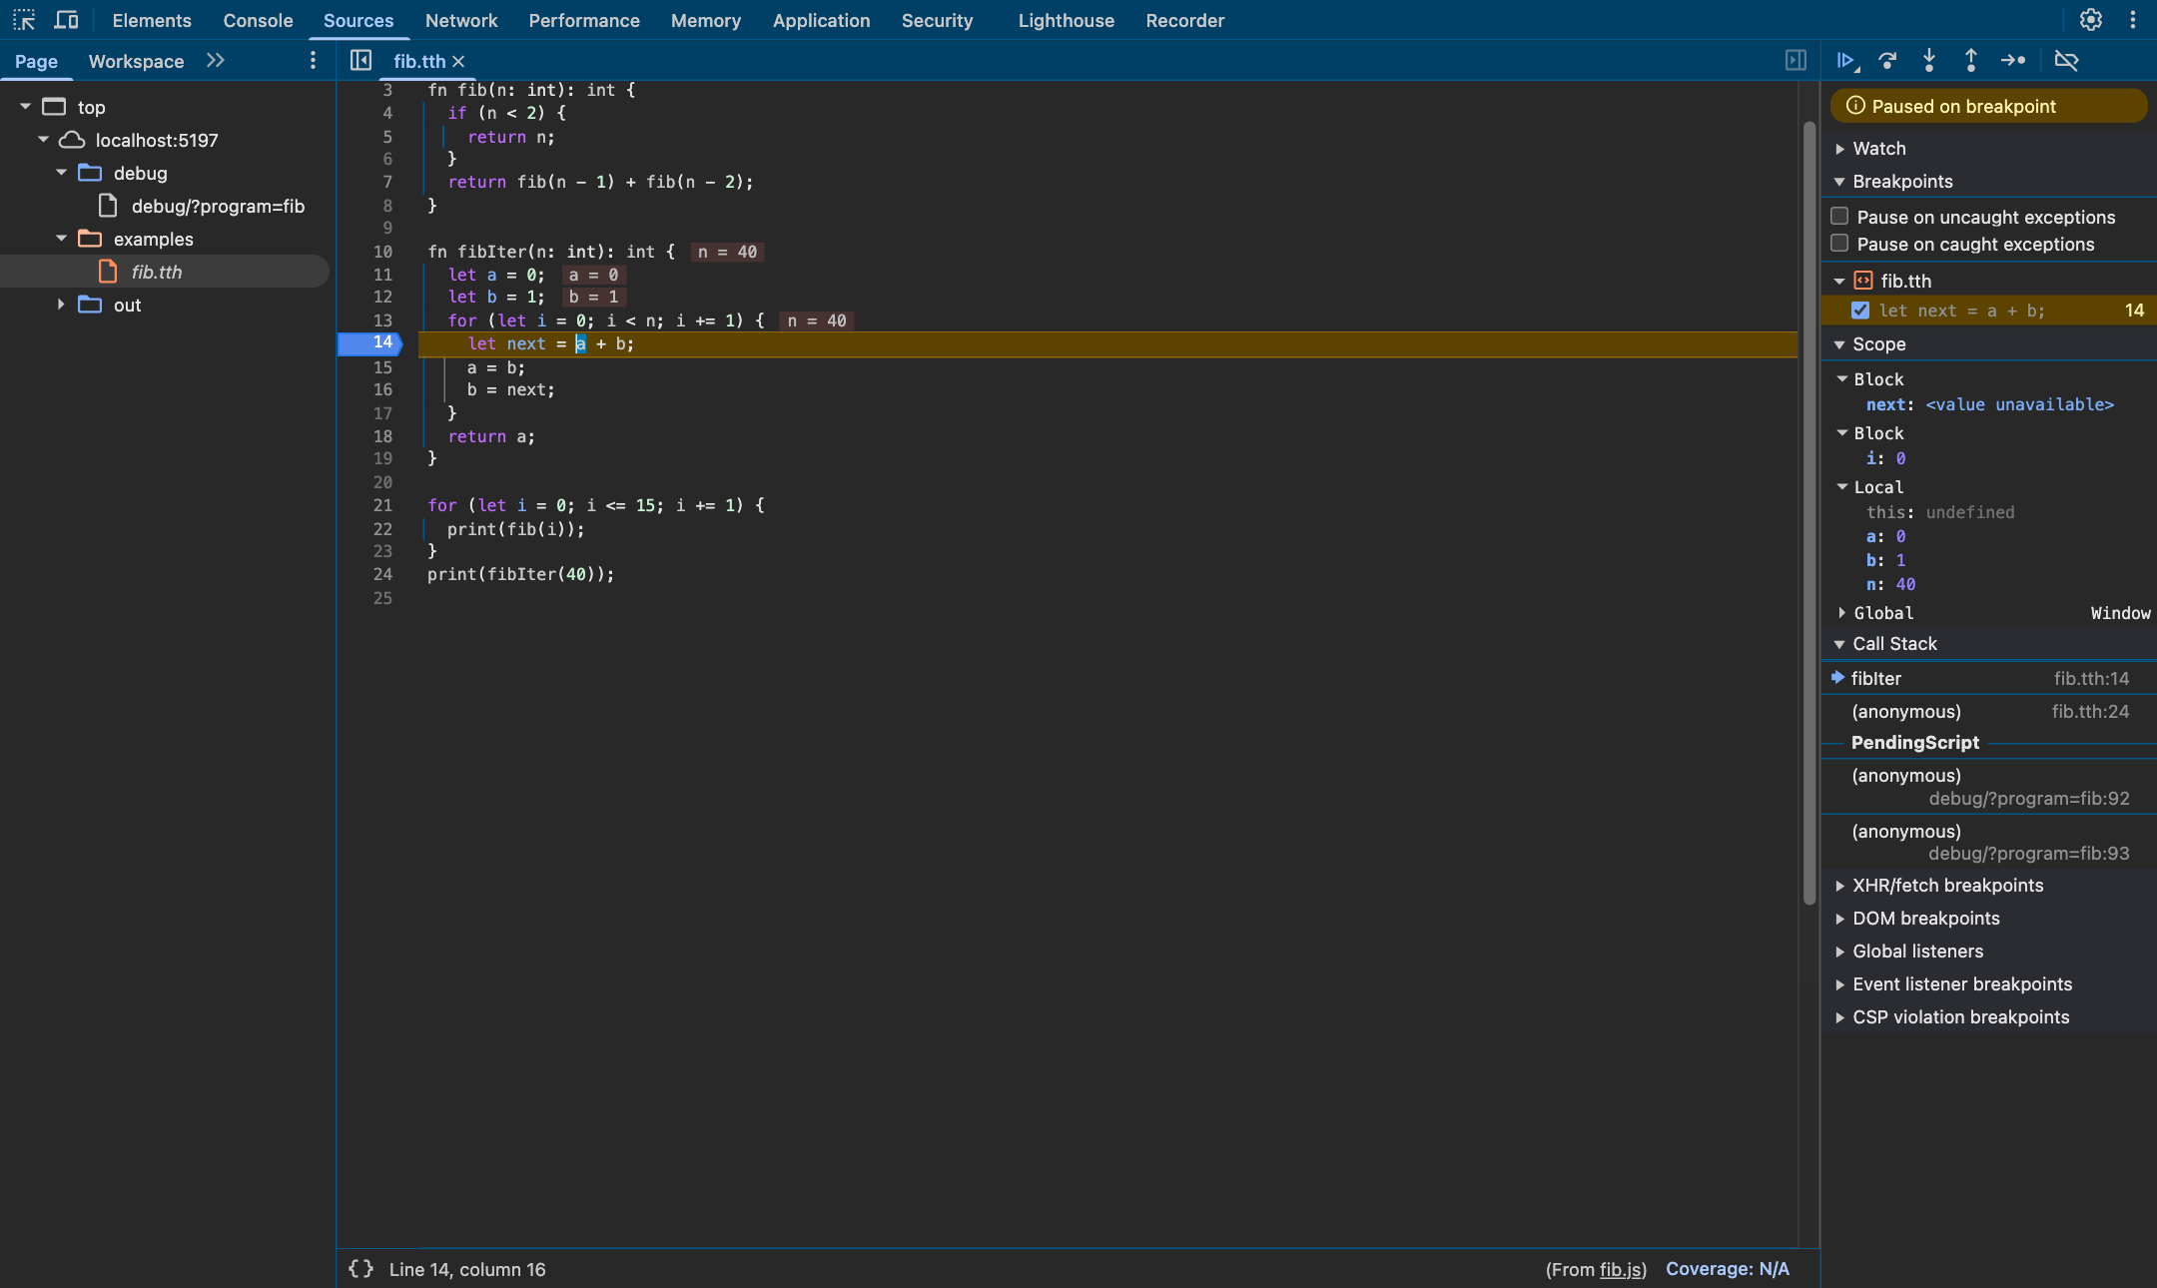
Paused on fib.tth line 14
tether / 07-browser
20/20
breakpoints halted on their .tth statement
Breakpoints pane
fib.tth, line 14
Call stack
fibIter fib.tth:14
Scope
Tether variables a, b, n
Notes:
This is a real DevTools screenshot from that run. Chrome is paused on line 14 of fib.tth, the breakpoint is listed under fib.tth in the Breakpoints pane, the call stack shows fibIter at fib.tth line 14, and Scope shows the Tether variables a, b and n with their values. All 20 breakpoints behaved like this.

Slide 8
Twenty statements, four programs
tether / 07-browser
Program | Lines with a breakpoint | Halted there
fib.tth | 4, 5, 7, 11, 14, 15, 18, 22, 24 | 9 of 9
primes.tth | 7, 12, 20, 25 | 4 of 4
collatz.tth | 8, 10, 21 | 3 of 3
fizzbuzz.tth | 5, 15, 17, 29 | 4 of 4
Statements inside functions, loop bodies, both branches of if, and top-level code.
V8 sometimes stops a little later in the same statement, for example at a + b in let next = a + b. The mapped position is still inside the statement, which is what the check requires.
Notes:
The twenty statements cover functions, loop bodies, both branches of an if, and top-level code, across all four benchmarks. Every one passed. One detail: V8 sometimes moves a breakpoint slightly, for example to the start of a + b, but that position still maps inside the same statement.

Slide 9
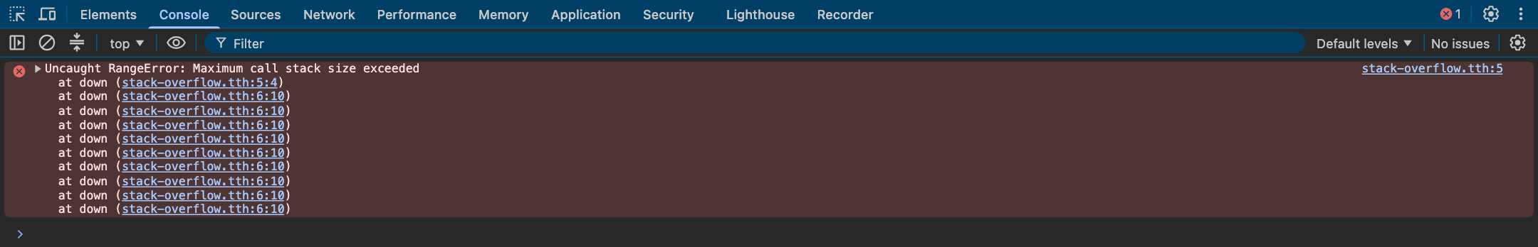
A runtime error, reported in the original source
tether / 07-browser
Chrome DevTools console, running out/stack-overflow.js
Frame | Generated position | Original position
down | out/stack-overflow.js:2:14 | stack-overflow.tth:5:4 · entering down
down | out/stack-overflow.js:3:10 | stack-overflow.tth:6:10 · recursive call
AC-5: the stack trace names the .tth file and line, and each frame links to it.
Notes:
For AC-5, a program that recurses forever runs in Chrome. The DevTools console shows the uncaught RangeError with every frame linked to stack-overflow.tth, line 6 column 10, the recursive call. The innermost frame is line 5, because V8 throws the overflow as the function is entered.

Slide 10
-O1: fold constants, remove dead code
tether / 08-optimise · milestone 8
-O0
-O1
let secondsPerDay = 24 * 60 * 60;
if (1 > 2) {
console.log("never");
}
while (false) {
console.log("never either");
}
if (true ? 3 < 4 : false) {
console.log("always");
} else {
console.log("never");
}
console.log(area(2, 3) + Math.trunc(10 / 3));
console.log("tether" + "-" + "o1");
let secondsPerDay = 86400;
{
console.log("always");
}
console.log(secondsPerDay);
console.log(area(2, 3) + 3);
console.log("tether-o1");
Same output at both levels, always. Folding is skipped where JavaScript would differ: division by zero, unsafe integers, −0. A folded value keeps the span of the whole expression (FR-O2).
Notes:
Milestone 8 adds -O1. On the left is the unoptimised output of a test program written to exercise the optimiser; on the right, -O1. Constant expressions are folded, like 24 times 60 times 60 into 86400, and code that can never run is removed. The program prints exactly the same output at both levels, which the tests check for every program. Folding is skipped where it could change the result, such as division by zero.

Slide 11
What -O1 costs the debugger
tether / 08-fidelity
Benchmarks: no loss
nothing to fold or remove, so the JavaScript is identical at both levels
optimisable.tth: 14 → 7
8 expressions folded, 7 statements removed
The real cost
removed code mostly never ran; but a breakpoint on a folded if line no longer stops
--map-report · docs/fidelity.md
Notes:
AC-6 asks for the mapping retention at -O0 and -O1. I want to be straightforward about the result: the four benchmarks lose nothing, because they contain no constant expressions or dead code, so -O1 produces identical JavaScript. To show the measurement actually works, the optimisation test program drops from 14 of 14 statements mapped to 7 of 14. Most of what is removed could never run, so no reachable breakpoint is lost there; the one visible cost is that a breakpoint on an if whose condition was folded no longer stops.

Slide 12
170 tests, and four kinds of evidence
tether / tests
Unit tests per phase
a failure points at one module (NFR-6)
Golden files
every dump, .js and .js.map compared byte for byte
Independent decoder
Node's SourceMap agrees with every mapping
Real browser
npm run verify:browser drives Chrome DevTools
Notes:
The final suite has 170 tests, all passing. The evidence comes in four kinds: unit tests per phase, golden files compared byte for byte, Node’s independent source-map decoder, and the real browser check, which is a separate script because it needs Chrome.

Slide 13
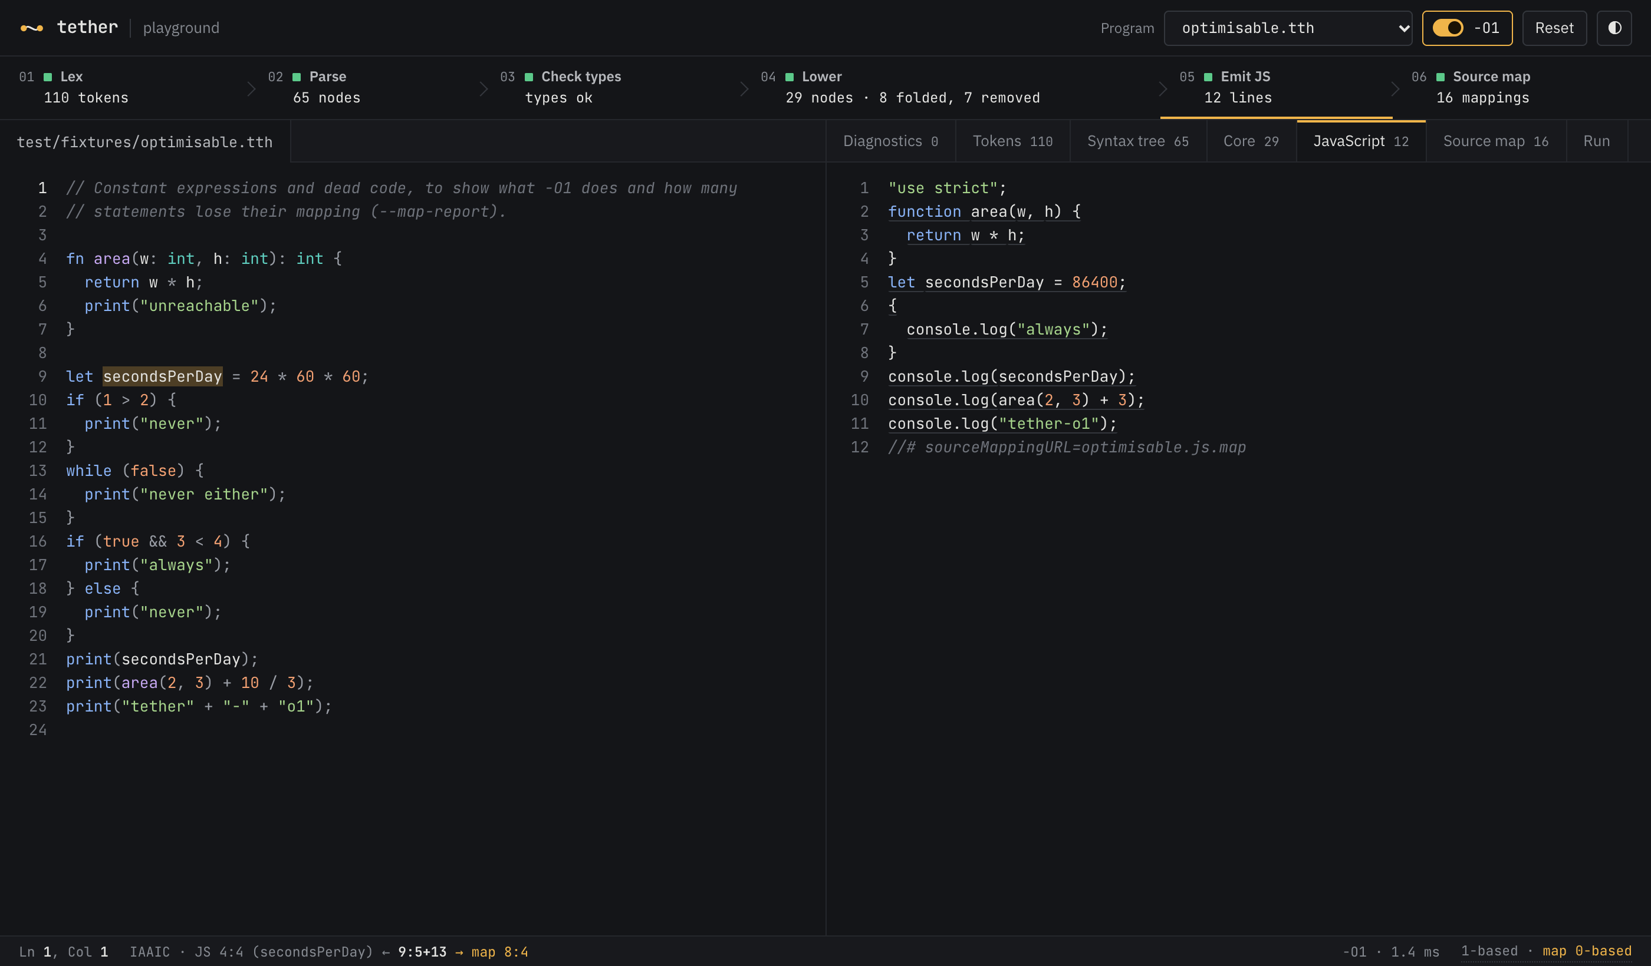
Playground: the whole compiler, live
tether / playground
Every phase, live
click a phase in the pipeline to open it
-O1 switch
shows what was folded and removed
Run
executes the generated program
Notes:
The playground runs the real compiler in the browser. With the -O1 switch on, the phase strip shows 8 expressions folded and 7 statements removed for the optimisation test program, and the JavaScript shrinks from 21 lines to 12.

Slide 14
Limitations and future work
tether / limits
Limitations
Future work
Mappings cover statements and identifiers, not every sub-expression
Verified on Chrome 155 and Node 25; Firefox and Node 18 not tested separately
The benchmarks have nothing for -O1 to remove, so their measured loss is zero by construction
A deliberately small language: no arrays, closures or modules; integers are JavaScript numbers
Expression-level mappings for more precise stack-trace columns (PRD open question 1)
Run the browser verification in Firefox as well
Constant propagation, with rules that keep mappings for code that still runs
Emit scope information, so debuggers can show the original variable names everywhere
Notes:
Some honest limitations. Mappings are statement and identifier level, not every sub-expression. I verified on Chrome and a current Node, not Firefox or Node 18 specifically. The benchmarks give zero fidelity loss under -O1 simply because there is nothing to optimise in them. And the language is deliberately small. The future work follows from these.

Slide 15
What this project shows
tether / conclusion
1
Positions have to be designed in from the first token
Every token and node carries a span, and exactly one function turns positions 0-based. Nothing was patched on at the end.
2
A claim about a source map needs independent evidence
Node's decoder and Chrome's own DevTools, not my code, confirm that the map is right.
3
Optimisation and debuggability trade off, measurably
Removed code loses its mappings: 100% to 50% on the test program, 0% loss where nothing is removed.
Notes:
Three things this project shows. First, positions must be designed in from the very first token; they cannot be added at the end. Second, a claim that a source map is correct needs independent evidence, which here is Node’s decoder and Chrome’s own DevTools. Third, optimisation and debuggability really do trade off, and the trade-off can be measured.

Slide 16
Live demo
tether / demo
# 1 compile and run
$ node bin/tether.js build examples/fib.tth && node out/fib.js
# 2 -O1 and the fidelity report
$ node bin/tether.js build test/fixtures/optimisable.tth --map-report
# 3 breakpoints in Chrome DevTools
$ npm run build:examples && npm run playground
open localhost:5173/debug/?program=fib, set a breakpoint on line 14
# 4 the playground with -O1
All commands are in REVIEW-DEMO.md. If the live browser step fails, docs/browser-verification.md has the screenshots.
Notes:
Now the live demo, following REVIEW-DEMO.md: compiling and running, the fidelity report, a breakpoint in Chrome DevTools, and the playground with -O1. If the live browser step fails for any reason, the verification report has the screenshots.

Slide 17
References
tether / references
[1] A. V. Aho, M. S. Lam, R. Sethi, J. D. Ullman. Compilers: Principles, Techniques, and Tools, 2nd ed. Addison-Wesley, 2006.
[2] V. R. Pratt. “Top Down Operator Precedence.” Proc. 1st ACM Symposium on Principles of Programming Languages (POPL), 1973.
[3] K. Clarke. “The Top-Down Parsing of Expressions.” Tech. report, Queen Mary College, University of London, 1986.
[4] T. S. Norvell. “Parsing Expressions by Recursive Descent.” Memorial University of Newfoundland, 1999.
[5] R. Nystrom. Crafting Interpreters. Genever Benning, 2021.
[6] Ecma International. ECMA-426: Source Map Format Specification, 1st ed., December 2024.
[7] J. Hennessy. “Symbolic Debugging of Optimized Code.” ACM TOPLAS 4(3):323–344, 1982.
[8] Y. Li, S. Ding, Q. Zhang, D. Italiano. “Debug Information Validation for Optimized Code.” PLDI 2020.
[9] C. Assaiante, D. C. D’Elia, G. A. Di Luna, L. Querzoni. “Where Did My Variable Go? Poking Holes in Incomplete Debug Information.” ASPLOS 2023.
Notes:
These are the sources from the literature survey.

Slide 18
Questions?
tether / questions
Antra · 24BDS0066
1:7+11
print("thank you");
Notes:
Thank you. I am happy to take questions.

