Slide 1


Predictive Analytics Project
Title:
Credit Card Fraud Detection
Presented by:
R2142220442 – Antra Chauhan
R2142220184 – Sumit Verma
Mentored by:
Dr. Achala Shakya

Slide 2
Content
Introduction
Literature Review
Objectives
Methodology
Working Model
References

Slide 3
Introduction
Credit card fraud is a growing global issue, involving the unauthorized use of a credit or debit card to make purchases or withdraw funds, leading to significant financial losses. The rapid increase in online transactions has made early and accurate detection of fraudulent activities more crucial than ever to minimize losses and build customer trust. However, fraud detection presents several challenges, including highly imbalanced data—where fraudulent transactions are rare compared to legitimate ones—along with the need for real-time processing to avoid impacting legitimate users and keep up with evolving fraud tactics. To address these challenges, this study aims to develop a robust machine learning model that can accurately detect fraudulent transactions. We use Random Forest and XGBoost classifiers due to their effectiveness in handling imbalanced data, high accuracy, and efficiency, making them suitable choices for a reliable fraud detection system.

Slide 4
Literature Review
Traditional Techniques: Early fraud detection relied on rule-based systems and logistic regression, which struggled to adapt to evolving fraud tactics, resulting in high false positives.
Machine Learning Advances: ML methods like SVM and neural networks improved detection but required extensive preprocessing and tuning.
Ensemble Learning:
Random Forest: Combines decision trees to reduce overfitting and handle imbalanced data.
AdaBoost: Iteratively boosts weak classifiers, effective for complex, high-dimensional data.
Performance: Studies show ensemble models (Random Forest, AdaBoost) outperform individual models, excelling in precision, recall, and ROC AUC, especially with balanced training sets (e.g., using SMOTE).

Slide 5
Objective
Develop an Accurate Fraud Detection Model: Create a machine learning model to reliably identify fraudulent transactions.
Minimize False Positives: Ensure the model reduces false positives to avoid interrupting legitimate transactions.
Handle Imbalanced Data: Effectively address the skewed nature of transaction data, where fraud cases are rare.
Compare Model Performance: Evaluate and compare the effectiveness of Random Forest and XGBoost classifiers in terms of accuracy, precision, recall, and ROC AUC.
Real-Time Efficiency: Optimize model performance for real-time fraud detection, ensuring timely response without delays

Slide 6
Methodology
Dataset: Used a publicly available credit card fraud dataset, containing transaction features and fraud labels. Addressed heavy data imbalance (few fraud cases).
Data Preprocessing:
Applied data resampling techniques (e.g., SMOTE) to balance the dataset.
Standardized features for consistent scaling and improved model performance.
Algorithm Selection:
Random Forest: Chosen for its robust handling of imbalanced data and high accuracy.
XGBoost: Selected for its boosting approach, which improves weak learners iteratively.
Model Training and Tuning:
Split data into training and testing sets.
Tuned hyperparameters (e.g., tree depth, learning rate) for optimal performance.
Evaluation Metrics:
Used accuracy, precision, recall, F1-score, and ROC AUC to assess model effectiveness.

Slide 7
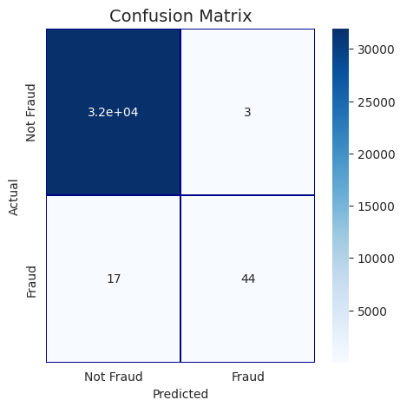
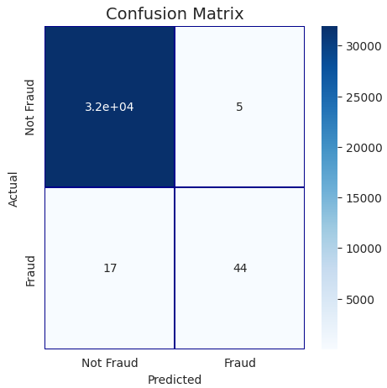
Working Module
Random Forest Classifier
Ada Boost Classifier
0.8606088025692754
0.860577512478847

Slide 8
Conclusion
Effective Fraud Detection: Both Random Forest and XGBoost proved to be effective in identifying fraudulent transactions, with high accuracy and strong performance on imbalanced data.
Model Comparison: Random Forest outperformed XGBoost in terms of the AUC-ROC curve, indicating stronger performance in distinguishing between fraudulent and legitimate transactions.
Practical Application: Ensemble methods like Random Forest and XGBoost can enhance fraud detection systems, improving real-time response and reducing false positives.
Future Work: Further tuning, additional features, and testing with larger datasets could increase accuracy and adaptability to evolving fraud pattern.

Slide 9
Thank You

