Slide 1

Team Name: Antriksh-22
Team Leader Name: Antriksh
Problem Statement: Intelligent Candidate Discovery & Ranking for Redrob AI

Slide 2
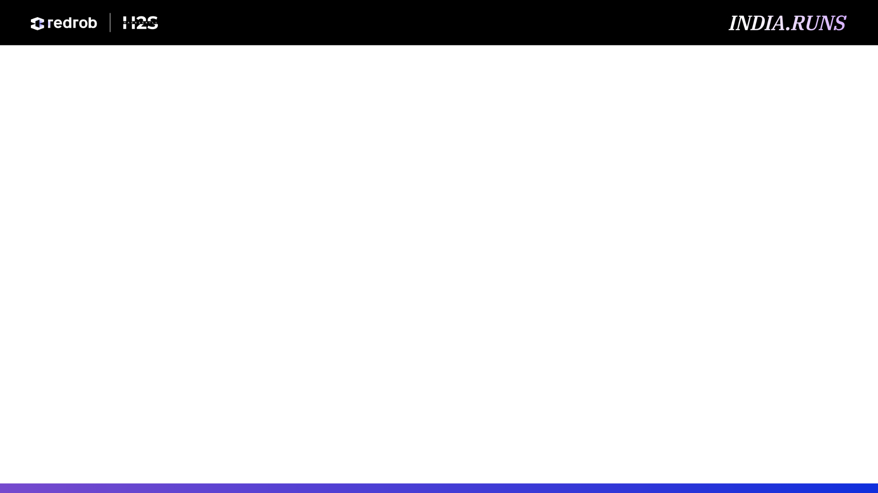
Solution Overview
A hybrid AI ranking engine that identifies the best Senior AI Engineer candidates for Redrob. It combines JD understanding, production-signal scoring, semantic profile matching, behavioral indicators, and explainable final ranking into one reproducible pipeline.
Traditional filters over-rank keyword stuffing. Our approach scores evidence: AI/backend skill depth, years fit, production ownership, recruiter activity, GitHub signal, tenure stability, location/relocation, and role context. Every selected candidate receives a concise reason tied to observed data.

Slide 3
JD Understanding & Candidate Evaluation
Extracted requirements: 5-9 years preferred, production ML systems, embeddings, retrieval, ranking, LLM re-ranking, strong Python/backend capability, scrappy product shipping, evaluation infrastructure, mentorship, and founding-team ownership.
Important signals: core AI skills, profile summary, career history, skill proficiency/duration, production language in role descriptions, average tenure, GitHub activity, recruiter response rate, interview completion, open-to-work status, and relocation/location suitability.

Slide 4
Ranking Methodology
The pipeline streams all 100,000 JSONL profiles, converts each profile into a normalized evidence text, computes sparse hashed semantic similarity to the JD, and keeps only the strongest candidates in memory.
Algorithms: deterministic hashed vector similarity, weighted skill matching, 5-9 year experience fit, behavioral multiplier, tenure penalty for short stints, location/relocation bonus, and optional Gemini reranking when GEMINI_API_KEY is available.
Final local score = 25% semantic + 25% AI/backend skill depth + 20% experience + 15% behavioral quality + 10% tenure + 5% location fit, with guardrail penalties for weak core skills, low experience, and job hopping.

Slide 5
Explainability & Data Validation
Each row includes a human-readable reason summarizing title, years, strongest AI/backend skills, behavior score, and tenure score. This makes the ranking auditable by recruiters and challenge reviewers.
Justifications are generated from structured candidate fields only: profile, skills, career history, and Redrob signals. The default mode is deterministic and does not invent facts.
Missing values fall back to neutral defaults. Suspicious patterns such as short tenures, weak production evidence, low AI/backend skill depth, or poor engagement reduce the score instead of crashing the pipeline.

Slide 6
End-to-End Workflow
1. Read Redrob JD from DOCX. 2. Stream candidates.jsonl. 3. Build evidence text per candidate. 4. Score semantic, skills, experience, behavior, tenure, and location. 5. Keep the top pool. 6. Optionally rerank top 15 with Gemini. 7. Export valid 100-row CSV and ranked PDF report.

Slide 7
System Architecture JobDescriptionAnalyzer: reads/parses the JD. EmbeddingEngine: deterministic sparse vectors, optional Gemini embeddings/rerank path. CandidateEvaluator: streaming scorer over JSON/JSONL candidate data. GeminiReranker: optional qualitative top-15 refinement with safe fallback. Deliverables: redrob_submission.csv, ranked_candidates.csv, recommended_candidates_report.pdf, PPT.

Slide 8
Results & Performance
Top results are senior AI/ML/NLP engineers with strong retrieval, RAG, vector DB, Python, MLOps, and stable tenure signals. #1 CAND_0018499 - score 1.0000: Senior Machine Learning Engineer with 7.2 yrs; AI/backend match 100/100 via RAG, Embeddings, Recommendation Systems, Pinecone, Weaviate; behavior 100, tenure 100. #2 CAND_0046525 - score 0.9935: Senior Machine Learning Engineer with 6.1 yrs; AI/backend match 100/100 via LLMs, pgvector, LangChain, Machine Learning, LlamaIndex; behavior 100, tenure 100. #3 CAND_0042029 - score 0.9870: Senior Data Scientist with 6.5 yrs; AI/backend match 100/100 via RAG, Embeddings, Weaviate; behavior 100, tenure 100. #4 CAND_0092278 - score 0.9805: Senior NLP Engineer with 6.8 yrs; AI/backend match 100/100 via LLMs, pgvector, Machine Learning, Milvus; behavior 100, tenure 100. #5 CAND_0005260 - score 0.9740: Senior NLP Engineer with 5.2 yrs; AI/backend match 100/100 via Python, RAG, Embeddings, pgvector, MLOps; behavior 100, tenure 100.
The full 100,000-candidate dataset was streamed locally in about 98 seconds on this machine. The scorer uses standard-library sparse vectors, so it avoids large memory usage and remains free-tier friendly.

Slide 9
Technologies Used
Python 3, CSV/JSON streaming, DOCX XML extraction, sparse hashed vectors, deterministic scoring heuristics, optional modern Google GenAI SDK, and the official Redrob validator.
These choices keep the solution reproducible, explainable, fast, and submission-safe. No secret keys are stored in code; Gemini is enabled only through GEMINI_API_KEY.

Slide 10
Submission Assets
GitHub repository: https://github.com/Antriksh-22/Data-ai-challenge-redrob- Final submission CSV: redrob_submission.csv, validated with official validate_submission.py. Ranked recommendations PDF: recommended_candidates_report.pdf. Generated on: 2026-06-07.

Slide 11


