Slide 1
NETWORKS BASICS

Slide 2
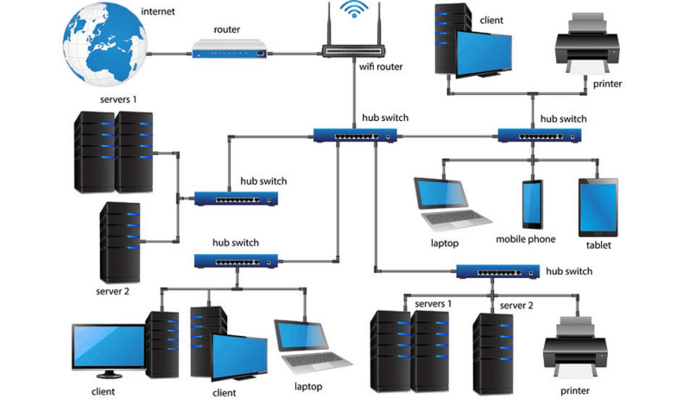
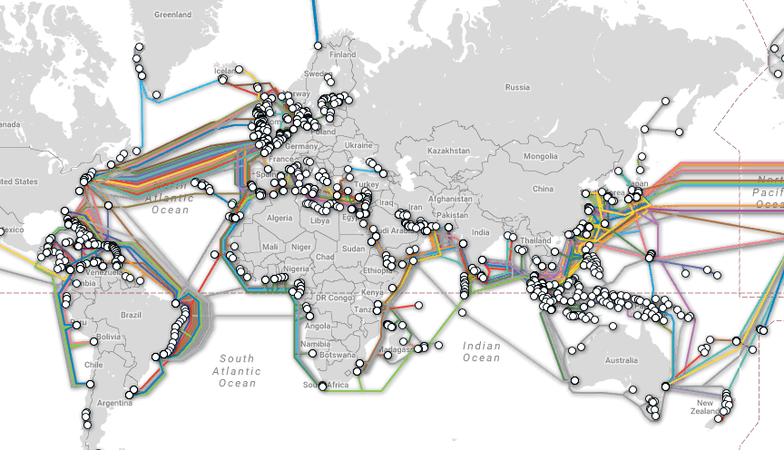
Computer Networks
WAN
LAN
MAN
PAN

Slide 3
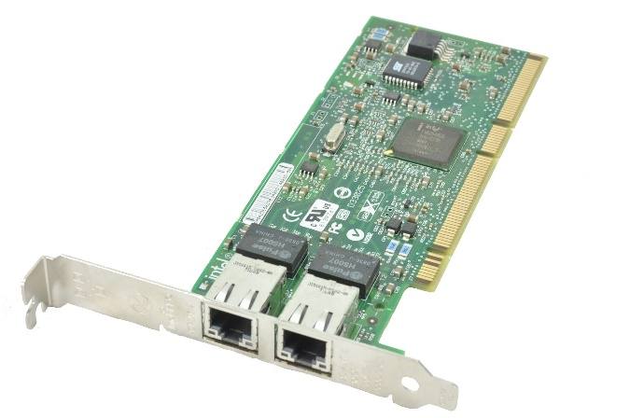

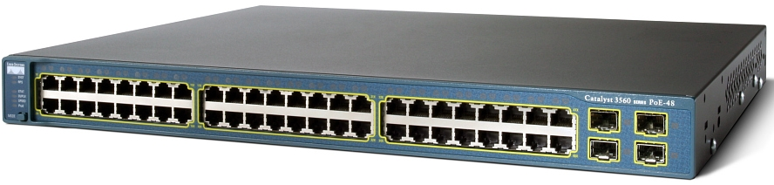
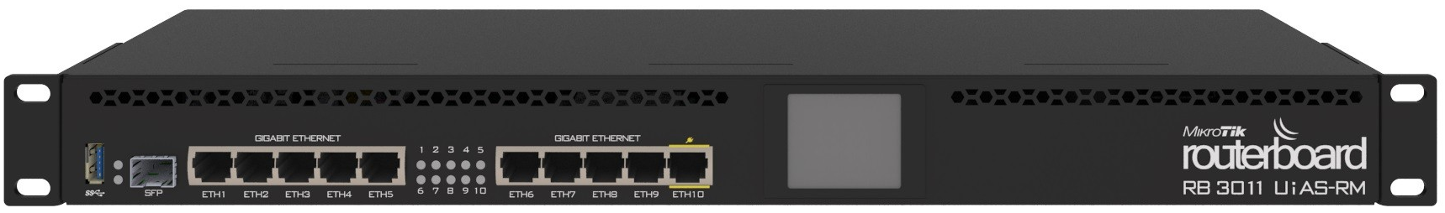
Hardware
Switch
Router
Wi-Fi AP
L2, L3, L7

Slide 4
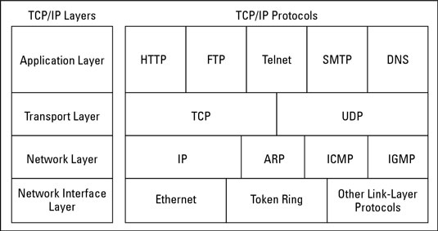
TCP/IP
Ethernet, Wi-Fi, PPP
IPv4
IPv6
TCP
UDP
HTTP
SMTP, IMAP
DNS, DHCP

Slide 5
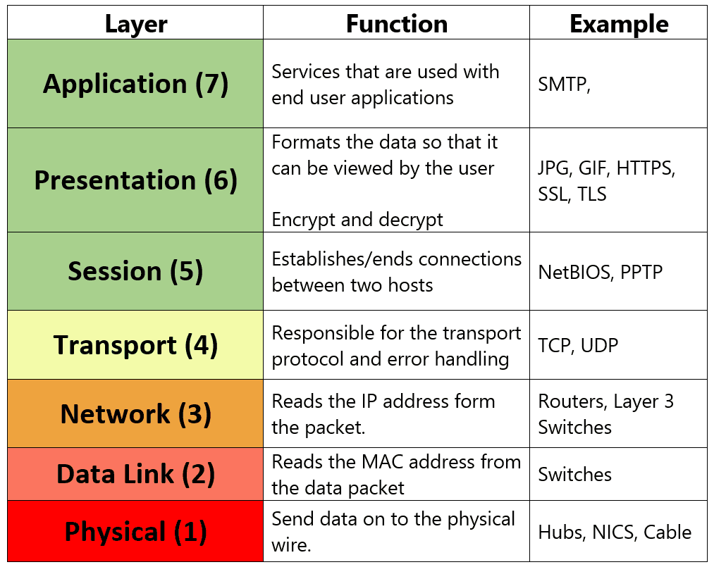
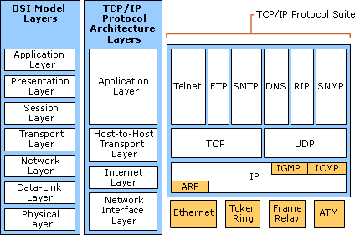
ISO/OSI
Open Systems Interconnection Basic Reference Model

Slide 6
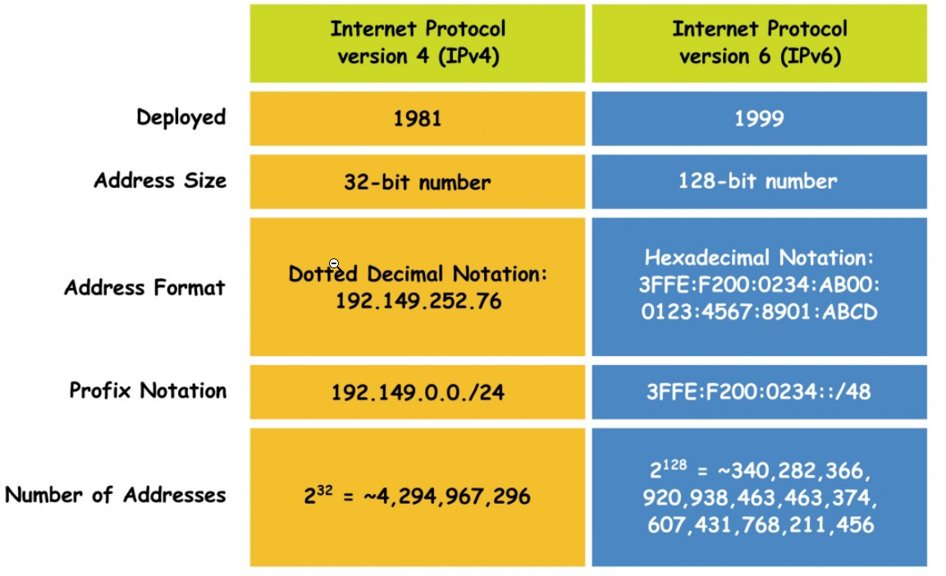
IPv4 vs IPv6

Slide 7
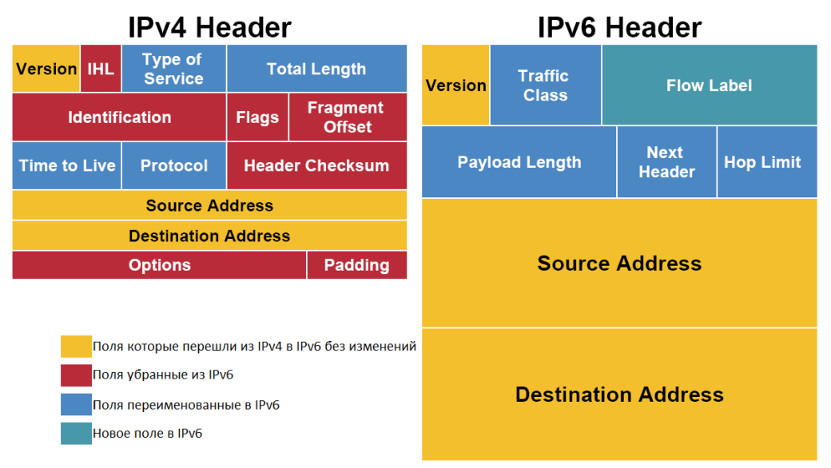
IPv4 vs IPv6

Slide 8
TCP vs UDP
Protocol | TCP | UDP
Connection | Established SYN, ACK, FIN | Connectionless
Usage | High reliability | Efficient Transmission, Huge number of clients
Ordering of data | Rearranges packets in order | no order
Reliability | yes | no
Streaming | Byte stream with congestion control | Individual datagrams
Error Checking | error checking and recovery | checksum - drop datagrams if error
Acknowledgement | Segments acknowledgements | -

Slide 9
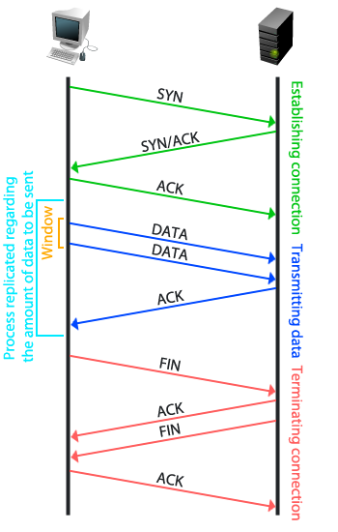
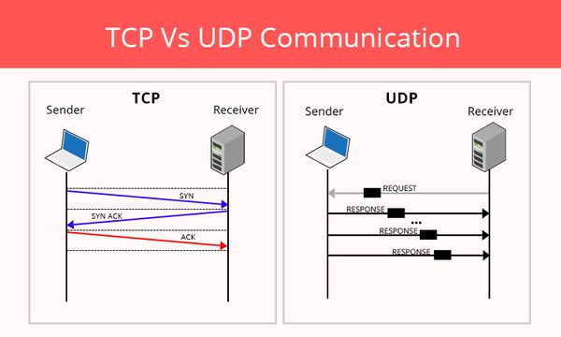
TCP and UDP

Slide 10
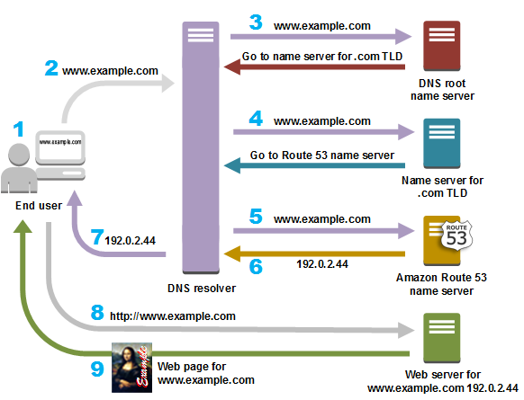
DNS
Distributed database
A and AAAA
CNAME
MX
TXT
PTR
NS
SRV

Slide 11
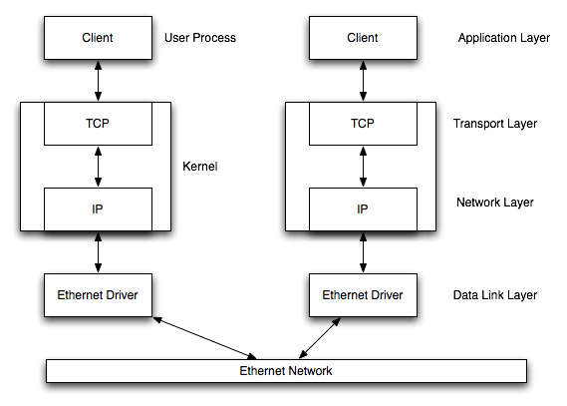
TCP/IP in OS

Slide 12
UNIX
Network Layer L3: AF Address Family: inet == ipv4, inet6 == ipv6, unix == unix.sockets unix >> loopback ; unix.socket 777 644 ; 10.0.0.45:5000
Transport Layer L4:
Stream sockets == tcp socket
Datagram sockets == udp socket ICMP == raw sockets

Slide 13
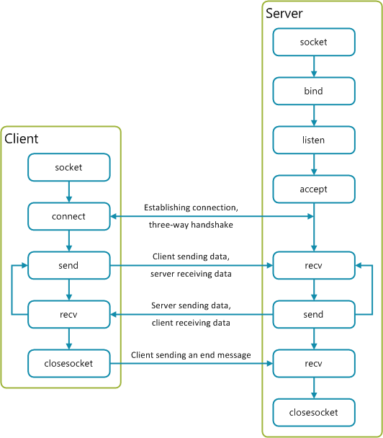
Python
import ipaddress
import socket
socket.AF_INET
socket.AF_UNIX
socket.AF_INET6
socket.SOCK_STREAM
socket.SOCK_DGRAM
s = socket.socket()
s.bind()
s.listen()
s.accept()
s.connect()
s.send()
s.sendto()
s.recv()
s.recvfrom()
s.close()

Slide 14
TCP client
# Client import socket as sock s = sock.socket(sock.AF_INET,sock.SOCK_STREAM) s.connect((‘httpbin.org’, 80)) s.send(b "GET / HTTP/1.1\r\nHost: httpbin.org\r\n\r\n")
data = s.recv(100000)
s.close()

Slide 15
TCP Socket
# Server import socket as sock s = sock.socket(sock.AF_INET,SOCK_STREAM) s.bind((‘127.0.0.1', 2042)) s.listen(1) conn, addr = sock.accept() while True: name = conn.recv(1024) if not name: break conn.send(b’Hello!!!') conn.close()
# Client import socket sock = socket.socket() sock.connect(("localhost", 2042)) message = input("Your name: ") sock.send(bytes(message, 'utf-8')) data = sock.recv(1024) sock.close() print(data)

Slide 16
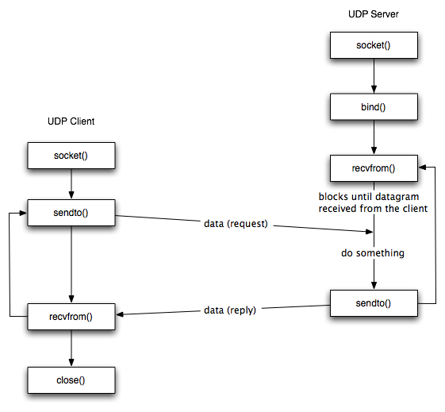
Python
import ipaddress
import socket
socket.AF_INET
socket.AF_UNIX
socket.AF_INET6
socket.SOCK_DGRAM
s = socket.socket()
s.bind()
s.sendto()
s.recvfrom()
s.close()

Slide 17
UDP Socket
# Client import socket as sock sock = socket.socket(sock.AF_INET,SOCK_DGRAM) message = input("Your name: ") sock.sendto(bytes(message, 'utf-8’) ,("localhost", 2042)) data,address = sock.recvfrom(1024) sock.close() print(data)
# Server import socket as sock s = sock.socket(sock.AF_INET,SOCK_DGRAM) s.bind((‘127.0.0.1', 2042)) while True: data,address = s.recvfrom(1024) print((data,address)) s.sendto(b’Hello!!!’,address) s.close()

