Slide 1
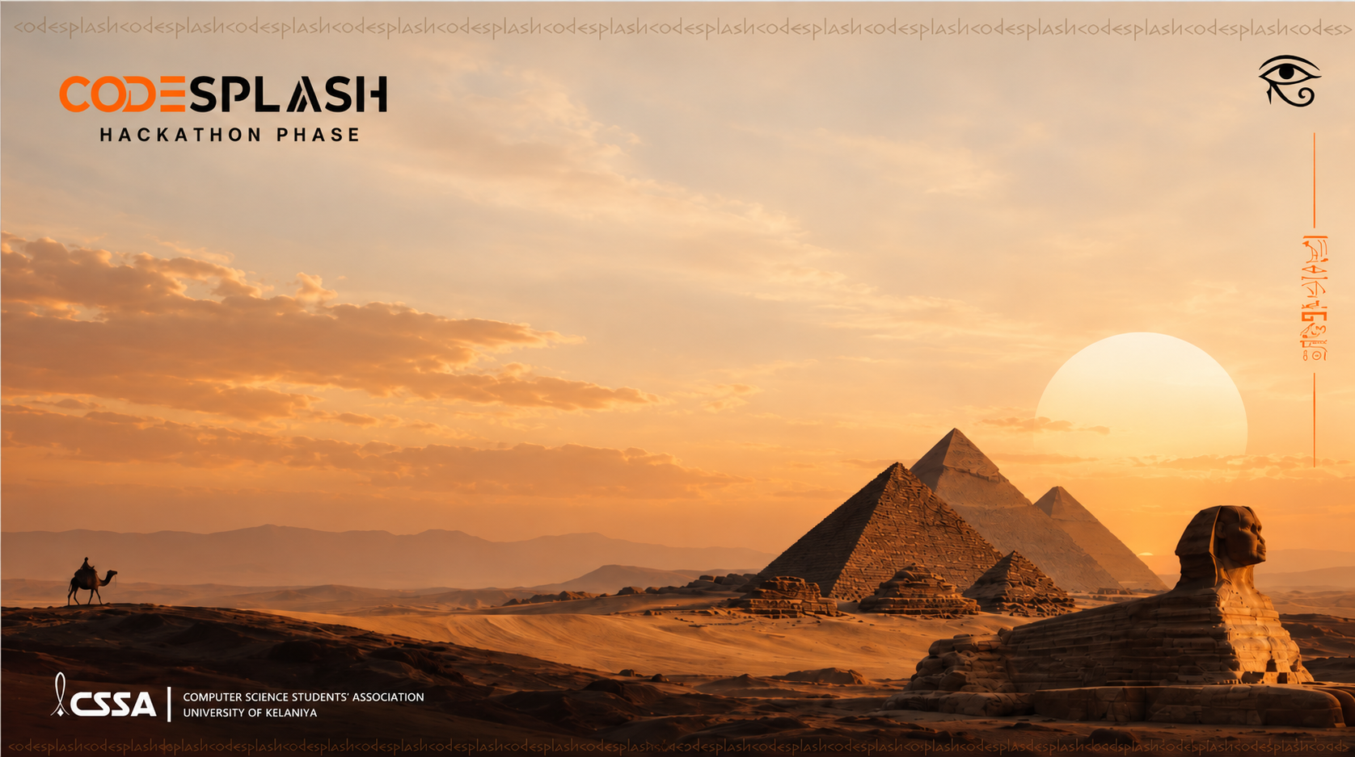
ClearanceX
Project focus
Team Name
Explainable reconciliation
Ants
University Name
Members Details
University Of Moratuwa
Nadija Welihena Gamage
Kaveen Hirumal
Aloka Fernando
Notes:
“Good morning. We are Team Ants from the University of Moratuwa. Our project is ClearanceX, an explainable document reconciliation assistant for shipping teams.
Before a declaration is prepared, someone must decide whether several documents tell the same story. We help that person identify conflicting evidence, understand the difference, and make a recorded decision.”
**Delivery:** Look at the judges. Introduce the team once. Avoid reading all names and the university label from the slide.
Repository baseline: 83ef75c; review 30 September 2026.
Sources: User-supplied CodeSplash title slide.

Slide 2
Agenda
01. Why?
02. What?
03. How?
The structural bottleneck and financial toll.
Our explainable AI reconciliation platform.
System architecture and pipeline deep dive.

Slide 3

01. WHY:
Sri Lanka’s apparel sector drives over $5 Billion in annual export revenue, standing as the backbone of the national economy.
Yet, moving these high value exports across borders is currently bottlenecked by a manual system, which is highly inefficient and unreliable.

Slide 4




01. WHY: THE CURRENT BASELINE
Manual Document Reconciliation
Sri Lanka's 300+ BOI exporters rely on human eyes to match unstandardized data.
5-8 Documents
Visual Hunting
Cross-Verification
ASYCUDA Entry
Invoices, BoL, LC, Packing Lists, AWB
Manual line-item extraction.
Identify mismatches (e.g., weight).
Manual typing into CUSDEC.

Slide 5
01. WHY: THE IMPACT
The Cost of Manual Verification
1-2h
10-20%
$500K
Lost Per Shipment
Initial Rejection Rate
Capital Frozen
Manual extraction & cross-referencing.
Minor discrepancies fail CUSDEC.
Demurrage & delayed Letters of Credit.

Slide 6

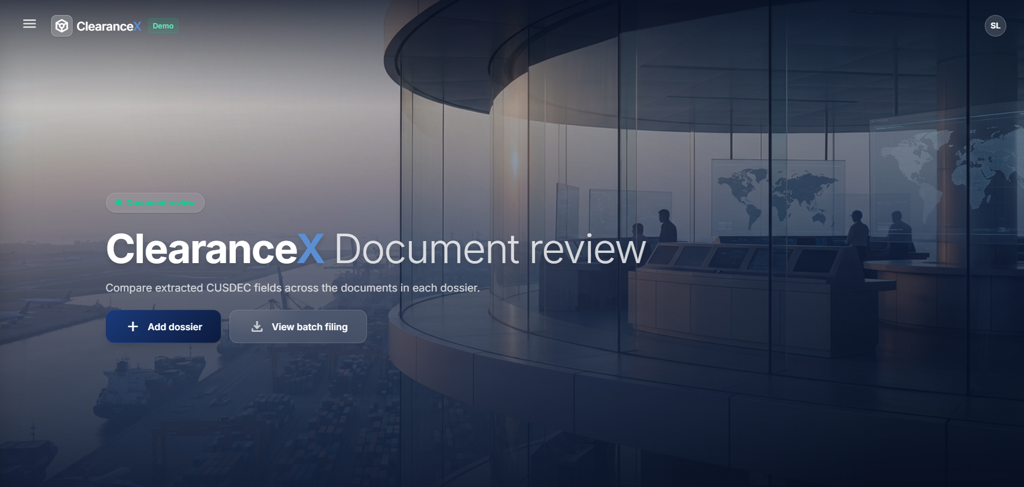
02. WHAT
ClearanceX
The Explainable AI solution to automate the manual system, implementing text extraction and content recognition. cross-referencing, and audit systems.
A seamless system to turn messy, formless documents into a
CUSDEC

Slide 7


02. WHAT
The Core Workflow & Feedback Loop
1
2
3
4
Upload & Extract
Cross-Validate
Review & Resolve
CUSDEC Export
AI parses the PDF dossier and extracts entity data.
Rules engine flags data discrepancies across files.
System suggests values. User manually verifies or accepts suggestions to update CUSDEC.
Verified payload mapped directly to ASYCUDA XML.
Continuous Learning: The Normalization Cache
The system caches human corrections. Future occurrences of the same discrepancy (e.g., entity name variations) auto-resolve without user input.

Slide 8


03. HOW
System Architecture
From unstructured dossiers to verified ASYCUDA payloads.
PaddleOCR
OpenAI Pipeline
NetworkX
Image-to-text data extraction.
Entity classification to JSON payload
Document Classification
Entity Classification
Relational knowledge graph construction.
Node - Entity /Resource
Edge - Value

Slide 9


03. HOW
System Architecture
From unstructured dossiers to verified ASYCUDA payloads.
Reasoning Engine
Interactive Frontend
Creating CUSDEC Document
Discrepancy detection by cross checking each entity. logical prioritization of the entities.
User can either select the recommended solution or manually update it.
When all the discrepancies have been corrected , CUSDEC document is created .

Slide 10
How We Have Used Explainable AI ?
SYSTEM TRANSPARENCY
LAYER 1
LAYER 2
LAYER 3
LAYER 4
Provenance
Reasoning Chain
Confidence
Counterfactuals
Direct mapping to raw OCR bounding boxes.
Step-by-step deductive proof of failed rules.
Quantified uncertainty scores across extraction models.
Prescribed data deltas for immediate correction.

Slide 11
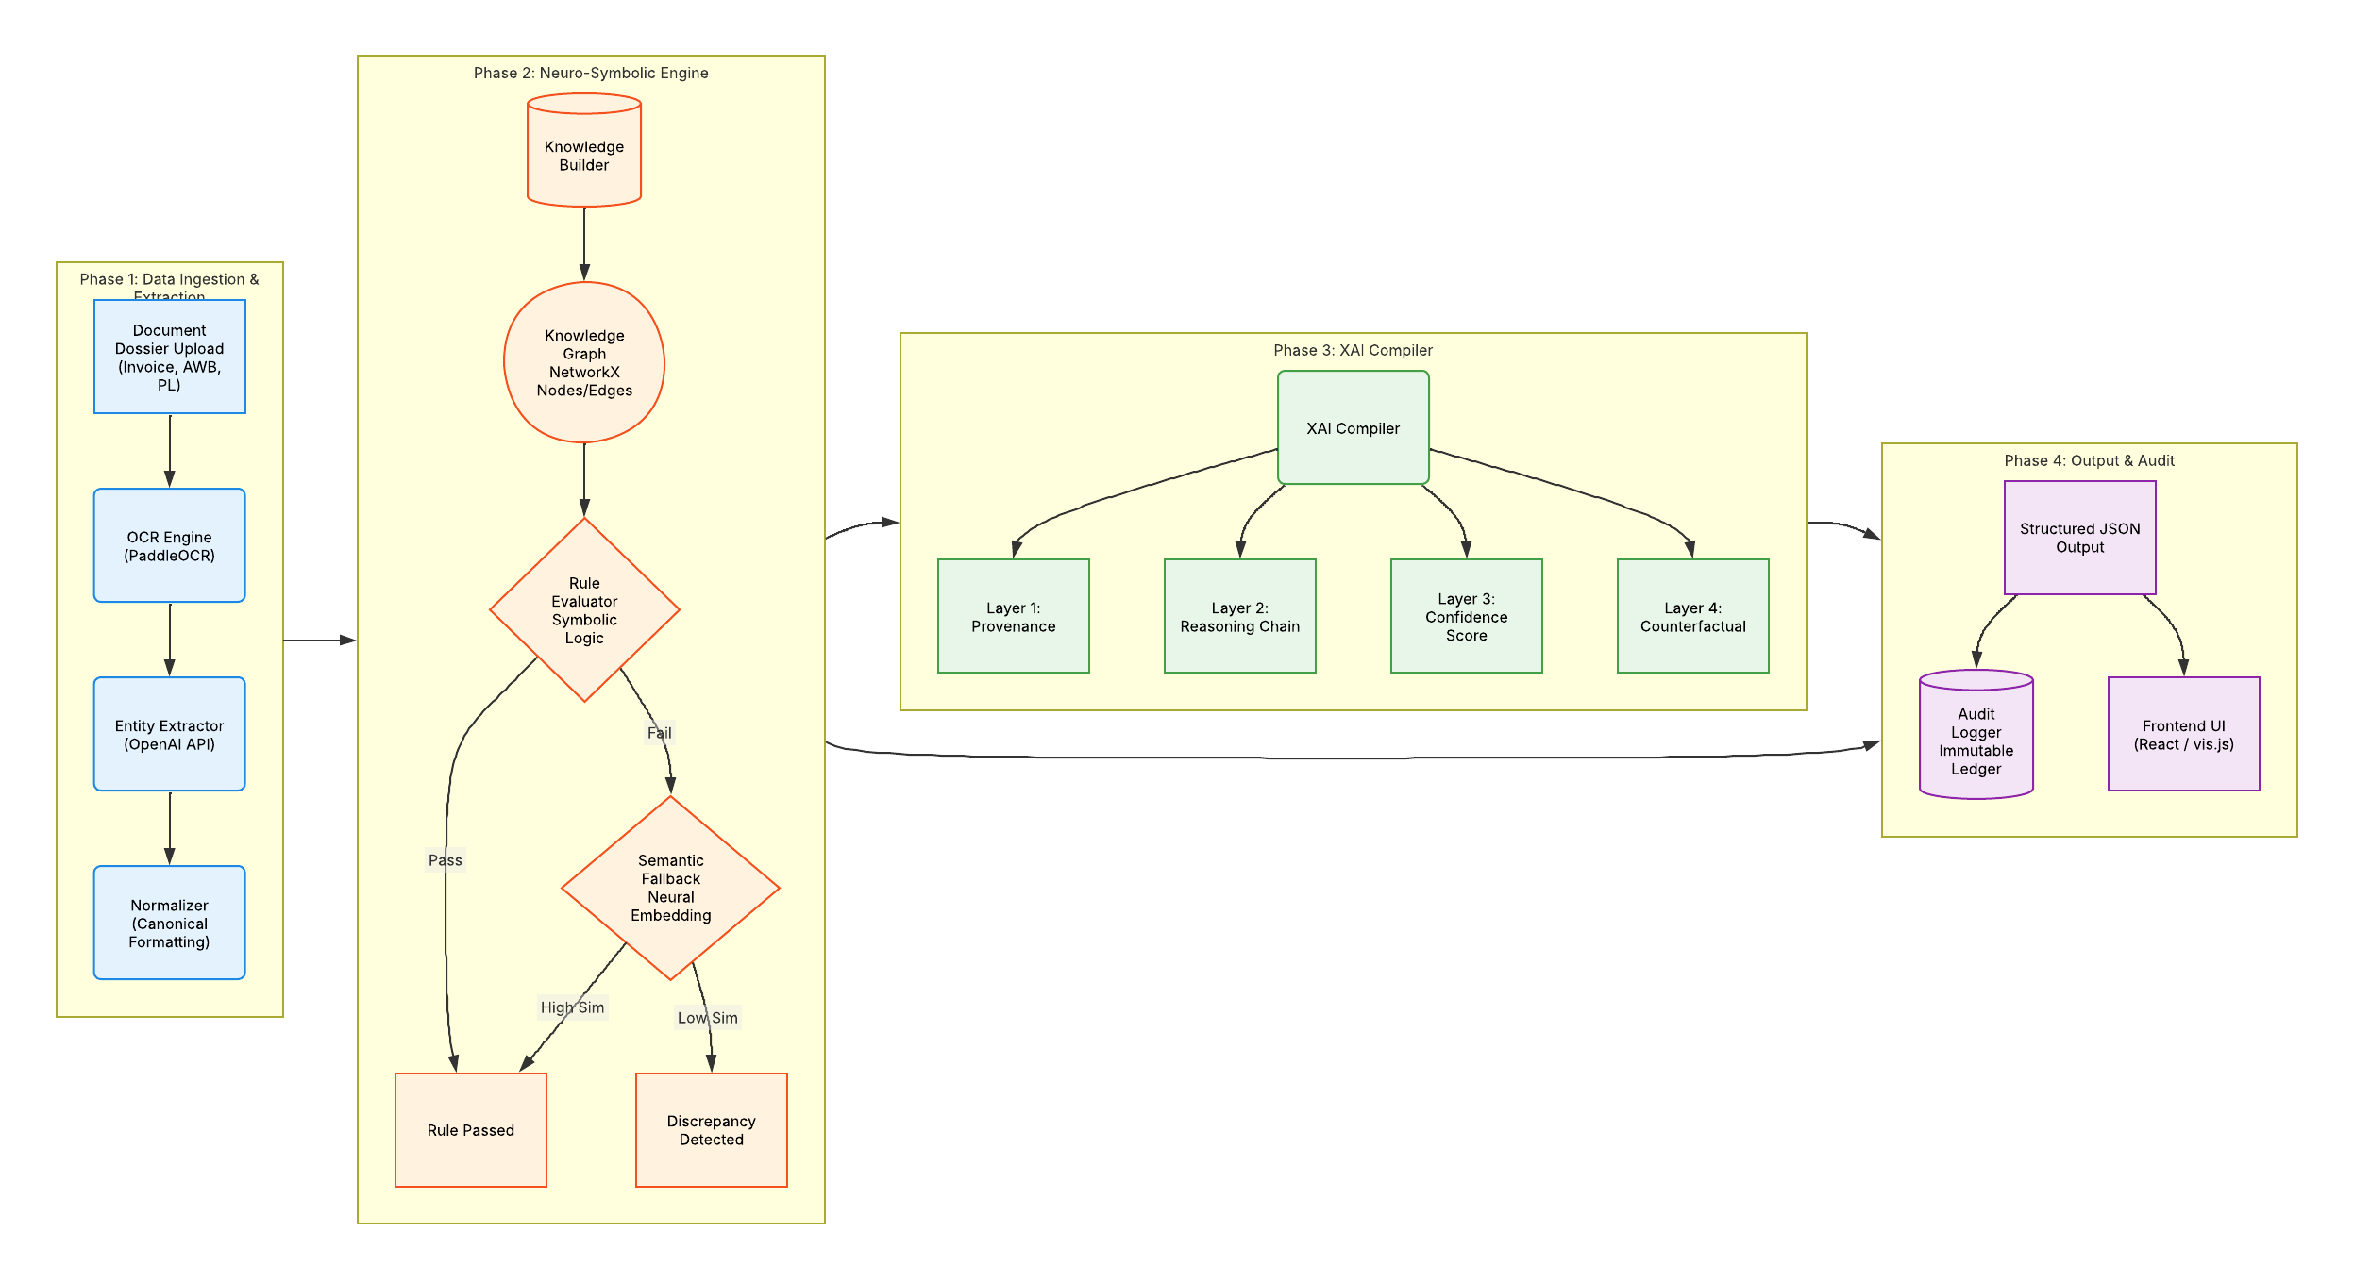
Full Architecture

Slide 12
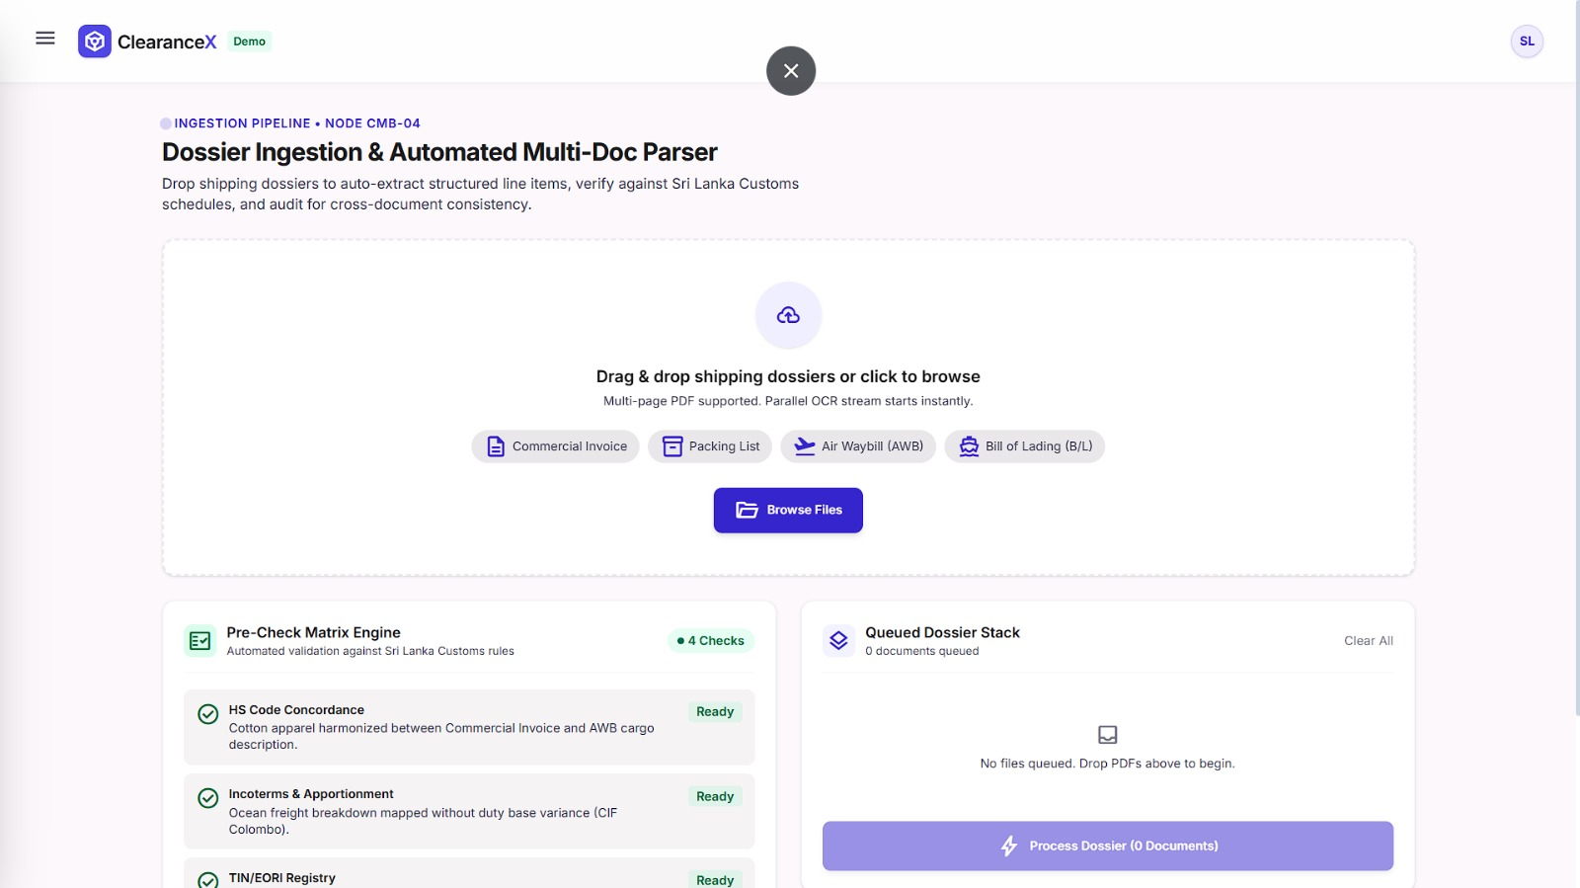
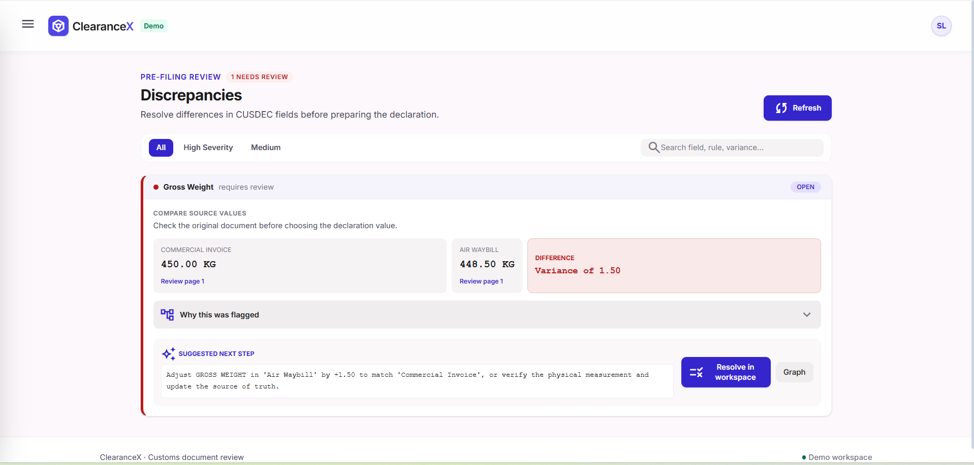
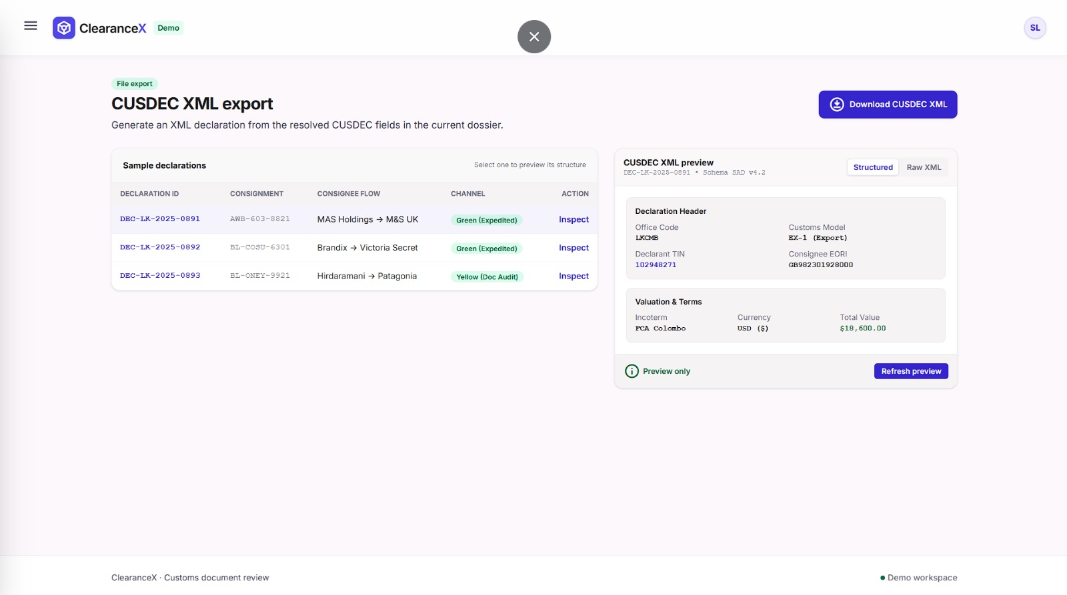
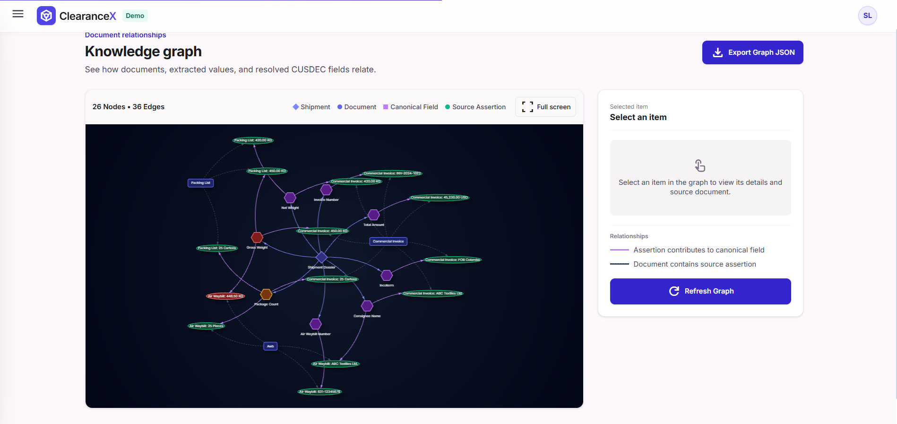

Slide 13
OPTIMIZATIONS
Entity Extraction
Optimized Extraction
Separate API Requests
Batching Requests
Regex
Layout-LMV3
Open AI
The system currently makes separate API calls for every unknown entity it finds
We will bundle unknown entities into a single batched request to cut latency and costs
Regex
Open AI

Slide 14
OPTIMIZATIONS
PostgreSQL
PostgreSQL + Redis
Querying a disk-based database for known entities creates bottlenecks at high scale.
Adding a Redis in-memory cache serves entities directly from RAM for sub-millisecond lookups.

Slide 15
Thank You

