Slide 1
Missing orthodox population in the poll tax register of Vyborg 1880-1917
Antti Härkönen
2021-03-24

Slide 2
Introduction

Slide 3
Background
Vyborg was part of the autonomous Grand duchy of Finland from 1812 to 1917
The city had a large Orthodox minority, of which 90% were Russians
Vyborg was a mid-level hub of commerce and migration in the central place system
Vyborg connected Eastern Finland to St. Petersburg

Slide 4
Research problem
Original idea to determine change of segregation
Problems with data quality
Determining how much population actually changes necessary

Slide 5
Sources

Slide 6
Parish records
Most not available
Vyborg health council reports total population by denomination in yearly reports
Only available 1905-

Slide 7
Sources for migration
Lutheran parish in St. Petersburg
Poll tax register and parish registers both unreliable due to migration

Slide 8
Poll tax registers
For taxation, also record for voting rights and property ownership
Senate degree in 1878: from 1880 onward poll tax registers should have columns for non-lutherans
Religion recorded until 1920s

Slide 9
Problems with sources
Poll tax register numbers for orthodox population are inconsistent
Total numbers of orthodox fluctuate too wildly to be real
Some households with Russian names are marked Orthodox in some years and not in other years

Slide 10
Method

Slide 11
Time series analysis
statistical methods for working with time series data
common problems:
spectral analysis (finding repeating patterns)
shift point analysis (finding a point when a chance happens)
autoregression models (how much previous observations affect next observation)
moving average methods
combinations of the above, e.g. ARMA

Slide 12
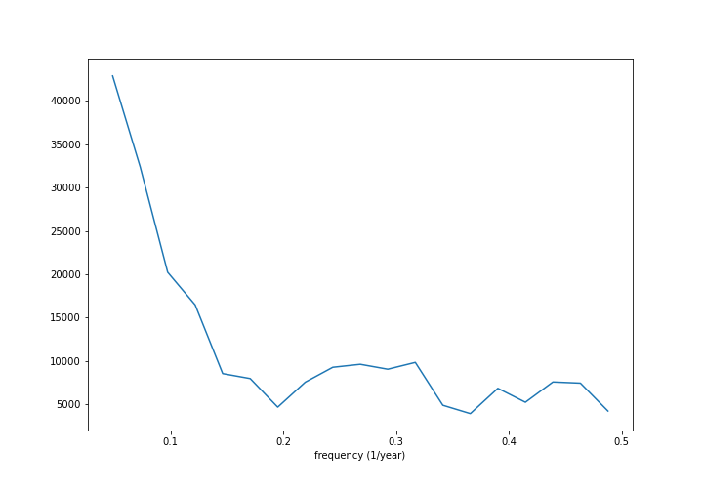
Fourier transform

Slide 13
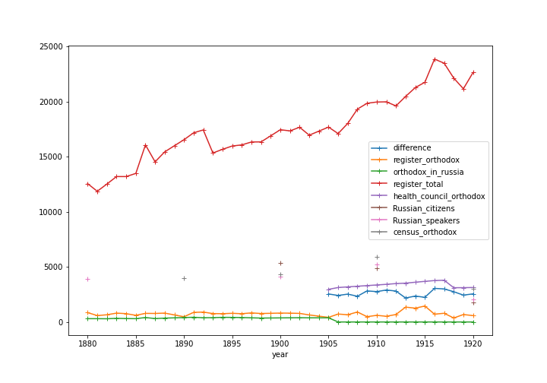
Time series (1)

Slide 14
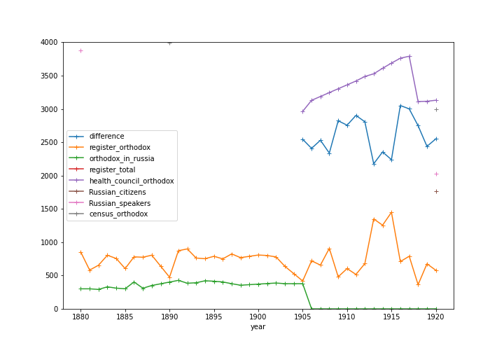
Time series (2)

