Slide 1


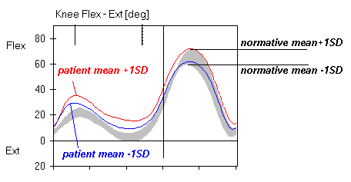
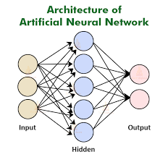

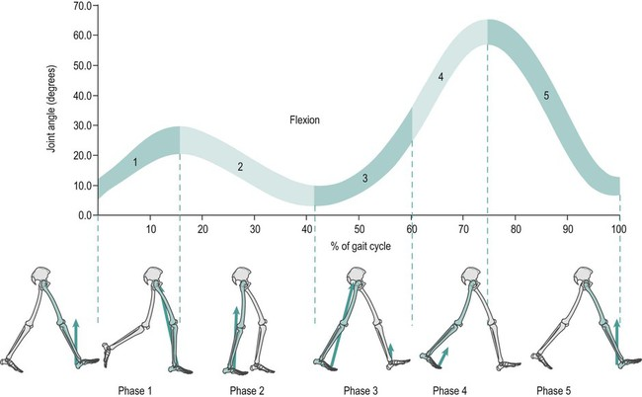
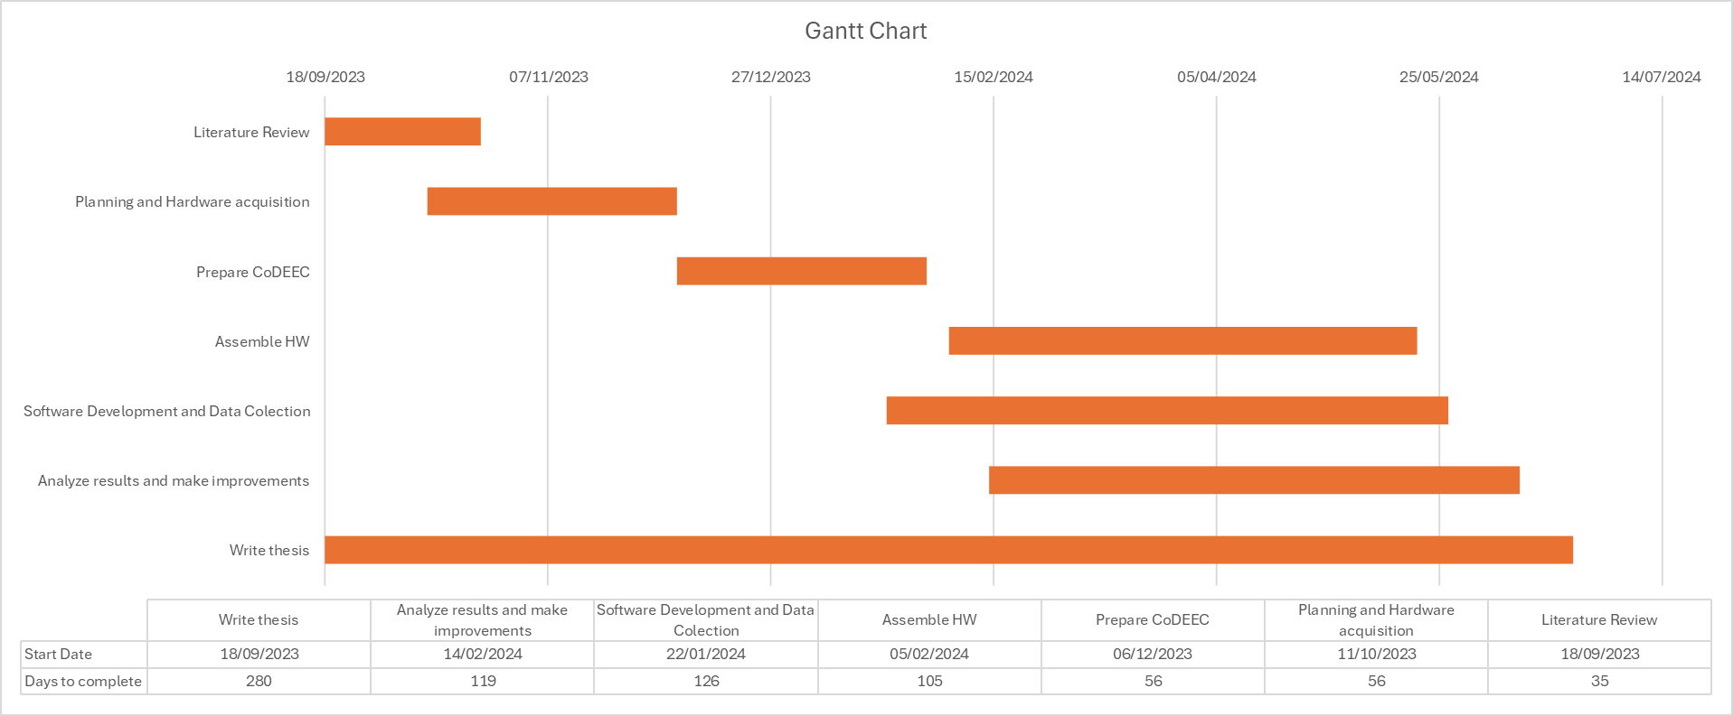


Human gait analysis using a wireless knee pad Francisco Alexandre Antunes Advisors: António Coimbra, João Ferreira ISR - Institute of Systems and Robotics
CoDEEC 2024 Winter Edition
Motivation:
The objective of this work is to analyse human gaits and diagnose knee injuries. This is accomplished by using a knee pad equipped with an encoder to collect data over a period of time. The collected data is then transmitted in real-time via wireless communication to a central processing unit for immediate analysis. The results are subsequently presented on a web application. Traditional gait analysis often relies on bulky and immobile equipment, which limits its practicality in real-world scenarios. By using an encoder to collect data on knee movement during gait, the diagnostic process can be automated, making it more reliable. The aim of this work is to diagnose potential knee injuries using deep learning, a highly effective method for analysing and interpreting large datasets.
Methods:
The work is divided into two main parts: data acquisition and data processing. To acquire the data, the hardware requires calibration, and software is used to collect the data that the encoder will read.
Data processing techniques are then employed to validate the collected data and ensure its usability. Finally, a neural network is used to provide a preliminary diagnosis of the gait. The dataset used to train the neural network will be created based on other existing datasets.
Data will be represented using graphics through a web application created with Python Django, a Python library for web development that integrates with an SQLite database and provides unique functions for user interaction.
Materials:
Dataset
Arduino MKR 1010
Absolute Encoder 14-bit, radial
Knee pad
Buzzer Piezo
Expected Results:
It is expected to have a similar result as the graphic above where it presents the variation of knee angle during a period of time and default healthy values (in gray).
It is expected a diagnose given by the trained neural network.
Encoder
Work Plan:

