Slide 1
Data mining of the technological stock market
AIAD 2018/2019
Developed by:
Arthur Matta - up201609953
Diogo Reis – up201505472
Tiago Magalhães – up201607931

Slide 2
The Problem
After the first part of this project we have a system that simulates the behavior of investors in the technological stock market.
This simulation has a lot of parameters associated with it, the most important and the one that we wish to study is the risk aversion of investors. Risk aversion means how likely the investor is to make risky moves or not, what can be considered a risky move in the stock market is something very complex and is not the point of this study, here we consider a risky move investing in companies that have low standards of quality and perform badly.
As such with this study our main aim is to figure out the ideal risk aversion for the investors of our simulation.

Slide 3
Experiments
To execute our experiments we created a large number of investors for our simulation. These investors differed only in name and risk factor everything else was the same to make results easier to interpret.
When creating these investors we tried to make them a good representation of the risk aversion spectrum to make our results significant.
As such all investors have a starting capital of $50000 and vary between them in risk by 5%. We have roughly 20 investors.
Some more companies were also created but we do not believe these are significant to mention as what we wish to study is the investors behaviors and not the companies.

Slide 4
Collected Data
During the simulation of our system the following data points are collected:
- Investors Risk Factor = Risk aversion of the investor.
- Investor Capital Value = Investor Money + Stock Value.
- Capital Week Delta = Investor capital change over last week.
- Number of companies.
- Company average quality factor.
- Number of low-quality companies.
- Average quality factor of low-quality companies.
- Number of average quality companies.
- Average quality factor of average quality companies-
- Number of high-quality companies.
- Average quality factor of high-quality companies.

Slide 5
Collected Data
The presented data points are captured everyday of our simulation and for every investor so that we have a historic of capital evolution for every risk value that we can analyze.
Keep in mind that when we mention every day of the simulation, we mean internal days of the program and not real-life days.
This data is then exported into a CSV file that is then analyzed in Rapid Miner.

Slide 6
Analysis Models
We chose 4 different models to analyze our data, while our problem is a regression problem, we discovered that the regression functions were not the best at all for our problems.
As such we used the following 4 models:
- Linear Regression
- Deep Learning
- Decision Tree
- Support Vector Machine
We found out that for our dataset and for our problem the decision tree seemed to be the best model.

Slide 7
Analysis Models
These 4 models obtained the following relative error results:
Model Name | Error | Uncertainty
Linear Regression | 24.96% | 27.81%
Decision Tree | 9.23% | 24.19%
Deep Learning | 20.55% | 20.03%
Support Vector Machine | 28.86% | 26.03%

Slide 8
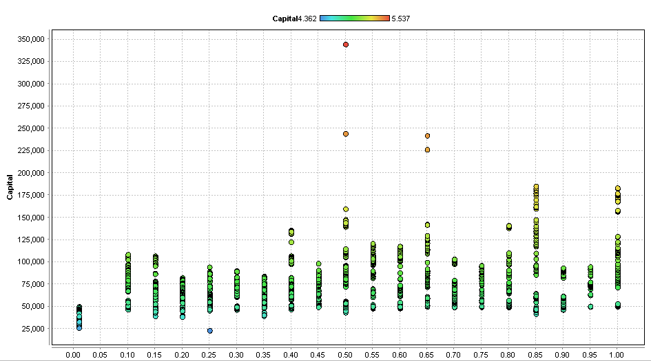
Results

Slide 9
Results
We can observe that most investors make money over time except for the one that was completely risk averse.
As expected, the highest return on investment seems to come from the middle of the road risk aversion investor with 50% of risk aversion .
Another interesting observation is that riskier behavior seems to overall lead to higher return over time in our simulation environment. While on the other hand less risky behavior leads to much less money likely due to missing out on opportunities to buy stock that will go up in the future.
To be noted that while 50% risk factor led to the higher capital gains 85% of risk factor leads consistently to higher capital values, meaning that it might be the superior approach to investment.

Slide 10
Conclusions And Future Work
We have achieved our goal of discovering the best risk factor for our simulation. Despite that we are not yet happy with the results 9% of error is not a value that we are happy with.
We believe that our problem is possible to be modeled, however out simulation still needs work to create more realistic investors that generate better data.
As such future work is mostly in the area of improving our simulation as we believe the data mining model is in a good place.
If we were to continue working on this project, we would likely remake the simulation system from scratch in a better system, Jade is not performant enough and not well designed enough for our needs and has given us a lot of headaches over time.

