Slide 1
ONTARIO RESEARCH FUNDING SUMMARY

Slide 2
AGENDA
EXECUTIVE SUMMARY
PROBLEM STATEMENT
DASHBOARD
RECOMMENDATION

Slide 3
EXECUTIVE SUMMARY
This dataset reflects a comprehensive record of Ontario-funded research projects over six years. Key metrics include total projects reviewed, distribution of funding by research focus, and project outcomes. Using Tableau, the goal is to visualize these insights effectively, aiding executive decision-making on future funding strategies.

Slide 4
PROBLEM ANALYSIS
How does the distribution of funding across various research fields from July 2018 to November 2024 in Ontario impact the advancement of these fields, and what trends can be identified in terms of funding allocation, project outcomes, and financial commitment?
The analysis will focus on funding amount, research field, project duration, geographic location, project type, financial trends over time, research output, and others, to evaluate patterns, gaps, and opportunities for optimizing future funding strategies.
This will help stakeholders make informed decisions to enhance the effectiveness of Ontario’s financial support for research projects.

Slide 5
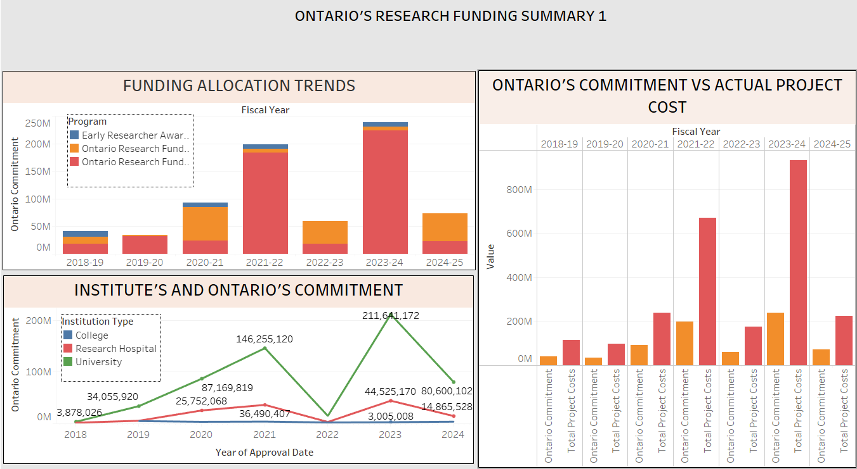
DASHBOARD - 1

Slide 6
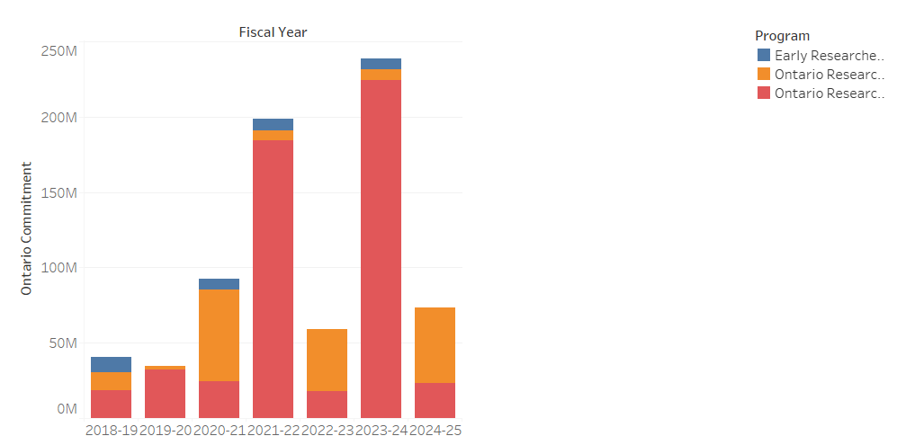
Trends in Funding Allocation
The fiscal years 2021–2022 and 2023–2024 saw the largest funding allocations, totaling over $200 million, indicating times of increased project investments or strategic initiatives.
Significant Rise After 2020–21: There is a noticeable sharp increase in funding after 2020–21, most likely because of refocused policy efforts or pandemic-related research priorities.
Declining Trend in 2024–25: There is a notable drop in funding in 2024–25, which could be a sign of either a change in strategic focus or the completion of large projects.

Slide 7
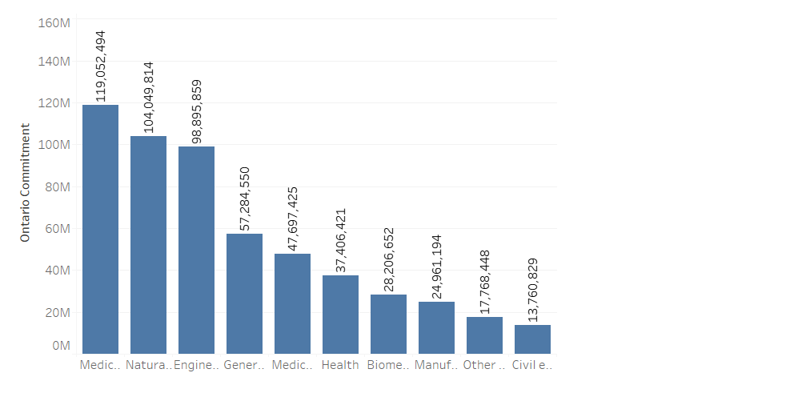
Project Distribution By Research
Lead in Medical and Health Sciences: With the largest funding (~119M), this field demonstrated its importance in Ontario's research agenda, which is probably influenced by healthcare priorities.
Natural Sciences and Engineering Follow Closely: The importance of fields like engineering (99M) and natural sciences (104M) in promoting innovation and technology is highlighted.
Neglected Areas: The low funding for disciplines like civil engineering (13.7M) and other research (17.8M) raises the possibility of underfunding critical infrastructure research.

Slide 8
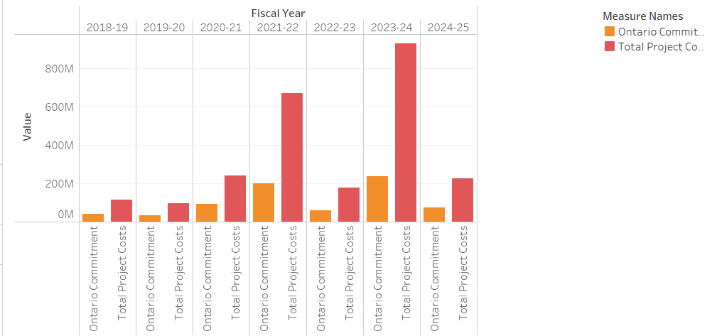
Ontario's financial commitment to actual project costs
The graph shows a significant gap between Ontario's commitments (orange) and actual project costs (red) across fiscal years, with costs consistently exceeding commitments.
The gap widens significantly in 2021-22 and peaks in 2023-24, indicating underfunding and rising project expenditures. Improved budget alignment and cost management are recommended.

Slide 9
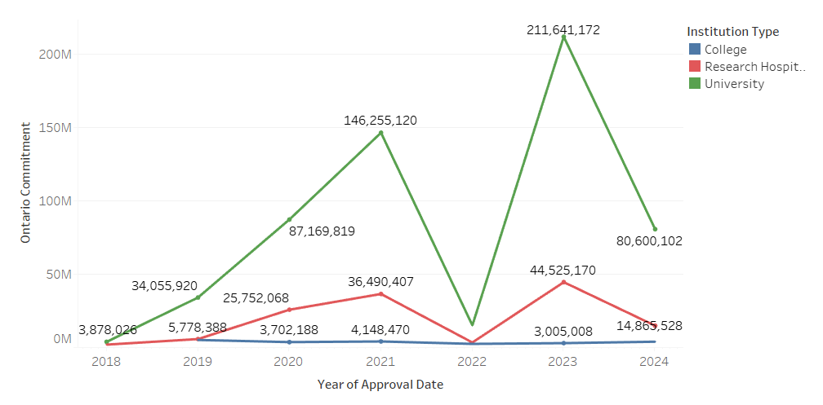
Institutes and Ontario Commitment
The Line graph illustrates that Ontario's commitment (green) experienced a significant spike in 2021, followed by a decrease and a recovery in 2024.
The Institute's commitment (red) showed a gradual and steady increase starting in 2022, while the other commitments (blue) remained flat with minimal change throughout.

Slide 10
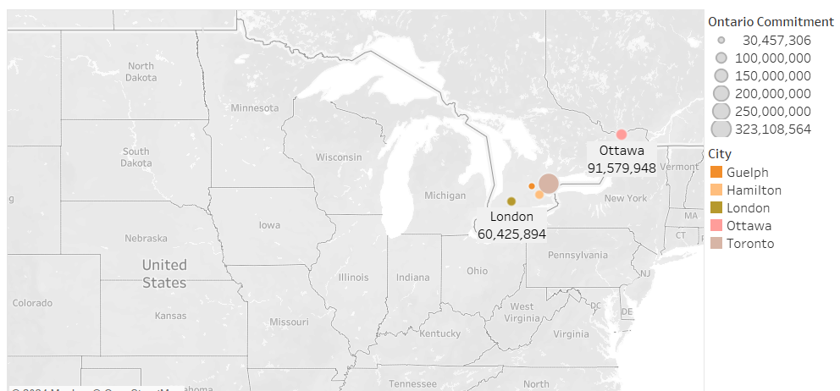
Top 5 Funding by City
The map shows the funding amounts for different cities. Ottawa (shown in red) has the most funding, with 91,579,948.
Hamilton (shown in orange) comes second with 69,529,990. The size of the markers on the map shows the amount of funding, and Ottawa stands out with the highest funding compared to other cities.

Slide 11
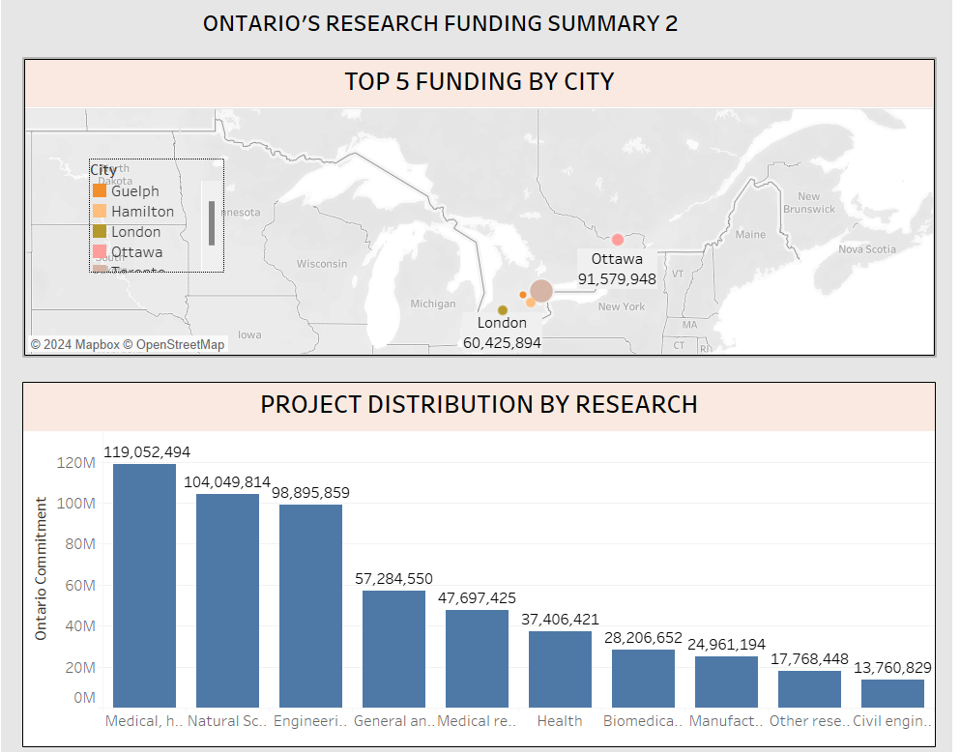
DASHBOARD - 2

Slide 12
recommendation
Increase Support for High-Impact Cities: Maintain or increase funding in top research cities like Ottawa and Guelph to strengthen their leadership in innovation and economic growth.
Targeted Investment in Health and Medical Research: Prioritize continued funding in medical and health research to drive healthcare advancements and strengthen Ontario's position in global medical innovation.
Support Emerging and Underfunded Research Areas: Increase funding in underserved sectors like Biomedical, Manufacturing, and Civil Engineering to diversify Ontario’s research portfolio and drive innovation across industries.
Monitor and Adjust Funding Allocation Based on Performance: Regularly assess funded projects and adjust funding to ensure resources are directed towards successful, high-impact research aligned with Ontario's priorities.
Public and Private Sector Collaboration: Encourage partnerships between public research institutions and the private sector to commercialize research and drive economic growth through innovation hubs and joint ventures.

