Slide 1
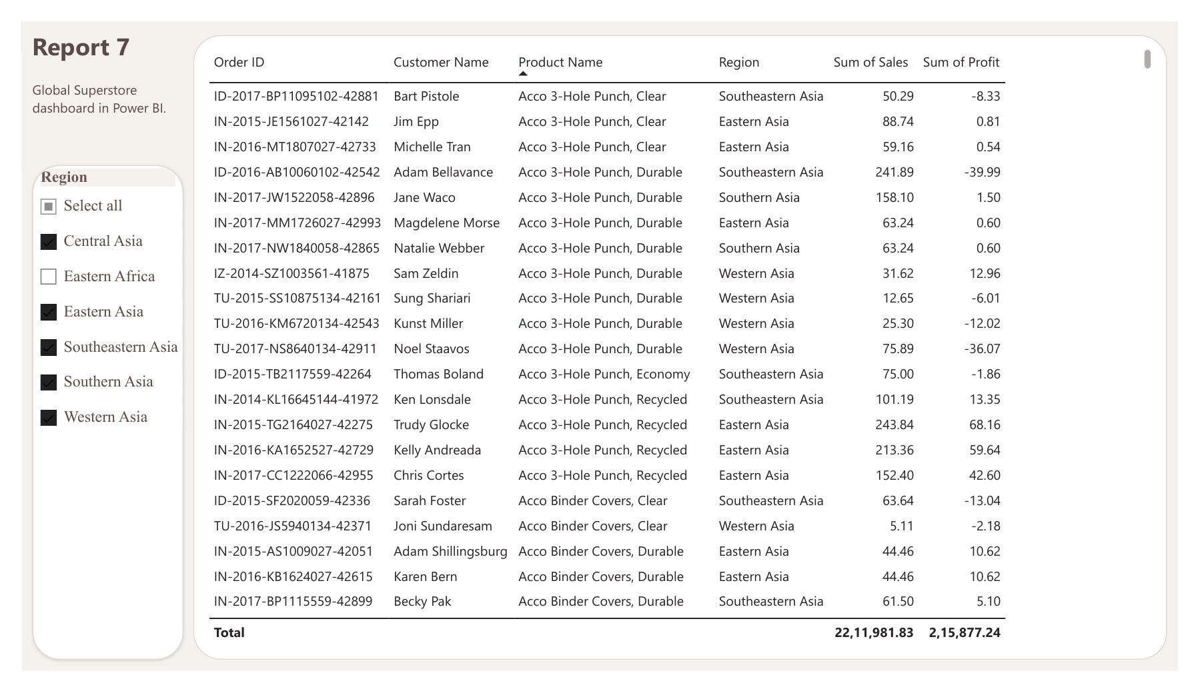
EXPERIMENT 7
Integration of Advanced Analytics with BI Reports using Microsoft Power BI
Business Intelligence Lab | Unit 2, Session 7
Report 7: Global Superstore detail table
Aim
To integrate advanced analytics with Business Intelligence reports using Microsoft Power BI and generate business insights, strategic recommendations, and executive presentations that support organizational decision-making.
Notes:
Introduce Experiment 7 and its aim. The image is the Report 7 detail table from the Global Superstore Power BI report.

Slide 2
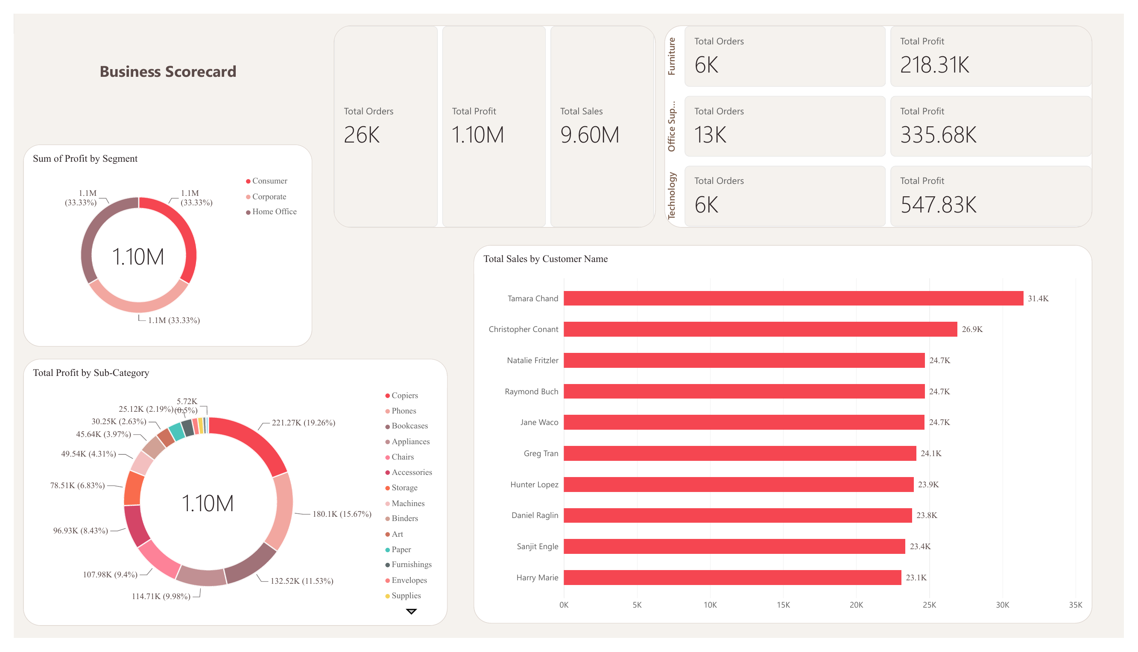
Business scorecard at a glance
26K
Total orders
1.10M
Total profit
9.60M
Total sales
Power BI Business Scorecard dashboard
Technology earns about 50% of profit (547.83K) from only 6K of 26K orders; Office Supplies drives volume with 13K orders.
Experiment 7 | BI Lab Unit 2, Session 7
2
Notes:
Overall margin is about 11.5% (1.10M profit on 9.60M sales). Profit is split evenly across Consumer, Corporate and Home Office segments. Copiers (221.27K) and Phones (180.1K) are top sub-categories. Top customer: Tamara Chand at 31.4K sales.

Slide 3
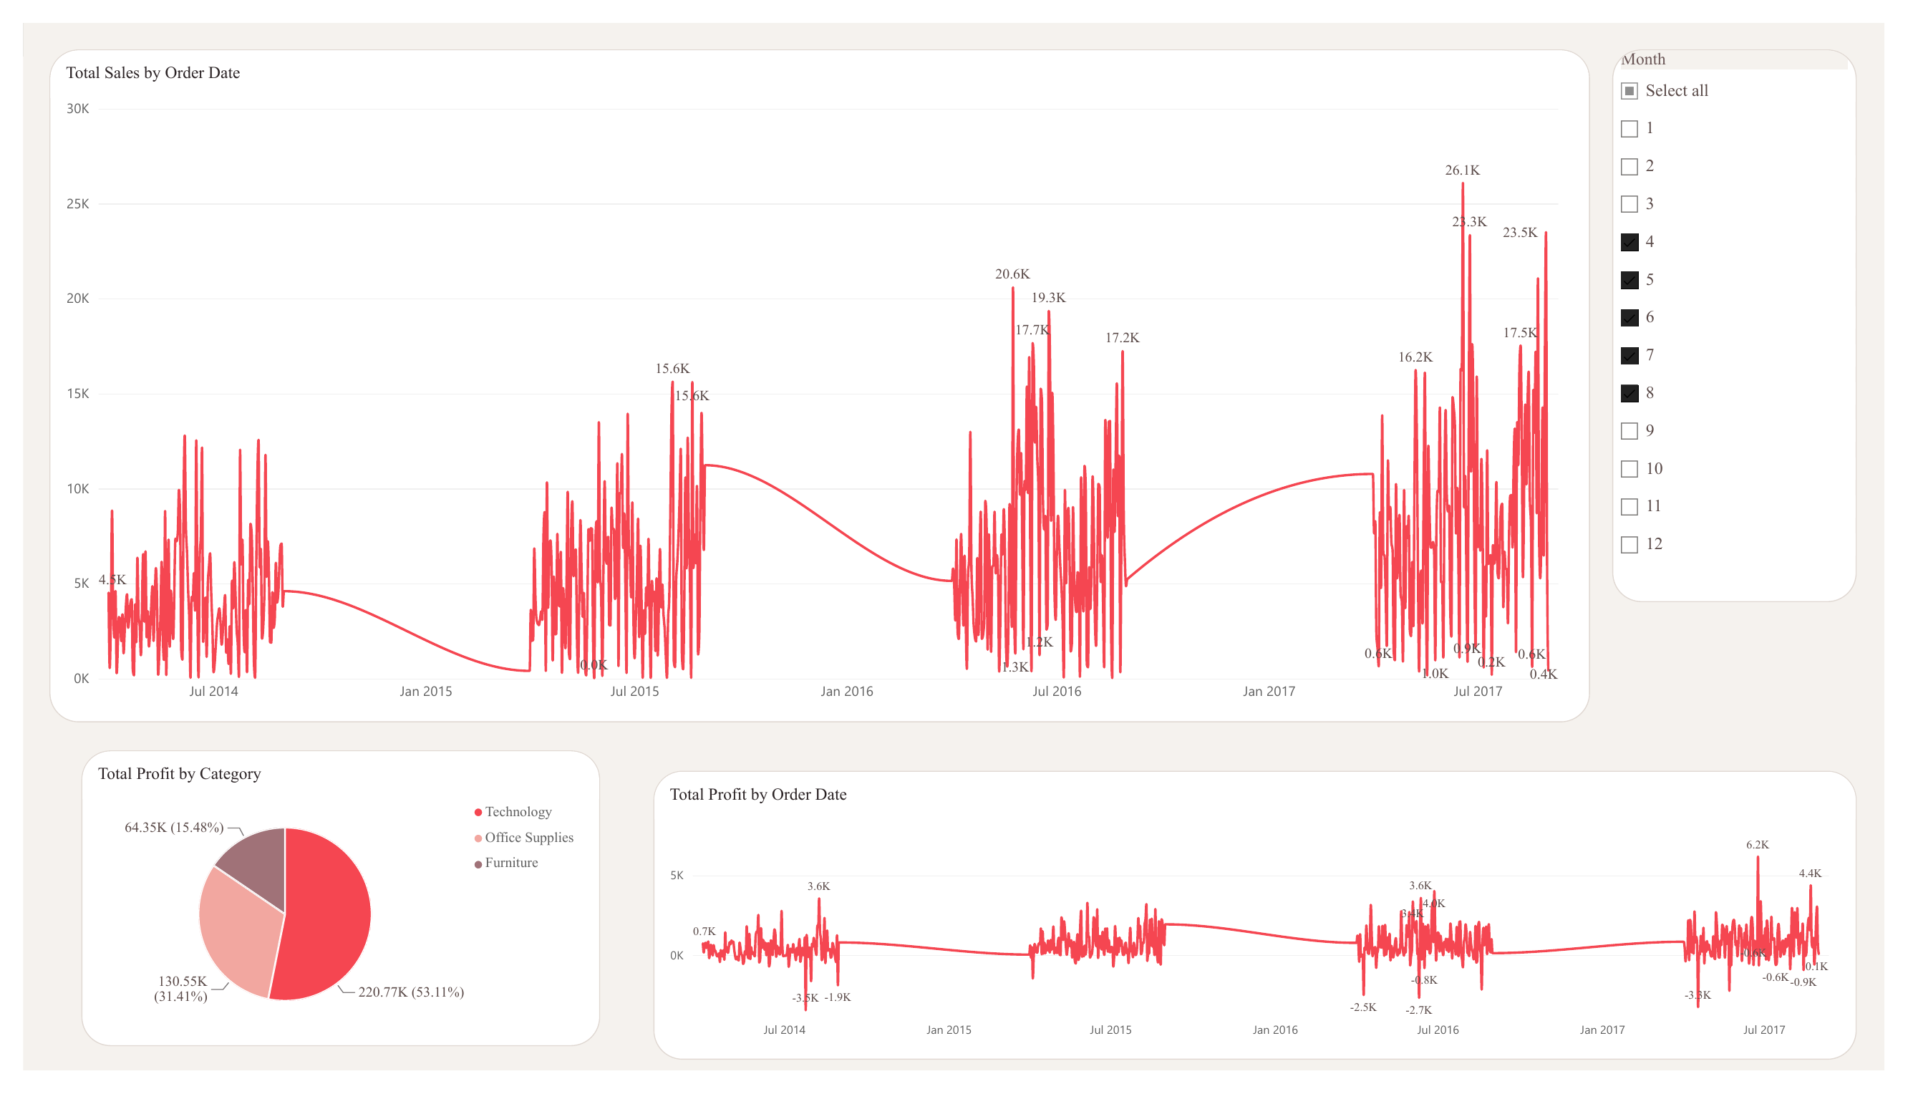
Sales trends and profit drivers
Yearly sales peaks keep rising: about 12.8K in 2014 to 26.1K in 2017.
Technology delivers 53.11% of profit (220.77K); Office Supplies 31.41%; Furniture 15.48%.
Profit is mostly positive, with occasional loss days of up to 3.5K.
Sales and profit over time (Month filter: Apr to Aug)
Experiment 7 | BI Lab Unit 2, Session 7
3
Notes:
Figures shown reflect the Month slicer selection (months 4 to 8) on this dashboard page.

Slide 4
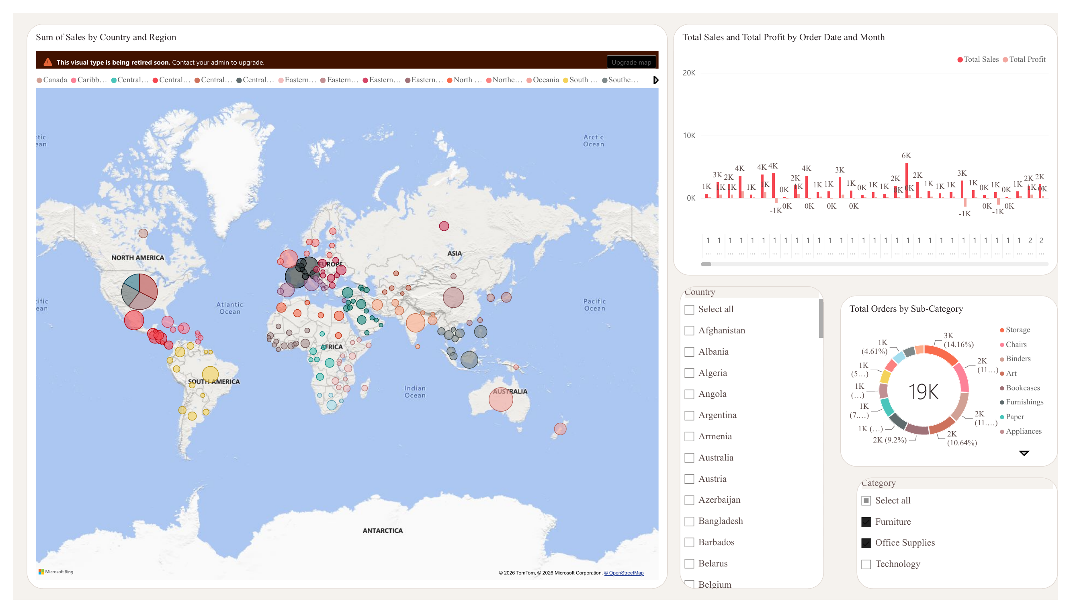
Geography and order patterns
Sales are concentrated in North America and Europe, the largest map bubbles.
Asian regions selected in Report 7: 2.21M sales, 215.9K profit (about 9.8% margin).
Storage, Chairs and Binders lead order volume; some months run at a loss.
Sum of sales by country and region
Experiment 7 | BI Lab Unit 2, Session 7
4
Notes:
Margin for Asia is 215,877.24 divided by 2,211,981.83. Order counts shown for Furniture and Office Supplies categories (19K orders).

Slide 5
Strategic recommendations
1
Back Technology
2
Fix loss-making orders
Highest profit share from the fewest orders; prioritise Copiers and Phones.
Review pricing and discounts on lines that sell below cost.
3
Plan for peaks
4
Grow beyond core markets
Sales peaks grow every year; align stock and staffing ahead of them.
Invest in mid-size regions and retain top customers.
Conclusion: integrating analytics into Power BI reports turns raw sales data into clear decisions.
Notes:
Recommendations are derived from the scorecard, trend and geography views.

