Slide 1
CLOUD SECURITY (OE00056)
UNIT-I

Slide 2
Objectives
CO₀₁ | Define and explain key cyber security concepts and principles.
CO₀₂ | Analyze network security mechanisms and evaluate their effectiveness.
CO₀₃ | Apply cryptographic techniques to secure data and communications.
CO₀₄ | Evaluate identity and access management (IAM) systems and practices.

Slide 3

Scope
Cloud security is a discipline of cyber security dedicated to securing cloud computing systems. This includes keeping data private and safe across online-based infrastructure, applications, and platforms. Securing these systems involves the efforts of cloud providers and the clients that use them, whether an individual, small to medium business, or enterprise uses.
Introduction to NLP
3

Slide 4
SYLLABUS
Unit-1: Security Concepts
Introduction of security, confidentiality authentication, access control paas, saas, iaas concept in cloud security User authentication in the cloud, Cryptographic Systems User authentication in the cloud, Cryptographic Systems Symmetric cryptography stream ciphers block ciphers modes of operation public-key cryptography hashing, digital signatures
Unit-2: Security Fundamentals and Risk Issues in the Cloud
Cloud Information Security Objectives, Cloud Security services Cloud Security Design Principles Secure Cloud Software Requirements, Security Policy Implementation and decomposition Cloud Computing and Business Continuity/Disaster Recovery CIA triad, Privacy and compliance risk, Infrastructure Security The Network Level, Infrastructure Security: The Host Level, The Application Level. Data Security and Storage: Aspects of Data Security, Data Security Mitigation, Provider Data and Its Security.
Unit-3: Identity and Access Management
Introduction, Definitions, Trust Boundaries, Challenges Identity and Access Management Architecture and Practices Getting Ready for the Cloud Relevant IAM Standards and Protocols for Cloud Services Cloud Authorization Management Cloud Authorization Management Cloud Service Provider IAM Practice.
Unit-4: Security Management in the Cloud
Security Management Standards Availability Management PaaS, Availability, Management SaaS, Availability, Management, IaaS Availability Management Access Control, Security Vulnerability Patch, and Configuration Management
Unit-5: Legal and Compliance Issues
Legal and Compliance Issues ,Responsibility ownership of data, right to penetration test local law where data is held examination of modern Security Standards (eg.PCIDSS) how standards deal with cloud services and virtualization, compliance for the cloud provider vs. compliance for the customer.
Text Books
Tim Mather, Subra Kumaraswamy, Shahed Latif, Cloud Security and Privacy, O’Reilly.
Raghu Yeluri, Enrique Castro-Leon, Building the Infrastructure for Cloud Security A Solutions view, Apress open.
Ronald L. Krutz, Russell Dean Vines, Cloud Security A Comprehensive Guide to Secure Cloud Computing, Wiley.
References
John Rittinghouse, James Ransome, Cloud Computing, CRC Press.
J.R. ("Vic") Winkler, Securing the Cloud, Syngress.
Cloud Security Alliance, Security Guidance for Critical Areas of Focus in Cloud Computing.
Vmware, VMware Security Hardening Guide, White Paper.
Cloud Security Alliance 2010, Top Threats to Cloud Computing, Microsoft.

Slide 5
What is Cloud security?
Cloud security, also known as cloud computing security, is a collection of security measures designed to protect cloud-based infrastructure, applications, and data.
Introduction to NLP
5

Slide 6
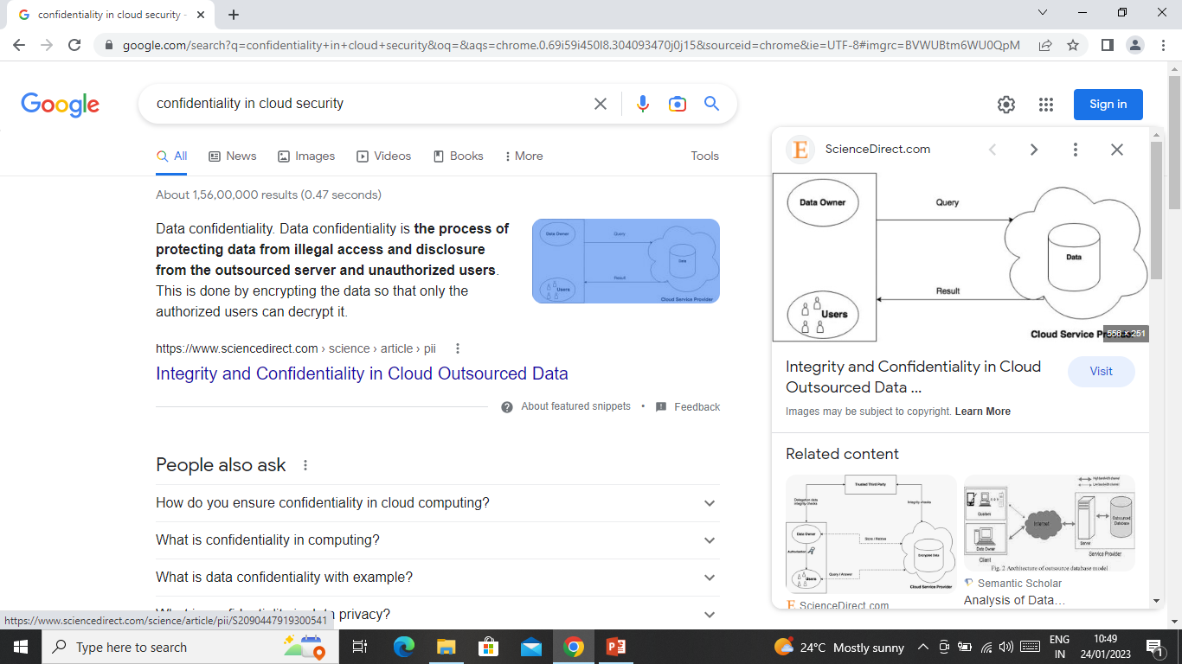
CONFIDENTIALITY AND PRIVACY
Data confidentiality. Data confidentiality is the process of protecting data from illegal access and disclosure from the outsourced server and unauthorized users. This is done by encrypting the data so that only the authorized users can decrypt it.
Introduction to NLP
6

Slide 7
INTEGRITY AND SECURITY
Data integrity in the cloud system means preserving information integrity. The data should not be lost or modified by unauthorized users.
Every individual has the right to control his or her own data, whether private, public or professional.
Introduction to NLP
7

Slide 8
Authentication
Cloud computing is helping businesses to store a large amount of data at relatively low costs but it is essential these service providers offer methods to ensure users are authenticated.
Cloud Authentication Methods
API Keys
Firebase Authentication
Google Authentication
Google Authorization and Service Accounts
Introduction to NLP
8

Slide 9
Question…….

