Slide 1
CLOUD SECURITY (OE00056)
UNIT-I

Slide 2
Objectives
CO₀₁ | Define and explain key cyber security concepts and principles.
CO₀₂ | Analyze network security mechanisms and evaluate their effectiveness.
CO₀₃ | Apply cryptographic techniques to secure data and communications.
CO₀₄ | Evaluate identity and access management (IAM) systems and practices.

Slide 3

Scope
Cloud security is a discipline of cyber security dedicated to securing cloud computing systems. This includes keeping data private and safe across online-based infrastructure, applications, and platforms. Securing these systems involves the efforts of cloud providers and the clients that use them, whether an individual, small to medium business, or enterprise uses.
Introduction to NLP
3

Slide 4
SYLLABUS
Unit-1: Security Concepts
Introduction of security, confidentiality authentication, access control paas, saas, iaas concept in cloud security User authentication in the cloud, Cryptographic Systems User authentication in the cloud, Cryptographic Systems Symmetric cryptography stream ciphers block ciphers modes of operation public-key cryptography hashing, digital signatures
Unit-2: Security Fundamentals and Risk Issues in the Cloud
Cloud Information Security Objectives, Cloud Security services Cloud Security Design Principles Secure Cloud Software Requirements, Security Policy Implementation and decomposition Cloud Computing and Business Continuity/Disaster Recovery CIA triad, Privacy and compliance risk, Infrastructure Security The Network Level, Infrastructure Security: The Host Level, The Application Level. Data Security and Storage: Aspects of Data Security, Data Security Mitigation, Provider Data and Its Security.
Unit-3: Identity and Access Management
Introduction, Definitions, Trust Boundaries, Challenges Identity and Access Management Architecture and Practices Getting Ready for the Cloud Relevant IAM Standards and Protocols for Cloud Services Cloud Authorization Management Cloud Authorization Management Cloud Service Provider IAM Practice.
Unit-4: Security Management in the Cloud
Security Management Standards Availability Management PaaS, Availability, Management SaaS, Availability, Management, IaaS Availability Management Access Control, Security Vulnerability Patch, and Configuration Management
Unit-5: Legal and Compliance Issues
Legal and Compliance Issues ,Responsibility ownership of data, right to penetration test local law where data is held examination of modern Security Standards (eg.PCIDSS) how standards deal with cloud services and virtualization, compliance for the cloud provider vs. compliance for the customer.
Text Books
Tim Mather, Subra Kumaraswamy, Shahed Latif, Cloud Security and Privacy, O’Reilly.
Raghu Yeluri, Enrique Castro-Leon, Building the Infrastructure for Cloud Security A Solutions view, Apress open.
Ronald L. Krutz, Russell Dean Vines, Cloud Security A Comprehensive Guide to Secure Cloud Computing, Wiley.
References
John Rittinghouse, James Ransome, Cloud Computing, CRC Press.
J.R. ("Vic") Winkler, Securing the Cloud, Syngress.
Cloud Security Alliance, Security Guidance for Critical Areas of Focus in Cloud Computing.
Vmware, VMware Security Hardening Guide, White Paper.
Cloud Security Alliance 2010, Top Threats to Cloud Computing, Microsoft.

Slide 5
Authentication and Access control
Access Control defines the rules and policies that determine which users or systems have access to specific resources and what actions they can perform. It answers the question, "What are you allowed to do?" Common access control methods include:
Introduction to NLP
5

Slide 6
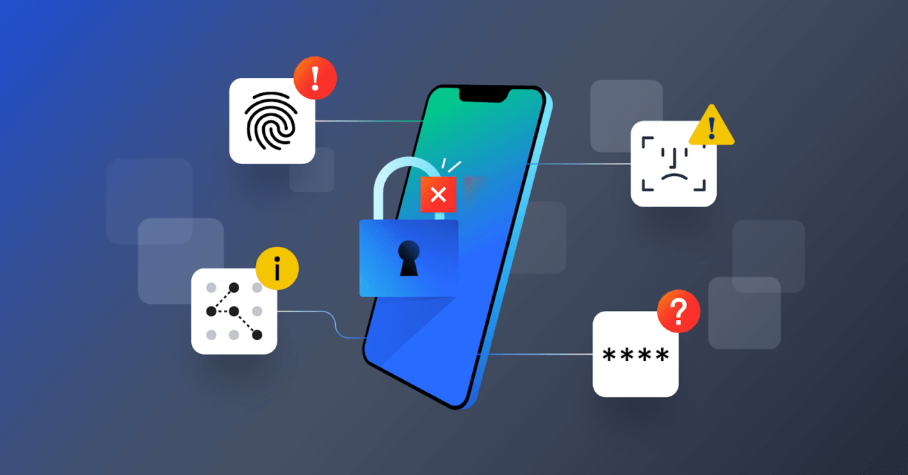
Authentication

Slide 7
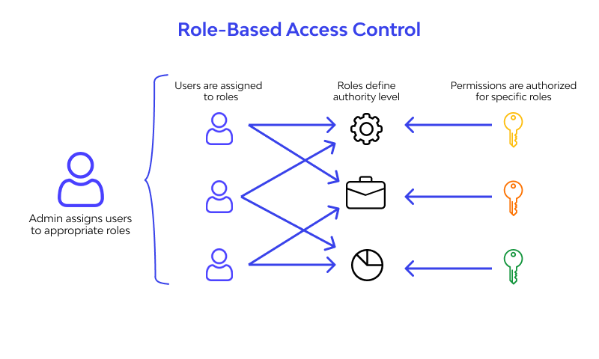

Slide 8
Role-Based Access Control (RBAC): Users are assigned roles, and access is granted based on those roles.
Attribute-Based Access Control (ABAC): Access is determined by attributes of the user, resource, and environment.
Mandatory Access Control (MAC): Access is controlled by a central authority, often based on security classifications.
Discretionary Access Control (DAC): Users can manage access permissions for their own resources.

Slide 9
Availability
Availability - High availability is the ultimate goal of moving to the cloud. The idea is to make your products, services, and tools available to your customers and employees at any time from anywhere using any device with an internet connection.

Slide 11
Defense in depth
Cloud security is a shared responsibility between you and your cloud provider. To develop a cloud security strategy that will protect your organization, it's important that you understand where the provider stops and where your responsibility begins.
Visibility
Exposure Management
Prevention Controls
Detection
Response

Slide 12
Defense-in-depth is an architectural design that originates from a military strategy requiring attackers to breach multiple lines of defense. In the context of protecting cloud workloads, defense-in-depth relies on multiple defensive mechanisms to protect valuable data, information and intellectual property.
CrowdStrike is an AWS Security Competency Partner, and to apply a defense -in- depth approach.
Visibility
Prevention
Remediation and response

Slide 13
Visibility
Visibility Drives Clarity
Visibility into all of an organization’s deployed assets and workloads allows operations and security teams to gain clarity into the current state of their environment.
View configurations of all components
Aggregate and monitor system calls and network traffic entering and leaving the workload
Audit API calls
Provide runtime visibility by introspecting system calls made by applications in an Amazon Elastic Cloud Compute (Amazon EC2) instance or a container

Slide 14
Cloud availability, cloud reliability, and cloud scalability all need to come together to achieve high availability. This means that your products and services are accessible anytime and anywhere, function reliably and as expected, and that the system can seamlessly scale up or down to accommodate customer demand without suffering a loss in performance.

Slide 15
Defense in depth, layered security architecture
Physical controls – These controls include security measures that prevent physical access to IT systems, such as security guards or locked doors.
Technical controls – Technical controls include security measures that protect network systems or resources using specialized hardware or software, such as a firewall appliance or antivirus program.
Administrative controls – Administrative controls are security measures consisting of policies or procedures directed at an organization’s employees, e.g., instructing users to label sensitive information as “confidential”.

Slide 16
Additionally, the following security layers help protect
Access measures – Access measures include authentication controls, biometrics, timed access and VPN.
Workstation defenses – Workstation defense measures include antivirus and anti-spam software.
Data protection – Data protection methods include data at rest encryption, hashing, secure data transmission and encrypted backups.
Perimeter defenses – Network perimeter defenses include firewalls, intrusion detection systems and intrusion prevention systems.
Monitoring and prevention – The monitoring and prevention of network attacks involves logging and auditing network activity, vulnerability scanners, sandboxing and security awareness training.

