Slide 1

G2M Case Study
Virtual Internship
03/06/2024

Slide 2
Background –G2M(cab industry) case study
XYZ is a private equity firm in US. Due to remarkable growth in the Cab Industry in last few years and multiple key players in the market, it is planning for an investment in Cab industry.
Objective : Provide actionable insights to help XYZ firm in identifying the right company for making investment.
The analysis has been divided into three parts:
Data Understanding
Finding the most profitable Cab company
Recommendations for investment

Slide 3
Data Exploration
20 Features( including 5 derived features)
Timeframe of the data: 31/01/2016 to 31/12/2018
Total data points :10,676
Assumptions:
Outliers are present in Price_Charged feature but due to
unavailability of trip duration details ,we are not treating this as outlier.
Profit is consider as a derived feature which is
calculated using the Price Charged and Cost of Trip features.
Users feature of city dataset is treated as number of cab users in the city,
which includes Yellow and Pink cab.
Cab_Data.csv
Customer_ID.csv
Transaction_ID.csv
City.csv
holidays.csv
Finalcab_data

Slide 4
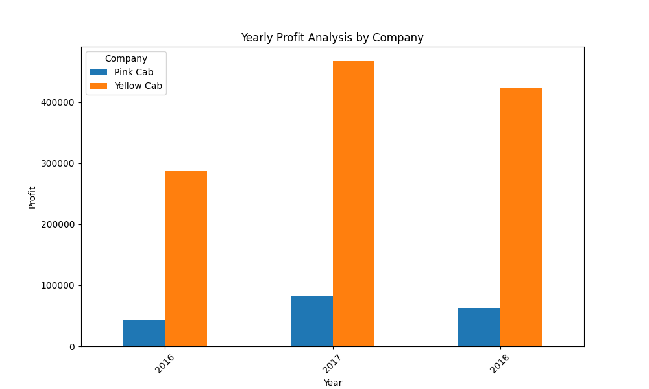
Yearly Profit Analysis
Yellow cab earns the higher profit compared to Pink in the three consecutive years.

Slide 5
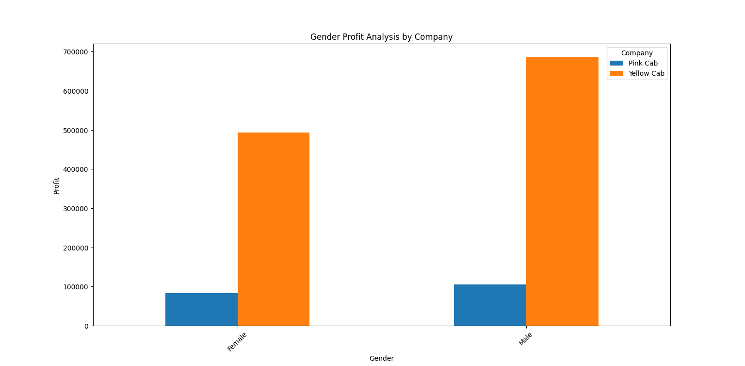
Profit Analysis Gender wise
The graph reveals nearly same pattern on yellow and pink cab for both male and female. Here also yellow cab have higher profit compare to the other.

Slide 6
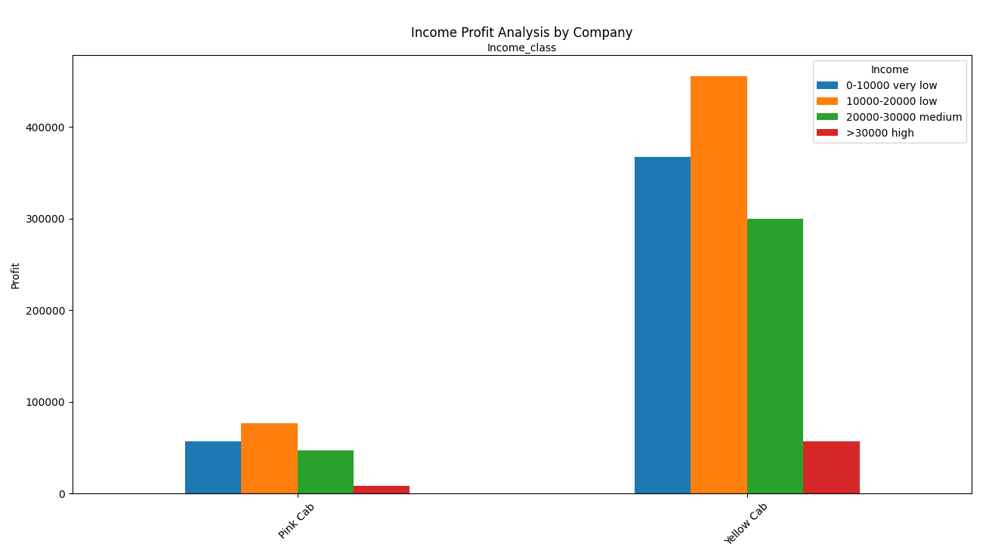
Income Class wise Profit Analysis
Even though all type of income class categories contribute towards the profit of yellow and pink cabs, low class shows the highest attitude for cab usage. The plot also reveals that yellow cab has more favors cab users in all the income class categories.

Slide 7
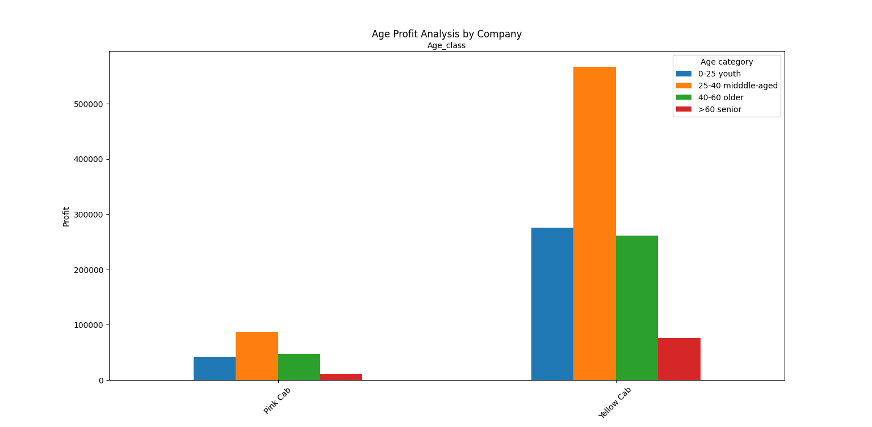
Age GroupWise Profit Analysis

Slide 8
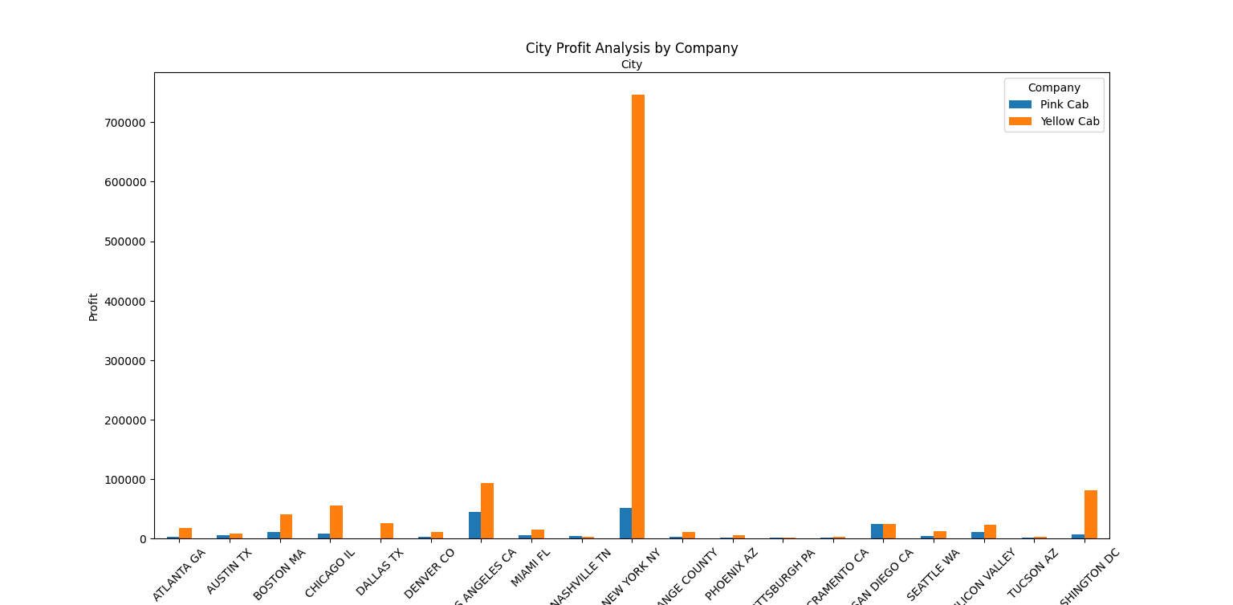
City Wise Cab Users Covered By Company
This is the number
of users covered by
Yellow and Pink cab
In the city. It is clear that New York city shows the highest rate in the cab users.

Slide 9
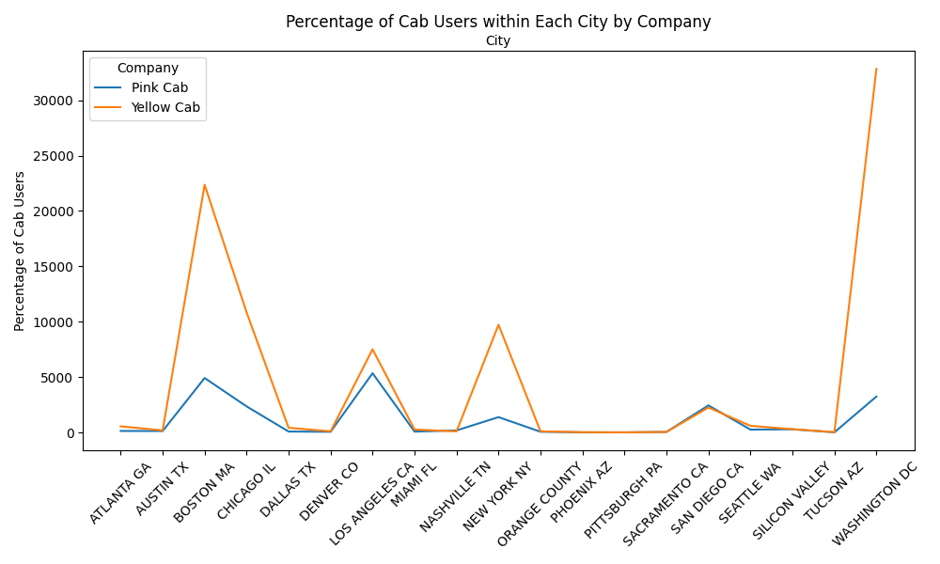
Percentage of cab users in each city
This is the percentage of cab users in each city for the two cab companies.

Slide 10
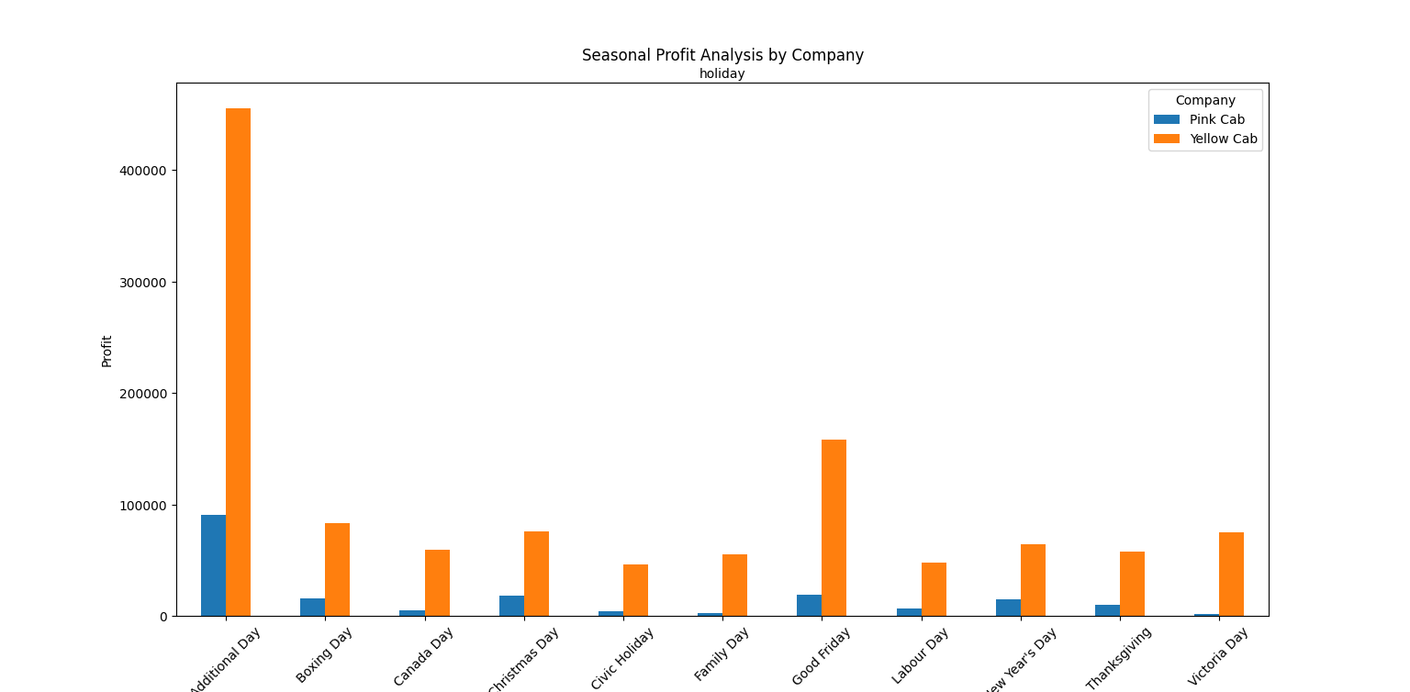
Seasonal profit analysis

Slide 11
Recommendations
We have evaluated both the cab companies on following points and found Yellow cab better than Pink cab:
Yearly profit : Yellow cab earns highest profit rate in all the three consecutive years compared to Pink cab.
Age wise Reach :Yellow cab has maximum reach in all the age categories if it’s youth, middle-aged, older or senior than Pink cab.
Income wise Reach :Both the cabs are very popular in very low and low income class but here also Yellow cab is performing better than Pink cab in offering their services to all the four income class group (very low, low, medium and high)
Seasonal profit: Here also yellow cab favors most compared to Pink.
On the basis of above point , we will recommend Yellow cab for investment.

Slide 12
Thank You

