Slide 1


Text Emotion Analysis
PRESENTED BY:
1.Himanshu Gautam 2.Mohit Jain 3.Anurag Singh
SUPERVISOR: Dr. Durga Prasad Mishra
CO-SUPERVISOR: Dr. Navneet Garg

Slide 2

What is Text Emotion Analysis?
Text emotion analysis is the process of identifying and understanding the emotional state expressed in written text.
It uses natural language processing and machine learning techniques to detect and classify the emotions conveyed in online reviews , customer feedback and other textual data.

Slide 3

Problem Statement
In the era of digital communication accurately deciphering emotions conveyed through text poses a significant challenge.
This project aims to address this challenge by developing and evaluating advanced deep learning models for text emotion analysis.

Slide 4

Objective
The primary objective of this project is to explore and evaluate state-of-the-art methods and techniques for text emotion analysis.
With a focus on achieving accurate and robust emotion detection and classification in diverse textual contexts.

Slide 5




Applications of Text Emotion Analysis
Customer Service
Text emotion analysis helps customer service teams identify and respond to customer sentiment, improving satisfaction and loyalty.
Brand Monitoring
Brands leverage text emotion analysis to track public perception, detect emerging issues, and manage their online reputation.
Healthcare
In healthcare, text emotion analysis can help clinicians better understand patient experiences and provide more personalized care.
Media and Journalism
Journalists use text emotion analysis to gauge reader sentiment and optimize content for greater engagement and impact.

Slide 6
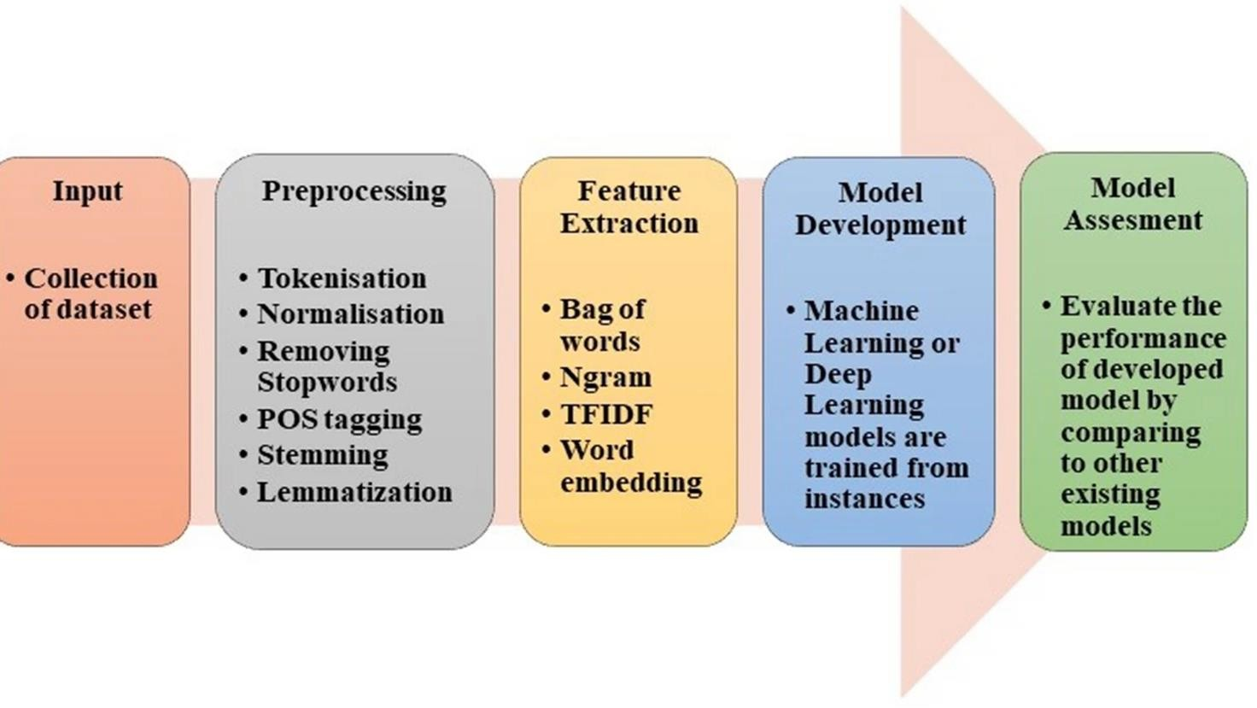
Material and Methods
We selected appropriate data, performed meticulous labeling, developed robust feature vectors, and formulated the hybrid CNN Bi-LSTM approach.

Slide 7

Dataset & Labeling
Datasets are structured collections of data in spreadsheets, databases, or text files, containing diverse information for analysis and processing.
Emotion labels ('joy', 'fear', 'anger', 'sadness', 'neutral') mapped to unique integer values via predefined encoding, facilitating machine learning.

Slide 8

Preprocessing & Feature Extraction
Text preprocessing is a vital component of text classification, encompassing a range of techniques to prepare and transform text data for analysis.
Feature extraction transforms raw data (text, images, signals) into suitable formats for deep learning algorithms, converting text into numerical features.

Slide 9

Model Selection
Machine Learning Models:
Support Vector Machines (SVM)
Deep Learning Models:
Long Short-Term Memory (LSTM) networks
CNN-BiLSTM models
Transformer-based models (e.g., BERT, GPT)

Slide 10
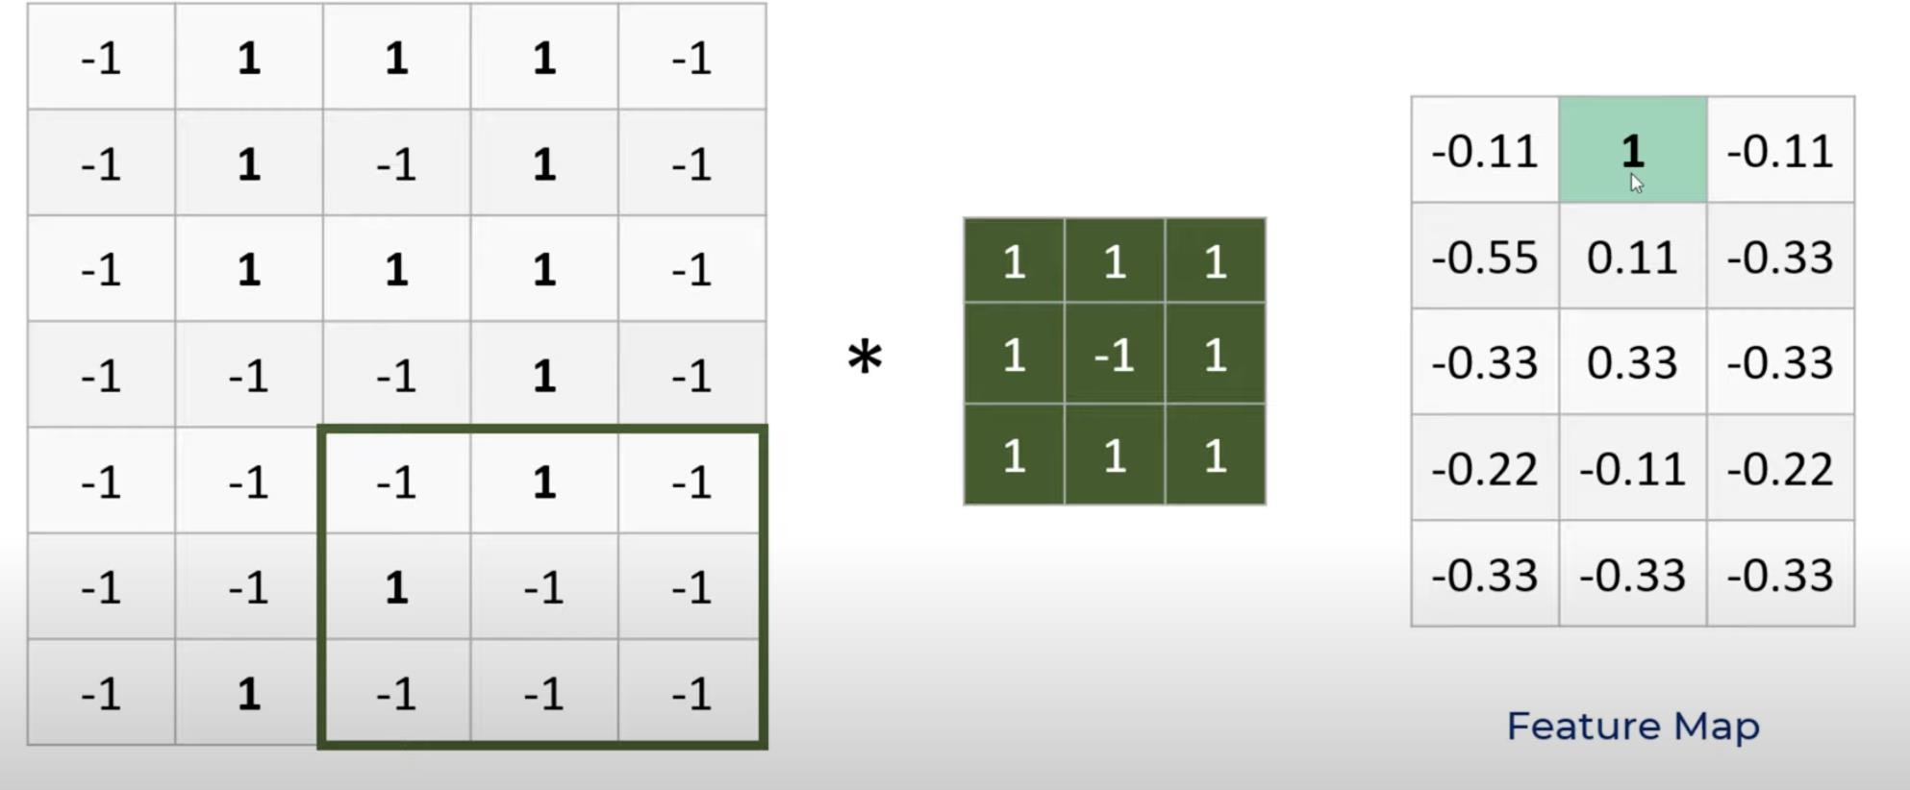
Convolutional Neural Networks (CNNs)
Best for feature extraction.
Features can be phrases like "not good" or "very happy", word-embedding etc.

Slide 11
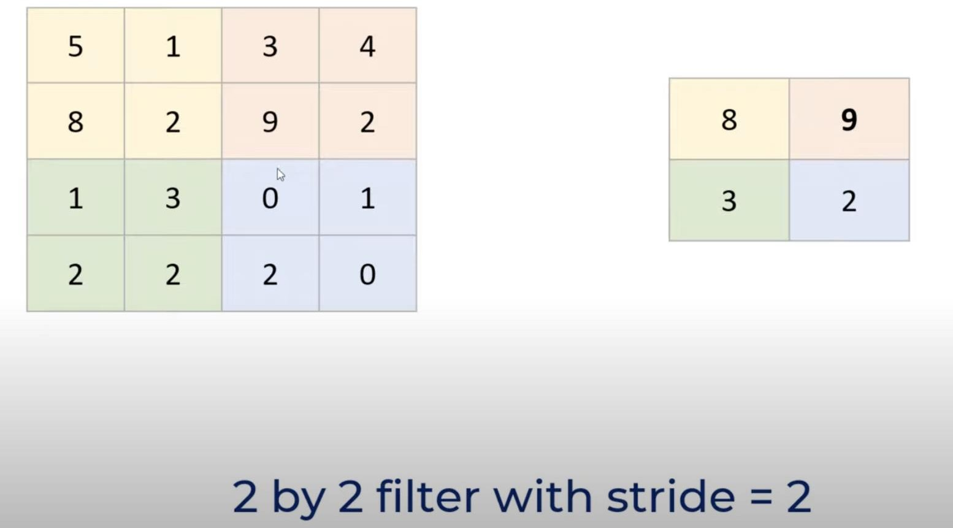
Pooling layer
Pooling layer helps reduce
the size of data.
Reduces over-fitting as there are less parameters.
Model is more tolerant towards variations.

Slide 12
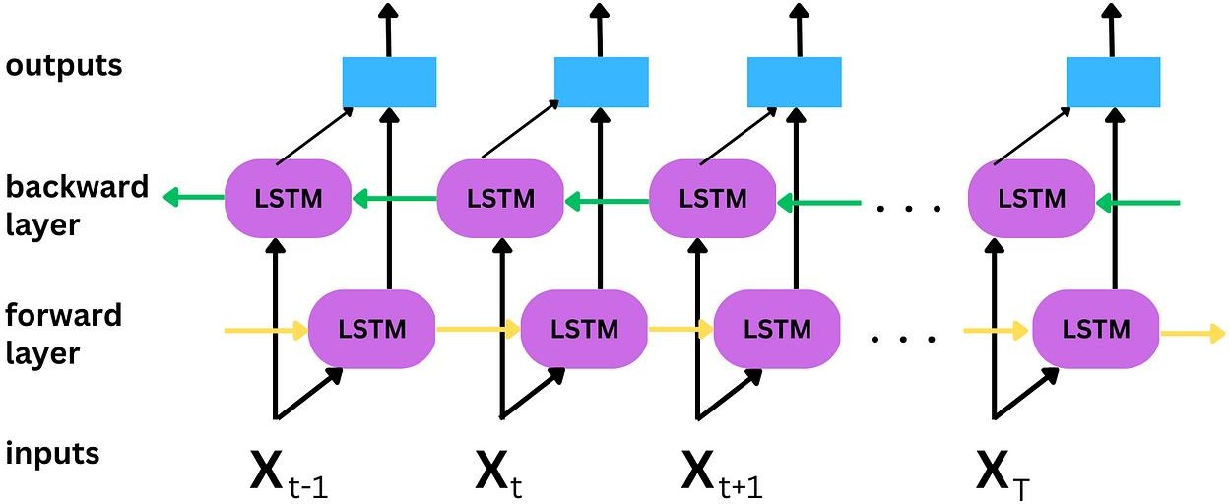
Why Bi-LSTM?
Traditional neural networks don't have persistence.
Unfortunately, as that gap grows, RNNs become unable to learn to connect the information.
Bi-LSTMs are explicitly designed to avoid the long-term dependency problem.

Slide 13
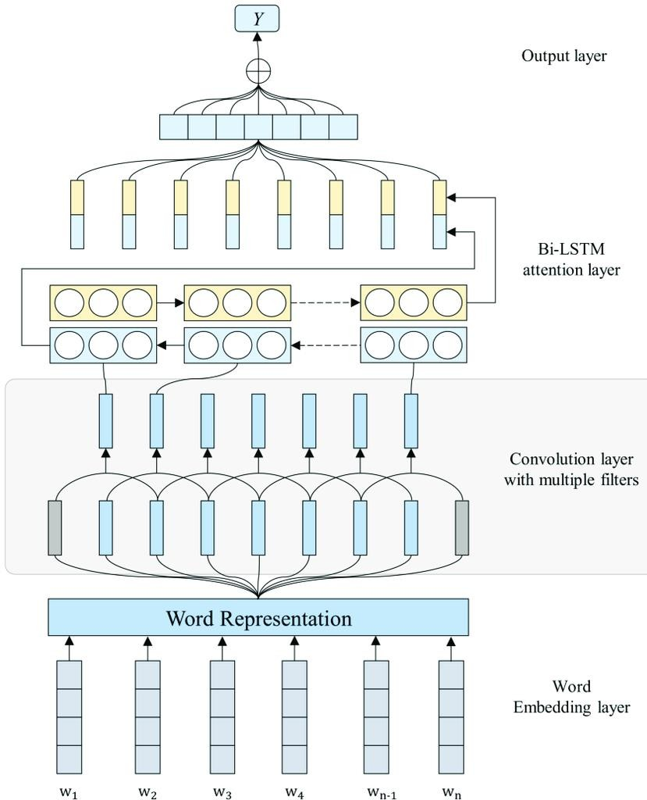
Hybrid model (CNN+Bi-LSTM)
The hybrid model combines the strengths of Convolutional Neural Networks (CNN) and Bidirectional Long Short- Term Memory (Bi-LSTM) for text emotion analysis.
The CNN captures local features and patterns, while the Bi-LSTM models long-range dependencies in the text.

Slide 14
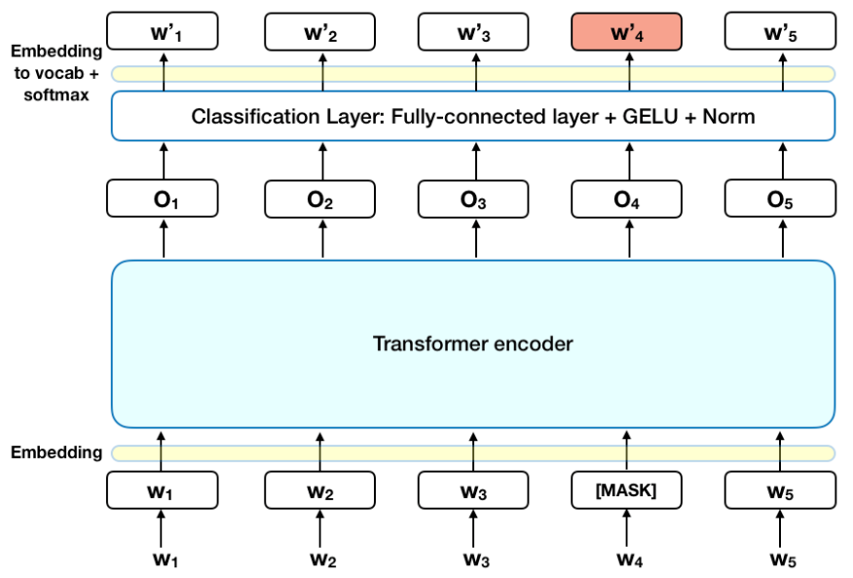
BERT Model
BERT is a pre-trained language model that captures context by considering words from both directions (left-to-right and right-to-left).
It delivers state-of-the-art results in NLP tasks like question answering, sentiment analysis, and named entity recognition through fine-tuning.

Slide 15
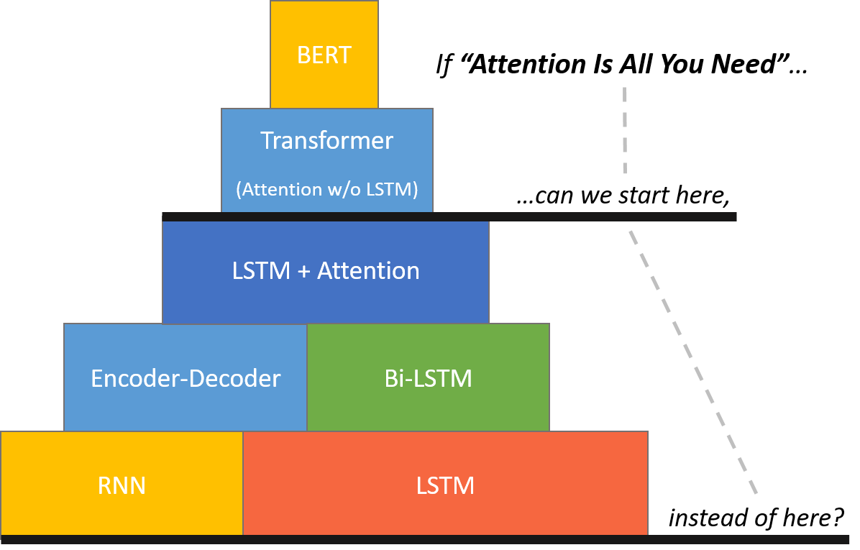
Comparison Between CNN-BiLSTM and BERT
CNN-BiLSTM efficiently combines CNN for localized feature extraction and BiLSTM for sequential context, making it suitable for simpler emotion detection tasks, though it may struggle with complex emotional nuances.
BERT utilizes transformer-based bidirectional self-attention, capturing intricate relationships across the entire text, leading to superior performance in detecting subtle and mixed emotions.
Training Efficiency: CNN-BiLSTM is more resource-efficient and faster to train, while BERT, though computationally intensive, provides state-of-the-art accuracy in emotion detection tasks

Slide 16
Transformer-Based Approach for Dimensional Emotion Recognition
Model Architecture: Incorporates an ALBERT encoder with 12 transformer layers, tokenization, embeddings, positional encodings, a dropout layer (rate 0.1), and a final dense regression layer for VAD score prediction.
ALBERT for Efficiency: Optimized with weight-sharing across layers, reducing parameters while maintaining performance, and pre-trained on 25 GB of large-scale corpora for semantic understanding.
Fine-tuning for Emotion Recognition: Adapts ALBERT with a regression layer, trained on 59,000+ samples split into training, validation, and test sets to predict continuous VAD scores.
Training Highlights: Employs the AdamW optimizer, MSE loss function, and 20 epochs of training with a batch size of 32 for robust and stable performance.

Slide 17
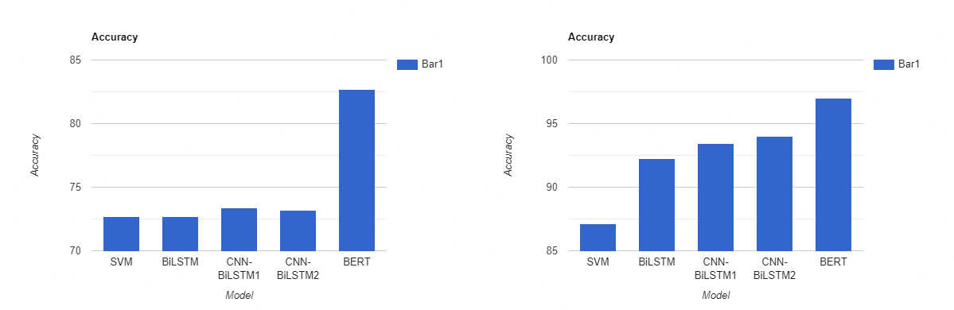
Observation
Dataset-1
Dataset-2

Slide 18
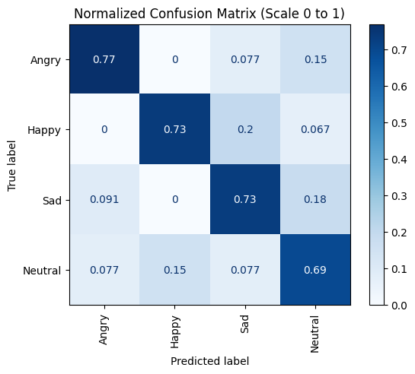
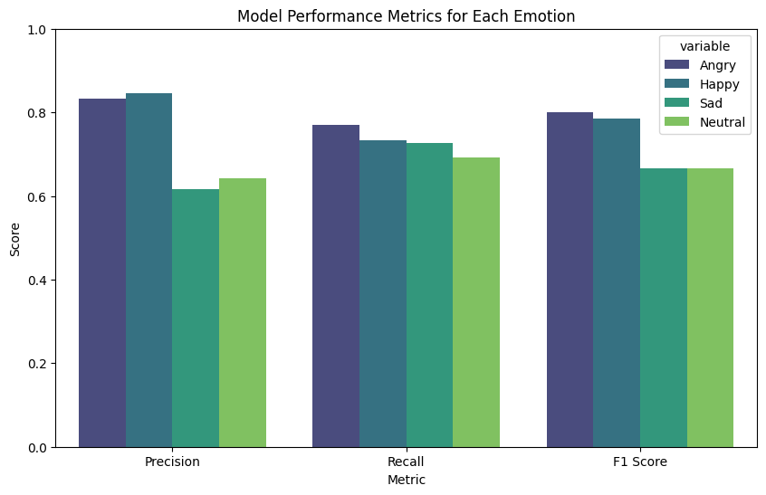
Hindi Dataset Observation

Slide 19
F1 Score, Precision & Recall
Emotion | Precision | Recall | F1-score
Anger | 0.94 | 0.95 | 0.94
Fear | 0.94 | 0.86 | 0.90
Joy | 1.00 | 0.91 | 0.95
Love | 0.77 | 1.00 | 0.87
Sadness | 0.98 | 0.97 | 0.97
Surprise | 0.75 | 0.99 | 0.85

Slide 20
Evaluation of the Dimensional Emotion Recognition Model
Emotion |  | DL group |  |  | Rule Group
 | Precision | Recall | F1-score | Precision | Recall | F1-score
Empty | 0.87 | 0.66 | 0.75 | 0.26 | 0.04 | 0.07
Threatened | 0.87 | 0.90 | 0.89 | 0.31 | 0.29 | 0.05
Tranquil | 0.79 | 0.56 | 0.65 | 0.19 | 0.24 | 0.21
Excited | 0.77 | 0.92 | 0.84 | 0.52 | 0.40 | 0.07
Rooted | 0.89 | 0.90 | 0.89 | 0.61 | 0.94 | 0.74
 | Macro F1 | Micro F1 | Average F1 | Macro F1 | Micro F1 | Average F1
Total | 0.80 | 0.86 | 0.86 | 0.23 | 0.59 | 0.48

Slide 21
Testing
Message: ['I saw a tiger entering my house while i was alone']
Probabilities for each emotion in given message: sadness: 33.21581482887268
joy: 1.5119134448468685
love: 0.06470673251897097
anger: 8.698828518390656
fear: 56.042128801345825
surprise: 0.4666124004870653
predicted: fear

Slide 22



Future Work
Multimodal Fusion
Cross-Lingual Emotion Analysis
Developing models that can effectively analyze emotional content across different languages and cultural contexts.
Diverse Dataset Curation
Collecting and annotating larger, more diverse datasets to capture the richness and complexity of human emotional expression.
Integrating text with other modalities, such as audio, video, and facial expressions, to provide a more comprehensive understanding of emotional states.

Slide 23









Conclusion
The CNN-BiLSTM model achieves superior accuracy in emotion detection, effectively leveraging GloVe and Word2Vec embeddings to capture semantic relationships in text.
Transformers like ALBERT demonstrate exceptional performance in dimensional emotion recognition, accurately predicting Valence, Arousal, and Dominance (VAD) scores.
The hybrid model excels in classifying nuanced emotions such as joy, anger, fear, and surprise, with accuracy rates reaching 94%.
Future directions include multimodal emotion recognition integrating text, speech, and facial expressions, as well as domain-specific and multilingual adaptations.
Ethical considerations, addressing biases, and applications in VR/AR for real-time emotion tracking present significant opportunities for advancing emotion recognition systems.

Slide 24
References
[1] B. Jang, M. Kim, G. Harerimana, S. Kang, and J. W. Kim, “Applied sciences Bi- LSTM Model to increase accuracy in text classification:Combining Word2vec CNN and attention mechanism,” Appl. Sci.,vol. 10, no. 17, 5841, 2020.
[5] K. Pasupa, T. Seneewong, and N. Ayutthaya, “Thai sentiment analysis with deep learning techniques: A comparative study based on word embedding , POS-tag , and sentic features,” Sustain. Cities Soc., vol. 50, no. 7, 101615, 2019. doi: 10.1016/j.scs.2019.101615
[2] M. U. Salur and I. Aydin, “A novel hybrid deep learning model for sentiment classification,” IEEE Access, vol. 8, pp. 58080–58093,2020. doi: 10.1109/ACCESS.2020.2982538
[6] M. P. Akhter, Z. Jiangbin, I. R. Naqvi, M. Abdelmajeed, A.Mehmood, and M. T. Sadiq, “Document-level text classification using single-layer multisize filters convolutional neural network,” IEEE Access, vol. 8, no. Ml, pp. 42689–42707, 2020. doi:
10.1109/ACCESS.2020.2976744
[3] S. Soumya and K. V Pramod, “Hybrid deep learning approach for sentiment classification of malayalam tweets,” Int. J. Adv. Comput. Sci. Appl., vol. 13, no. 4, pp. 891–899, 202
[7] A. Wahdan, S. Hantoobi, S. A. Salloum, and K. Shaalan, “A systematic review of text classification research based on deep learning models in Arabic language,” Int. J. Electr. Comput. Eng., vol. 10, no. 6, pp. 6629–6643, 2020. doi: 10.11591/IJECE.V10I6.PP6629-6643
[4] S. Kumar, C. Akhilesh, K. Vijay, and B. Semwal, “A multibranch CNN-BiLSTM model for human activity recognition using wearable sensor data,” Vis. Comput., vol. 38, no. 12, pp. 4095–4109, 2021. doi: 10.1007/s00371-021- 02283-3
[8] W. Fang, H. Luo, S. Xu, P. E. D. Love, Z. Lu, and C. Ye, “Automated text classification of near-misses from safety reports: An improved deep learning approach,” Adv. Eng. Informatics, vol. 44, no. March 2019, 101060, 2020. doi: 10.1016/j.aei.2020.101060

Slide 25


