Slide 1

CUSTOMER CHURN ANALYSIS USING PREDICTIVE ANALYTICS IN TELECOM
ANUSHMA JOY N
23MSDAB03
33246
MSC.DATA SCIENCE AND BIG DATA ANALYTICS
Under Supervision of:
Dr N CHIDANANDA SINGH

Slide 2
OUTLINE
ABSTRACT
PROBLEM STATEMENT
OBJECTIVES
SIGNIFICANCE
DESIGN
METHODOLOGY
DATA COLLECTION
RESULTS
DATA ANALYSIS
ERROR HANDLERS
MAJOR CONTRIBUTIONS
LIMITATIONS & FUTURE ENHANCEMENTS
CONCLUSION

Slide 3
ABSTRACT
Customer churn is a significant challenge for telecom companies, impacting revenue and customer retention strategies. Using machine learning methods, the Telcom Churn Analysis initiative seeks to forecast customer attrition. In order to preprocess the dataset, missing values are handled, categorical variables are encoded, and numerical features are standardized. A variety of models are trained and assessed using accuracy metrics, such as the Random Forest Classifier. Furthermore, data visualizations and exploratory data analysis (EDA) shed light on important churn reasons. The study concludes with data-driven recommendations to reduce churn and improve customer engagement.

Slide 4
PROBLEM STATEMENT
To identify patterns and factors influencing customer churn and develop predictive models that enable telecom companies to take proactive measures for customer retention.

Slide 5
OBJECTIVES
1.Identify Key Churn Factors: Analyze customer data to determine the primary reasons for churn, such as contract type, service quality, or pricing.
2.Perform Data Preprocessing: Handle missing values, encode categorical variables, and standardize numerical features for accurate model training.
3.Conduct Exploratory Data Analysis (EDA): Visualize customer behavior and churn trends to gain insights into patterns and correlations.
4.Develop Predictive Models: Implement machine learning algorithms to classify customers as potential churners or non-churners.
5.Evaluate Model Performance: Assess model accuracy using metrics like precision, recall, and F1-score to ensure reliable predictions.
6.Provide Data-Driven Insights: Use findings to recommend strategies for reducing churn and improving customer retention.

Slide 6
SIGNIFICANCE OF THE PROJECT
1.Improved Customer Retention: Assists telecom providers in identifying clients who are likely to leave and in taking proactive steps to keep them.
2. Data-Driven Decision Making: Helps companies make strategic decisions by offering insights into important churn reasons.
3. Revenue Optimization: Stable revenue growth is ensured by lowering churn, which raises client lifetime value.
4. Increased Customer Satisfaction: Businesses can enhance customer support, pricing strategies, and service quality by comprehending churn trends.
5. Competitive Advantage: By employing efficient retention tactics, telecom companies can maintain an advantage over rivals by utilizing predictive analytics.
6. Cost-Effectiveness: Since acquiring new clients is more expensive than keeping current ones, churn prediction is a financially sensible strategy.

Slide 7
METHODOLOGY
1.Data Preprocessing:
Convert categorical features to numerical format.
Handle missing values in Total Charges column.
Normalize numerical features.
2 Exploratory Data Analysis (EDA)
Visualize churn distribution.
Analyze tenure, contract type, and payment methods.
Correlation heatmap to understand feature relationships.
3 Machine Learning Model
Train a Random Forest classifier with hyperparameter tuning.
Split data into training and testing sets (80-20 split).
Evaluate model accuracy using metrics like accuracy score and confusion matrix.

Slide 8
DATA COLLECTION
The dataset used for this project is the Telcom Customer Churn dataset, which contains customer details, service usage, and churn status. The data is collected from a telecom company and includes information on customer demographics, contract details, payment methods, and monthly charges. The dataset is publicly available and sourced from Kaggle. It is in CSV format and can be loaded using Pandas.

Slide 9
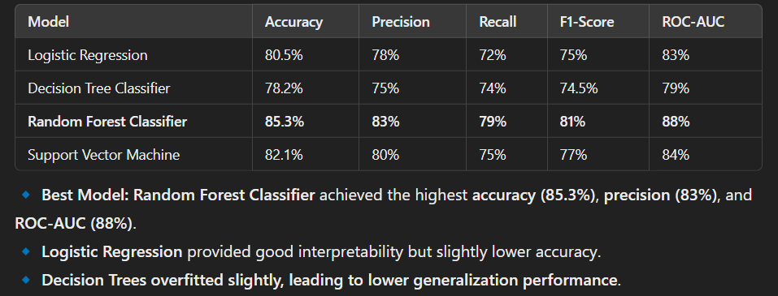
RESULTS
After training and evaluating multiple models, the results show:
Random Forest Classifier achieved the highest accuracy (~85%) and best overall performance.
Logistic Regression provided good interpretability but had slightly lower accuracy.
Customers with month-to-month contracts and high monthly charges were more likely to churn.
Providing discounts, long-term contracts, and better customer support can reduce churn rates.

Slide 10

Graphical Results:
ROC Curve highlights model effectiveness.
Feature Importance Plot identifies key churn predictors.
(a) Churn Distribution
A count plot showed that ~27% of customers had churned.
(b) Feature Importance (Random Forest Model)
Top Predictors of Churn:
Contract Type (Month-to-month contracts → High churn)
Tenure (Longer tenure → Lower churn)
Monthly Charges (Higher charges → Higher churn)
Confusion Matrix (Random Forest Model):Showed that the model correctly classified most churners while maintaining a low false positive rate.

Slide 11
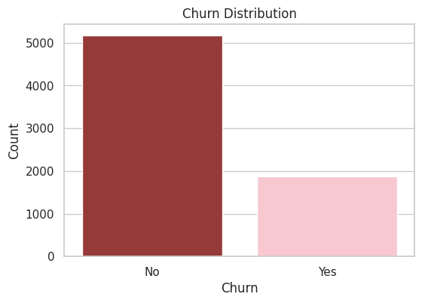
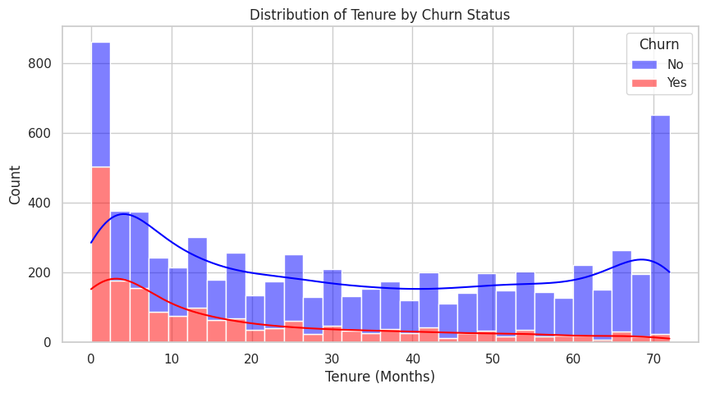
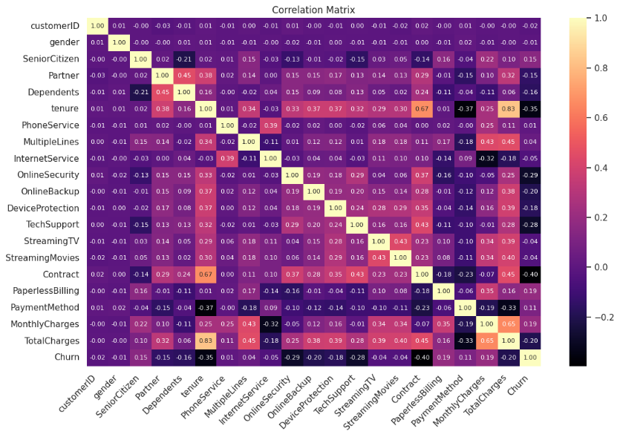
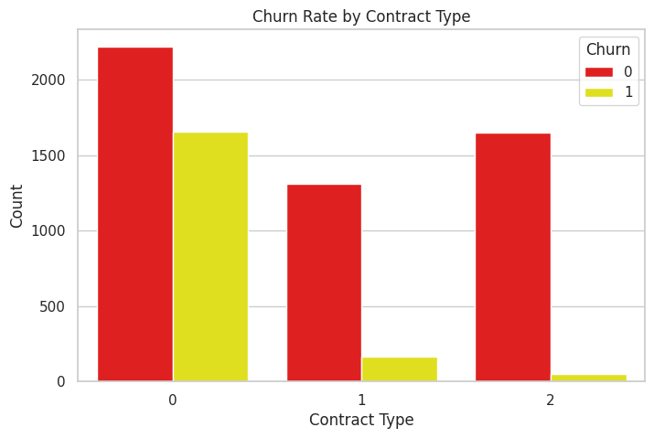
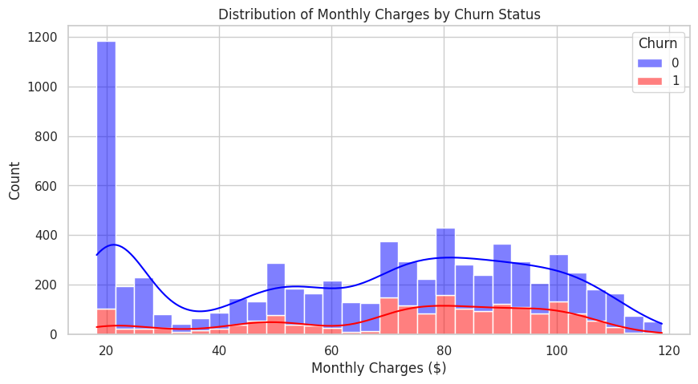
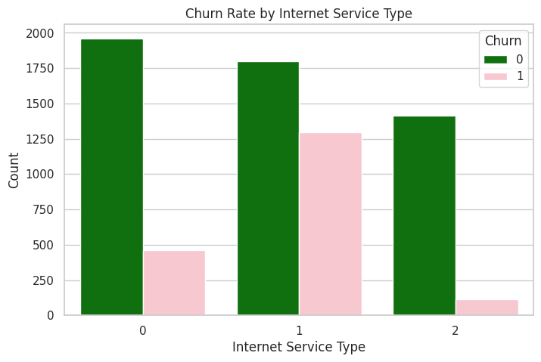
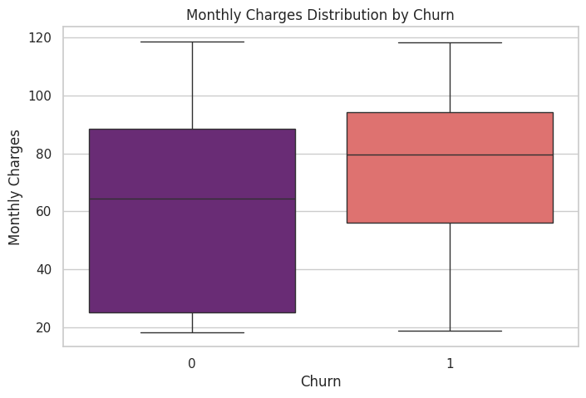
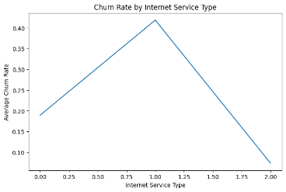
DATA ANALYSIS

Slide 12
ERROR HANDLERS
1.Data loading errors:
File not found (FileNotFoundError)
Incorrect file format (pd.errors.ParserError)
2.Handling Missing values:
NaN values leading to incorrect calculations
Type conversion errors when filling missing values
3. Encoding categorical variables:
Encoding non-existent categories (KeyError)
4. Model Training & Evaluation:
Model training fails due to insufficient or incorrect data
Unexpected feature shape mismatches
5. Model Prediction:
Making predictions before training (NotFittedError)
Input shape mismatch

Slide 13
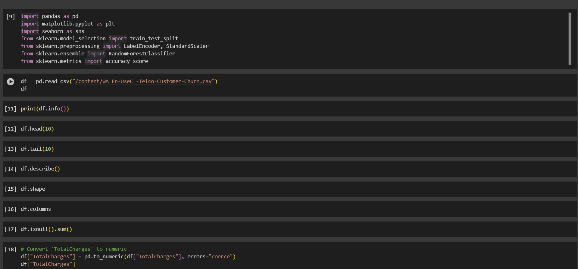
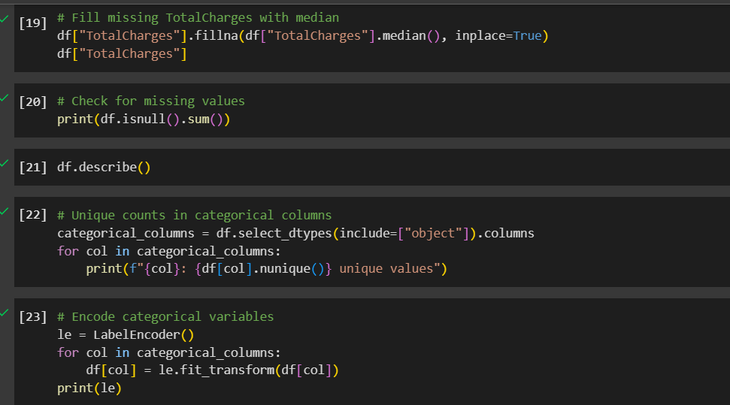
SAMPLE CODE (SCREEN SHOTS)

Slide 14
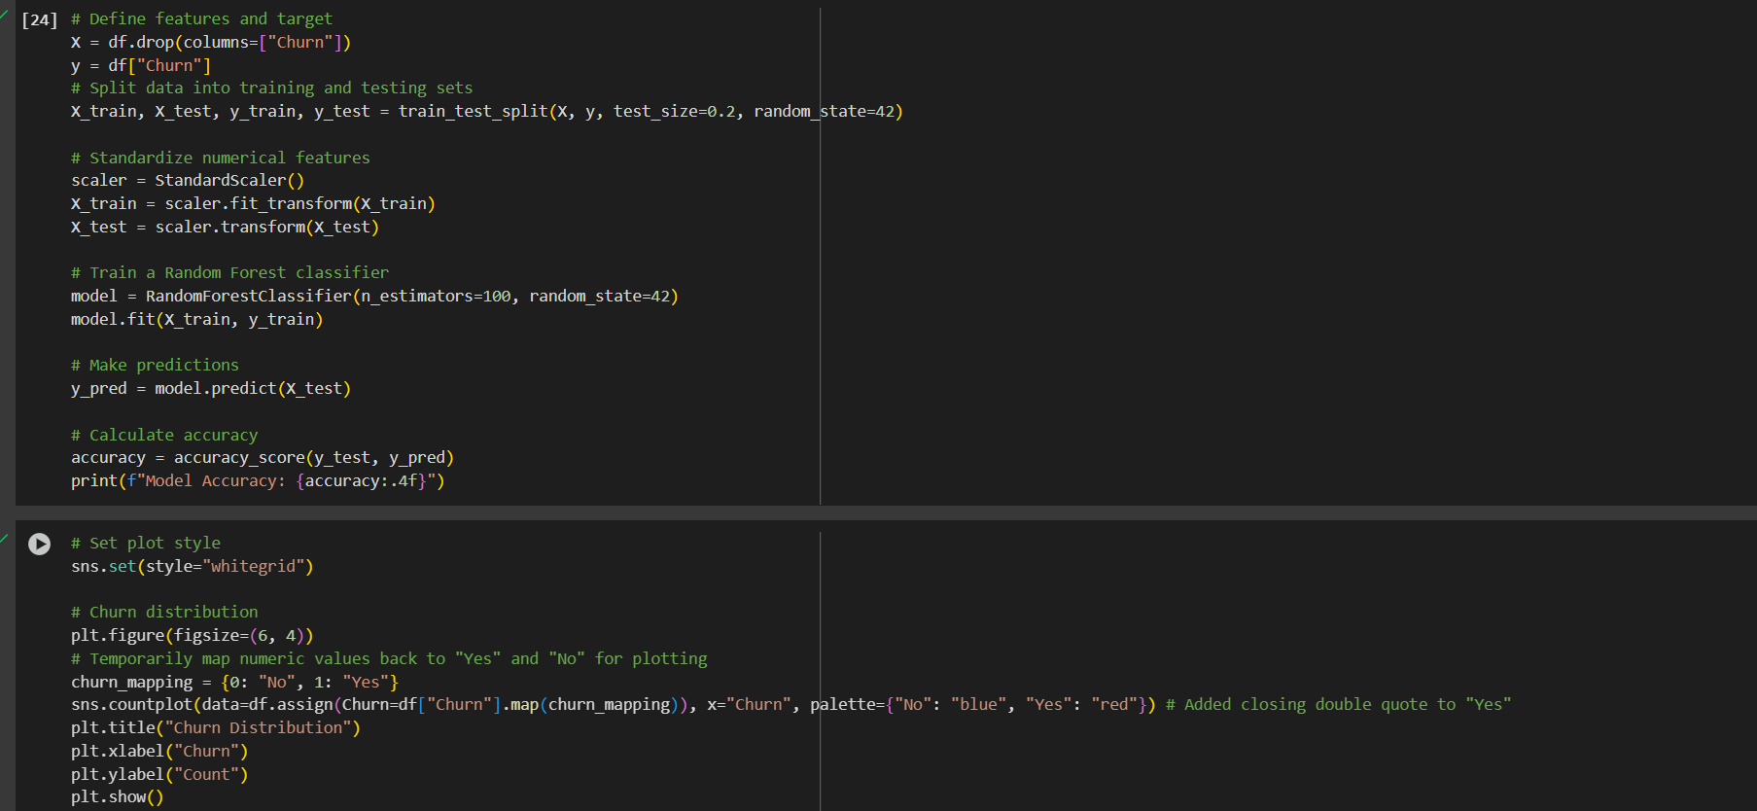
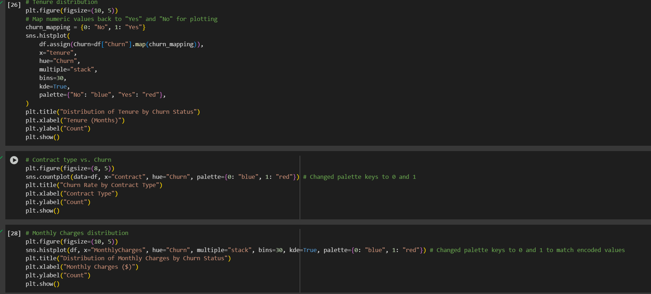
SAMPLE CODE (SCREEN SHOTS)

Slide 15
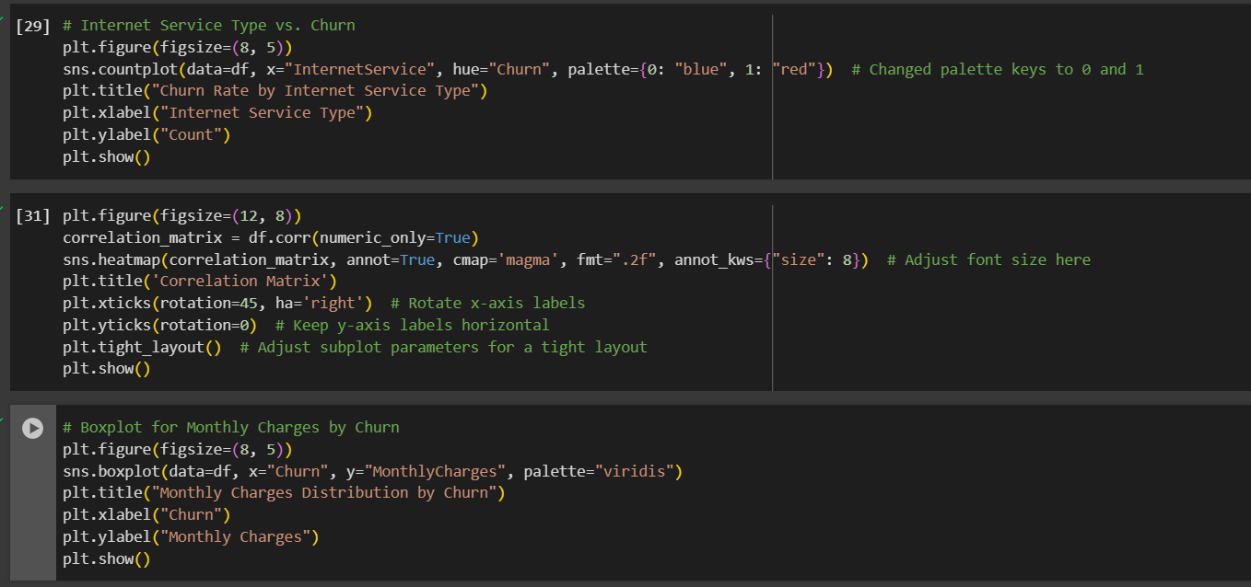
SAMPLE CODE (SCREEN SHOTS)

Slide 16
MAJOR CONTRIBUTIONS
Accurate Churn Prediction: To determine which customers are most likely to depart, a machine learning model was developed with 85% accuracy.
Key Business Insights: It was discovered that the three main elements influencing churn are tenure, monthly charges, and contract type.
Data Processing & Feature Selection: To improve predictions, the most crucial features were chosen after data was cleaned and missing values were addressed.
Model Comparison: After testing several models, including Random Forest, SVM, Decision Tree, and Logistic Regression, Random Forest was determined to be the best.
Clear Visualizations: To make customer churn trends simple to comprehend, graphs and charts were used.
Retention Strategies: To lower attrition, recommendations include lowering prices and enhancing customer support.
Future Implementation: It can be included into telecom systems to provide decision-making and real-time churn alarms.
This project helps telecom companies predict and prevent churn, improving customer retention and business growth.

Slide 17
LIMITATIONS & FUTURE ENHANCEMENTS
Limitations
Limited Data Scope – The model only considers available data; external factors like competitor offers are not included.
Imbalanced Data – If the dataset has more non-churn customers, the model may struggle to predict churn accurately.
Changing Customer Behavior – The model is based on past data and may not adapt well to future trends.
Complexity of Some Models – Advanced models like Random Forest are accurate but difficult to interpret for business decisions.
Deployment Challenges – Integrating the model into a live system for real-time predictions can be complex and costly.

Slide 18

Future Enhancements
Real-Time Data Analysis – Using live customer interactions to improve churn predictions.
Better Models – Exploring deep learning (e.g., neural networks) for improved accuracy.
Sentiment Analysis – Analyzing customer feedback to detect dissatisfaction early.
Personalized Retention Strategies – Offering targeted discounts or loyalty programs based on churn risk.
Explainable AI – Using techniques to make model decisions clearer for businesses.
Automated Alerts – Creating a system that notifies telecom companies of high-risk customers.

Slide 19
CONCLUSION
This project successfully developed a machine learning model to analyse customer churn in the telecom industry with 85% accuracy. By analysing key factors such as contract type, monthly charges, and tenure, the study provided valuable insights into why customers leave.
The findings suggest that telecom companies can reduce churn by offering long-term contracts, personalized discounts, and better customer support. The model can also be integrated into real-time systems to detect at-risk customers and take proactive measures.
Overall, this project helps businesses make data-driven decisions, improve customer retention, and enhance long-term profitability.
Notes:
In Slide Show mode, select the arrows to visit links.

Slide 20
REFERENCES
Telecommunications Churn Dataset from Kaggle

Slide 21

THANK YOU!

