Slide 1
Smart Parking Solutions
Subtitle: Revolutionizing the Way we Park
ARTHI.K (Leader)
ANTHONY MERCY.G
ANUCIYA.G

Slide 2
Abstract
Parking is a ubiquitous challenge in urban environments, often characterized by congestion, frustration, and inefficiency. The presentation on smart parking solutions delves into innovative technologies and approaches that promise to transform the way we park our vehicles. This abstract provides a glimpse into the world of smart parking and its potential to alleviate the parking-related woes.

Slide 3
Introduction
Briefly introduce the topic of smart parking.
Explain the significance of modernizing parking systems.
State the objectives of the presentation.

Slide 4
Block diagram:
+-------------------------------------------+
| Smart Parking System |
+-------------------------------------------+
_________ _________
/ \ / \
+------+ | Sensors | | Server | +-------+
| \_________/ \___________/
| | | |
| | | |
| +------v------+ +-----v------+ +---v------+
| | Data | | Database | | User |
| | Processing | | Management | | Interface |
| +------------+ +------------+ +------------+
| | |
| | |
| +------v------+ +---v------+
| | Control | | Display |
| | Center | | Devices |
| +------------+ +----------+

Slide 5
|
|
| +-------------+
| | Barrier |
| | Mechanisms |
| +-------------+
|
|
| +-------------+
| | Payment |
| | Systems |
| +-------------+
|
|
| +-------------+
| | Mobile |
| | App |
| +-------------+
|
|
| +-------------+
| | CCTV |
| | Surveillance|
| +-------------+

Slide 6
Sensors:
These are physical devices located in parking spaces that detect the presence or absence of vehicles. They send data to the server regarding parking space occupancy.
Server:
The central server processes data from sensors, manages the database, and handles communication between various components.
Data Processing:
This component handles data received from sensors, applying algorithms to determine parking space availability and status.

Slide 7
Database Management:
The database stores information about parking spaces, user accounts, and transaction history.
User Interface:
This interface allows users to interact with the smart parking system, check availability, and make reservations.
Control Center:
The control center oversees the overall operation of the smart parking system and can manually control barriers if necessary.

Slide 8
Barrier Mechanisms:
These are physical barriers (e.g., gates, bollards) that restrict access to parking spaces. They can be controlled by the system to grant or deny access.
Payment Systems:
This component handles payment processing for parking fees, including options like credit card payments and mobile payments.
Mobile App:
A mobile application allows users to access and interact with the smart parking system using their smartphones.
CCTV Surveillance:
Closed-circuit television cameras provide real-time monitoring and security for the parking area.

Slide 9
The Parking Challenge
Highlight the common issues and challenges in traditional parking systems.
Use visuals or infographics to illustrate traffic congestion and wasted time due to parking

Slide 10
Benefits of Smart Parking
List the advantages of smart parking systems:
Reduced congestion
Time savings
Lower emissions
Improved revenue for parking operators

Slide 11
How Smart Parking Works
Explain the technology behind smart parking:
Sensors and cameras
Data analytics and real-time updates
Mobile apps and reservation systems
Types of Smart Parking Solutions
Describe various smart parking technologies:
Sensor-based systems
License plate recognition
Mobile apps and payments
Automated parking garages

Slide 12
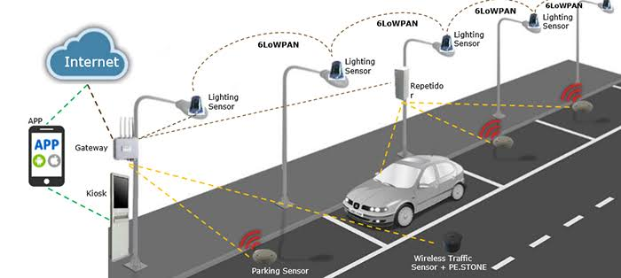
SMART PARKING SYSTEM IN INDIA

Slide 13
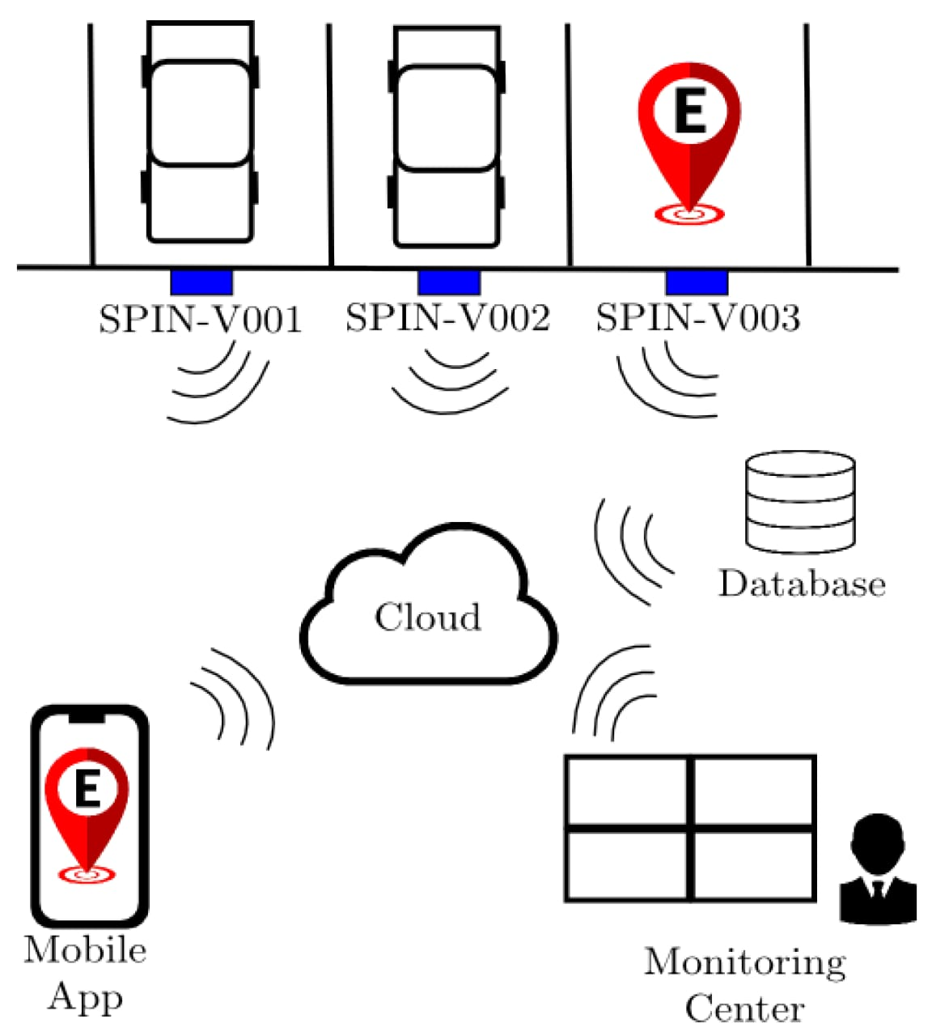
SENSOR USING SMART PARKING

