Slide 1

Deterministic College and Scholarship Prediction Using Structured CAP Cutoff Data
Theme- SDG Goals < SDG 4: Quality Education >
Category- Software
Group No - 8
Group Members- Ananya Dongare , Arya Ghole , Kimaya K Kanyalkar , Sanika Jawane
Guide- Prof. Snehal Kangane

Slide 2
Outline
Introduction
Literature Survey
Limitations of existing systems
Problem statement and Objectives
Proposed Methodology
Experimental Setup
Implementation
Conclusion and Future work
References

Slide 3
Introduction
Engineering admissions through MHT-CET CAP counselling involves multi-parameter decision-making
Seat allocation depends on rank, category, gender, seat type, and quota distribution
CAP cutoff datasets are large, unstructured, and difficult to interpret manually
Existing approaches require extensive data comparison across multiple sources
Scholarship information remains fragmented and disconnected from admission guidance
There is a need for a structured and integrated decision-support system

Slide 4
Introduction
Motivation (Mapped with SDG 4 – Quality Education)
Need for equal access to educational guidance
Rural and economically weaker students lack support
Scholarship awareness is limited
Promote data-driven and transparent decision-making
Objectives of the Project
Develop web-based College Predictor using historical cutoff data
Recommend eligible scholarships based on student profile
Implement rule-based eligibility filtering
Provide simple and user-friendly interface
Reduce dependency on paid counselling services

Slide 5
Literature Survey
Author & Year | Technique | Dataset | Key Result | Limitation
Yousafzai et al., 2020 [1] | ML (Decision Tree, RF) | Student records | Improved prediction accuracy | Not suitable for CAP counselling
Ahmed et al., 2020 [2] | Regression Models | Academic datasets | Accurate prediction | No scholarship integration
John & Martin, 2021 [3] | ML Algorithms | Admission data | Probability prediction | Limited parameters
Patil & Sawant, 2021 [4] | ML Recommendation | Entrance scores | College prediction | No financial aid support
Uzoma et al., 2024 [5] | Recommender Systems | Course dataset | Improved recommendations | No multi-parameter filtering
CAP Portals | Static Data Display | CAP PDFs | Cutoff information | Manual analysis required

Slide 6
Literature Survey
Existing systems focus on academic performance prediction
Use machine learning models such as Decision Trees, Random Forest, and Regression
Some systems provide admission probability prediction
Real-world CAP portals display historical cutoff data
These solutions assist decision-making but lack integrated guidance.

Slide 7
Limitations of existing Systems
Most systems focus only on academic performance prediction
No direct use of real CAP counselling cutoff datasets
Scholarship recommendation not integrated with college prediction
Limited eligibility parameters considered
No centralized platform combining counselling + financial guidance
Static cutoff portals require manual interpretation
Lack of transparency in prediction logic
Minimal support for rural and economically weaker students

Slide 8
Problem statement and Objectives
Problem Statement:
Students face difficulty in selecting colleges during CAP counselling
Large and complex cutoff datasets are difficult to interpret
No centralized system for college and scholarship guidance
Objectives:
Analyze historical CAP cutoff data in structured format.
Predict eligible colleges based on student parameters.
Identify applicable scholarships based on eligibility.
Provide transparent and data-driven guidance.
Reduce dependence on private counselling services.

Slide 9
Proposed Methodology
Module Design:
Input Module: Student rank, category, gender, seat type, income.
College Filtering Module: Compares student rank against cutoff rank.
Scholarship Filtering Module: Validates income and category eligibility.
Output Module: Displays eligible colleges and scholarships.
Eligibility Logic:
College eligibility: Student Rank ≤ Cutoff Rank
Scholarship eligibility: Student Income ≤ Income Limit
Rule-based deterministic system without probabilistic prediction

Slide 10
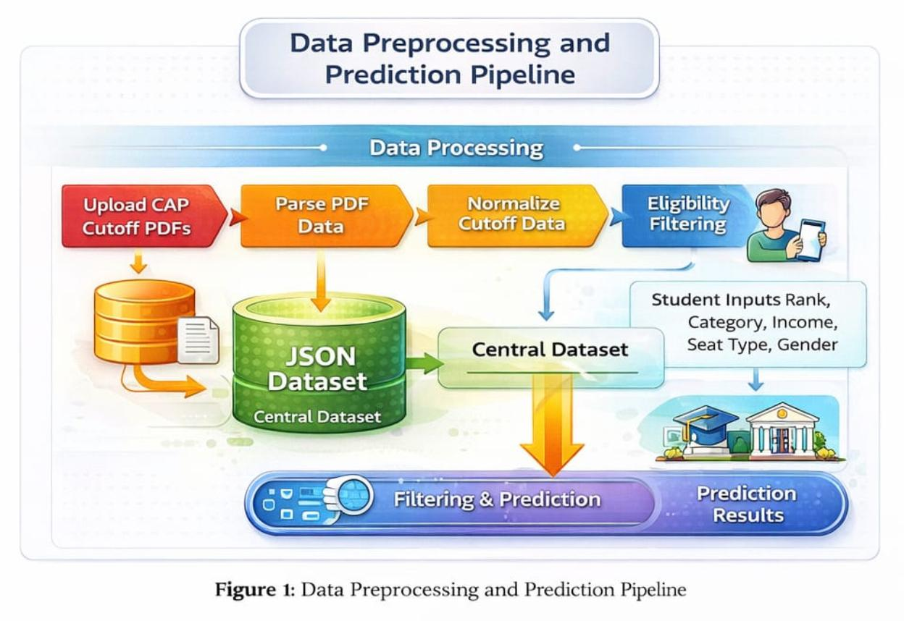
Proposed Methodology

Slide 11
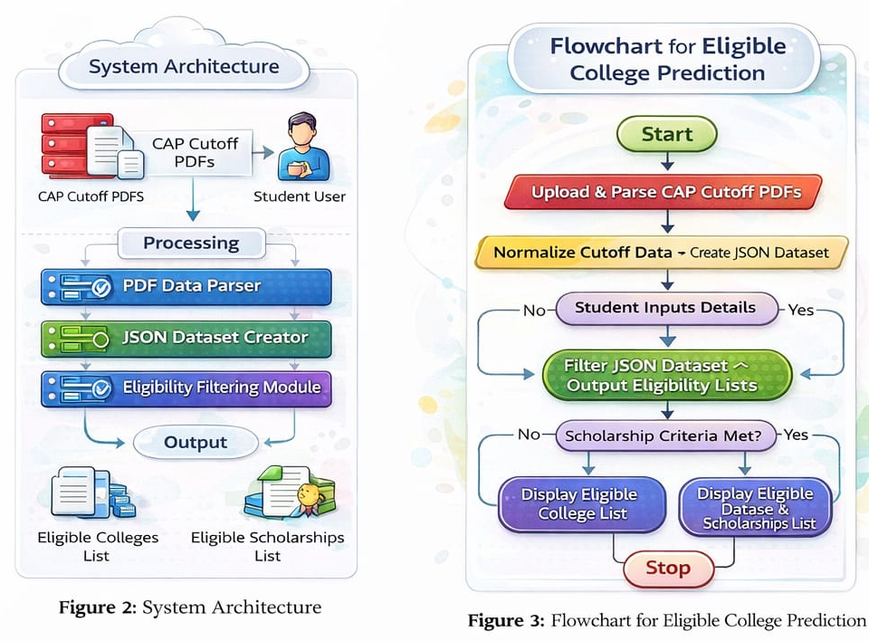
Proposed Methodology

Slide 12
Experimental Setup
Software Environment
Frontend: HTML, CSS, JavaScript
Backend: Python (Flask Framework)
Data Processing: Pandas
Database: JSON files
Performance Evaluation Parameters
Eligibility validation consistency
Filtering Time Efficiency
Correct Match Rate (Rank vs Cutoff Validation)
User Response Time
Dataset Details
MHT-CET CAP cutoff datasets (2024–2025, Rounds 1–4)
28,825 cutoff records across 366 institutes and 91 programs
Attributes: college, branch, category, seat type, cutoff rank.
Scholarship dataset with income and category criteria.
Data stored in structured JSON format

Slide 13
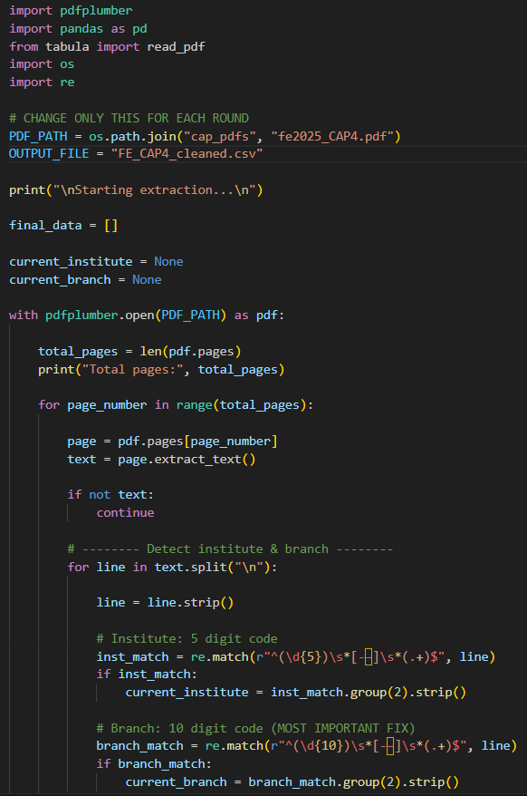
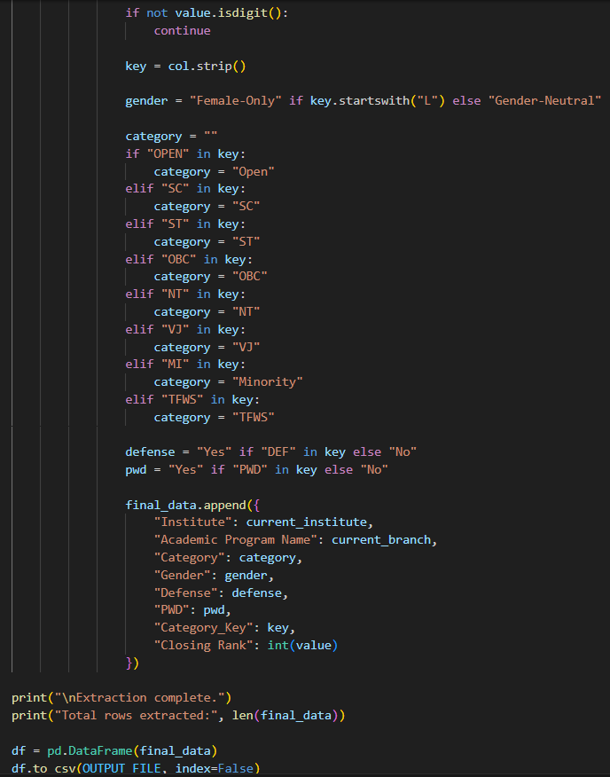
Implementation
Figure 1: PDF to CSV Extraction Module

Slide 14
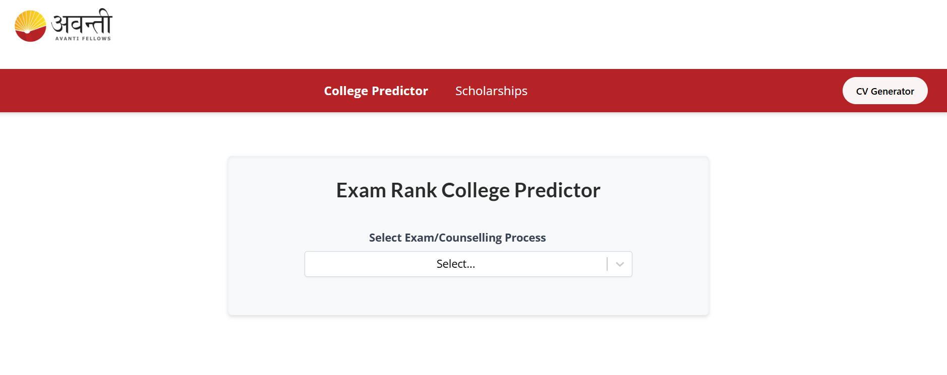
Implementation
Fig. 2. Exam Rank College Predictor & Scholarship Finder Interface
Displays the system interface for user interaction.

Slide 15
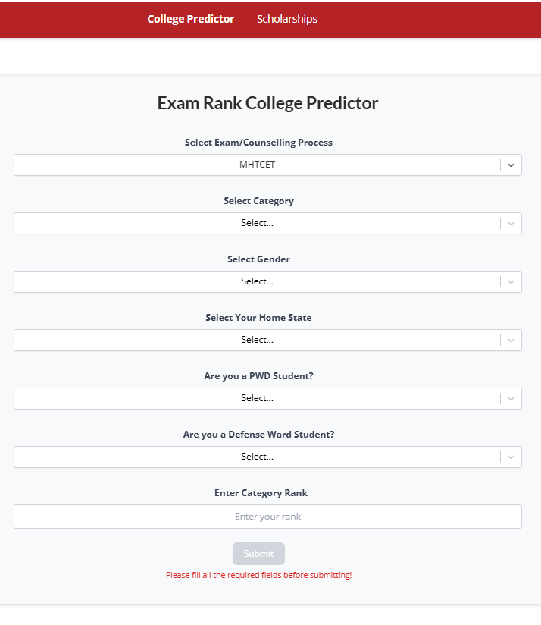
Implementation
Fig. 3. Exam Rank College Predictor Interface
Displays the user input form for selecting counselling parameters such as exam type, category, gender, and rank.

Slide 16
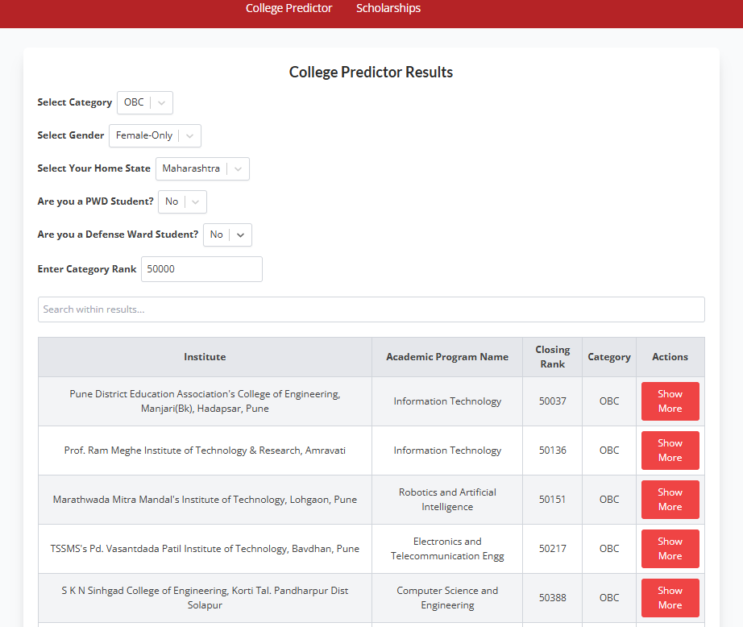
Implementation
Fig. 4. College Predictor Results Interface
Shows the list of eligible colleges and programs generated based on user input and cutoff filtering logic.

Slide 17
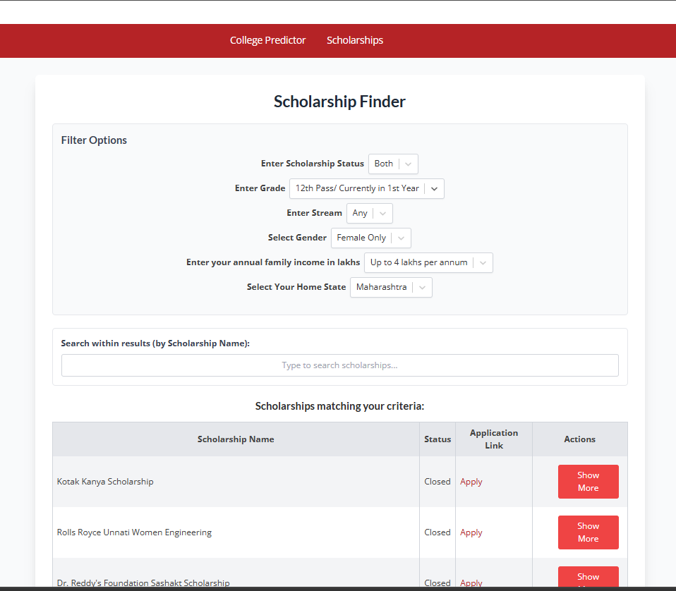
Implementation
Fig. 5. Scholarship Finder Interface
Illustrates the filtering interface where users can apply multiple criteria to search for relevant scholarships.

Slide 18
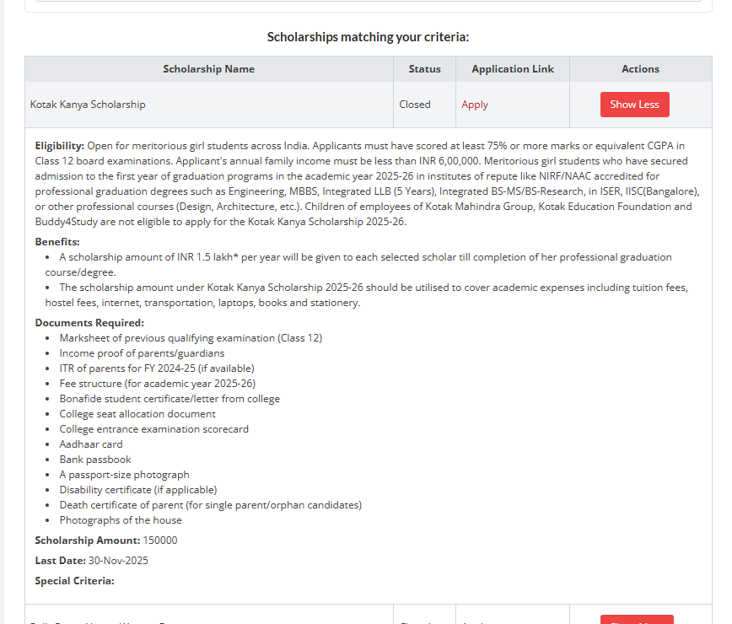
Implementation
Fig. 6. Detailed Scholarship Information View
Displays comprehensive details of a selected scholarship, including eligibility, benefits, required documents, and deadlines.

Slide 19
Conclusion and Future work
Conclusion
Automated CAP PDF → CSV → Normalized JSON pipeline
Implemented average cutoff computation
Designed rule-based eligibility filtering
Integrated college and scholarship recommendation
Provided fast and transparent decision-support system
Future Work
Real-time CAP data integration
ML-based predictive enhancement
Include other examinations for college prediction (e.g., JEE, NEET)
Mobile application development

Slide 20
References
[1] S. Rizwan, M. A. Khan, and A. Rehman, “Machine learning in educational data mining: Current trends and emerging gaps in predicting student performance,” IEEE Access, vol. 13, pp. 10234–10250, 2025.
[2] S. Boujmiraz, A. Cherkaoui, and H. Tairi, “Educational data mining for predicting students’ academic performance using machine learning algorithms,” Materials Today: Proceedings, vol. 80, pp. 1234–1240, 2026.
[3] Y. Lou, J. Wang, and X. Li, “Performance prediction using educational data mining techniques: A comparative study,” Education and Information Technologies, Springer, 2025.
[4] S. Bouallegue, M. B. Halima, and A. M. Alimi, “Machine learning approaches for early student performance prediction,” Information Sciences, vol. 660, pp. 120–135, 2026.
[5] A. Kulkarni and V. Patil, “Data-driven admission prediction systems for higher education: A structured approach,” Computers & Education: Artificial Intelligence, vol. 6, 100198, 2024.

Slide 21
Thank You...!!

