Slide 1
URJA
LOCAL-FIRST / DOCUMENT INTELLIGENCE
DOCUMENT → DATA
From messy utility
documents to structured,
validated data.
{ }
UTILITY BILL
provider
customer
billing
A document-understanding pipeline built for real Indian utility bills.
meter
evidence
PDF + IMAGES
INDICOCR
STRUCTURED JSON
Readable output.
Inspectable evidence.
LOCAL PROCESSING · GENERIC DOCUMENT MODEL · DOMAIN-AWARE RESULTS
URJA / PROJECT OVERVIEW
01

Slide 2
01 / THE INPUT
Utility bills are not just text
A single page can mix scripts, tables, identifiers, payment cues and provider-specific layouts.
SCHEMATIC PAGE
01
LANGUAGE
02
STRUCTURE
UTILITY / ELECTRICITY
Hindi, Marathi, English and mixed scripts
Tables, headings, notices and payment blocks
Account ••••••2778
03
IDENTITY
04
MEASUREMENTS
हिन्दी
मराठी
EN
Account references, customer details and dates
Meter readings, units and usage history
भुगतान / Payment details
PERIOD
UNITS
DEMAND
Aug
356.12
2.04 kW
Jul
581.18
3.67 kW
The challenge is not reading text.
Jun
474.23
3.23 kW
The challenge is understanding the document.
Representative document anatomy
QR / PAY
Layout carries meaning: which value belongs to which account, period, table or payment action.
URJA / TECHNICAL OVERVIEW
02

Slide 3
02 / WHY DOCUMENT UNDERSTANDING
Plain OCR can read a value and still lose its meaning
Structure links text to rows, fields, pages and evidence.
TEXT-ONLY PATH
URJA STRUCTURED PATH
01
PDF / PAGE IMAGE
DOCUMENT
PDF / images
visual layout + multilingual text
OCR
IndicOCR
02
PLAIN OCR TEXT
LAYOUT
tables + sections
tokens without table or field links
SEMANTICS
fields + evidence
03
CONTEXT LOST
CHECKS
validation
values become hard to interpret
STRUCTURED JSON
fields / tables / source evidence
Text survives; relationships do not.
Interpretation depends on preserved relationships, not OCR alone.
URJA / TECHNICAL OVERVIEW
03

Slide 4
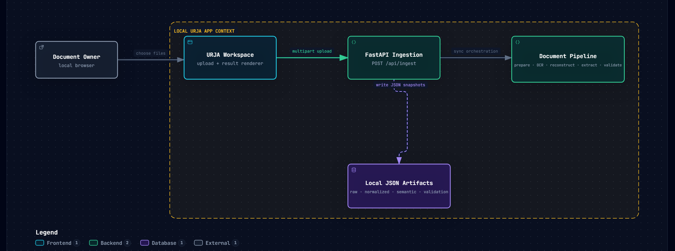
03 / SYSTEM ARCHITECTURE
A local processing path, with explicit file persistence
The API coordinates the current synchronous pass and writes inspectable JSON artifacts.
LOCAL APP CONTEXT
Filesystem output lives under data/documents/; the current API returns results after processing completes.
URJA / TECHNICAL OVERVIEW
04

Slide 5
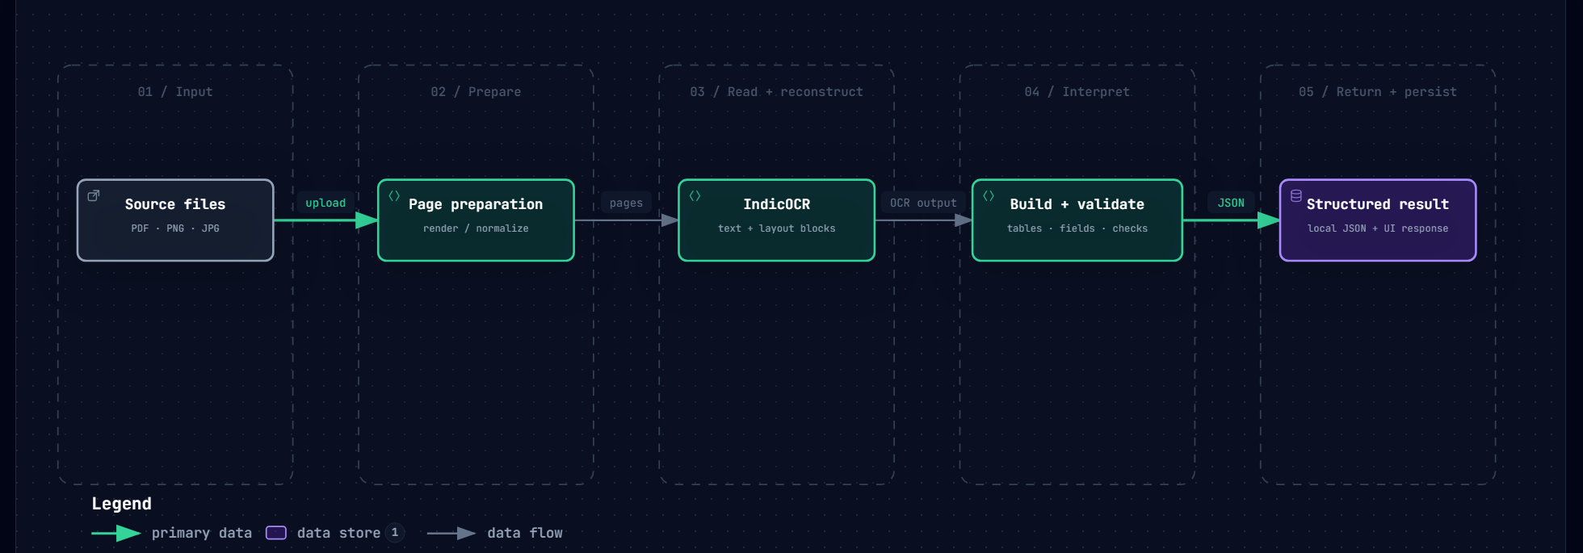
04 / PROCESSING PIPELINE
One ordered pass from uploaded files to dashboard data
PDFs become page images; the same per-page IndicOCR path handles uploaded images.
01 UPLOAD
02 PREPARE
03 OCR
04 RECONSTRUCT
05 EXTRACT
06 VALIDATE
07 SAVE JSON
08 RENDER
Semantic extraction and deterministic checks currently specialize in electricity bills. Other types retain generic document structure.
URJA / TECHNICAL OVERVIEW
05

Slide 6
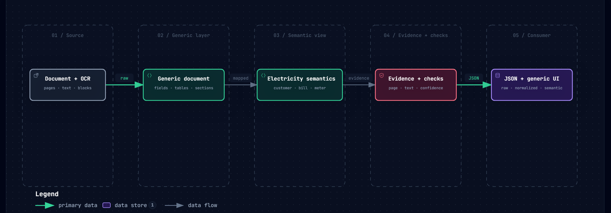
05 / OUTPUT MODEL
A document record carries more than extracted values
Generic OCR structure stays available alongside the current electricity semantic view.
IDENTITY
BILLING
USAGE
DOCUMENT
TRUST
provider · customer · account
dates · amounts · payment
meter · readings · history
tables · notes · notices
validation · field evidence
Gas and water semantic adapters are future work; they are not current specialized extractors.
URJA / TECHNICAL OVERVIEW
06

Slide 7
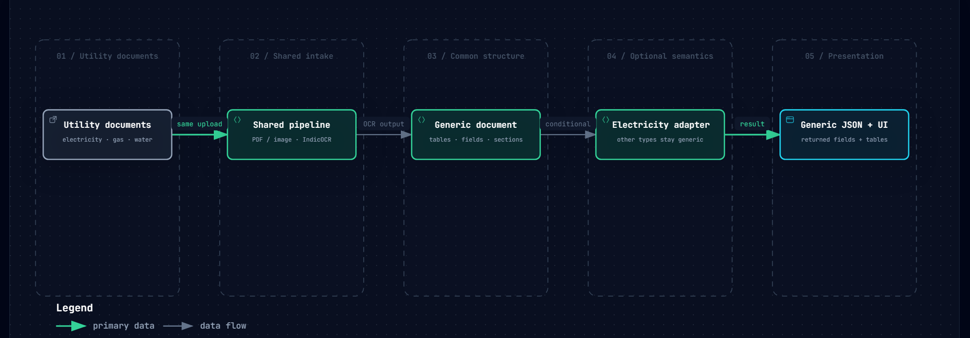
06 / EXTENDING BEYOND ONE BILL LAYOUT
One input path. Domain adapters grow by type.
Provider-specific layouts do not require provider-specific frontend pages.
CURRENT
Generic document reconstruction + electricity semantics
PLANNED
Gas / water domain mappings and broader provider coverage
Unsupported domains can retain generic OCR/document structure; specialized extraction is not implied.
URJA / TECHNICAL OVERVIEW
08

Slide 8
07 / DASHBOARD EXPERIENCE
A focused workspace, not an operations console
The browser shows a quiet indeterminate state while the current API performs its synchronous pass.
WORKING STATE
DOCUMENT RESULTS
COMPLETED
Processing your document
test_bill.pdf
Electricity bill · 4 pages
Sent to local processor
Processing locally
PROVIDER
ACCOUNT
CURRENT BILL
XXX…
••••••2778
₹XX.xx
No live page or stage telemetry is exposed by the API.
DUE DATE
USAGE
METER
17 Sep 20XX
XX.xx kWh
XX.33 → XX.28
No invented percentages or page counts.
INDETERMINATE BY DESIGN
DETECTED TABLES
11 OCR tables
6 usage periods
Validation: passed
Identity values masked for presentation.
URJA / TECHNICAL OVERVIEW
09

Slide 9
08 / STATUS & NEXT STEPS
A working prototype, with a clear expansion path
Current scope is useful and inspectable; broader utility coverage still needs domain work.
IMPLEMENTED NOW
NEXT
✓
PDF and image ingestion, with ordering and image grouping
→
Semantic adapters for gas, water and more providers
✓
Per-page IndicOCR and explicit OCR failure status
→
Broader schema review for cross-utility common fields
✓
Generic page, field, table, section and visual representation
→
Persisted document library and lifecycle management
✓
Electricity semantic adapter with candidate evidence
→
Streaming processing-stage and page progress
✓
Deterministic validation and local JSON artifacts
→
More provenance review and conflict-resolution UX
✓
Frontend summary, generic tables and technical JSON views
→
Historical usage analysis and production hardening
NEXT MILESTONE
Add the next domain adapter without changing the shared intake and rendering contract.
URJA / TECHNICAL OVERVIEW
10

