Slide 1
Teradata Training Program

Slide 2
Module 1
Teradata Overview
After completing this module, you will be able to:
  Describe the purpose of the Teradata product.
  Give a brief history of the product.
  Identify supported operating systems.
  List activities Teradata DBA’s never have to perform.
  Describe the Competitive Advantages of Teradata.

Slide 3
What is Teradata?
Teradata is a Relational Database Management
System (RDBMS):
  Designed to run the world’s largest commercial databases
  Preferred solution for enterprise data warehousing
  Open, UNIX-MP-RAS or NT-based system platforms
  Compliant with ANSI industry standards
  Runs on single (SMP) or multiple (MPP) nodes
  Database server to client applications throughout the enterprise
  Uses parallelism to manage terabytes of data
Win NT
Win 95
Teradata
DATABASE
IBM
Main-
frame
UNIX

Slide 4
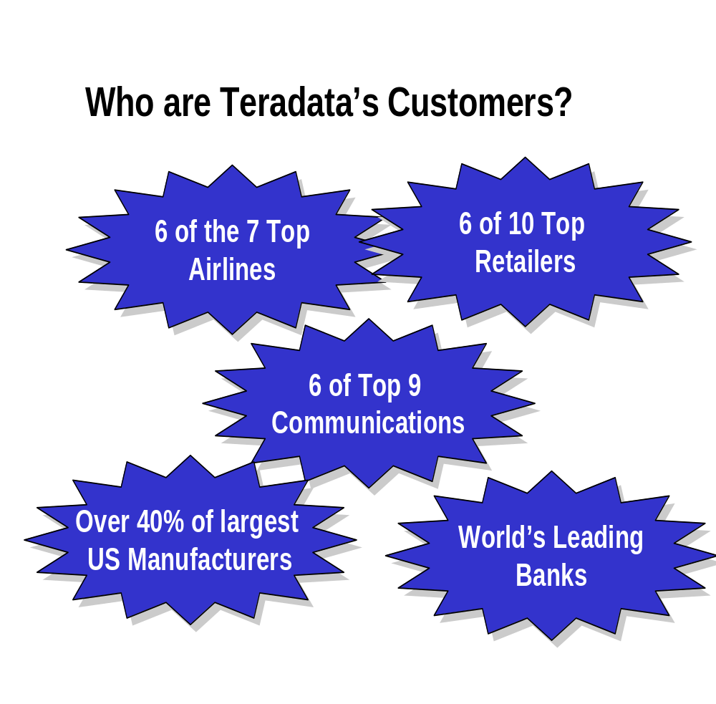

Slide 5
Teradata Competitive Advantages
Unlimited, Proven Scalability
Unlimited Parallelism - Parallel sorts/aggregations, temporary tables - “Shared-Nothing” architecture
Mature Optimizer - Complex queries, joins per query, ad-hoc processing
Model the Business - 3NF, robust view processing, star schema
Lowest TCO - ease of setup & maintenance, robust parallel utilities, no re-orgs, lowest disk to data ratio, robust expansion utility
High Availability - no single point of failure,
scalable data loading, parallel load utilities

Slide 6
Teradata—A Brief History
1979 Teradata Corp founded in Los Angeles, California.
Development begins on a massively parallel database
computer.
Teradata sells the first database computer DBC/1012 to Wells
Fargo Bank Of California.
1989 Teradata and NCR partner on next generation of DBC.
1990 First Terabyte system installed and in production.
1991 NCR is acquired by AT&T.
1992 Teradata is merged into AT&T / NCR.
1995 Teradata Version 2 for UNIX operating systems released.
1996 AT&T spins off NCR Corporation with Teradata product.
1997 Teradata database becomes industry leader in scalable
data warehousing.

Slide 7
The Value of Teradata
  Enormous capacity
    Billions of rows
    Terabytes of data
  High-performance parallel processing
  Single database server for multiple clients “Single Version of the Truth”
  Network and mainframe connectivity
  Industry standard access language (SQL)
  Fault tolerance at all levels of hardware and software
  Data integrity and reliability

Slide 8
Teradata Manageability
Things Teradata DBA’s NEVER Have to Do!
Reorganize data or index space
Pre-prepare data for loading (convert, sort, split, etc.)
‘Ensure that queries run in parallel
Design, implement and support partition schemes.
Write programs to figure how to divide data into partitions
Write or run programs to split the input data into partitions for loading
They know that if data doubles, the system can expand easily to accommodate it.
The workload for creating a table of 100,000 rows is the same as creating 1,000,000,000 rows!

Slide 9
Teradata and the Data Warehouse
  Complete data warehousing solution.
  Runs on single node systems for data mart requirements.
  Runs on multi-node systems for data warehouse requirements.
  Linear scalability allows for ease of expansion of systems.
  It can store hundreds of Terabytes of data on a single system.
  Allows customers to answer core business questions.
ATM
MVS
POS
Operational Data
Teradata
Data Warehouse
Cognos
Biz
Objects
Access Tools
Access
End Users

Slide 10
Module 2
Components and Architecture
After completing this module, you will be able to:
  Define a Node.
  List and describe the major components of the Teradata architecture.
  Describe the overall Teradata parallel architecture.
  Describe how Teradata functions with channel and network attached clients.

Slide 11
What is a Node?
Channel-Attached Systems
PC
W/S
CHANNEL
LAN
CHANNEL DRIVERS
GATEWAY
APPLICATION
APPLICATION
OR UTILITY
UNIX
PDE
PE
VPROC
PE
VPROC
BYNET DRIVER
AMP
VPROC
AMP
VPROC
AMP
VPROC
AMP
VPROC
Vdisk
Vdisk
Vdisk
Vdisk
Applications, the LAN gateway, and channel-driver software run as processes.
AMPs and PEs are virtual processors (vprocs) which run under the Parallel Database Extensions (PDE).
AMPs are associated with virtual disks (vdisks) via the disk array controller.
A single node is a Symmetric Multi-Processor (SMP)

Slide 12
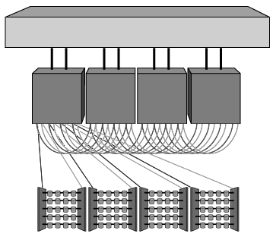
MPP System
BYNET
Nodes
Disk Arrays
  Multiple nodes may be configured to provide a Massively Parallel Processing (MPP) system.
  A physical message-passing layer called the BYNET is needed to interconnect multiple nodes.
  Teradata is linearly expandable—as your database grows, additional nodes may be added.
  The BYNET can support 512 nodes.
  A single system can support a maximum of 16,384 vprocs.
  The maximum number of vprocs per node can be as high as 128.

Slide 13
Major Components of a Teradata System
Node
Parsing Engine(s) (PEs)
BYNET
AMP
AMP
AMP
AMP
Disk Storage
Disk Storage
Disk Storage
Disk Storage

Slide 14
BYNET
SQL Request
Answer Set Response
Parsing Engine
BYNET
AMP
AMP
AMP
AMP
Dual redundant, fault-tolerant bi-directional interconnect network that enables:
Automatic load balancing of message traffic.
Automatic reconfiguration after fault detection.
Scalable bandwidth as nodes are added.
The BYNET is responsible for:
  Broadcast, multicast, and point-to-point communications between nodes and virtual processors.
  Merging answer sets back to the PE.
  Making Teradata parallelism possible.

Slide 15
The Parsing Engine
SQL Request
Answer Set Response
Parsing Engine
Session Control
Parser
Optimizer
Dispatcher
BYNET
AMP
AMP
AMP
AMP
The Parsing Engine is responsible for:
  Managing individual sessions (up to 120)
  Parsing and optimizing your SQL requests
  Dispatching the optimized plan to the AMPs
  ASCII / EBCDIC conversion (if necessary)
  Sending the answer set response back to the requesting client

Slide 16
The Access Module Processor (AMP)
SQL Request
Answer Set Response
Parsing Engine
BYNET
AMP
AMP
AMP
AMP
AMPs are responsible for:
  Storing and retrieving rows to and from the disks
  Lock management
  Sorting rows and Aggregating columns
  Join processing
  Output conversion and formatting
  Creating answer sets for clients
  Disk space management and Accounting
  Special utility protocols
  Recovery processing
  AMPs perform all tasks in parallel- Teradata’s
  “Shared-Nothing” Architecture

Slide 17
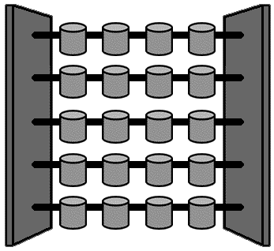
Disk Arrays
AMP 1
vproc
AMP 2
vproc
AMP 3
vproc
AMP 4
vproc
Rank1 Rank2 Rank3 Rank4
  Each AMP vproc is assigned to a vdisk.
  A vdisk may contain 119 GB of disk space.

Slide 18
Teradata Functional Overview
Channel-Attached System
Network-Attached System
Client Application
Client Applications
BO
Microstrategy
BTEQ
Client Application
CLI
CLI
Channel
MTDP
TDP
MOSI
Teradata Node
LAN
TPA
PDE
OS
UN
IX/
NT
Channel Driver
Teradata Gateway
Parsing Engine
Parsing Engine
BYNET
AMP
AMP
AMP
AMP

Slide 19
Teradata Functional Overview (contd.)
CLI (Call Level Interface)
Library of routines for blocking/unblocking requests and responses to/from the RDBMS
Performs logon and logoff functions
TDP (Teradata Director Program)
Session balancing across multiple PEs
Failure notification (application failure, Teradata restart)
Logging, verification, recovery, restart, security
MTDP (Micro Teradata Director Program)
Performs many of the TDP functions including session management but not session balancing
MOSI (Micro Operating System Interface)
Provides operating system and network protocol independent interface

Slide 20
Operating System (UNIX MP-RAS or Windows 2000)
PDE and BYNET S/W (Message Passing Layer)
PE vproc
PE vproc
AMP
vproc
AMP
vproc
AMP
vproc
AMP
vproc
AMP
vproc
AMP
vproc
AMP
vproc
AMP
vproc
AMP
vproc
AMP
vproc
Vdisk
Vdisk
Vdisk
Vdisk
Vdisk
Vdisk
Vdisk
Vdisk
Vdisk
Vdisk
Teradata RDBMS V2R5 executes on UNIX MP-RAS or Windows 2000.
Uses general purpose SMP/MPP hardware.
Virtual AMPs and PEs (Vprocs) replace hardware AMPs and PEs.
“Shared Nothing” Architecture - each AMP has its own memory and manages its own disk space.
Parallel Database Extensions (32 bit) replaces TOS (16 bit). PDE is unique per OS.
Can run DSS, OLTP, OLCP, or OLAP applications.
Major performance and feature enhancements over V1.

Slide 21
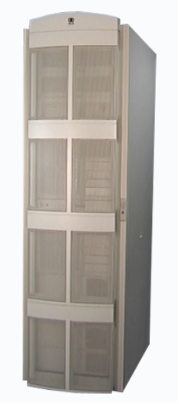
SMC
SMC - 2U
BYNET V2
NCR uses industry standard rack-based cabinets.
Shown are examples of a Processor rack and a Storage or disk array rack.
BYNET V2
SMPxxx-4
6841-2456
SMPxxx-5
SMPxxx-6
SMPxxx-7
6841-2456
with door
NCR 5380
NCR 6841

Slide 22
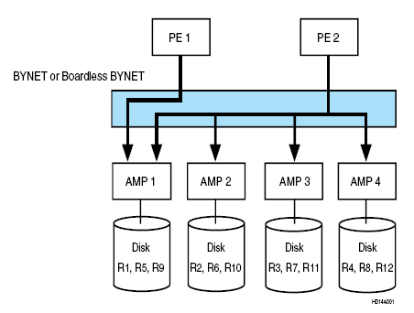
Example: SQL Statement
1. SELECT * FROM Table_01 WHERE AcctNo = 129317 ;
2. SELECT * FROM Table_01 WHERE AcctBal > 1000 ;
In this example (assuming that ‘AcctNo’ column is the UPI for Table_01) :
  • PEs 1 and 2 receive requests 1 and 2.
  • The data for account 129317 is contained in table row R9 and stored on AMP1.
  • Information about all account balances is distributed evenly among the disks of all four AMPs.

Slide 23
Teradata Parallelism
PE
PE
PE
Session A
Session B
Session C
Session D
Session E
Session F
BYNET
AMP 1
AMP 2
AMP 3
AMP 4
Task 1
Task 2
Task 3
.
.
80
Task 1
Task 2
Task 3
.
.
80
Task 1
Task 2
Task 3
.
.
80
Task 1
Task 2
Task 3
.
.
80
Each PE can handle up to 120 sessions in parallel.
Each Session can handle multiple REQUESTS.
The BYNET can handle all message activity in parallel.
Each AMP can perform up to 80 tasks in parallel.
All AMPs work in parallel to service any request.
Each AMP can work on several requests in parallel.
TERADATA PERFORMS ALL TASKS IN PARALLEL TO PROVIDE EXCEPTIONAL PERFORMANCE!

Slide 24
Linear Growth and Expandability
Parsing
Parsing
Engine
Parsing
Engine
Engine
SESSIONS
AMP
AMP
AMP
PARALLEL PROCESSING
Disk
Space
Disk
Space
Disk
Space
DATA
Node
Node
Node
NODE
Components may be added as requirements grow without Loss of Performance
Double the number of AMPs - number of users remains the same - performance will double.
Double the number of AMPs and double the number of users - performance will stay the same.
Teradata is linearly expandable

Slide 25
Module 3
Accessing Teradata Objects
After completing this module, you will be able to:
  List and define four Teradata database objects: tables, views, macros, and triggers.
  Describe the function of the Data Dictionary.
  Explain the use of SQL for accessing database objects.
  List the commands used to find out information about database objects.
  Define the commands used to manipulate macros.

Slide 26
Teradata Objects
  Five fundamental objects may be found in a Teradata database:
    Tables — rows and columns of data
    Views — predefined subsets of existing tables
    Macros — predefined, stored SQL statements
    Triggers — event driven procedures
    Stored Procedures
  These objects are created, maintained, and deleted using Structured Query Language (SQL).
  Object definitions are stored in the Data Dictionary (DD).
DD
DEFINITIONS
OF ALL
DATABASE
OBJECTS
DATABASE
TABLE 1
TABLE 2
TABLE 3
VIEW 1
VIEW 2
VIEW 3
MACRO 1
MACRO 2
MACRO 3
TRIGGER 1
TRIGGER 2
TRIGGER 1
SP 3
SP 2
SP 3

Slide 27
The Data Dictionary (DD)
The Data Dictionary (DD)
  Is an integrated set of system tables.
  Contains definitions of and information about all objects in the system.
  Is entirely maintained by the RDBMS.
  Is “data about the data” or “metadata.”
  Is distributed across all AMPs.
  Is accessed via Teradata-supplied views.
Examples of views:
  DBC.Tables—information about all tables
  DBC.Users—information about all users
  DBC.AllRights—information about access rights
  DBC.DiskSpace—info about space utilization

Slide 28
Structured Query Language (SQL)
SQL is:
  4th-generation language used to access the database
  non-procedural (no IF, GO TO, OPEN, PERFORM)
  set-oriented
SQL consists of:
  Data Definition Language (DDL)
    Defines database objects (tables, users, views, macros)
      CREATE - DROP - ALTER
  Data Manipulation Language (DML)
    Manipulates rows and data values
      INSERT - SELECT - UPDATE - DELETE
  Data Control Language (DCL)
    Grants and revokes access rights
      GRANT and REVOKE
  Teradata Extensions to SQL
      HELP - SHOW - EXPLAIN

Slide 29
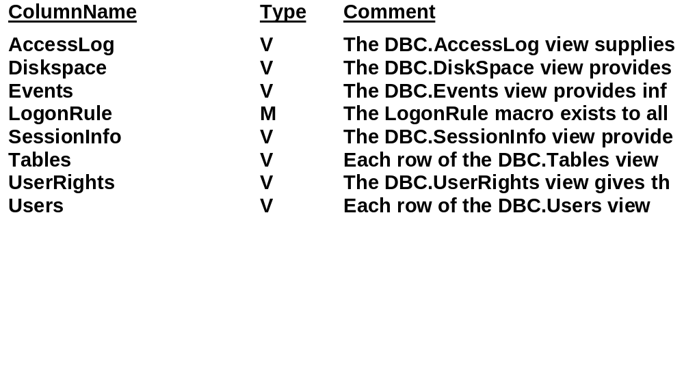
Getting Information about Objects
HELP DATABASE DBC;
SHOW TABLE employee;
CREATE SET TABLE CUSTOMER_SERVICE.employee ,FALLBACK ,
NO BEFORE JOURNAL,
NO AFTER JOURNAL
(
employee_number INTEGER,
manager_employee_number INTEGER,
department_number INTEGER,
job_code INTEGER,
last_name CHAR(20) NOT CASESPECIFIC NOT NULL,
first_name VARCHAR(30) NOT CASESPECIFIC NOT NULL,
hire_date DATE NOT NULL,
birthdate DATE NOT NULL,
salary_amount DECIMAL(10,2) NOT NULL)
UNIQUE PRIMARY INDEX ( employee_number );

Slide 30
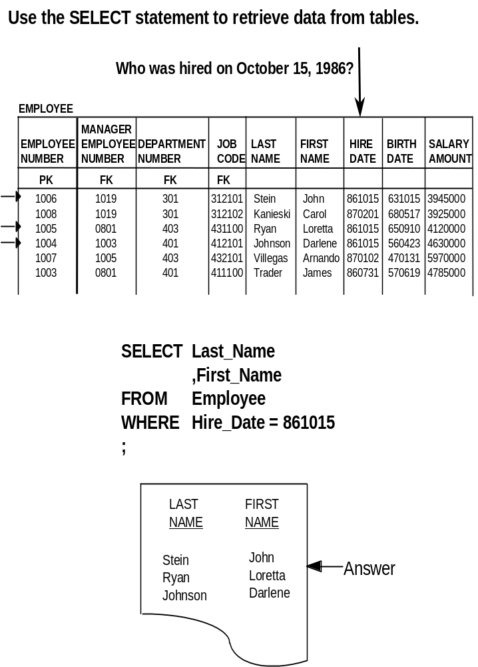
The SELECT Statement

Slide 31
The Join Operation
A join operation is used when the SQL query requires
information from multiple tables.
Who works in Research and Development?
EMPLOYEE
MANAGER
EMPLOYEE EMPLOYEE DEPARTMENT JOB LAST FIRST HIRE BIRTH SALARY
NUMBER NUMBER NUMBER CODE NAME NAME DATE DATE AMOUNT
PK FK FK FK
1006 1019 301 312101 Stein John 861015 631015 3945000
1008 1019 301 312102 Kanieski Carol 870201 680517 3925000
1005 0801 403 431100 Ryan Loretta 861015 650910 4120000
1004 1003 401 412101 Johnson Darlene 861015 560423 4630000
1007 1005 403 432101 Villegas Arnando 870102 470131 5970000
1003 0801 401 411100 Trader James 860731 570619 4785000
DEPARTMENT
MANAGER
DEPARTMENT DEPARTMENT BUDGET EMPLOYEE
NUMBER NAME AMOUNT NUMBER
PK FK
501 marketing sales 80050000 1017
301 research & development 46560000 1019
302 product planning 22600000 1016
403 education 93200000 1005
402 software support 30800000 1011
401 customer support 98230000 1003
201 technical operations 29380000 1025
FIRST
LAST
NAME
NAME
John
Carol
Stein
Kanieski
Answer

Slide 32
Views
  Pre-defined subsets of existing tables
  Consist of specified columns and/or rows from the table(s)
  Act as a window into an underlying table
  Have no data of their own
Single table view
  Subset of columns from one table
  Allows users to read and update a subset of the underlying table
Employee (TABLE)
MANAGER
EMPLOYEE EMPLOYEE DEPARTMENT JOB LAST FIRST HIRE BIRTH SALARY
NUMBER NUMBER NUMBER CODE NAME NAME DATE DATE AMOUNT
PK FK FK FK
1006 1019 301 312101 Stein John 861015 631015 3945000
1008 1019 301 312102 Kanieski Carol 870201 680517 3925000
1005 0801 403 431100 Ryan Loretta 861015 650910 4120000
1004 1003 401 412101 Johnson Darlene 861015 560423 4630000
1007 1005 403 432101 Villegas Arnando 870102 470131 5970000
1003 0801 401 411100 Trader James 860731 570619 4785000
Emp_403 (VIEW)
EMP NO DEPT NO LAST NAME FIRST NAME HIRE DATE
1005 403 Villegas Arnando 870102
801 403 Ryan Loretta 861015

Slide 33
Multi-table Views
  A multi-table view allows users to access data from multiple tables as if it were in a single table.
  Multi-table views are also called join views.
  Join views are used for reading only, not updating.
Employee (TABLE)
MANAGER
EMPLOYEE EMPLOYEE DEPARTMENT JOB LAST FIRST HIRE BIRTH SALARY
NUMBER NUMBER NUMBER CODE NAME NAME DATE DATE AMOUNT
PK FK FK FK
1006 1019 301 312101 Stein John 861015 631015 3945000
1008 1019 301 312102 Kanieski Carol 870201 680517 3925000
1005 0801 403 431100 Ryan Loretta 861015 650910 4120000
1004 1003 401 412101 Johnson Darlene 861015 560423 4630000
1007 1005 403 432101 Villegas Arnando 870102 470131 5970000
1003 0801 401 411100 Trader James 860731 570619 4785000
Department (TABLE)
MANAGER
DEPARTMENT DEPARTMENT BUDGET EMPLOYEE
NUMBER NAME AMOUNT NUMBER
PK FK
501 marketing sales 80050000 1017
301 research & development 46560000 1019
302 product planning 22600000 1016
403 education 93200000 1005
402 software support 30800000 1011
401 customer support 98230000 1003
201 technical operations 29380000 1025
EmpDept (VIEW)
LAST DEPARTMENT
NAME NAME
Stein research & development
Kanieski research & development
Ryan education
Johnson customer support
Villegas education
Trader customer support

Slide 34
Macros
  A macro is a predefined set of SQL statements.
  You can create macros for frequently occurring queries or sets of operations.
Features and Benefits
  Source code that is stored in the database.
  Can be modified and executed at will.
  Re-optimized at execution time.
  Can be executed interactively or by batch applications.
  Executed by a single EXECUTE command.
  Can accept user-provided parameter values.
  Simplify and control access to the system.
  Enhance system security.
  Reduce LAN/Channel traffic because they reduce the size of the query transmitted from the client application.
  Available to all connected hosts because they are stored in the Teradata DD.
Result
To create macro:
  CREATE MACRO customer_list AS
  (SELECT customer_name FROM customer;);
To execute macro:
  EXEC customer_list;
Customer_Name
ABC Corp.
First National Bank
Zundell’s Retail
Food 4 Less
:
:

Slide 35
Macro Related Commands
REPLACE MACRO macroname Apply changes to a
AS macro or create a new
(. . . ); macro.
DROP MACRO macroname; Remove a macro definition from the DD.
CREATE MACRO birthday_list AS
(SELECT last_name
,first_name
,birthdate
FROM employee
WHERE department_number = 201
ORDER BY birthdate; ) ;
Change "CREATE" to "REPLACE" and include
the minor sort.
REPLACE MACRO birthday_list AS
(SELECT last_name
,first_name
,birthdate
FROM employee
WHERE department_number = 201
ORDER BY birthdate
,last_name; ) ;

Slide 36
The EXPLAIN Facility
The EXPLAIN modifier preceding an SQL statement generates an English translation of the parser’s plan.
It is fully parsed and optimized but not executed.
EXPLAIN returns:
  Text showing how a statement will be processed (a plan).
  An estimate of how many rows will be involved.
  A relative cost of the request (in units of time).
This information is useful for:
  Predicting row counts.
  Predicting performance.
  Testing queries before production.
  Analyzing various approaches to a problem.
EXPLAIN SELECT last_name, department_number
FROM employee;
Explanation (partial):
3) We do an all-AMPs RETRIEVE step from CUSTOMER_SERVICE.employee
by way of an all-rows scan with no residual conditions into Spool 1,
which is built locally on the AMPs. The size of Spool 1 is
estimated to be 24 rows. The estimated time for this step is 0.15
seconds

Slide 37
Module 4
Creating a Teradata Database
After completing this module, you will be able to:
  Distinguish between a Teradata Database and a Teradata User.
  Define Perm Space and explain how it is used.
  Define Spool Space and its use.
  Define Temp Space and its use.
  Describe the hierarchy of objects in a Teradata system.

Slide 38
A Teradata Database
A Teradata database is a defined, logical repository for:
  Tables (requires perm space)
  Views (uses no perm space)
  Macros (uses no perm space)
Space limits may be specified for a database:
  Perm Space—max amount of space available for tables
  Spool Space—max amount of work space available for requests
  Temp Space —used for temporary tables
A database with no perm space can have views and macros but no tables.
A Teradata database is created with the CREATE DATABASE command.
Example
CREATE DATABASE new_db FROM existing_db AS
PERMANENT = 20000000
,SPOOL = 50000000
,TEMP = 20000000
;
‘New_db’ is owned by ‘existing_db.’
A database is empty until objects are created within it.

Slide 39
A Teradata User
  A Teradata user is a database with an assigned password.
  A Teradata user may also own tables, views, macros,and triggers but users with no permspace may not own tables.
  A user may logon to Teradata and access objects within:
    Itself
    Other databases for which it has access rights
  A user is created with the CREATE USER command.
Example
CREATE USER new_user FROM existing_user AS
PERMANENT = 10000000
,PASSWORD = ‘lucky_day’
,SPOOL = 20000000
,TEMP = 20000000
;
‘New_user’ is owned by ‘existing_user.’
A user is empty until objects are created within it.

Slide 40
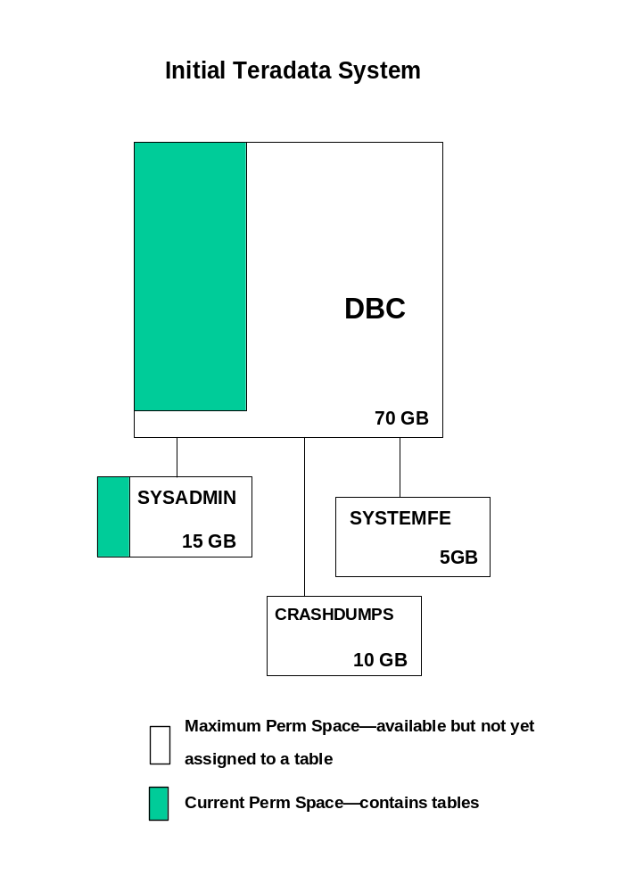

Slide 41
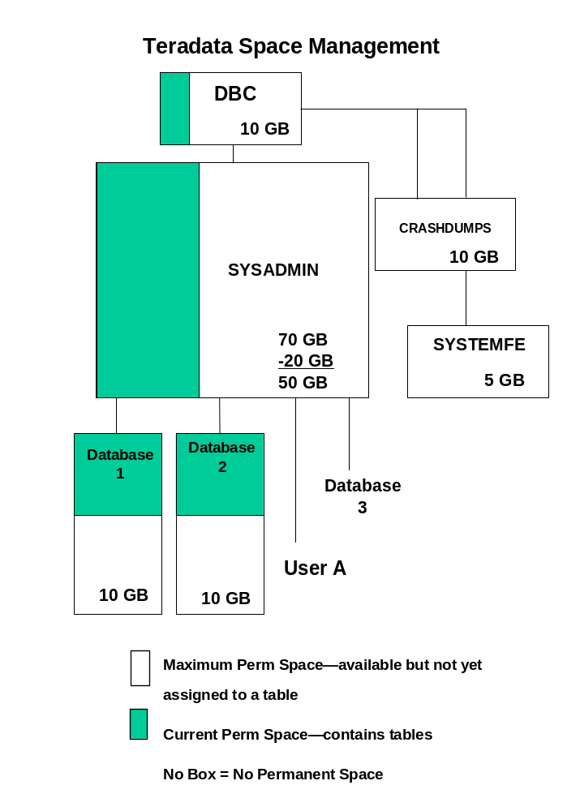

Slide 42
The Hierarchy of Databases
User DBC
User SYSDBA
User A
Database 3
Database 1
Database 2
User D
User B
User C
Maximum Perm Space—available but not yet assigned to a table
Current Perm Space—contains tables
No Perm Space—may not contain tables
No Box
A new database or user must be created from an existing database or user.
All Perm space specifications are subtracted from the creator.
Perm space is a zero-sum game—the total of all Perm Space
allocations must equal the total amount of disk space available.
Perm space is used for tables only.
Perm space currently unassigned is available to be used as Spool or Temp.

Slide 43
Creating Tables
Creating a table requires:
  Defining columns
  Assigning a primary index
  Optional assignment of secondary indexes
CREATE TABLE Employee
(Employee_Number INTEGER NOT NULL
,Last_Name CHAR(20) NOT NULL
,First_Name VARCHAR(20)
,Salary_Amount DECIMAL(10,2)
,Department_Number SMALLINT
,Job_Code CHAR(3))
UNIQUE PRIMARY INDEX (Employee_Number)
INDEX (Last_Name)
;
Primary ----->
Secondary -->
Database objects may be created or dropped as needed.
CREATE
Tables
Views
DROP
Macros
Secondary indexes may be:
Created at table creation
Created after table creation
Dropped after table creation
CREATE
INDEX (secondary only)
DROP

Slide 44
Module 5
Storing and Accessing Data Rows
After completing this module, you will be able to:
  Explain the purpose of the Primary Index.
  Distinguish between Primary Index and Primary Key.
  State the reasons for selecting a UPI vs. a NUPI.
  Describe the tasks that Teradata Database Administrators never need to perform.

Slide 45
How Does Teradata Store Rows?
  Teradata uses hash partitioning and distribution to randomly and evenly distribute data across all AMPs.
  The rows of every table are distributed among all AMPs - and ideally will be evenly distributed among all AMPs.
  Each AMP is responsible for a subset of the rows of each table.
  Evenly distributed tables result in evenly distributed workloads.
  The data is not placed in any particular order
  The benefits of unordered data include:
  No maintenance needed to preserve order, and
  It is independent of any query being submitted.
  The benefits of automatic data placement include:
  Distribution is the same regardless of data volume
  Distribution is based on row content, not data demographics

Slide 46

How Do Other Databases Store Rows?
  Many use range distribution
  Creates intensive maintenance for DBA
  DBA’s must consider:
    How to partition the data
    How large to make the partitions
    Where is there data contention
    How are users accessing the data
Placing all data into a single partition creates bottlenecks for all queries against that data.
“Time to
REORG again!”
DBA
Teradata DBAs never need to do costly reorganizations!

Slide 47
Primary Indexes
The mechanism used to assign a row to an AMP
A table must have a Primary Index
The Primary Index cannot be changed
UPI
If the index choice of column(s) is unique, we call this a UPI (Unique Primary Index).
A UPI choice will result in even distribution of the rows of the table across all AMPs.
UPI’s guarantee even data distribution
and eliminate duplicate row checking.
NUPI
If the index choice of column(s) isn’t unique, we call this a NUPI (Non-Unique Primary Index).
A NUPI choice will result in even distribution of the rows of the table proportional to the degree of uniqueness of the index.
Why would you choose an Index that is different from the Primary Key?
Join performance
Known access paths

Slide 48
Creating a Primary Index
A Primary Index is defined at table creation.
It may consist of a single column or a combination of up to 16 columns.
UPI
CREATE TABLE sample_1
(col_x INT
,col_y INT
,col_z INT)
Unique PRIMARY INDEX (col_x);
NUPI
CREATE TABLE sample_2
(col_x INT
,col_y INT
,col_z INT)
PRIMARY INDEX (col_x);
Note: Changing the Primary Index requires dropping and recreating the table.

Slide 49
Primary Index Values
The value of the Primary Index for a specific row
determines its AMP assignment.
This is done using the hashing algorithm.
PE
PI Value
Hashing
algorithm
Row assignment
Row access
AMP
AMP
AMP
Accessing the row by its Primary Index value is:
Always a one-AMP operation
The most efficient way to access a row
Other table access techniques:
Secondary index access
Full table scans

Slide 50
Accessing Via a Unique Primary Index
CUSTOMER table
CREATE TABLE Customer
(Cust INT
,Name CHAR(10)
,Phone CHAR(8) )
UNIQUE PRIMARY INDEX (Cust);
Cust
Name
Phone
PK
UPI
37 White 555-4444
98 Brown 333-9999
74 Smith 555-6666
95 Peters 555-7777
27 Jones 222-8888
56 Smith 555-7777
45 Adams 444-6666
84 Rice 666-5555
49 Smith 111-6666
51 Marsh 888-2222
31 Adams 111-2222
62 Black 444-5555
12 Young 777-4444
77 Jones 777-6666
72 Adams 666-7777
40 Smith 222-3333
SELECT * FROM customer WHERE cust = 45;
PE
UPI = 45
Hashing
Algorithm
BYNET
AMP 1
AMP 2
AMP 3
AMP 4
Base Table
Base Table
Base Table
Base Table
Cust
Name
Phone
Cust
Name
Phone
Cust
Name
Phone
Cust
Name
Phone
UPI
111-6666
UPI
444-5555
UPI
777-4444
UPI
222-8888
49
Smith
444-6666
62
Black
666-5555
12
Young
555-6666
27
Jones
666-7777
45
Adams
555-7777
84
Rice
555-7777
74
Smith
333-9999
72
Adams
222-3333
56
Smith
888-2222
95
Peters
777-6666
98
Brown
111-2222
40
Smith
51
Marsh
77
Jones
31
Adams
37
White
555-4444

Slide 51
Accessing Via a Non-Unique Primary Index
CREATE TABLE Customer
(Cust INT
,Name CHAR(10)
,Phone CHAR(8) )
PRIMARY INDEX (Phone);
CUSTOMER table
Cust
Name
Phone
PK
NUPI
37 White 555-4444
98 Brown 333-9999
74 Smith 555-6666
95 Peters 555-7777
27 Jones 222-8888
56 Smith 555-7777
45 Adams 444-6666
84 Rice 666-5555
49 Smith 111-6666
51 Marsh 888-2222
31 Adams 111-2222
62 Black 444-5555
12 Young 777-4444
77 Jones 777-6666
72 Adams 666-7777
40 Smith 222-3333
SELECT * FROM customer WHERE phone = ‘555-7777’;
PE
PI = ‘555-7777’
Hashing
Algorithm
BYNET
AMP 1
AMP 2
AMP 3
AMP 4
Base Table
Base Table
Base Table
Base Table
Cust
Name
Phone
Cust
Name
Phone
Cust
Name
Phone
Cust
Name
Phone
NUPI
NUPI
NUPI
NUPI
37
White
555-4444
45
Adams
444-6666
49
Smith
111-6666
77
Jones
777-6666
84
Rice
666-5555
98
Brown
333-9999
12
Young
777-4444
95
Peters
555-7777
31
Adams
111-2222
72
Adams
666-7777
27
Jones
222-8888
56
Smith
555-7777
40
Smith
222-3333
74
Smith
555-6666
62
Black
444-5555
51
Marsh
888-2222

Slide 52
Primary Keys and Primary Indexes
Indexes are conceptually different from keys:
  A PK is a relational modeling convention which allows each row to be uniquely identified.
  A PI is a Teradata convention which determines how the row will be stored and accessed.
Primary Key
Logical concept of data modeling
Teradata doesn’t need to recognize
No limit on column numbers
Documented in data model
(Optional in CREATE TABLE)
Must be unique
Uniquely identifies each row
Values should not change
May not be NULL—requires a value
Does not imply an access path
Chosen for logical correctness
Primary Index
Physical mechanism for access and
storage
Each table must have exactly one
16-column limit
Defined in CREATE TABLE statement
May be unique or non-unique
Used to place and locate each row
on an AMP
Values may be changed (Del+ Ins)
May be NULL
Defines most efficient access path
Chosen for physical performance
  A significant percentage of tables may use the same columns for both the PK and the PI.
  A well-designed database will use a PI that is different from the PK for some tables.

Slide 53
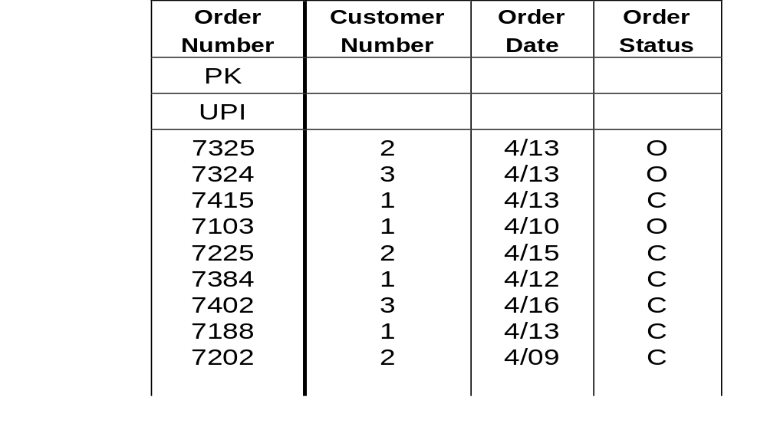
Row Distribution Using a UPI
Order
AMP 1
AMP 2
AMP 3
AMP 4
7202
2
4/09
C
7325
2
4/13
C
7188
1
4/13
C
7103
1
4/10
C
7225
2
4/15
C
7324
3
4/13
C
7415
1
4/13
C
7402
3
4/16
C
7384
1
4/12
C
  The PK column(s) will often be used as a UPI.
  PI values for Order_Number are known to be unique
  (it’s a PK).
  Teradata will distribute different index values evenly across all AMPs.
  Resulting row distribution among AMPs is uniform.

Slide 54
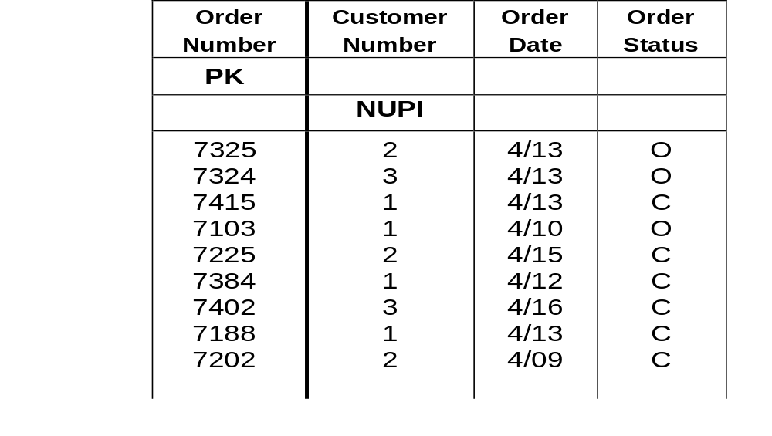
Row Distribution Using a NUPI
Order
AMP 1
AMP 2
AMP 3
AMP 4
7325
2
4/13
0
7384
1
4/12
C
7402
3
4/16
C
7202
2
4/09
C
7103
1
4/10
C
7225
2
4/15
C
7415
1
4/13
C
7324
3
4/13
0
7188
1
4/13
C
  Customer_Number may be the preferred access column for ORDER table, thus a good index candidate.
  Values for Customer_Number are non-unique and therefore a NUPI.
  Rows with the same PI value distribute to the same AMP causing row distribution to be less uniform or skewed.

Slide 55
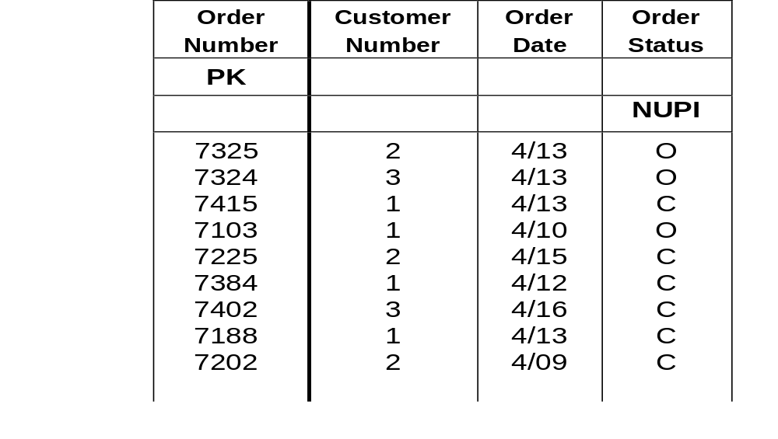
Row Distribution Using a Highly NUPI
Order
AMP 1
AMP 2
AMP 3
AMP 4
7402
3
4/16
C
7103
1
4/10
O
7202
2
4/09
C
7324
3
4/13
0
7225
2
4/15
C
7325
7325
2
4/13
0
7415
1
4/13
C
2
4/13
0
7188
1
4/13
C
7384
1
4/12
C
  Values for Order_Status are highly non-unique, and therefore, it is a NUPI.
  Only two values exist, so only two AMPs will ever be used for this table.
  This table will not perform well in parallel operations.
  Highly non-unique columns are poor PI choices.
  The degree of uniqueness is critical to efficiency.

Slide 56
Module 6
Primary Index Mechanics
After completing this module, you will be able to:
  Explain the roles of the hashing algorithm and hash map in locating rows.
  Explain the makeup of the Row-ID and its role in row storage.
  Describe the sequence of events for locating a row given its PI value.

Slide 57
Hashing Primary Index Values
Primary Index value = 25
Parsing Engine
Hashing Algorithm
Row Hash
Bucket #
Hash Map
Message Passing Layer
AMP
AMP
AMP
AMP
25
PI value
Hashing
Algorithm
Row Hash/Bucket #
Bucket #
Message
Passing Layer
Target AMP
Hash Map

Slide 58
Why is Automatic Distribution Good?
No Key Sequence
No user defined order
Ease of Joining
Rows with high affinity are stored on same node
Reduces inter-connect traffic
Simplicity of Set-up
The only effort required for Teradata hashing is
selection of the column(s) that comprise the Primary Index
TERADATA’S AUTOMATIC HASH DISTRIBUTION ELIMINATES COSTLY DATA MAINTENANCE TASKS!

Slide 59
Hashing Down To The AMPs
Index value(s)
{
The hashing algorithm is designed to
ensure even distribution of unique
values across all AMPs.
Hashing Algorithm
Different hashing algorithms are used
for different international character sets.
{
Row Hash
DSW #
A row hash is the 32-bit result of
applying a hashing algorithm to an
index value.
{
Hash Map
A hash map is uniquely configured for each system.
It is an array which associates
DSW numbers with specific AMPs.
{
Two systems with the same number of
AMPs will have the same hash map.
AMP #
Changing the number of AMPs in a system
requires a change to the hash map.

Slide 60
A Hashing Example
Order
SELECT * FROM order
WHERE order_number = 7225;
7225
Hashing Algorithm
32 bit Row Hash
DSW #
Remaining 16 bits
0000 0000 0001 1010
1100 0111 0101 1011
0
0
1
A
(Hexadecimal)

Slide 61
The Hash Map
7225
Hashing Algorithm
32 bit Row Hash
DSW #
Remaining16 bits
0000 0000 0001 1010
1100 0111 0101 1011
V V V V
0 0 1 A
Bucket Number
(Hexadecimal)
HASH MAP
0 1 2 3 4 5 6 7 8 9 A B C D E F
000
0
1
0
2
0
3
0
4
0
5
0
6
0
7
0
8
0
1
0
2
0
3
0
4
0
5
0
6
0
7
0
8
001
0
1
0
2
0
3
0
4
0
5
0
6
0
7
0
8
0
1
0
2
0
3
0
4
0
5
0
6
0
7
0
8
0
1
0
2
0
3
0
4
0
5
0
6
0
7
0
8
0
1
0
2
0
3
0
4
0
5
0
6
0
7
0
002
8
0
1
0
2
0
3
0
4
0
5
0
6
0
7
0
8
0
1
0
2
0
3
0
4
0
5
0
6
0
7
0
003
8
0
1
0
2
0
3
0
4
0
5
0
6
0
7
0
8
0
1
0
2
0
3
0
4
0
5
0
6
0
7
0
004
8
005
0
1
0
2
0
3
0
4
0
5
0
6
0
7
0
8
0
1
0
2
0
3
0
4
0
5
0
6
0
7
0
8
AMP 1
AMP 2
AMP 3
AMP 8
7225 2 4/13 O

Slide 62
Identifying Rows
A row hash is not adequate to uniquely identify a row.
  Consideration #1
    A Row Hash = 32 bits = 4.2 billion possible values.
    Because there is an infinite number of possible values, some values will have to share the same row hash.
1254
7769
Data values in
Hash Algorithm
22936
22936
Hash Synonyms
  Consideration #2
    A primary index may be non-unique (NUPI).
    Different rows will have the same PI value and thus the same row hash.
  Conclusion
    A row hash is not adequate to uniquely identify a row.
(John)
Smith
(Dave)
Smith
NUPI Duplicates
Hash Algorithm
64758
64758
Row hashes out

Slide 63
The Row-ID
To uniquely identify a row, we add a 32-bit uniqueness value.
  The combined row hash and uniqueness value is called a Row-ID.
Row-ID
Row Hash
(32 bits)
Uniqueness Id
(32 bits)
Each stored row has a Row-ID as a prefix.
Row-ID Row Data
Rows are logically maintained in Row-ID
sequence.
Row-ID
Row Data
Row
Hash
Unique
Id
EmpNo LastNm FirstNm
5032 0001 1018 Reynolds Jane
5032 0002 1020 Davidson Evan
5032 0003 1031 Green Jason 5033 0001 1014 Jacobs Paul
5034 0001 1012 Chevas Jose
5034 0002 1021 Carnet Jean
: : : : :

Slide 64
Module 7
Secondary Indexes and Table Scans
After completing this module, you will be able to:
  Define secondary indexes.
  Distinguish between the implementation of unique and non-unique secondary indexes.
  Define full table scans and describe their causes.
  Describe the operation of a full-table scan in a parallel environment.

Slide 65
Secondary Indexes
There are three general ways to access a table:
Primary index access (one-AMP access)
Secondary index access (two-or all-AMP access)
Full Table Scan (all-AMP access)
  A secondary index is an alternate path to the rows of a table.
  A table can have from 0 to 32 secondary indexes.
  Secondary indexes:
    Do not affect table distribution.
    Add overhead, both in terms of disk space and maintenance.
    May be added or dropped dynamically as needed.
    Are chosen to improve table performance.

Slide 66
Choosing a Secondary Index
A secondary index may be defined:
At table creation (CREATE TABLE)
Following table creation (CREATE INDEX)
Using up to 16 columns
USI
If the index choice of column(s) is unique, it is called a USI (unique secondary index).
Accessing a row via a USI typically requires 2 AMPs.
NUSI
If the index choice of column(s) is non-unique, it is called a NUSI (non-unique secondary index).
Accessing a row via a NUSI requires all AMPs.
USI
NUSI
CREATE UNIQUE INDEX (employee-number) on employee
CREATE INDEX (last-name) on employee
CREATE INDEX (last-name, first-name) on employee
Note:
Secondary indexes cause an internal sub-table to be built.
Dropping the index causes the sub-table to be deleted.

Slide 67
Unique Secondary Index (USI) Access
PE
Create USI
CREATE UNIQUE INDEX (cust) on customer;
Customer table Id = 100
USI Value = 56
Access via USI
SELECT *
FROM customer
WHERE cust = 56;
Hashing Algorithm
Table ID
Row Hash
USI Value
100
602
56
BYNET
AMP 1
AMP 2
AMP 3
AMP 4
USI Subtable
USI Subtable
USI Subtable
USI Subtable
RowID
Cust
RowID
RowID
Cust
RowID
RowID
Cust
RowID
RowID
Cust
RowID
244, 1
74
884, 1
135, 1
98
555, 6
288, 1
31
638, 1
175, 1 37 107, 1
489, 1 72 717, 2
838, 1 12 147, 2
919, 1 62 822, 1
505, 1
77
639, 1
296, 1
84
536, 5
339, 1
40
640, 1
744, 4
51
915, 9
602, 1
56
778, 7
372, 2
45
471, 1
757, 1
27
388, 1
969, 1
49
147, 1
588, 1
95
778, 3
Table ID
Row Hash
Unique Val
100
778
7
BYNET
AMP 1
AMP 2
AMP 3
AMP 4
Base Table
Base Table
Base Table
Base Table
RowID
Cust
Name
Phone
RowID
Cust
Name
Phone
RowID
Cust
Name
Phone
RowID
Cust
Name
Phone
USI
NUPI
USI
NUPI
USI
NUPI
USI
NUPI
107, 1
37
White
555-4444
471, 1
45
Adams
444-6666
147, 1
49
Smith
111-6666
639, 1
77
Jones
777-6666
536, 5
84
Rice
666-5555
555, 6
98
Brown
333-9999
147, 2
12
Young
777-4444
778, 3
95
Peters
555-7777
638, 1
31
Adams
111-2222
717, 2
72
Adams
666-7777
388, 1
27
Jones
222-8888
778, 7
56
Smith
555-7777
640, 1
40
Smith
222-3333
884, 1
74
Smith
555-6666
822, 1
62
Black
444-5555
915, 9
51
Marsh
888-2222

Slide 68
Non-Unique Secondary Index (NUSI) Access
CREATE INDEX (name) on customer;
PE
Create NUSI
Customer table Id = 100
NUSI Value = ‘Adams’
Access via NUSI
SELECT *
FROM customer
WHERE name = ‘Adams’;
Hashing Algorithm
Table ID
Row Hash
NUSI Value
100
567
‘Adams’
BYNET
AMP 1
AMP 2
AMP 3
AMP 4
NUSI Subtable
NUSI Subtable
NUSI Subtable
NUSI Subtable
RowID
Name
RowID
RowID
Name
RowID
RowID
Name
RowID
RowID
Name
RowID
448, 1
White
107, 1
567, 2
Adams
471, 1 717, 2
432, 1
Smith
147, 1
262, 1
Jones
639, 1
656, 1
Rice
536, 5
852, 1
Brown
555, 6
770, 1
Young
147, 2
396, 1
Peters
778, 3
567, 3
Adams
638, 1
432, 3
Smith
884, 1
567, 6
Jones
338, 1
432, 5
Smith
778, 7
432, 8
Smith
640, 1
448, 4
Black
822, 1
155, 1
Marsh
915, 9
Base Table
Base Table
Base Table
Base Table
RowID
Cust
Name
Phone
RowID
Cust
Name
Phone
RowID
Cust
Name
Phone
RowID
Cust
Name
Phone
NUSI
NUPI
NUSI
NUPI
NUSI
NUPI
NUSI
NUPI
107, 1
37
White
555-4444
471, 1
45
Adams
444-6666
147, 1
49
Smith
111-6666
639, 1
77
Jones
777-6666
536, 5
84
Rice
666-5555
555, 6
98
Brown
333-9999
147, 2
12
Young
777-4444
778, 3
95
Peters
555-7777
638, 1
31
Adams
111-2222
717, 2
72
Adams
666-7777
388, 1
27
Jones
222-8888
778, 7
56
Smith
555-7777
640, 1
40
Smith
222-3333
884, 1
74
Smith
555-6666
822, 1
62
Black
444-5555
915, 9
51
Marsh
888-2222

Slide 69
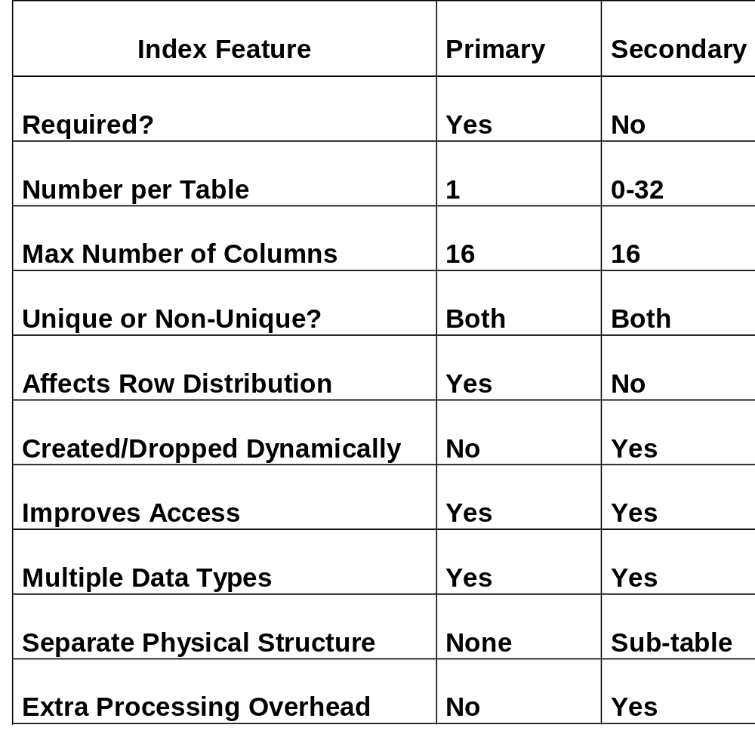
Comparison of Primary and Secondary Indexes

Slide 70
Full-Table Scans
  Every row of the table must be read.
  All AMPs scan their portion of the table in parallel.
  Primary Index choice affects FTS performance.
  Full-table scans typically occur when either:
    The index columns are not used in the query
    An index is used in a non-equality test
    A range of values is specified for the primary index
CUSTOMER
Cust_ID
Cust_Name
Cust_Phone
USI
NUSI
NUPI
Examples of Full-Table Scans:
SELECT * FROM customer WHERE Cust_Phone LIKE ‘524-_ _ _ _’;
SELECT * FROM customer WHERE Cust_Name <> ‘Davis’;
SELECT * FROM customer WHERE Cust_ID > 1000;

Slide 71
Module 8
Data Protection
After completing this module, you will be able to:
  Explain how locks prevent loss of data integrity.
  List the types and levels of locking provided by Teradata.
  Explain the concept of FALLBACK tables
  Describe the Recovery, Transient and Permanent Journals and their functions.
  List the utilities available for archive and recovery.

Slide 72
Locks
There are four types of locks:
Exclusive—prevents any other type of concurrent access
Write—prevents other Read, Write, Exclusive locks
Read—prevents Write and Exclusive locks
Access—prevents Exclusive locks only
Locks may be applied at three database levels:
Database—applies to all tables/views in the database
Table/View—applies to all rows in the table/views
Row Hash—applies to all rows with same row hash
Lock types are automatically applied based on the SQL command:
SELECT—applies a Read lock
UPDATE—applies a Write lock
CREATE TABLE—applies an Exclusive lock
Certain locks can be upgraded or downgraded:
LOCKING FOR ACCESS SELECT * FROM TABLE_A;
LOCKING FOR EXCLUSIVE UPDATE TABLE_B SET A = 2000;

Slide 73
Access Locks
Advantages of Access locks:
Permit quicker access to table in multi-user environment.
Have minimal blocking effect on other queries.
Very useful for aggregating large numbers of rows.
Sometimes called a ‘Dirty-Read’ or ‘Stale-Read’ lock.
Disadvantages of Access locks:
May produce erroneous results if performed during table maintenance.
Rule
Lock requests are queued behind all outstanding
incompatible lock requests for the same object.
A new ACCESS lock request is granted immediately.

Slide 74
Fallback
A fallback table is fully available in the event of an unavailable AMP.
A fallback row is a copy of a primary row stored on a different AMP.
PE
PE
BYNET
AMP 1
AMP 2
AMP 3
AMP 4
2
6
11
3
5
12
8
1
Primary rows
3
8
5
2
1
11
6
12
Fallback rows
Benefits of Fallback
  Permits access to table data during AMP off-line period
  Adds a level of data protection beyond disk array RAID
  Automatically restores data changed during AMP off-line
  Critical for high availability applications
Cost of Fallback
  Twice the disk space for table storage is needed
  Twice the I/O for INSERTs, UPDATEs and DELETEs is needed

Slide 75
Fallback Cluster
  A defined number of AMPs treated as a fault-tolerant unit.
  Fallback rows for AMPs in a cluster reside in the cluster.
  Loss of an AMP in the cluster permits continued table access.
  Loss of two AMPs in the cluster causes the RDBMS to halt.
Two Clusters of Four AMPs Each
AMP 1
AMP 2
AMP 3
AMP 4
62
8
27
34
22
50
5
78
19
14
1
38
5
34
14
19
38
8
22
62
1
50
27
78
AMP 5
AMP 6
AMP 7
AMP 8
41
66
7
58
93
20
88
2
45
17
37
72
93
72
88
45
7
17
37
58
41
20
2
66
Lose AMP 3 from cluster AMPs 1, 2 and 4 experience 33% increase in workload.
Lose AMP 6 from cluster AMPs 5, 7 and 8 experience 33% increase in workload.
Lose AMP 7 from cluster System halts.
System performance can be adversely affected when
any AMP has a disproportionate burden.

Slide 76
Fallback vs. Non-Fallback Tables
FALLBACK TABLES
ONE AMP DOWN
AMP
AMP
AMP
AMP
Data fully available
TWO OR MORE AMPs DOWN
  In different clusters
    Data fully available
  In the same cluster
    System halts
AMP
AMP
AMP
AMP
NON-FALLBACK TABLES
ONE AMP DOWN
Data partially available
Queries avoiding down AMP succeed
AMP
AMP
AMP
AMP
TWO OR MORE AMPs DOWN
  In different clusters
    Data partially available
    Queries avoiding down AMPs succeed
  In the same cluster
    System halts
AMP
AMP
AMP
AMP

Slide 77
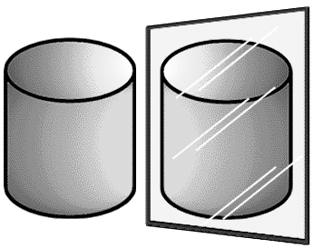
Raid Protection
Two types of disk array protection:
RAID-1 (Mirroring)
  Each physical disk in the array has an exact copy in the same array.
  The array controller can read from either disk and write to both.
  When one disk of the pair fails, there is no change in performance.
  Mirroring reduces available disk space by 50%.
  Array controller reconstructs failed disks quickly.
RAID-5 (Parity)
  For every 3 blocks of data, there is a parity block on a 4th disk.
  If a disk fails, any missing block may be reconstructed using the other three disks.
  Parity reduces available disk space by 25% in a 4-disk rank.
  Array controller reconstruction of failed disks is longer than
  RAID 1.
Primary
Mirror
Block 0
Block 1
Block 2
Parity
Parity
Block 3
Block 8
Block 4
Block 5
Parity
Block 6
Block 7
Summary
RAID-1 - Good performance with disk failures
Higher cost in terms of disk space
RAID-5 - Reduced performance with disk failures
Lower cost in terms of disk space

Slide 78
Recovery Journal For Down AMPs
Recovery Journal is:
Automatically activated when an AMP is taken off-line
Maintained by other AMPs in the cluster
Totally transparent to users of the system
While AMP is off-line:
Journal is active
Table updates continue as normal
Journal logs Row-IDs of changed rows for down-AMP
When AMP is back on-line:
Restores rows on recovered AMP to current status
Journal discarded when recovery complete
AMP 1
AMP 2
AMP 3
AMP 4
41
66
7
58
93
20
88
2
45
17
37
72
93
72
88
45
7
17
37
58
41
20
2
66
RJ
Row-ID 7
RJ
Row-ID 41
RJ
Row-ID 66

Slide 79
Transient Journal
Transient Journal
Consists of a journal of transaction before images.
Provides rollback in the event of TXN failure.
Is automatic and transparent.
Before images are reapplied to table if TXN fails.
Before images are discarded upon TXN completion.
Successful TXN
BEGIN TRANSACTION
UPDATE Row A — Before image Row A recorded
(Add $100 to checking)
UPDATE Row B — Before image Row B recorded
(Subtract $100 from savings)
END TRANSACTION — Discard before images
Failed TXN
BEGIN TRANSACTION
UPDATE Row A — Before image Row A recorded
UPDATE Row B — Before image Row B recorded
(Failure occurs)
(Rollback occurs) — Reapply before images
(Terminate TXN) — Discard before images

Slide 80
Archiving and Recovering Data
ARC
  The Archive/Restore utility
  Runs on IBM, UNIX and NT
  Archives data from RDBMS
  Restores data from archive media
  Permits data recovery to a specified checkpoint
ASF2
  The Archive Storage Facility 2
  XWindows front end for ARC
  Easy creation of scripts for archive/recovery
  Runs on UNIX nodes
Common uses of ARC
Dump database objects for backup or disaster recovery
Restore non-fallback tables after disk failure.
Restore tables after corruption from failed batch
processes.
Recover accidentally dropped tables, views, or macros.
Recover from miscellaneous user errors.

Slide 81
The Permanent Journal
An optional, user-specified, system-maintained journal used for database recovery to a specified point in time.
  Used for recovery from unexpected hardware or software disasters.
  May be specified for:
    One or more tables
    One or more databases
  Permits capture of before images for database rollback.
  Permits capture of after images for database roll forward.
  Permits archiving change images during table maintenance.
  Reduces need for full-table backups.
  Provides a means of recovering NO FALLBACK tables.
  Requires additional disk space for change images.
  Requires user intervention for archive and recovery activity.

Slide 82
Administrative Tools
Teradata Manager
  Graphical system management tool
  PC based (Windows NT, Windows 95)
  Collects, analyzes, and displays:
    Performance information
    Database utilization
  WinDDI for easy coding of DDL commands
  Graphical or report based
  Provides standard DBA functions
Database Query Manager (DBQM)
  Query workload management tool
  Runs, suspends, schedules later or rejects query based on current workload and set thresholds
  Restricts queries based on analysis control:
    Too long -- Too many rows
  Restricts queries based on object control:
    User ID - Table - Day/time - Group ID
  Logs workload performance for analysis
  Restricts based on environmental factors
    CPU
    Disk utilization
    Network activity
    Number of users

Slide 83
Platform Support
Client Platforms
Channel-Attached
Mainframes
Microsoft
MS-DOS
Windows
Windows NT
IBM MVS
VM
OS2
NCR UNIX SVR4 MP-RAS
Other UNIX platform support
HP-UP
IBM AIX
SUN Solaris
DEC Alpha
SGI/IRIX
SUN OS
Pyramid
IBM
Hitachi
Amdahl
Bull
WorldMark
DELL
Compact
HP
Others
Database Server Platforms
NCR UNIX SVR4 MP-RAS
Microsoft
Windows NT
Windows 2000

