Slide 1



Slide 2

INTRODUCTION
Women’s safety remains one of the
most pressing global challenges, both in
physical spaces and in digital environments.
While several mobile applications and
community initiatives exist,
They primarily focus on reactive responses
(panic buttons, emergency calling) or provide limited
reporting capabilities.
None successfully integrate the power of community-driven
reporting, reputation building, and Open Source Intelligence
(OSINT) into a single structured ecosystem.

Slide 3

OBJECTIVES
The objective of noTease is to create a location-aware, community-centric safety network where individuals can:
• Quickly report suspicious incidents or encounters in their vicinity
• Engage in threaded discussions with others who have observed similar activities.
• Identify recurring patterns in behavior or locations through OSINT-assisted aggregation
• Build collective case files that
accumulate evidence, reports, and
context over time.

Slide 4
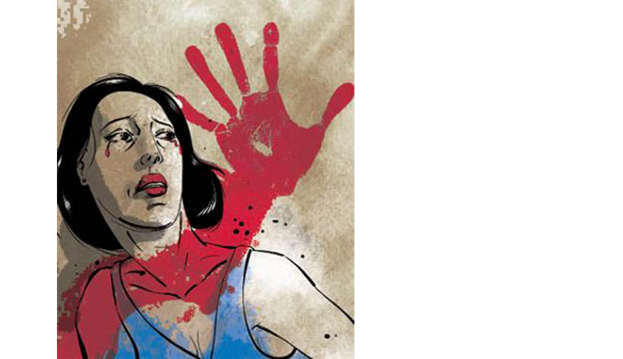


Motivation
Current applications for women’s safety (e.g., “panic button” apps, location sharing tools) exhibit significant gaps:
Reactive Design
Isolation
They assist only after an emergency occurs.
Reports remain siloed, lacking broader community validation
Shallow Insight
Limited OSINT Use
Modern intelligence practices are
missing from existing safety apps.
No tools exist to connect multiple
small incidents into broader behavioral
patterns.

Slide 5
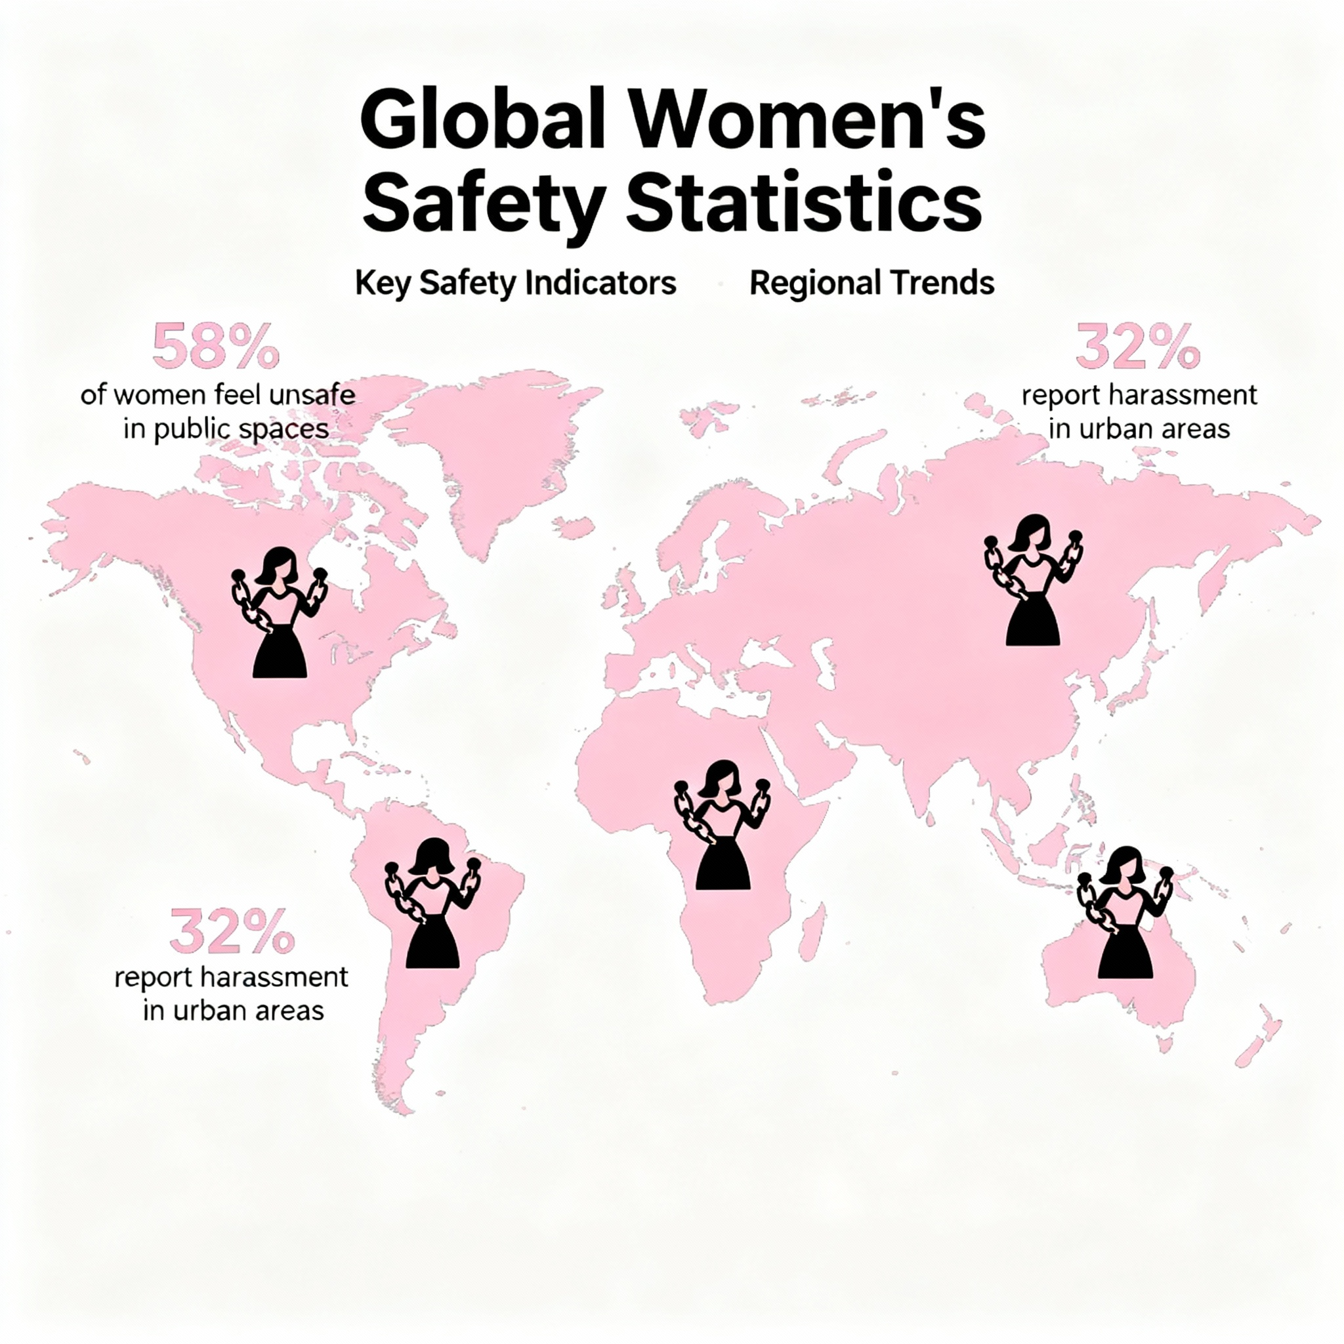



PROPOSED SOLUTION
noTease introduces a dual-tab system that balances urgency with depth:
Alerts: A stream of immediate, geo-tagged safety signals (e.g., “Suspicious activity near the metro at 8PM”). Alerts are concise and location-based, helping communities react quickly.
noTease: Threaded discussions where users unpack incidents, share context, and connect observations. noTease transforms individual voices into community intelligence.
Each Alert generates a Case File:
• Snapshot: A concise overview of the reported incident.
• Evidence Locker: Repository for images, screenshots, and other supporting material.
• Flagged Votes: A transparent system where the community flags suspicious activities rather than assigning abstract credibility scores.
• Connected Reports: A web of linked incidents or individuals showing repeated patterns.
• Discussion Link: Direct bridge to the associated Gossip thread for collaborative analysis.

Slide 6
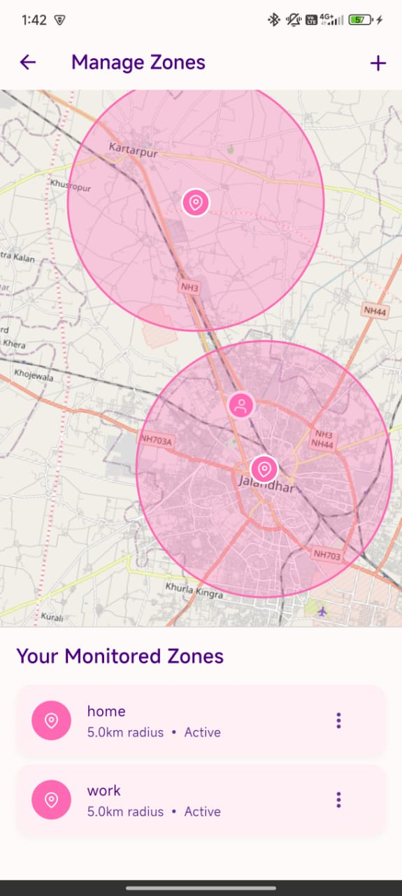
System Flow
User creates an Alert with location and details.
2. Alert spawns a Case File, which aggregates further inputs.
3. Other users attach Reports or Evidence to the Case File.
4. Community marks suspicious activity through Flagged votes.
5. Gossip threads build narrative depth and community consensus.

Slide 7




Why noTease is Different
You're never alone—our verified network mobilizes trusted neighbors for rapid, reassuring support in your moment of need.
Proactive Safety
Community Intelligence
Shifts focus from post-incident panic to preemptive awareness.
Leverages collective input to build stronger safety nets.
Pattern Recognition
Stealth and Anonymity:
Identifies recurring threats across time
and space.
Identifies recurring threats across time
and space.
Enables safe participation without fear of retaliation.

Slide 8



CONCLUSION
noTease aims to fill the critical gap between isolated safety applications and structured intelligence systems.
By merging Alerts, Gossip, and Case Files into a seamless workflow, it empowers communities to not only react but also anticipate,
connect, and protect.

Slide 9
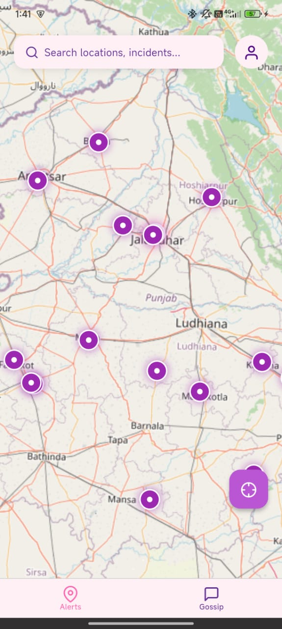
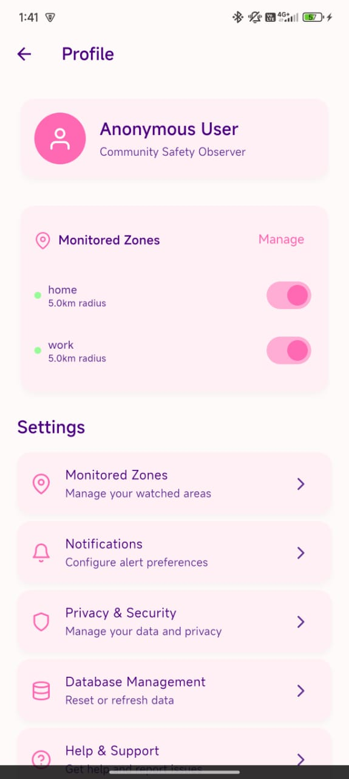
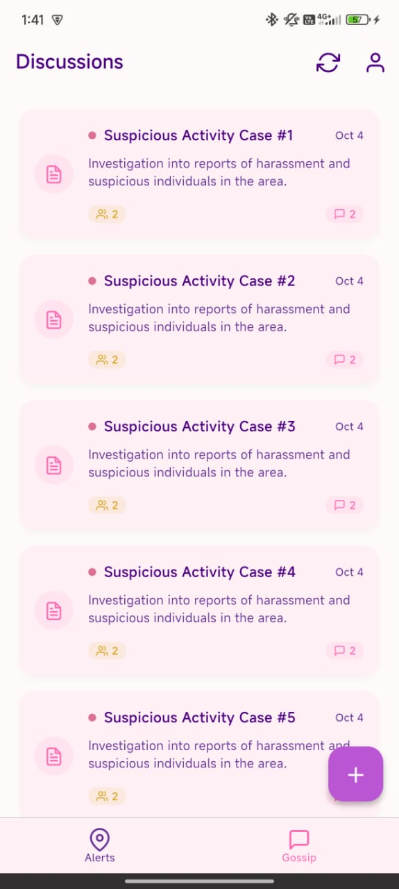
USER INTERFACE

Slide 10
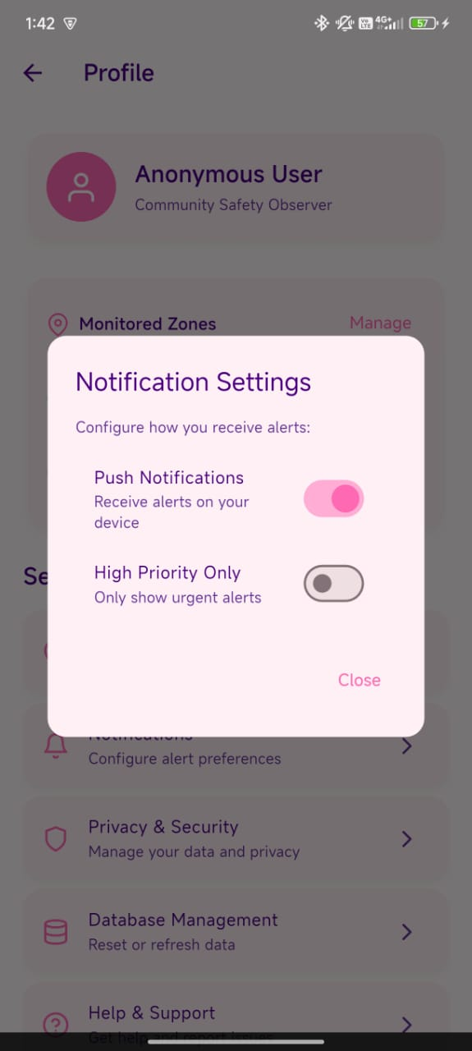

Slide 11
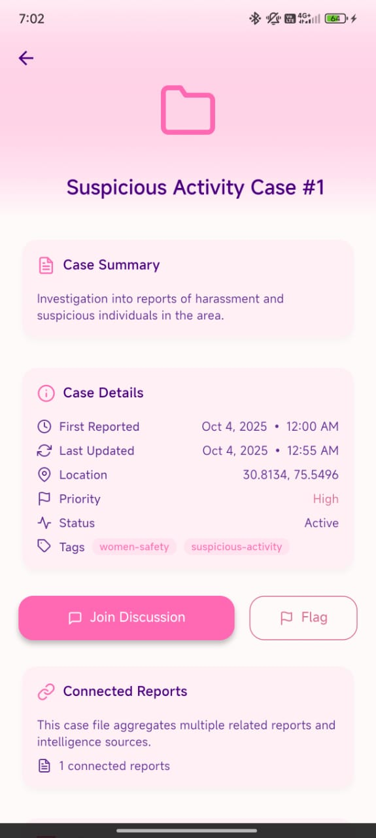
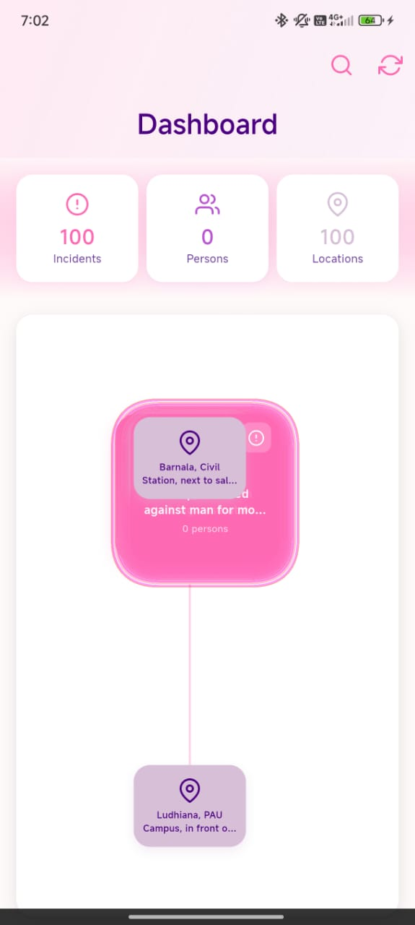

Slide 12
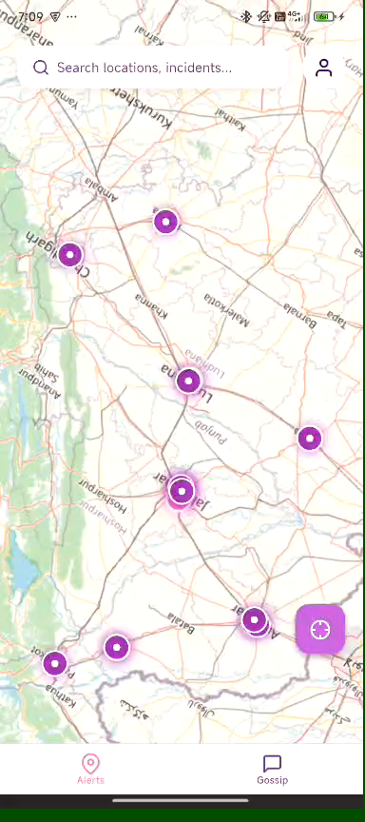
DEMO VIDEO:

