Slide 1
Topic:-
Recommender system for E-commerce

Slide 2
OUTLINE
Introduction
Parts of recommendation system
Menu Recommendation
Our Website
Procedure
Technologies Used
Output
Future Scope
Team Members

Slide 3
Introduction
Recommender systems are among the most popular applications of data science at the moment. They are used to predict “rating” or “preference” that a user would give to an item. Some companies that are actively using recommendation systems are; Amazon, Youtube, Netflix, Facebook e.t.c

Slide 4
Parts of recommendation system
Content based Filtering | Collaborative Filtering
Content-based filtering, makes recommendations based on user preferences for product features. | Collaborative filtering mimics user-to-user recommendations.

Slide 5
Menu Recommendation
Menu Recommendation engines discover data patterns in the data set by learning consumers’ choices and produces the outcomes that co-relates to their needs and interests.
The application provided user with menu recommendation depending on the users past preferences and the time of the day.

Slide 6
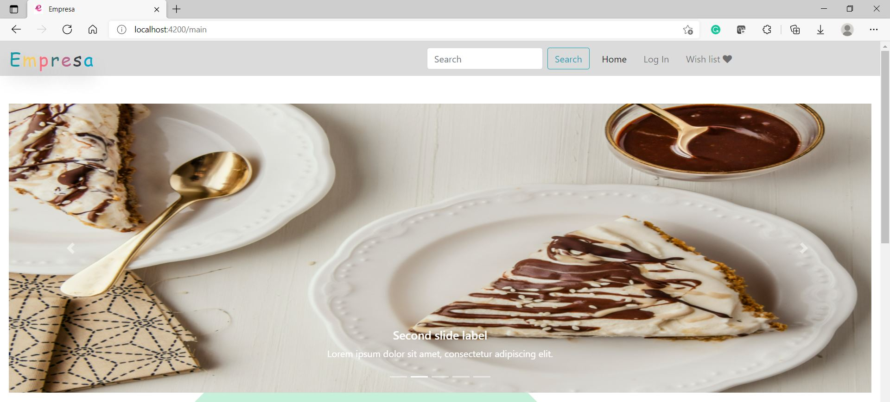
Web Page:
Header

Slide 7
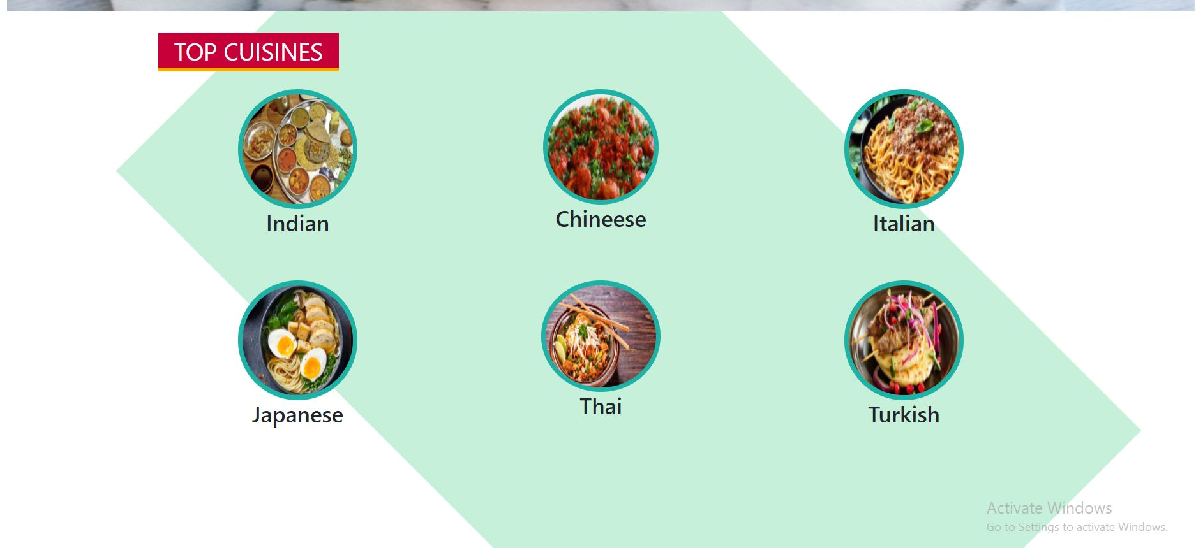
Web Page:
Home Page

Slide 8
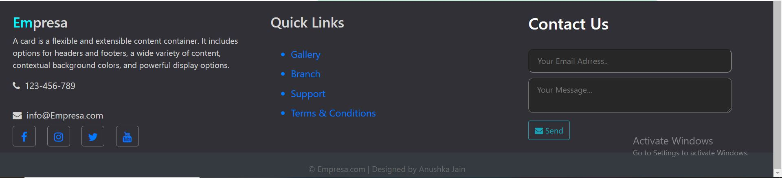
Web Page:
Footer

Slide 9
Procedure
Webpage
Creating different cuisine
Adding items to it
Creating database
2. Recommendation
Data Collection
Data initialization
Collect users recommendation data
Flash the recommendations to the user’s page.

Slide 10
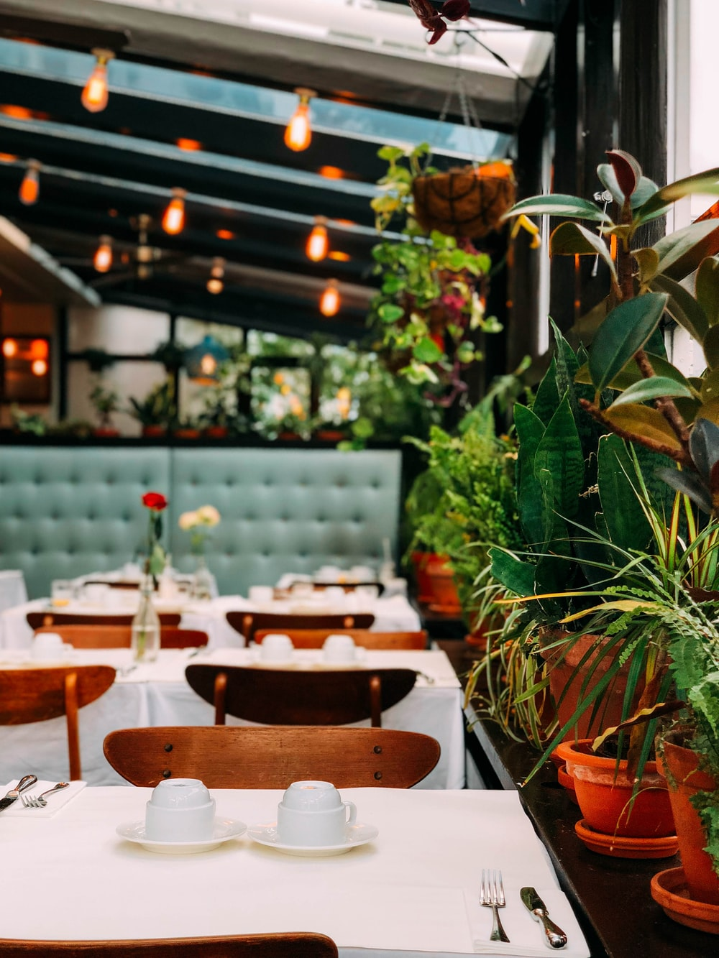
Technologies Used:
Html
Css
Bootstrap
Angular
Node.Js
MongoDB
Robo3T
Machine Learning
AI

Slide 11
OutPut:
STAGE 01
User inputs their choice
This will recommend the user the top cuisine he had previously or have searched in recent
STAGE 03
The user selects its choice of meal from a recommendation list if he/she likes it.
STAGE 02
STAGE 04
They may checkout with their choice of interest and this will be recorded in the data set for the next time

Slide 12
Future offerings
We can perform data analysis based on user data that we will collect which will help in further recommendations.

Slide 13
Team Members:
1. Yash Rajendra Jain – 18102021
2. Anushka Mahendra Jain - 18102001

