Slide 1
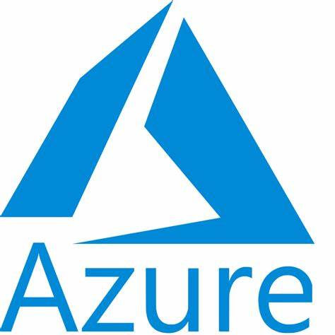



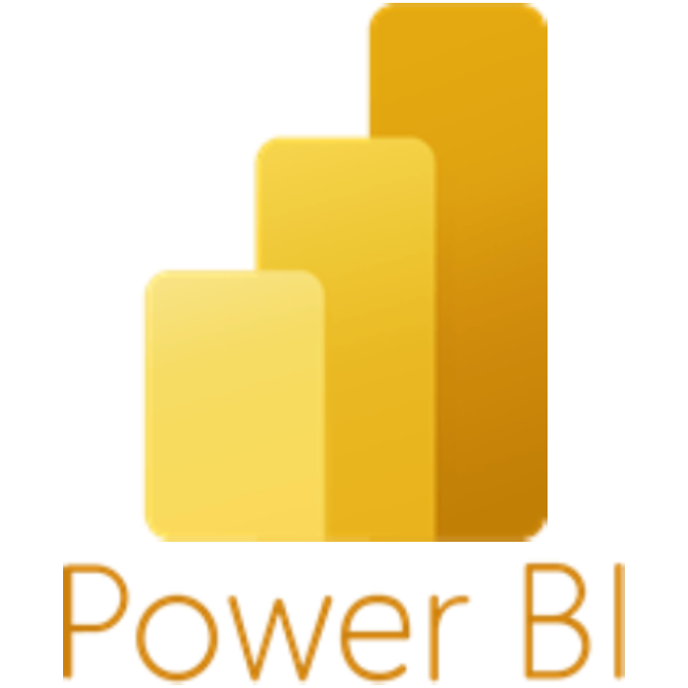
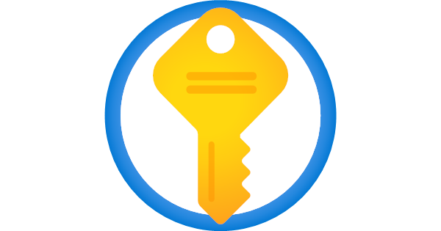

Assignment 1 Design
Data Sources
Data Ingestion & Transformations
Orchestration
Source 1
Source 2
1
2
5
6
Source 3
4
Data Factory Pipelines
ADLS Ingested
Data Factory Pipelines
ADLS Refined
Marketing System
3
Source n
ADLS Processed

Slide 2
Approach 1:
1. Ingested Layer - Store raw data as-is from the sources.
Create a data factory in ADF.
Set up self-hosted IR, linked services to connect to your source database and ADLS.
Create a pipeline with a copy activity to fetch data incrementally.
2. Store the data in the Ingested layer of ADLS.
3. Processed Layer - Clean and transform the raw data to ensure data quality and consistency.
Create dataflows to read data from the raw layer.
Apply transformations and write the cleaned data to the Processed layer.
4. Gold Layer - Provide highly curated and aggregated data ready for business intelligence (BI) use.
Use Dataflows to read data from the Processed layer.
Perform necessary transformations and aggregations.
5. Store the final dataset in the gold layer.
6. Set up access permissions and possibly create views or endpoints for BI developers(MS Team) to use.
Additional Considerations:
Ensure your ADF pipeline is set up to handle incremental loads by using watermarks or change data capture (CDC).
Implement data validation checks at each stage to ensure data quality.
Set up monitoring and logging for your pipelines to track performance and troubleshoot issues.
Configure proper access controls and encryption to secure your data in ADLS. Also use key vaults to manage credentials.

Slide 3
Approach 2:
Same as Approach 1 instead of Dataflows we can use Databricks for data processing.
Note: If we have complex data processing requirements then Databricks is the best solution. Synapse Analytics can be used for the same requirement. Few other ways also there.

