Slide 1
H1BVisa Application
ANU.R
UNDER GUIDENCE OF
SANDEEP AGARWAL Faculty Big Data NIIT
ANNU SHARMA Faculty Big Data NIIT

Slide 2
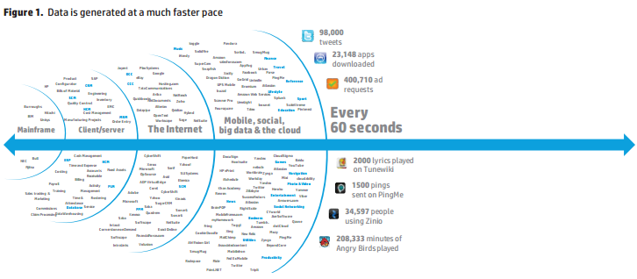
Problem of Data Explosion

Slide 3
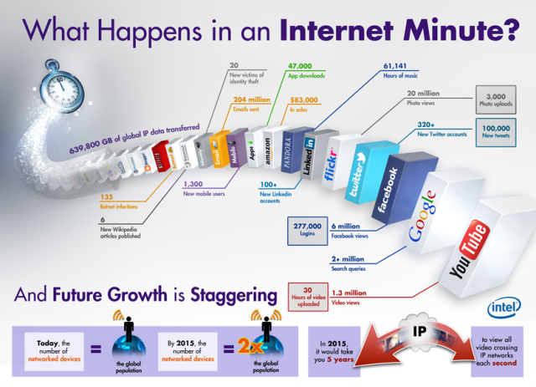
Contd...

Slide 4
BIG DATA
The volume of data that one has to deal has exploded to unimaginable levels in the past decade, and at the same time, the price of data storage has systematically reduced. Private companies and research institutions capture terabytes of data about their users’ interactions, business, social media, and also sensors from devices such as mobile phones and automobiles. The challenge of this era is to make sense of this sea of data.
This is where big data comes into picture. Big Data Analytics largely involves collecting data from different sources, munge it in a way that it becomes available to be consumed by analysts and finally deliver data products useful to the organization business. The process of converting large amounts of unstructured raw data, retrieved from different sources to a data product useful for organizations forms the core of Big Data Analytics.

Slide 5
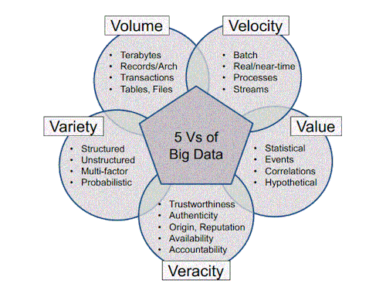
5v’s of Big Data

Slide 6
Introduction to Apache Hadoop
Apache Hadoop is an open source software framework for storage and large scale processing of data-sets on clusters of commodity hardware. Hadoop is an Apache top-level project being built and used by a global community of contributors and users.
Hadoop was created by Doug Cutting and Mike Cafarella in 2005. It was originally developed to support distribution for the Nutch search engine project.

Slide 7
Apache Hadoop framework modules and ecosystem.
Hadoop Common – contains libraries and utilities needed by other Hadoop modules.
Hadoop Distributed File System (HDFS) – a distributed file-system that stores data on commodity machines, providing very high aggregate bandwidth across the cluster.
Hadoop YARN – a resource-management platform responsible for managing computing resources in clusters and using them for scheduling of users' applications.
Hadoop MapReduce – an implementation of the MapReduce programming model for large scale data processing.
It’s ecosystem consists of projects such as: Apache Pig, Apache Hive, Apache HBase, Apache Phoenix, Apache Spark, Apache Zookeeper, Cloudera Impala, Apache Flume, Apache Sqoop, Apache Oozie, and Apache Storm.

Slide 8
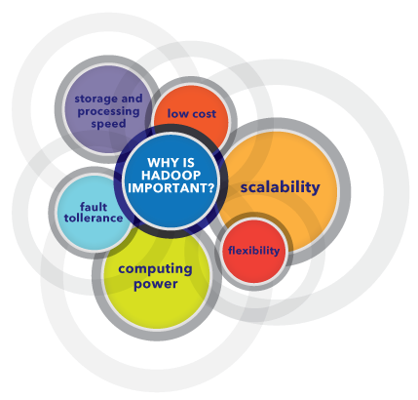
Advantages of Hadoop

Slide 9
Limitations of Hadoop
Issue with Small Files
Slow Processing Speed
Support for Batch Processing only
No Real-time Data Processing
Security
Vulnerable by Nature
No Caching
Lengthy Line of Code
Uncertainty

Slide 10
Project Introduction
H1B VISA PROGRAM - to live and work in the USA
The H1B Visa is the primary US work visa / permit made available to people from all over the world.
The US Government introduced the H1B visa program to offer and enable skilled International Professionals and International Students from all over the World the opportunity to live and work in the USA.
The H1B is the most popular and sought after US work visa and US Immigration requires 'every' foreign national to obtain a visa in order to legally work in America.
One of the main advantages of the H1B visa is that it is a 'dual intent' visa which means that you can apply for a Green Card (become a Legal Permanent Resident).
An H1B visa is typically valid for up to six (6) years and entitles your spouse (husband/wife) and children (under 21) to accompany you and live in the USA on an H4 visa. The H4 dependent visa does not allow your spouse/children to work (unless they get their own H1B visa).

Slide 11
Technologies used
Mapreduce jobs
Pig latin scripts
Hive
Sqoop

Slide 12

Why Mapreduce?
Hadoop MapReduce (Hadoop Map/Reduce) is a software framework for distributed processing of large data sets on compute clusters of commodity hardware. It is a sub-project of the Apache Hadoop project. The framework takes care of scheduling tasks, monitoring them and re-executing any failed tasks.
The MapReduce algorithm contains two important tasks, namely Map and Reduce.
Definite driver program control.
Good amount of Testability when combining lots of large data sets

Slide 13

Why Hive?
Apache Hive helps with querying and managing large datasets real fast. It is an ETL tool for Hadoop ecosystem.
Hive evolved as a data warehousing solution built on top of Hadoop Map-Reduce framework.
Hive provides SQL-like declarative language, called HiveQL, which is used for expressing queries. Using Hive-QL users associated with SQL are able to perform data analysis very easily.
Hive engine compiles these queries into Map-Reduce jobs to be executed on Hadoop. In addition, custom Map-Reduce scripts can also be plugged into queries. Hive operates on data stored in tables which consists of primitive data types and collection data types like arrays and maps.

Slide 14

Why Pig?
Apache Pig is an abstraction over MapReduce. It is a tool/platform which is used to analyze larger sets of data representing them as data flows. Pig is generally used with Hadoop; we can perform all the data manipulation operations in Hadoop using Pig.
To write data analysis programs, Pig provides a high-level language known as Pig Latin.
Using Pig Latin, programmers can perform MapReduce tasks easily without having to type complex codes in Java.
Apache Pig provides many built-in operators to support data operations like joins, filters, ordering, etc. In addition, it also provides nested data types like tuples, bags, and maps that are missing from MapReduce.

Slide 15

Why Scoop?
Sqoop is a tool designed to transfer data between Hadoop and relational database servers. It is used to import data from relational databases such as MySQL, Oracle to Hadoop HDFS, and export from Hadoop file system to relational databases.
When Big Data storages and analyzers such as MapReduce, Hive, HBase, Cassandra, Pig, etc. of the Hadoop ecosystem came into picture, they required a tool to interact with the relational database servers for importing and exporting the Big Data residing in them
Here, Sqoop occupies a place in the Hadoop ecosystem to provide feasible interaction between relational database server and Hadoop’s HDFS.
Sqoop − “SQL to Hadoop and Hadoop to SQL”

Slide 16
Flow Of Project
Load the data into HDFS.
Run required analysis by writing MapReduce or Hive or Pig programs.
Get the required output.
Visualize the data by drawing graphs for more in-depth understanding.

Slide 17
Analysis on H1Bvisa Data
Is the number of petitions with Data Engineer job title increasing over time?
Find top 5 job titles who are having highest growth in applications.
Which part of the US has the most Data Engineer jobs for each year?
Find top 5 locations in the US who have got certified visa for each year.
Which industry has the most number of Data Scientist positions?
Which top 5 employers file the most petitions each year?
Find the most popular top 10 job positions for H1B visa applications for each year?

Slide 18
Contd...
Find the percentage and the count of each case status on total applications for each year. Create a graph depicting the pattern of all the cases over the period of time.
Create a bar graph to depict the number of applications for each year
Find the average Prevailing Wage for each Job for each Year (take part time and full time separate).Arrange the output in descending order.
Which are employers along with the number of petitions who have the success rate more than 70% in petitions and total petitions filed more than 1000?
Which are the job positions along with the number of petitions which have the success rate more than 70% in petitions and total petitions filed more than 1000?

Slide 19
Sample Code and output
The number of applications for all 6 years?
Using Hive:
select year, count(*) from h1b_final group by year;
2011 358767
2013 442114
2015 618727
2012 415607
2014 519427
2016 647803
Total Records: 3002445

Slide 20
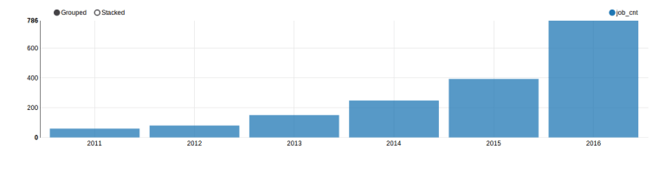
Contd...
Bar graph dipicting the growth of the annual application over the year

Slide 21
Contd...
Case-status offered by H1bvisa applications?
Using Hive:
select case_status, count(*) from h1b_final group by case_status;
CERTIFIED-WITHDRAWN 202659
WITHDRAWN 89799
CERTIFIED 2615623
DENIED 94364

Slide 22
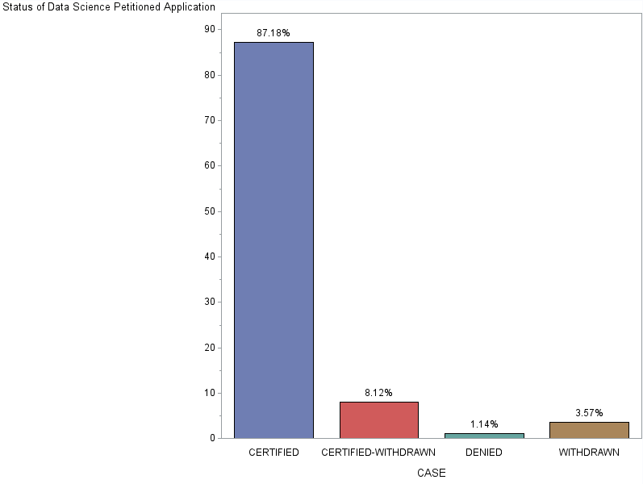
Contd...
Bar graph dicpicting the highest priority of case-status over the years

Slide 23
Code Repository
H1bvisa-Project
https://github.com/AnuR1234/H1bvisa.git
Assignments
https://github.com/AnuR1234/Assignments.git

Slide 24
Conclusion
The availability of Big Data, low-cost commodity hardware, and new information management and analytic software have produced a unique moment in the history of data analysis. The convergence of these trends means that we have the capabilities required to analyze astonishing data sets quickly and cost-effectively for the first time in history.
Using the Big data tools,we are able to work on the H1bvisa applications dataset,and did various analysis like the most trending jobs in the USA,annual growth over the years etc..
The Age of Big Data is here, and these are truly revolutionary times if both business and technology professionals continue to work together and deliver on the promise.

Slide 25
THANK
YOU !!!

