Slide 1
Unveiling Cricket Dynamics
World Cup 2023

Slide 2
Introduction
The World Cup 2023 Data Analysis project delves into the realm of cricket, focusing on the prestigious tournament held in 2023. Through thorough exploratory data analysis (EDA), this project aims to unravel the complexities of team and player dynamics, providing valuable insights into cricketing trends and performance metrics. By leveraging analytical skills and delving into the dataset, we seek to enhance our understanding of cricket statistics in a competitive sporting context.

Slide 3
Team Performance Analysis
Exploring team-wise performance metrics revealed intriguing patterns. Top-performing teams were identified based on runs scored and wickets taken. Analyses of batting and bowling styles provided insights into the strengths of different teams, shedding light on their strategies and approaches during the tournament.

Slide 4
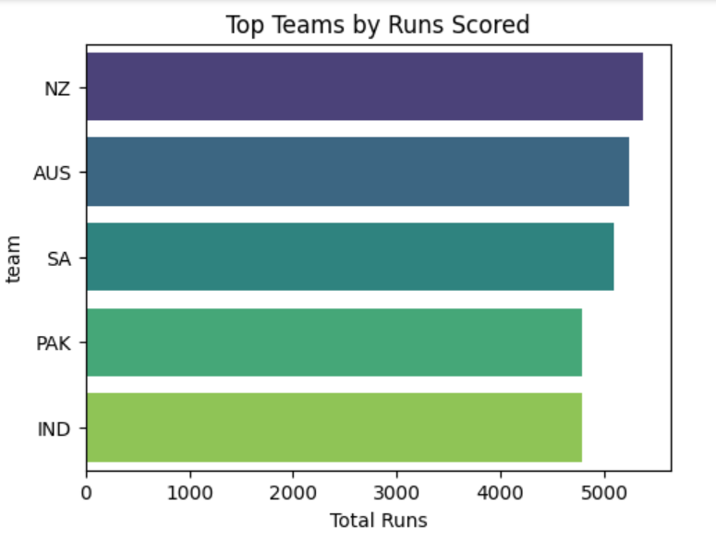
Teams By Run Scored

Slide 5
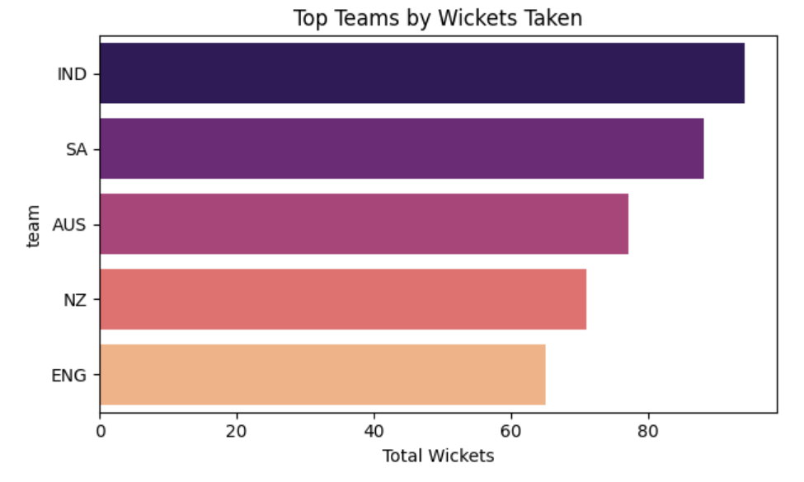
Teams By Wicket Taken

Slide 6
Player Performance Analysis
Evaluation of individual player statistics showcased standout performers in both batting and bowling. Leading run-scorers and wicket-takers were identified, with their impact on team performance assessed. By delving into player-level metrics, we gained a nuanced understanding of player contributions and their influence on team dynamics.

Slide 7
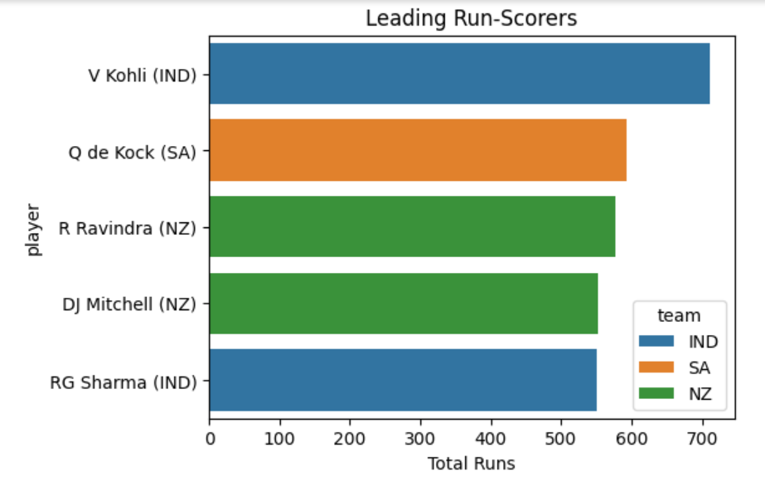
Run Scores Of Players

Slide 8
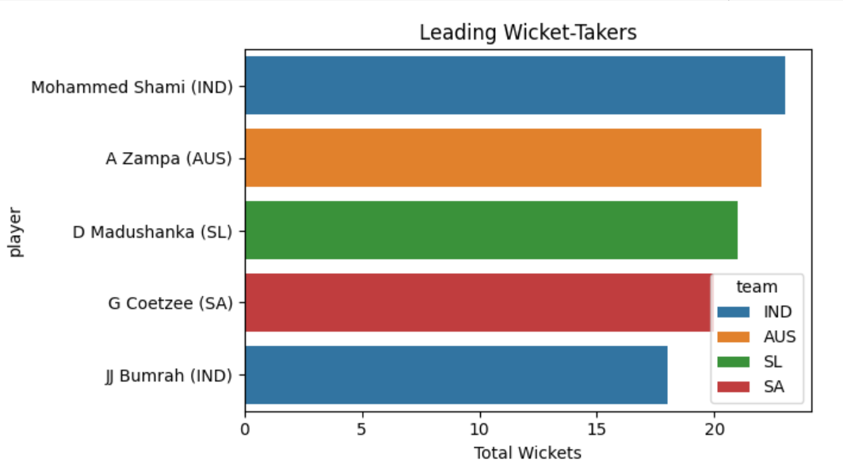
Player Who Takes Wicket

Slide 9
Opposition and Ground Analysis
Investigation into performance against different oppositions and across various playing grounds unveiled performance variations. Specific teams and players excelling in certain conditions were identified, highlighting the importance of adaptability and strategy in cricketing contests.

Slide 10
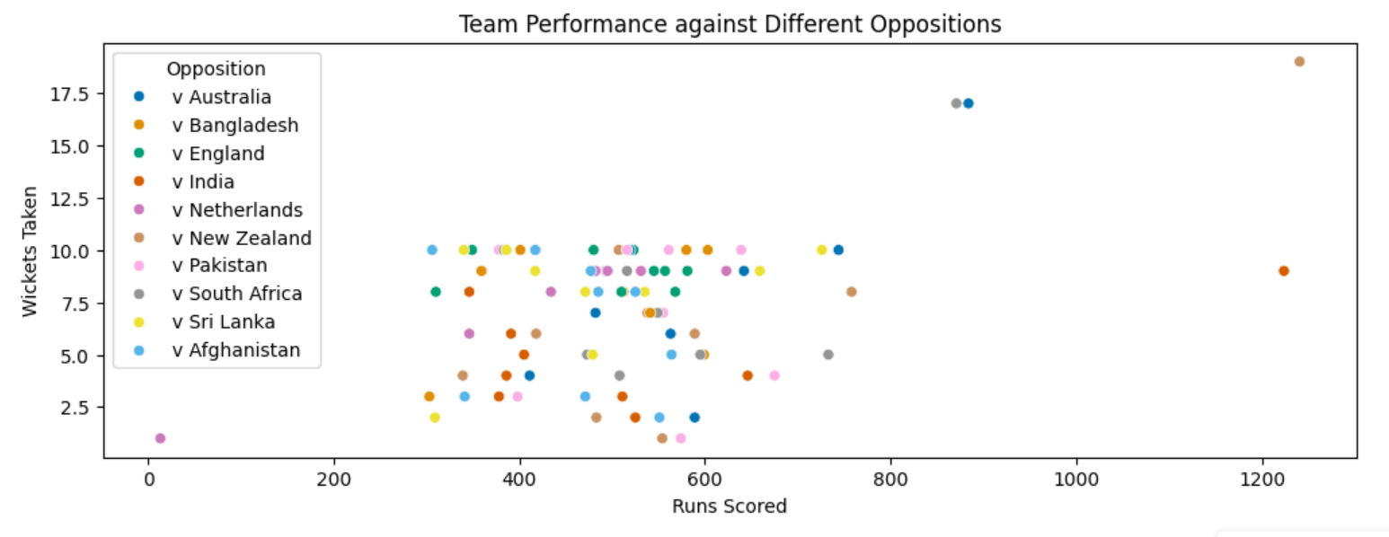
Team Performance against Oppositions

Slide 11
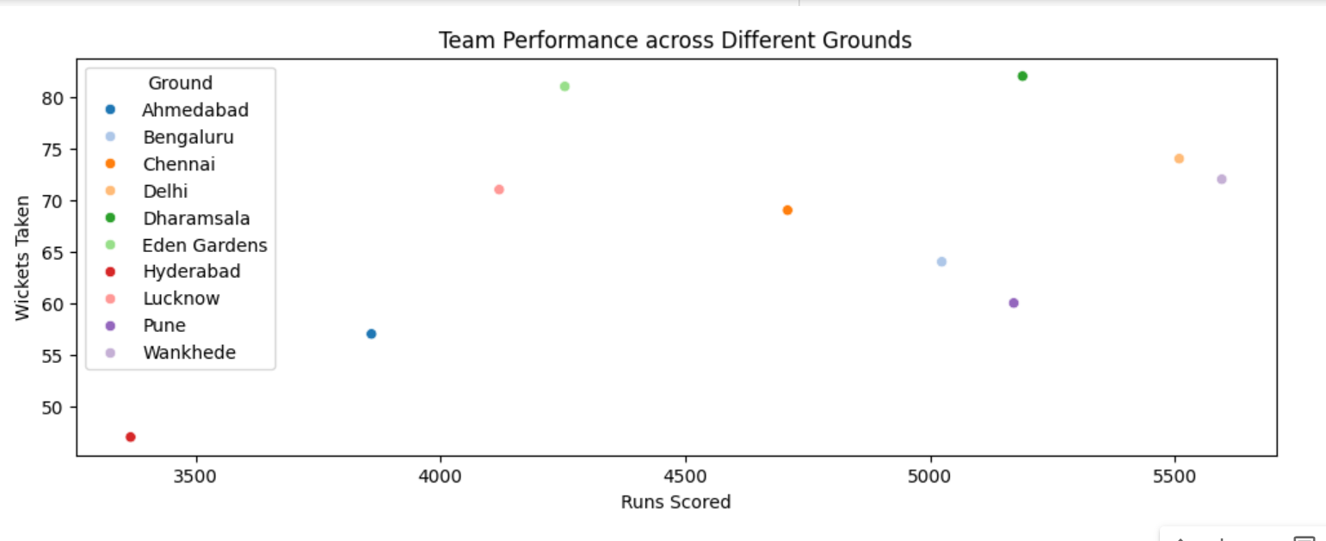
Team Performance Across Different Grounds

Slide 12
Temporal Analysis
Temporal trends over the course of the tournament provided insights into performance dynamics. By studying performance trends over time, we discerned patterns and changes in team and player performance, offering valuable insights into the evolving nature of the tournament.

Slide 13
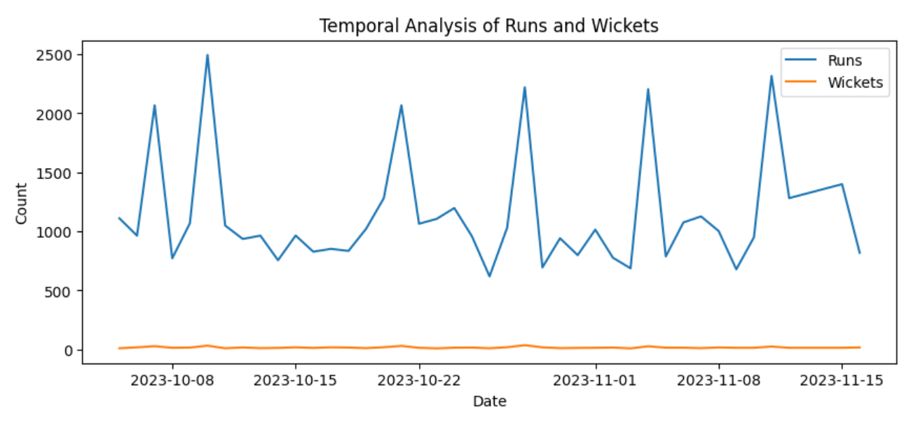
Temporal Analysis

Slide 14
Conclusion
The successful completion of this exploratory data analysis has provided valuable insights into the World Cup 2023, enabling a deeper understanding of team and player dynamics. By presenting findings in a clear and concise manner, this project showcases analytical skills and the ability to draw meaningful conclusions from the dataset. Moving forward, these insights serve as a foundation for further analysis and decision-making in the cricketing community, contributing to a richer understanding of cricket statistics and performance metrics in competitive sporting contexts.

