Slide 1
PROJECT ON AUTOMATION TESTING
Presented by: Anu Sharma

Slide 2
What is automation testing?
Test automation is the practice of running tests automatically, the results of which is to improve software quality. It’s primarily a quality assurance measure, and its activities involve the commitment of the entire software production team from business analysts to developers and DevOps engineers.
The general criteria for test automation are:
Repeatable – The test should be repeatable and must be able to run more than once.
Determinant - The outcome should be the same every time it’s run with the same input.
General approaches:
Graphical user interface testing - A testing framework that generates user interface events such as keystrokes and mouse clicks and observes the changes to validate if the behavior of the program is correct.
API driven testing - A testing framework that uses a programming interface to validate the behavior. Typically, API driven testing bypasses application user interface altogether. It can also be testing classes, modules or libraries with a variety of input arguments to validate that the results.

Slide 3
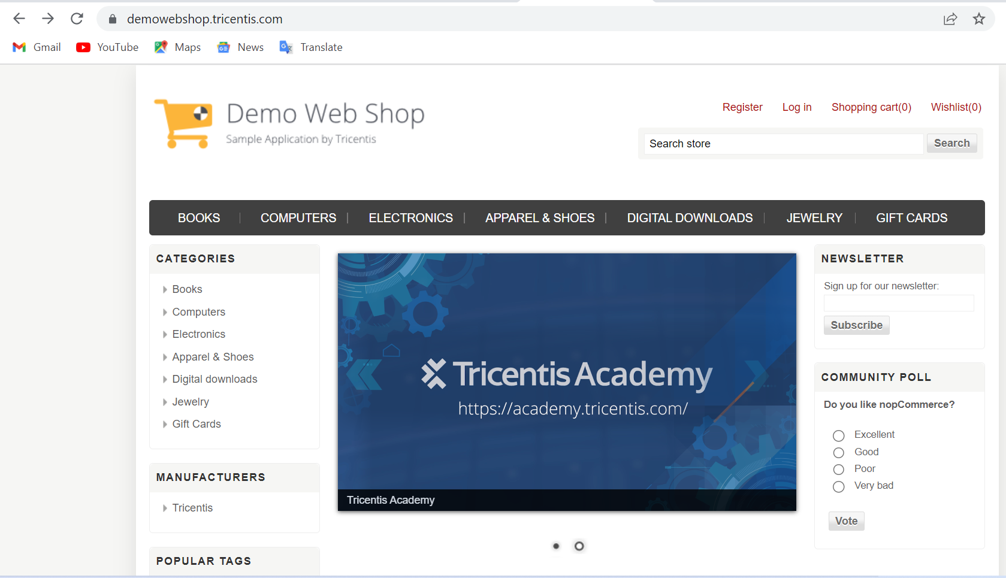
https://demowebshop.tricentis.com/

Slide 4
STEPS
Launch the chrome browser.
Navigate to this URL: https://demowebshop.tricentis.com/
Get and print all the names of categories shown on the left side of the page.
Enter valid email and signup for newsletter.
Click on Jewelry.
Get the text of all items shown and print out in the console.
Add any three items of your choice shown on the screen.
Retrieve the message shown on top of the screen and print it out in the console.
Click Checkout.
Checkout Guest, Add all valid details into billing address.

Slide 5
1st “add to cart” – Create your own jewelry
//Click on 1st Add to cart - INDEX XPATH
WebElement btn_cart1 = driver.findElement(By.xpath("(//input[@value='Add to cart'])[1]"));
Or
(//input[@value='Add to cart'])[position()=1])
//Click on 1st Add to cart button- Parent-Child XPATH AXES
//div[attribute::class='buttons']/input[1]//preceding::input[@value='Add to cart’]
//Absolute XPATH – Starting from root node
WebElement txt_length = driver.findElement(By.xpath("/html[1]/body[1]/div[4]/div[1]/div[4]/div[2]/div[2]/div[1]/form[1]/div[1]/div[1]/div[2]/div[4]/dl[1]/dd[2]/input[1]"));

Slide 6
2nd “add to cart” – BLACK & WHITE DIAMOND HEART
//Click on 2nd Add to cart button- - CSSSELECTOR(Class)
WebElement btn_cart = driver.findElement(By.cssSelector(".item-box:nth-child(2) .button-2"));
Or
//Click on 2nd Add to cart button- Parent-Child XPATH AXES
//div[@class= 'add-info']/following::input[1]

Slide 7
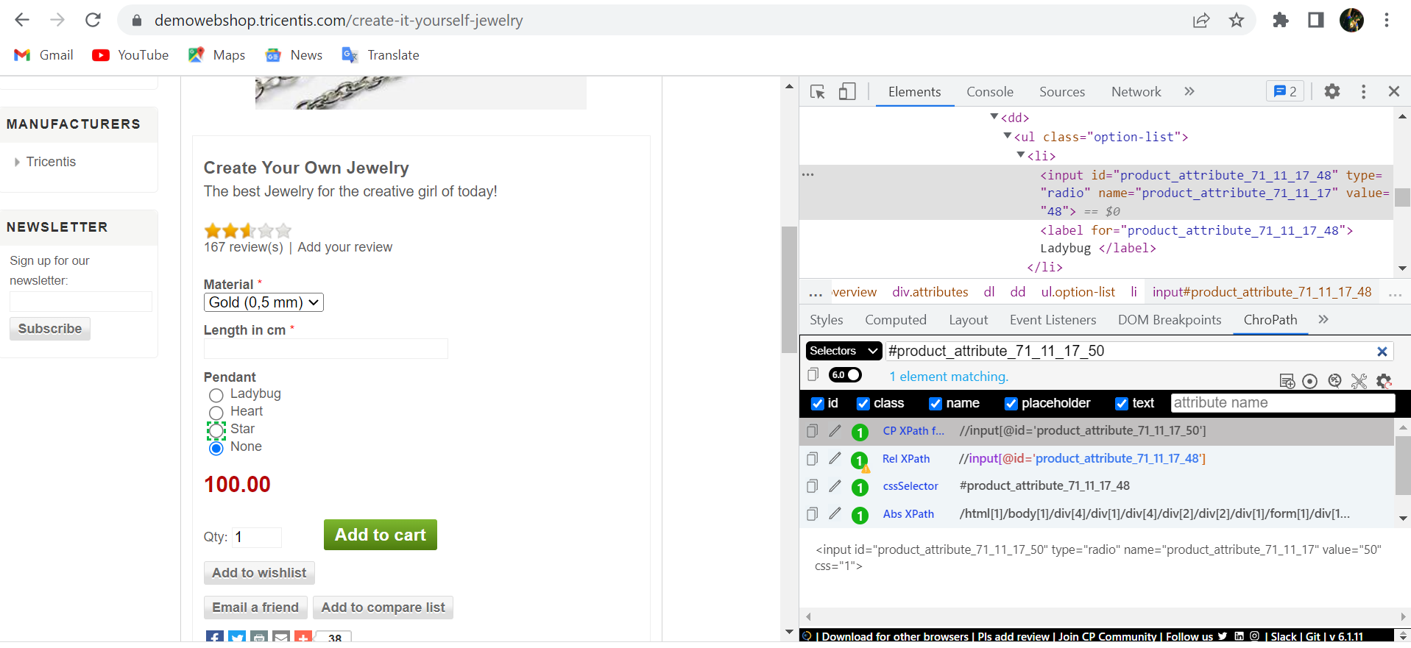
SELECTING the Pendant type radio button - CSSSELECTOR (Id)
driver.findElement(By.cssSelector("#product_attribute_71_11_17_50"));

Slide 8
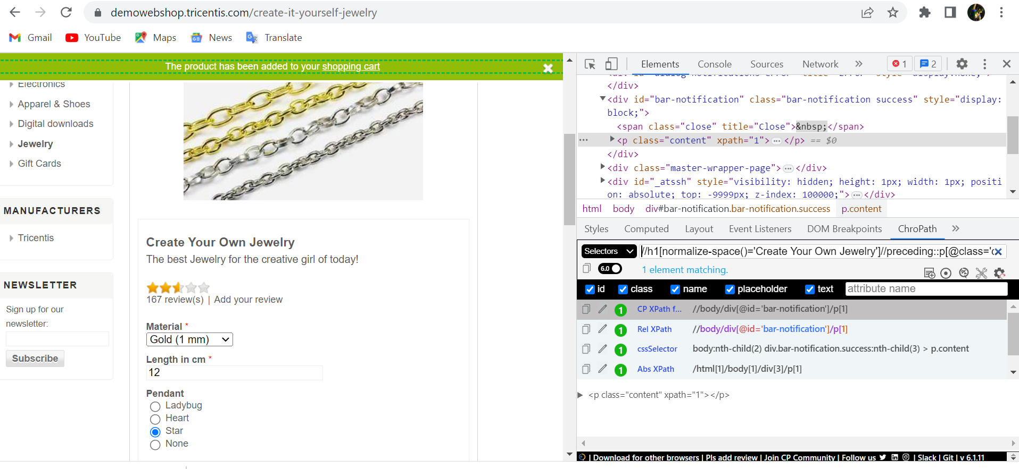
Retrieve the message of successfully added item in the cart – XPATH AXES
String notification_message = driver.findElement(By.xpath("//h1[normalize-space()='Create Your Own Jewelry']//preceding::p[@class='content']")).getText();

Slide 9
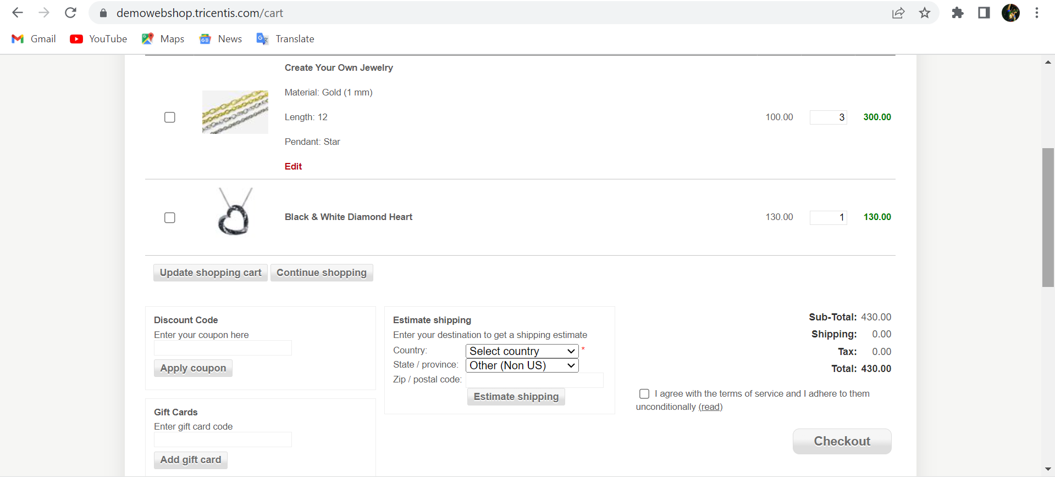
Click on "Shopping Cart" link on webpage – PARTIAL LINK TEXT OR LINK TEXT
driver.findElement(By.partialLinkText("Shopping"));

Slide 10
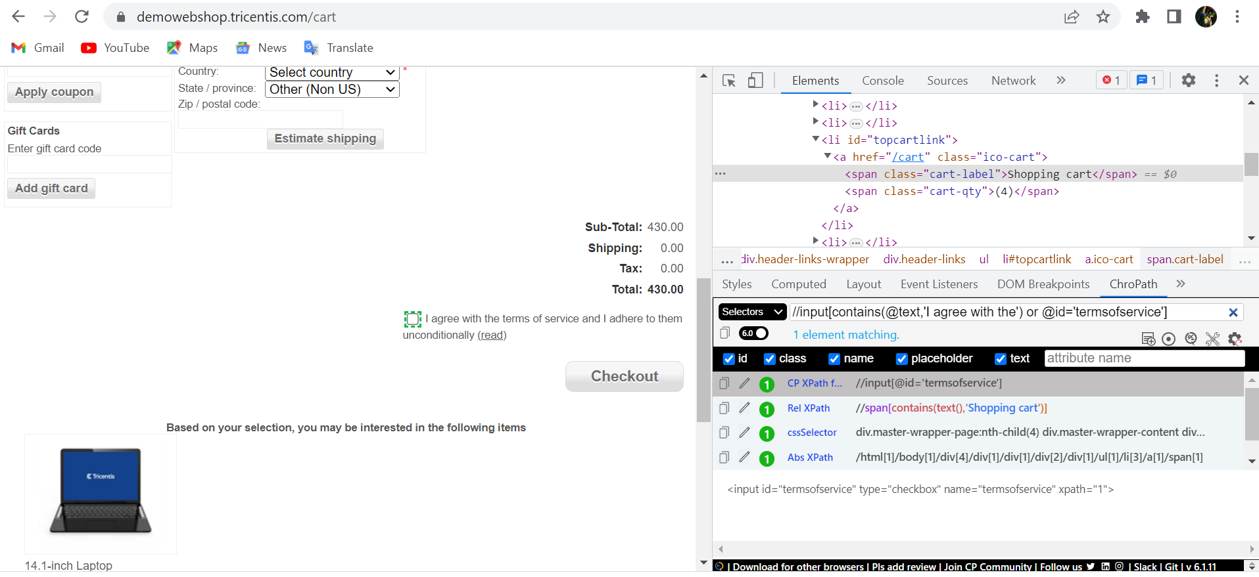
Select terms and agreement checkbox – XPATH CONTAINS
driver.findElement(By.xpath("//input[contains(@text,'I agree with the') or @id='termsofservice']"));

Slide 11

Select terms and agreement checkbox – XPATH AND Condition
WebElement chkbox_terms = driver.findElement(By.xpath("//input[@type='checkbox' and @id='termsofservice']"));

Slide 12
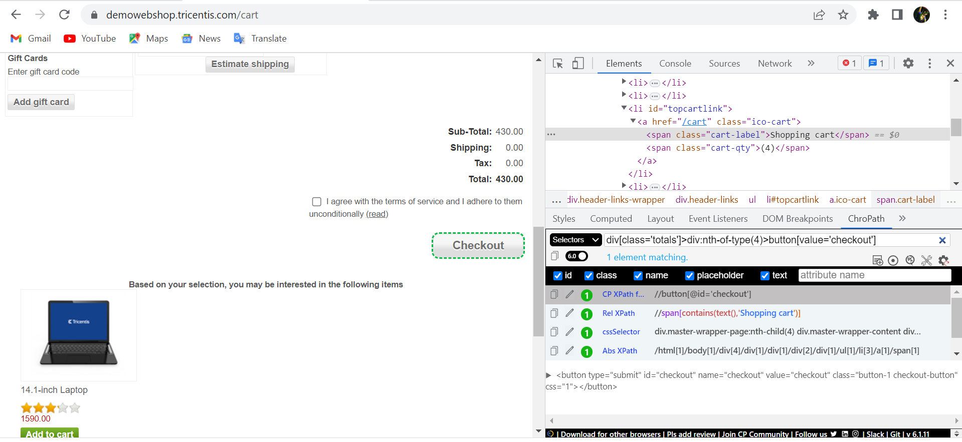
Click on Checkout button– PARENT-CHILD CSS SELECTOR
driver.findElement(By.cssSelector("div[class='totals']>div:nth-of-type(4)>button[value='checkout']"));

Slide 13
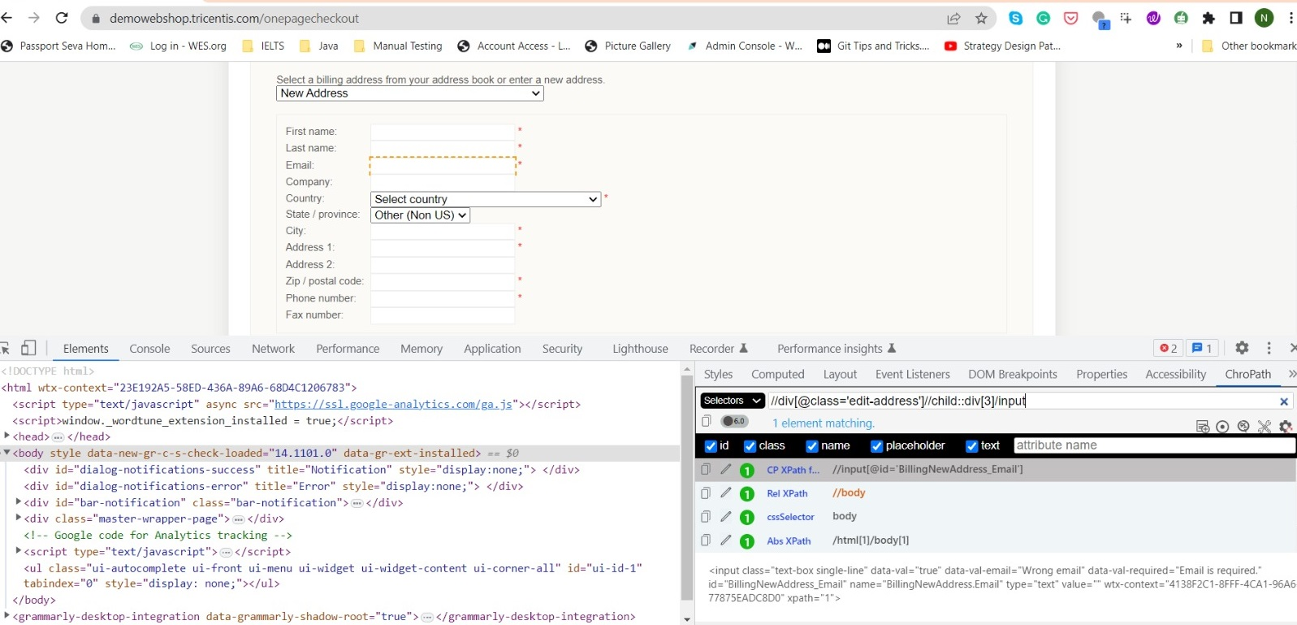
Enter EMAIL in THE billing address section – XPATH CHILD AXES
driver.findElement(By.xpath("//div[@class='edit-address']//child::div[3]/input"));

Slide 14
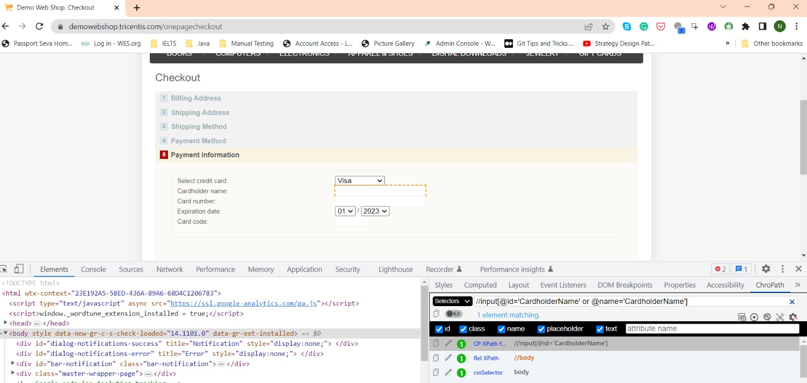
CARD HOLDER NAME IN PAYMENT INFORMATION– XPATH OR Condition
driver.findElement(By.xpath("//input[@id='CardholderName' or @name='CardholderName']"));

Slide 15
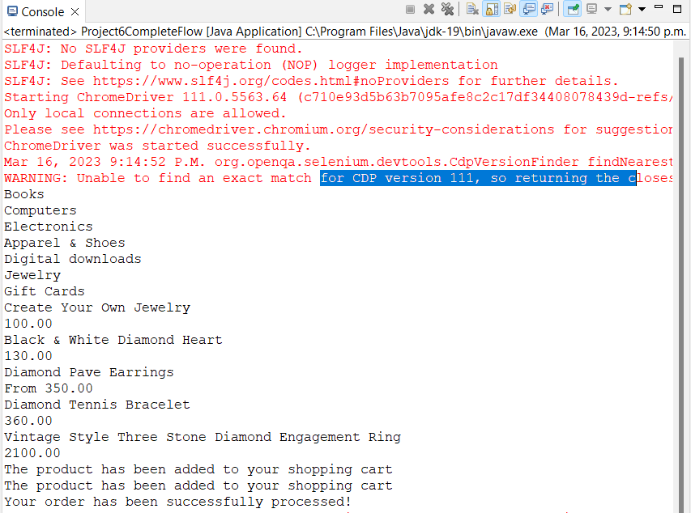
OUTPUT

Slide 16
BENEFITS OF AUTOMATION TESTING
Saves time and money - Once created, automated tests can be run repeatedly at no additional cost, and they are much faster than manual tests. Automated software testing can reduce the time to run repetitive tests from days to hours. A time savings that translates directly into cost savings.
Better test coverage - Test automation can easily execute thousands of different complex test cases during every test run providing coverage that is impossible with manual tests.
Faster debugging – Automated tests run in a continuous pipeline gives the team faster feedback, reducing debugging time and time to resolution.
Improves test accuracy - Automated tests perform the same steps precisely every time they are executed and never forget to record detailed results.

Slide 17
THANK YOU!

