Slide 1
Proposed System:
Two phases:
The suspicion phase
The decision phase.
The suspicion phase linear regression
The decision phase fuzzy logic
Potentially compromised nodes using three newly defined metrics.
No modification of the IEEE 802.11p standard.
Department of IT

Slide 2
Contd..
No need preexisting infrastructure.
Compare MANET,VANET have many constraints.
DOS attack target the operation of MAC layer.
Use several Technique.
DSRC,WAVE,EDCA,CSMA/CA
The EDCA 802.11 backoff procedure consists 4step:
A backoff value in the interval[0,Cw]
The value of Cw increases double+1
The backoff value
The backoff value=0
Department of IT

Slide 3
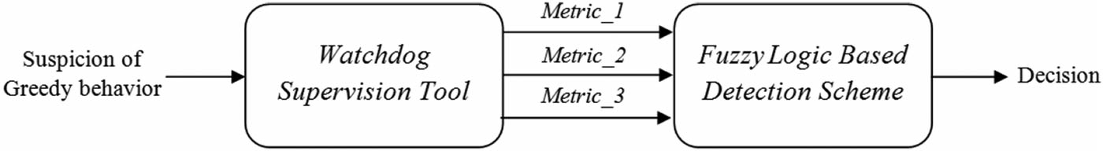
GDVAN Decision Phase
fuzzy logic can be an efficient tool for design.
This scheme detects nodes which aim to violate the proper use of the CSMA/CA protocol rules.
Increase their bandwidth.
3 parameter:
The Number of connection attempts,
The average of connection duration,
The average of waiting times between connections.
Department of IT

Slide 4
Inputs, Fuzzy Sets
Input :3 attributes.
In the classical theory of sets, an element belongs or does not belong to a set.
The gradual assessment of the membership of elements in a set.
Department of IT

Slide 5
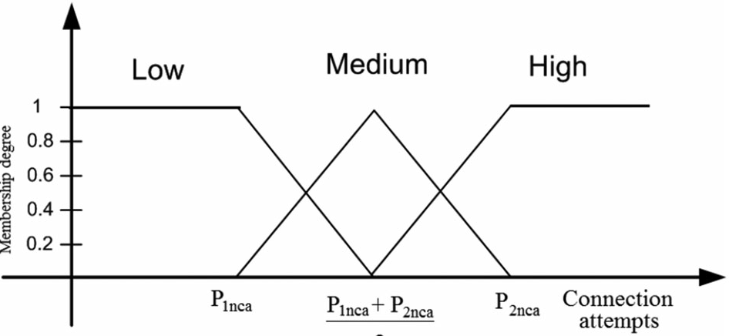
Fuzzification and Membership Degree
Switch from real to fuzzy domain.
we define the membership to one of the following chosen fuzzy sets ‘‘Low’’, ‘‘Medium’’ and ‘‘High’’, respectively denoted by L,M and H.
Ms:U->[0,1]
Ms(e)
Department of IT

Slide 6
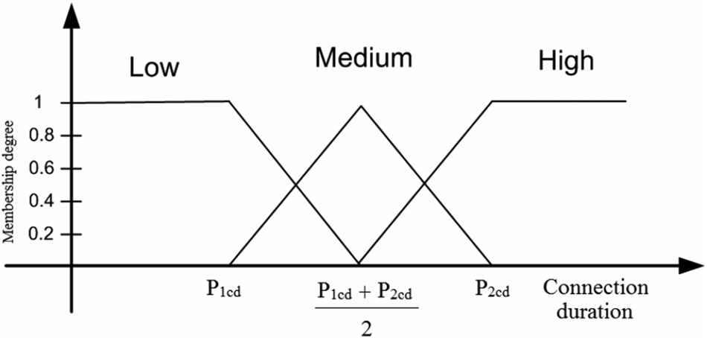
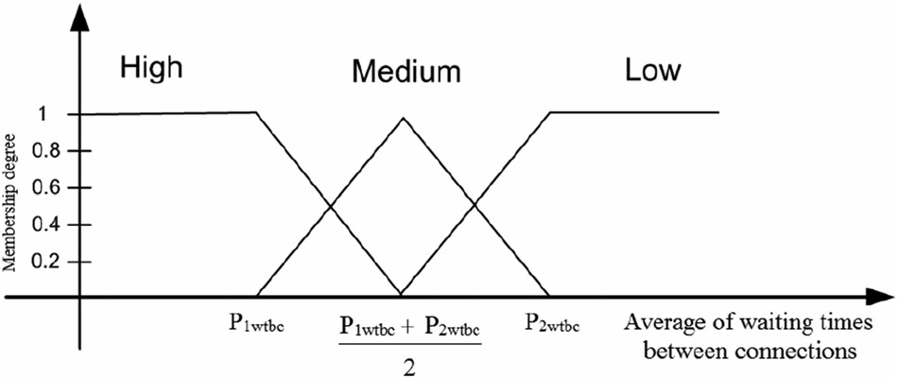
Department of IT

Slide 7
T Monitoring period
N Total number of vehicles.
Tca Number of total connections attempts during T.
Tcd Total connections duration of all vehicles during T.
P1nca Threshold of connection
P2nca Threshold of connection attempts
P1cd Threshold of connection duration.
P2cd Threshold of connection duration.
P1wtbc Threshold of waiting times between connections average from which we begin to suspect greedy behavior.
P2wtbc Threshold of waiting times between connections average from which have no suspected greedy behavior.
Department of IT

Slide 8
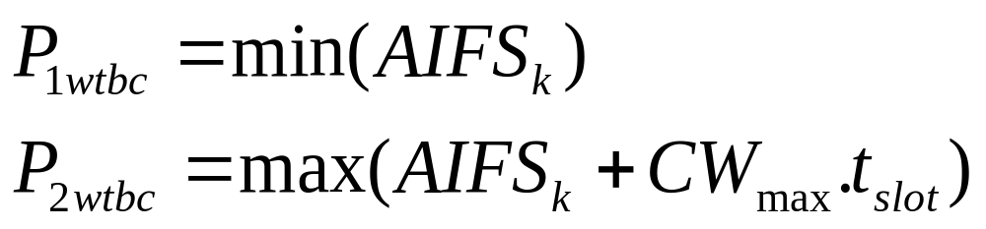
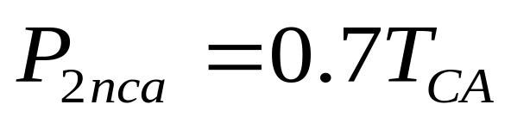

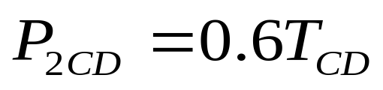
Department of IT

Slide 9
Decision Phase
INPUT: Monitoring period;File: Collected_Trafic_File;
State_Class -N; S; G
OUTPUT: Annonce_Decision(V_ID, State_Class)
begin
Extract Vehicle_IDs existing in File during the T period,
Extract N;
Calculate:TCD,P1cd,P2cd,P1wtbc,P2wtbc;
Foreach Vehicle--{Vehicle_IDs}do
Calculate:Tca,P1nca,P1nca; Calculate:V1;V2;V3;Calculate:Crisp;
If Crisp >50% for the class G then V _ID is G
Elseif Crisp >50% for the class S then V_ID is S
Else V_ID is N end end
Return: Annonce_Decision(V_ID, State_Class)
End
End
Department of IT

Slide 10
Tools Used
Ns2 simulator
Sumo simulator
Rstudio
Department of IT

