Slide 1

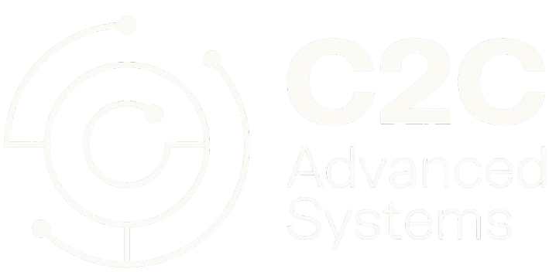
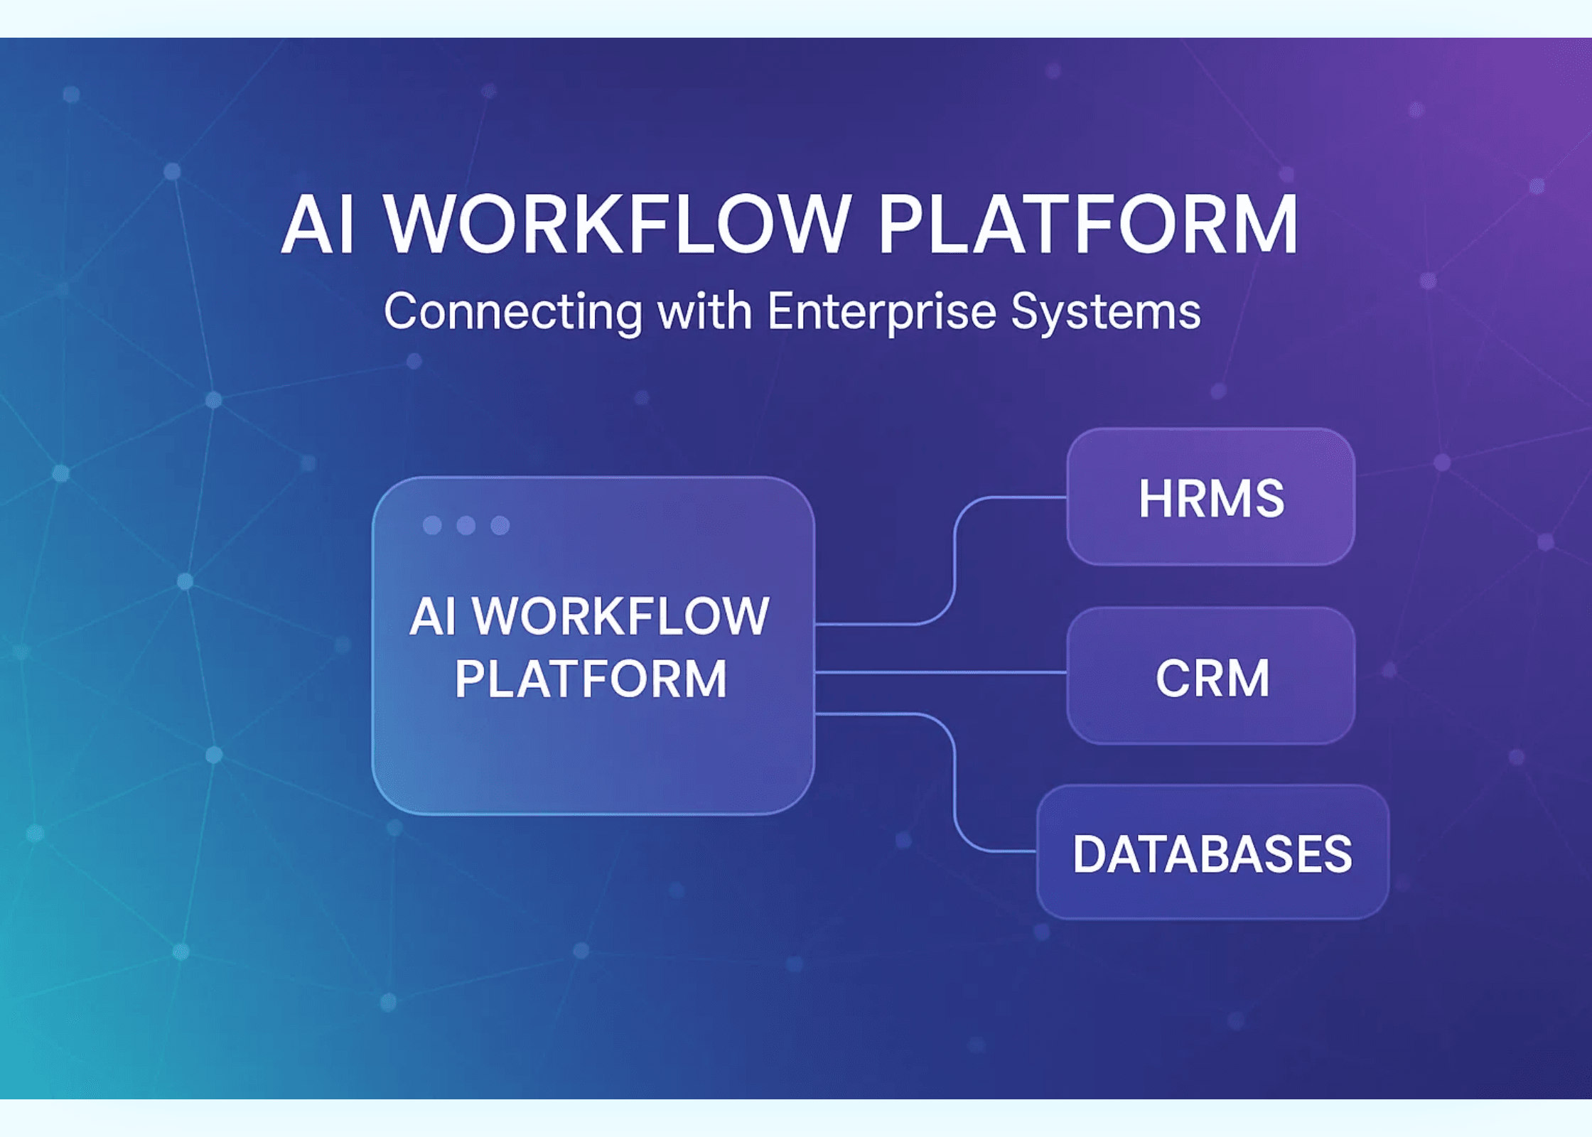
CogniVox.AI
Unified Agentic AI Workflow Platform
Connecting HRMS, CRM, SQL QA, Sales Analysis, and Enterprise Applications through Intelligent Multi-Agent Architecture
Helping every employee work smarter, faster, and more accurately

Slide 2

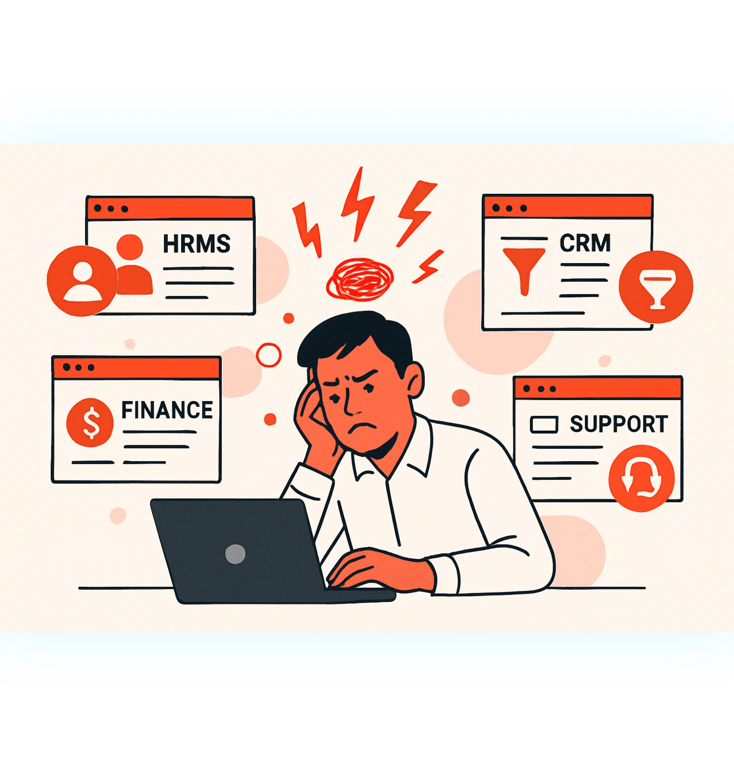
The Business Problem: The Cost of Context Switching
Enterprises struggle with fragmented systems and siloed knowledge
System Fragmentation
Enterprises run multiple, disconnected systems (HRMS, CRM, Finance, Support, Docs, SQL DBs)
Productivity Drain
Employees waste significant time switching between software to find answers
Knowledge Silos
Critical knowledge becomes siloed, outdated, or hard to retrieve, leading to inconsistent decisions
Manual Overload
Support teams are burdened with repetitive queries and manual, high-volume tasks
Result
Productivity Loss • Slow Decisions • Inefficient Workflows

Slide 3

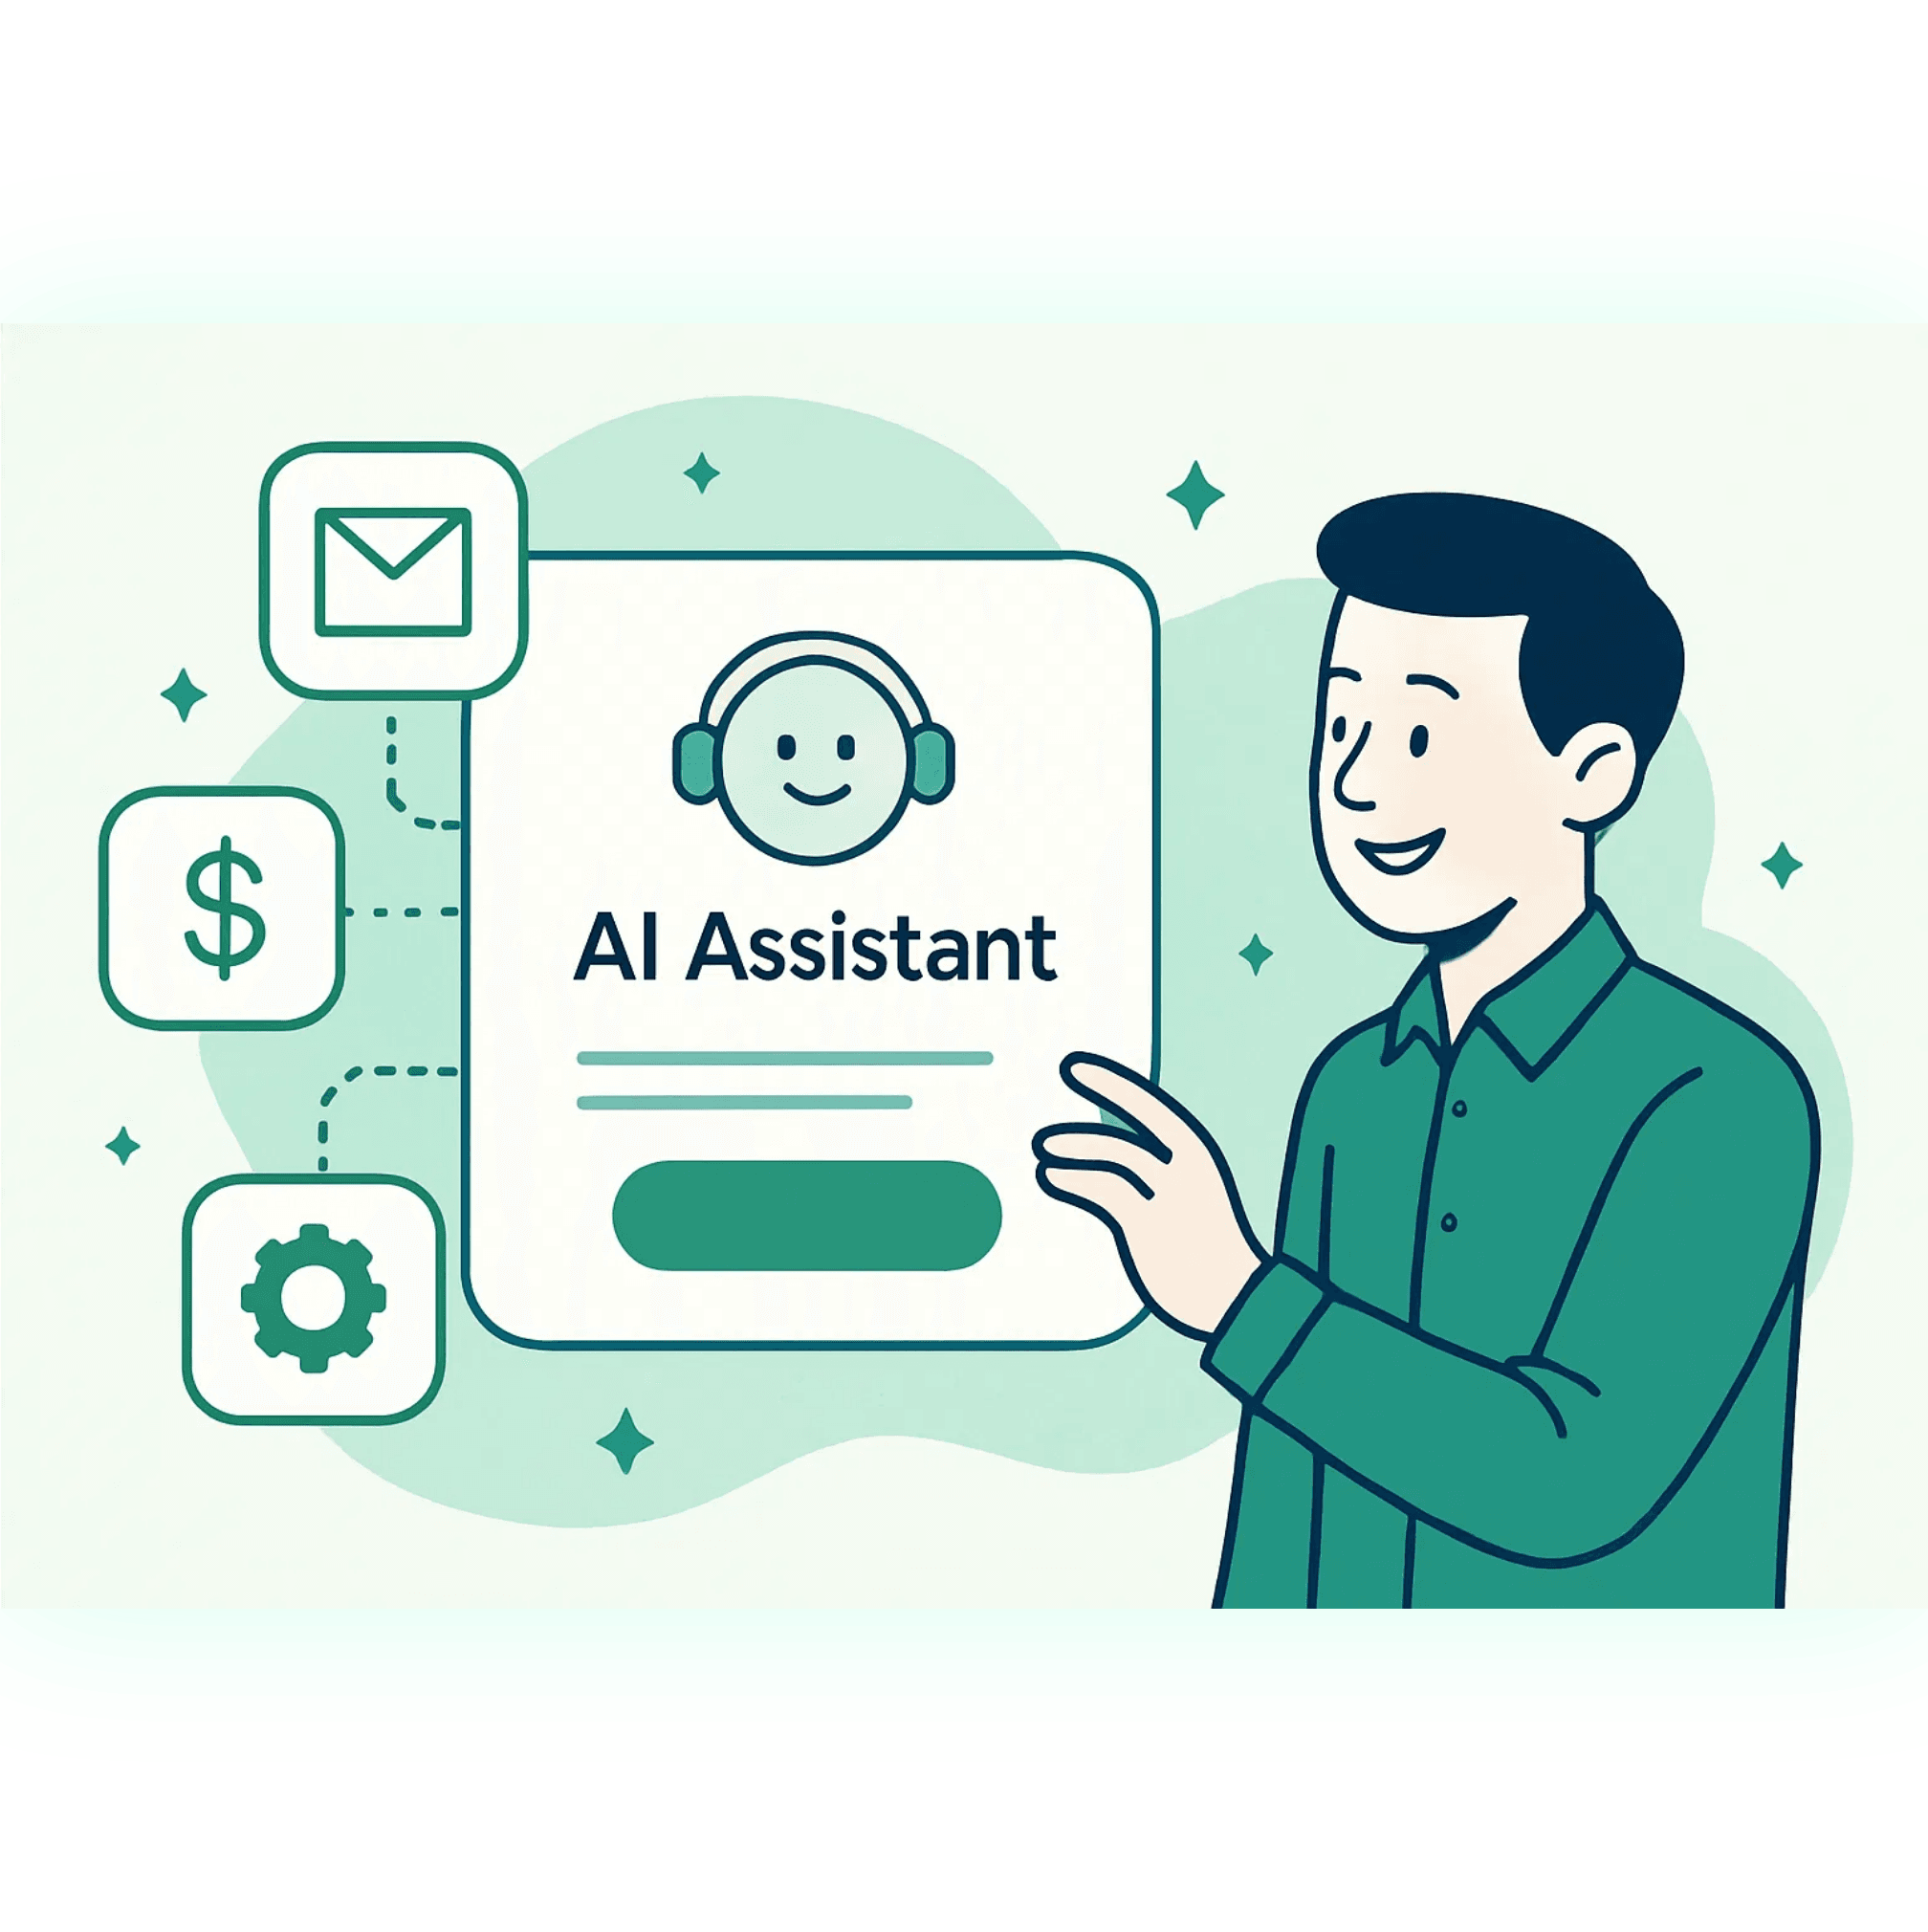
The Vision: One Interface. Zero Context Switching.
A single intelligent assistant that transforms enterprise workflows
Understands User Intent
Interprets complex, multi-step requests with natural language understanding
Pulls Knowledge
Seamlessly accesses and synthesizes knowledge from all business systems
Takes Action
Executes tasks and updates records directly in enterprise systems
Learns & Adapts
Continuously improves from every user interaction and feedback
The Outcome
One interface. Zero context switching. Maximum efficiency.

Slide 4

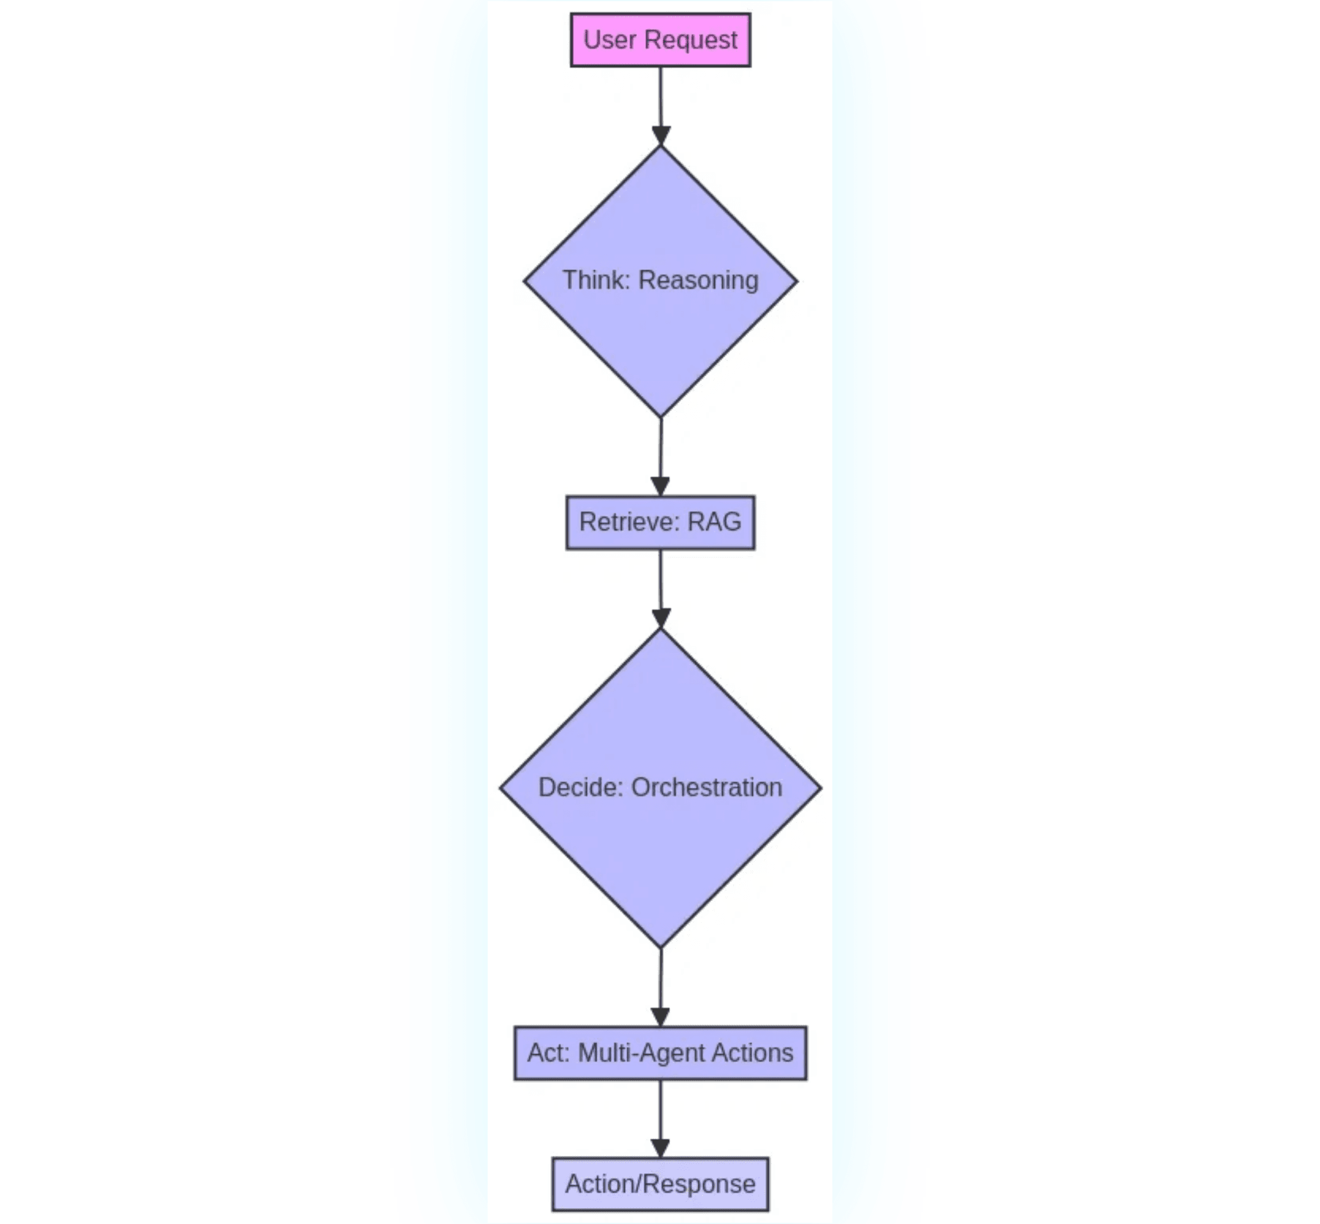
The Technical Differentiator: Agentic RAG
Beyond traditional RAG: A working digital co-worker
Traditional RAG
→
Retrieval: Find information
→
Generation: Answer questions
→
Limited to knowledge lookup
→
No system actions
CogniVox Agentic RAG
→
Think: Reasoning & planning
→
Retrieve: Precise knowledge
→
Decide: Tool orchestration
→
Act: Multi-system execution
Key Takeaway
This is not just a chatbot—this is a working, autonomous digital co-worker.

Slide 5

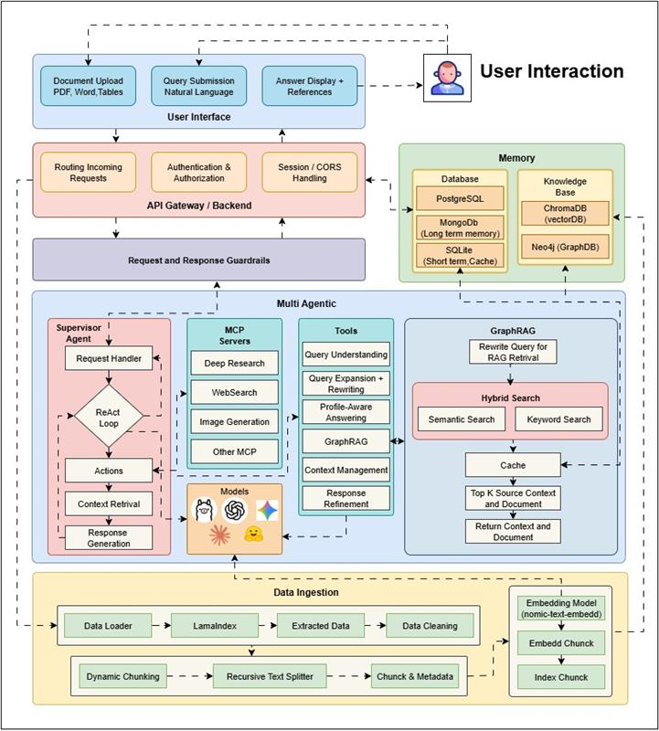
High-Level Architecture:
First three layers of the unified agentic flow
👤
User Interaction Layer
Chat, voice, email, and workflow triggers—multiple input channels for seamless user
engagement
🎯
Multi-Agent Coordinator
The intelligent brain that supervises and routes requests to the correct specialized agent or
tool
↓
🔒
API & Guardrails Layer
Ensures authentication, compliance, audit logging, and safe-response filtering for
enterprise security
↓
🔗
MCP Servers
The secure, high-speed connection layer for deep research and system actions (CRM
updates, HR actions)
📚
Knowledge Stores: RAG System
Retrieves precise context from documents and databases using vector and graph-based
retrieval
✨
Response Builder
Crafts the final, validated, and actionable answer with confidence scores and
recommendations

Slide 6
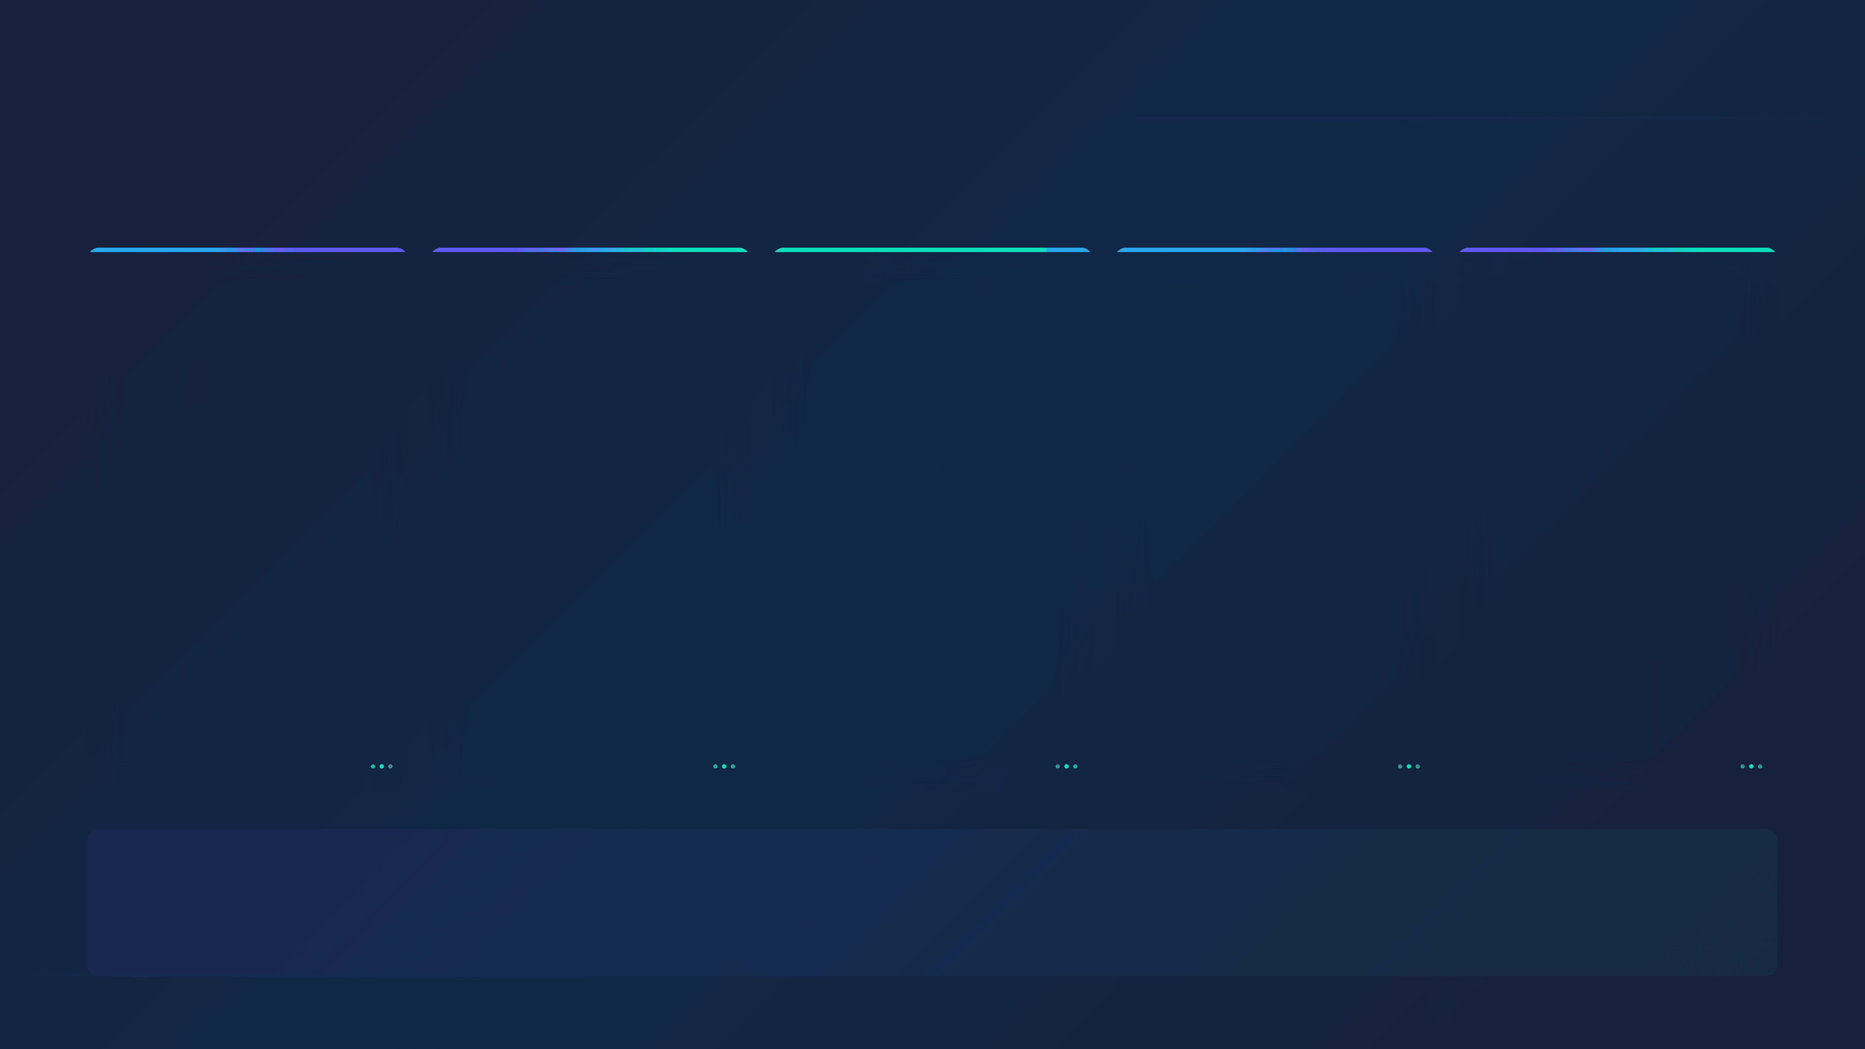
Key System Integrations: Connecting the Enterprise
Secure, flexible integration via MCP Servers and A2A Pipelines
Human Resources
Customer Relations
Data & Analytics
Knowledge Base
Support & Tickets
HRMS
CRM
SQL Databases
Documents
Ticketing
Employee data, PTO, roles, and organizational structure
Leads, accounts, tickets, and customer interactions
Fact tables, business records, and structured data
Policies, SOPs, manuals, and organizational knowledge
Case management, automated responses, and escalations
Connection
Connection
Connection
Connection
Connection
MCP Server + API
A2A API + Event Hooks
SQL QA Multi-Agent
Vector & Graph RAG
API + Workflow Agents
Integration Architecture
CogniVox connects to your enterprise ecosystem through MCP Servers for secure, audited inter-application execution and A2A Integration Pipelines for real-time data synchronization and event-driven workflows.

Slide 7

Intelligent Multi-Agent System: Specialized Expertise
Five specialized agents coordinated by a central orchestration layer
Central Coordination
Supervisor Orchestration Layer
Routes requests to specialized agents and synthesizes responses
↓ Distributes Tasks ↓
🎯
📊
👥
💼
📚
Intent Classifier Agent
SQL QA Agent
HRMS Action Agent
CRM Insight Agent
RAG Knowledge Agent
Understands user request and performs intelligent task routing
Queries structured data and returns verified results from databases
Creates or updates HR requests and manages employee workflows
Retrieves customer pipeline data and generates revenue forecasts
Fetches policy docs and knowledge base for relevant information
Task Routing
Verified SQL Results
Workflow Tickets
Revenue Reports
Relevant Snippets

Slide 8

Agentic Workflow in Action
User Request & Intelligent Routing
User Request
"Show me the current sales pipeline and apply leave for tomorrow."
↓
Multi-Agent Coordinator
Intelligent Request Analysis & Routing
Analyzes the request to identify two distinct tasks: sales pipeline retrieval and leave request processing. Routes each task to the appropriate specialized agent.
↓
📊 CRM Task
👤 HRMS Task
Assigned Agent
Assigned Agent
CRM Insight Agent
HRMS Action Agent
Specialized in customer data, pipeline analysis, and revenue forecasting
Specialized in employee workflows, leave management, and HR operations
Both agents execute in parallel → See execution details on the next slide

Slide 9

Execution & Results: Parallel Processing
Both systems execute simultaneously with coordinated responses
📊 CRM Flow (Sales)
👤 HRMS Flow (HR)
Step 2
Step 2
Query via MCP
Trigger Workflow
Connects to CRM via MCP Server to retrieve pipeline summary
Connects to HRMS via MCP to trigger leave request workflow
↓
↓
Step 3
Step 3
Generate Output
Create Ticket
Returns pipeline summary, deal stages, and revenue forecasts
Generates workflow ticket for leave approval and sends notification
Final Combined Response
Sales Pipeline
Leave Request
Current pipeline summary with deal stages, win probability, and revenue forecasts
Confirmation prompt for leave approval workflow with ticket reference
Result: A complex, multi-system action completed in a single, seamless interaction—no context switching, no manual coordination required

Slide 10

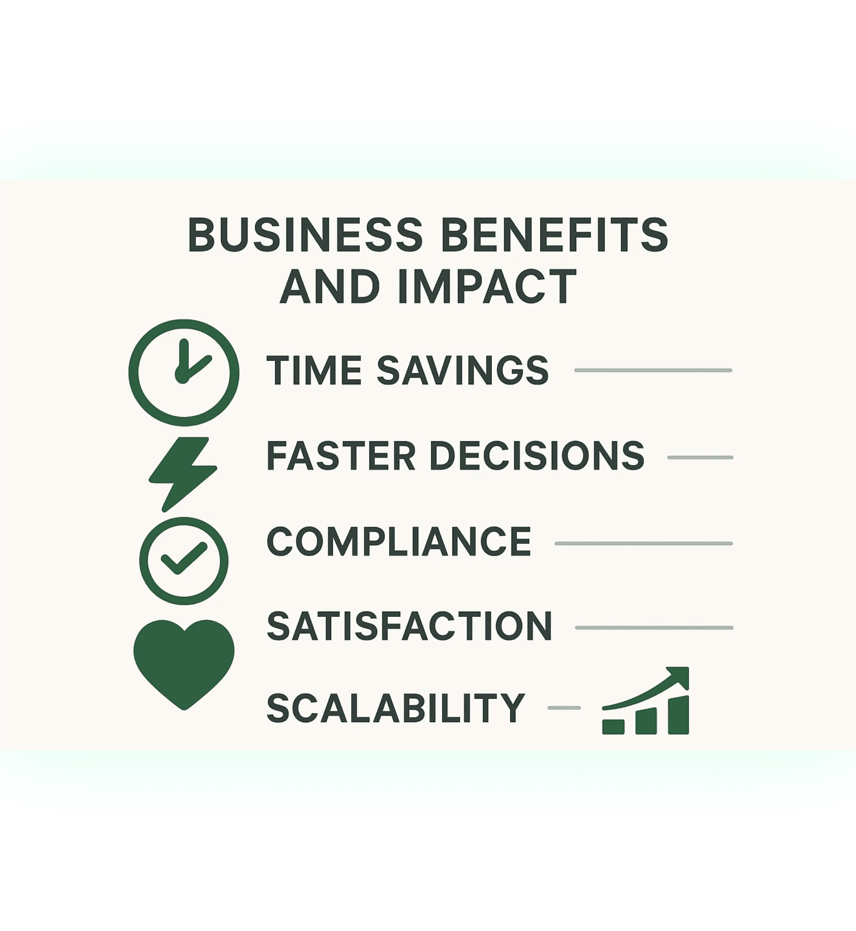
Business Benefits: Driving Quantifiable Impact
Measurable outcomes that deliver clear ROI
20–40% Time Savings
Reduced Manual Effort
Per employee, freeing up staff for high-value strategic work and innovation
Minutes Instead of Hours
Faster Decision-Making
Accelerates business cycles and enables real-time responsiveness to market changes
Reduced Errors & Audit Risks
Consistent & Compliant
Automated, validated responses ensure regulatory compliance and data accuracy
Higher Trust & Retention
Better Experience
Improved customer and employee satisfaction through faster, more accurate service
Growth Without Headcount
Enterprise Scalability
Supports organizational growth and expansion efficiently without proportional cost increases
Investment Value
CogniVox is an investment that delivers a clear, measurable ROI within the first deployment phase.

Slide 11

Technical Advantages: Robust, Secure, and Future-Proof
Built for enterprise reliability and continuous evolution
Agent-Based Reasoning
Graph-Enhanced RAG
Ensures correct workflow selection and execution every time, with transparent decision-making and audit trails for compliance.
Drastically reduces hallucinations and improves answer precision by leveraging knowledge graphs and semantic relationships.
MCP-Based Connections
Memory Layer
Allows secure, audited, and high-speed inter-application execution with standardized protocols and encryption.
Enables personalized, context-aware, and continuous conversations with persistent user interaction history and preferences.
Seamless Integration
Enterprise Ready
Works with existing systems—no need to replace core software. Extends current infrastructure without disruption.
Designed for scale with multi-tenant architecture, role-based access control, and comprehensive logging and monitoring.
Why This Matters
CogniVox combines cutting-edge AI techniques with enterprise-grade reliability. The result is a platform that not only delivers intelligent automation today but also adapts and improves as your organization evolves. No vendor lock-in, no legacy system replacement—just smarter work.

Slide 12


Deployment Roadmap: A Phased Approach to Value
Structured, low-risk implementation with rapid time-to-value
Phase 1
Phase 2
Phase 3
Phase 4
Foundation
Connectivity
Automation
Scaling
3-6 Weeks
6-12 Weeks
12-18 Weeks
Ongoing
Deploy core RAG + Multi-Agent QA. Focus: Knowledge Retrieval.
Connect HRMS + CRM via MCP + A2A. Focus: System Insights & Data Access.
Add workflow-automation + approval agents. Focus: Action & Workflow Execution.
Full organization rollout with continuous learning and new integrations. Focus: Enterprise-wide Efficiency.
✓ RAG System ✓ QA Agents ✓ Knowledge Base
✓ MCP Servers ✓ A2A Pipelines ✓ System Connectors
✓ Workflow Agents ✓ Approval Flows ✓ Automation Rules
✓ Org Rollout ✓ New Integrations ✓ Continuous Learning
Implementation Strategy
A structured, low-risk approach ensures rapid time-to-value with measurable ROI at each phase

Slide 13
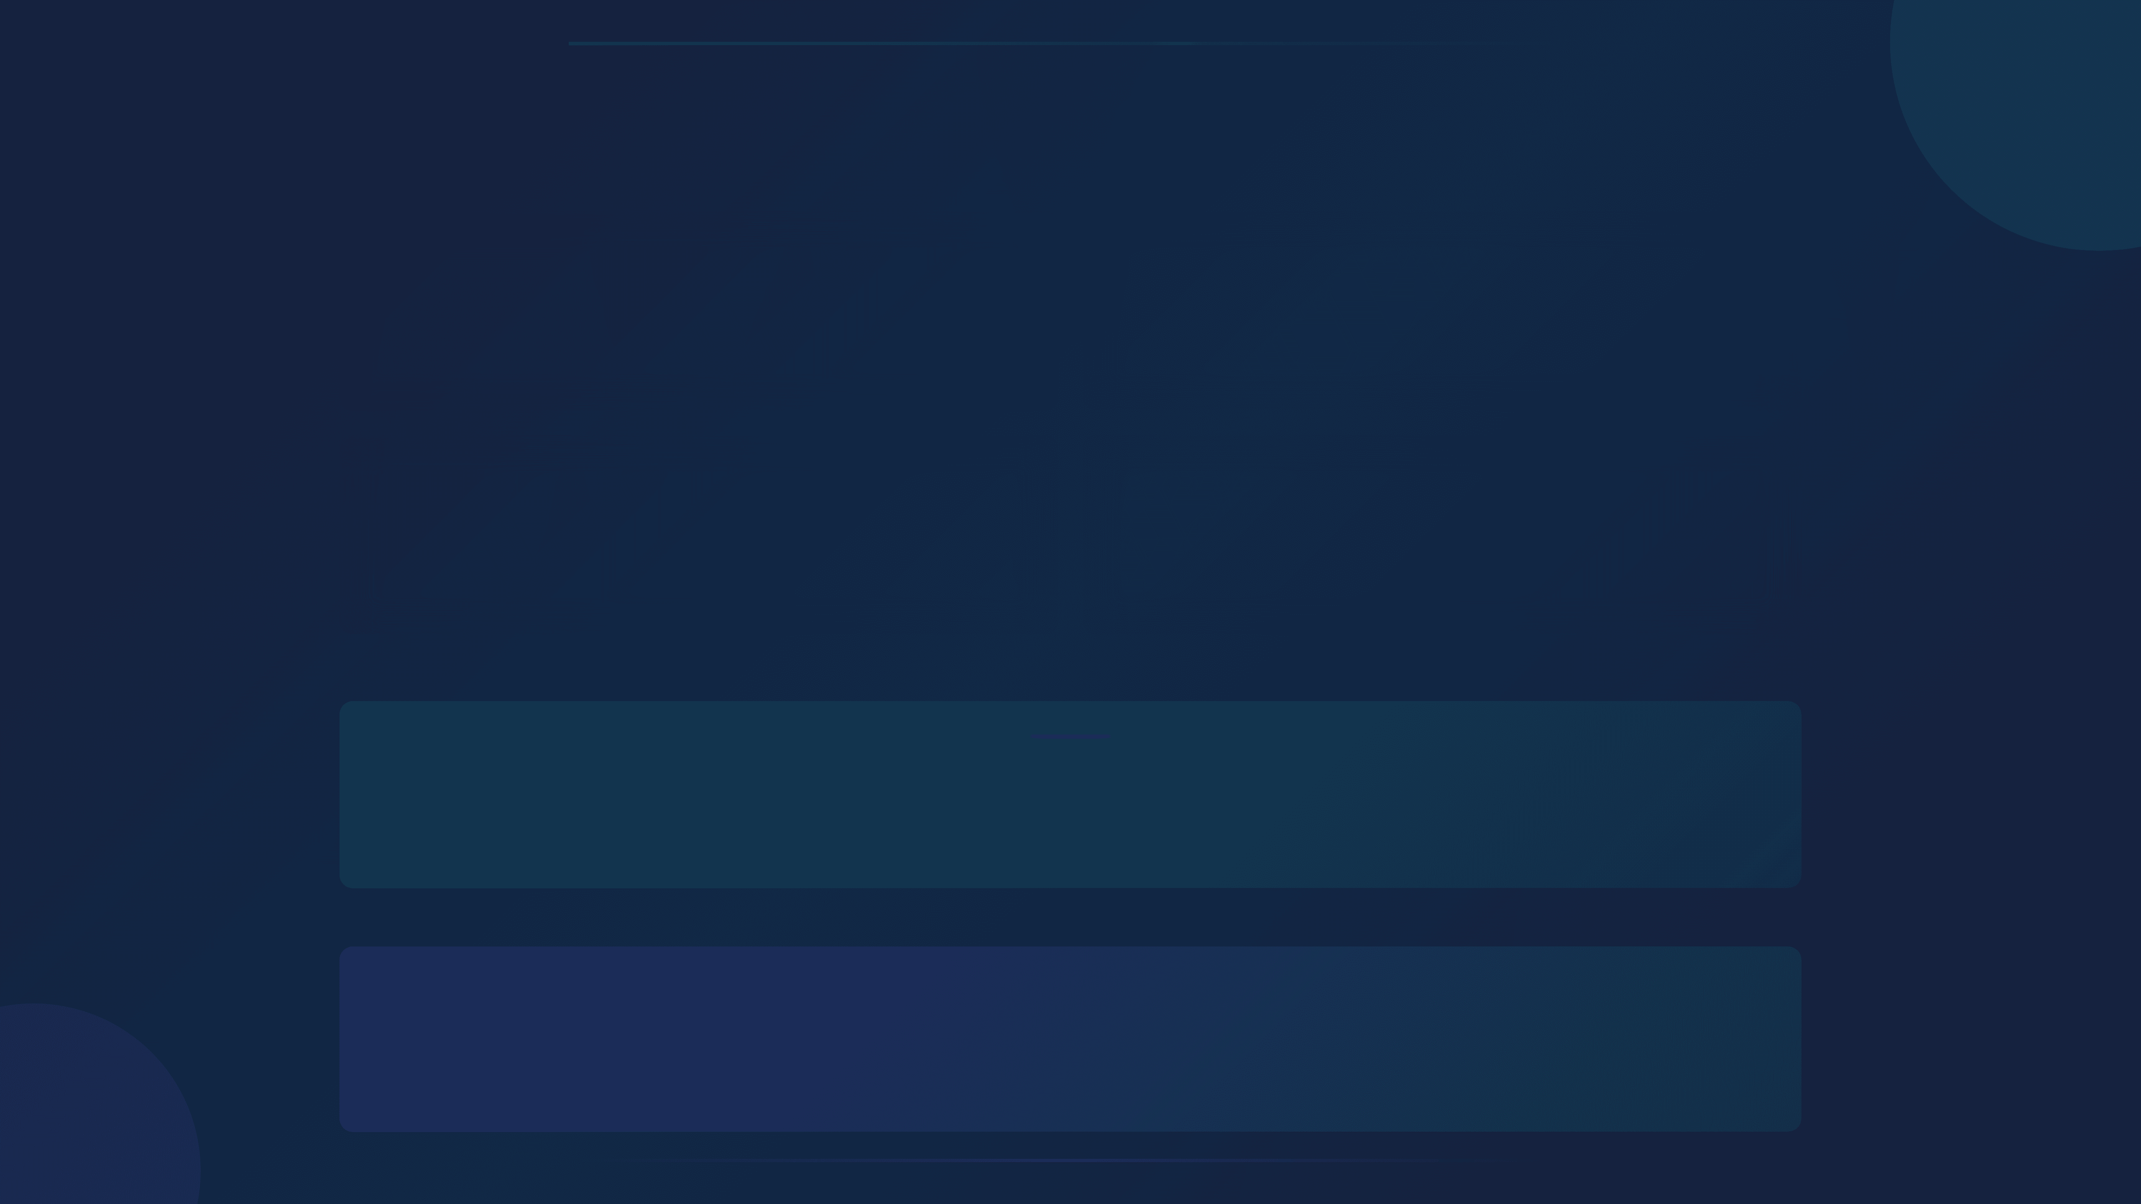
Enable Your Intelligent Operational Co-Pilot
⚡
🎯
Faster Work
Better Decisions
✨
📈
Less Friction
Higher Performance
We build the system. Your people become future-ready.
Transform how your organization works with intelligent automation that scales with your ambitions.
Next Step
Let's schedule a deep-dive technical demo and architecture review
Ready to enable your workforce with an intelligent operational co-pilot? Let's talk.

