Slide 1
Cognivox
AI-powered knowledge intelligence

Slide 2
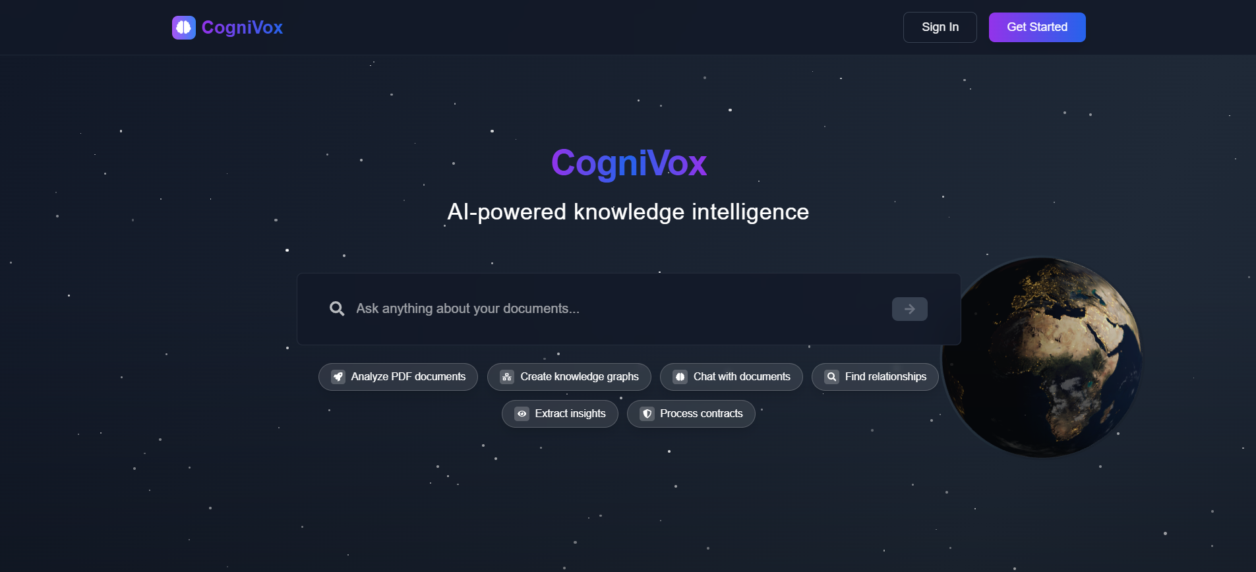
Landing Page

Slide 3
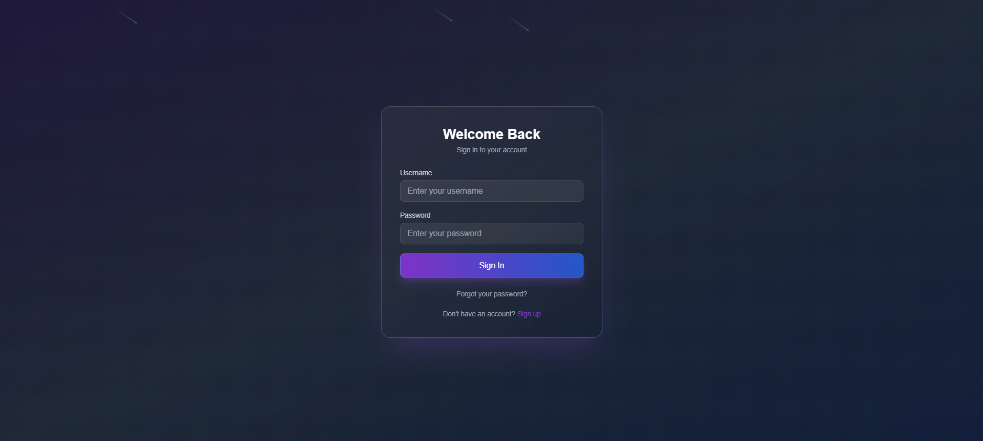
Login Page

Slide 4
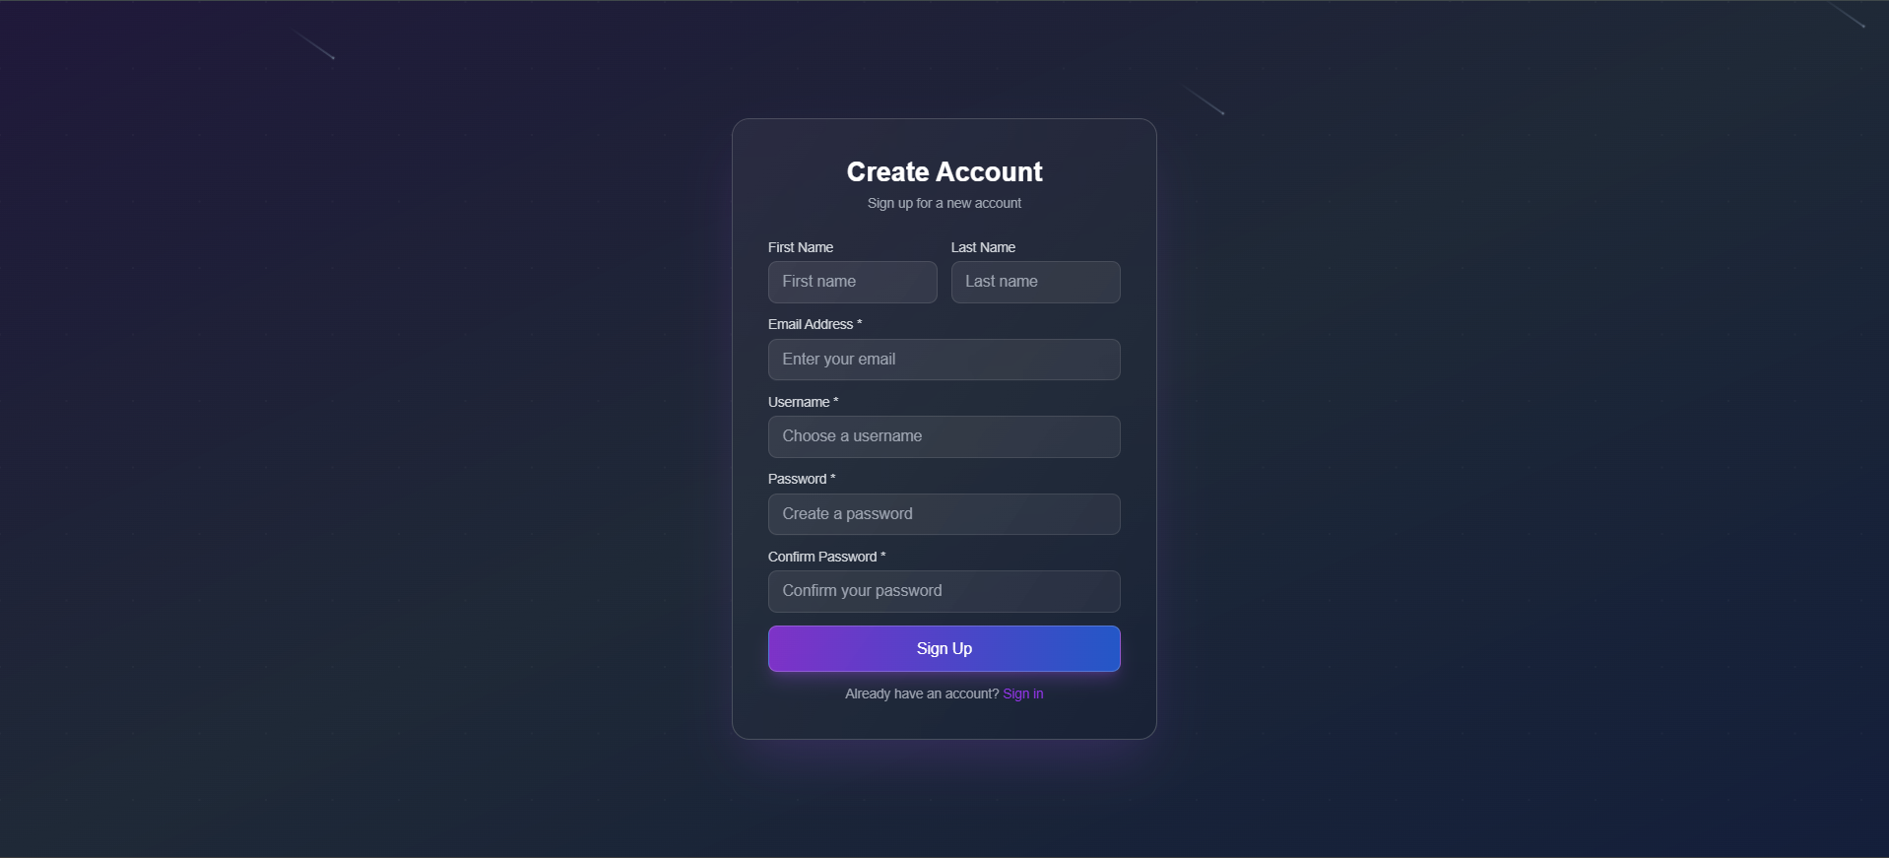
Sign Up Page

Slide 5
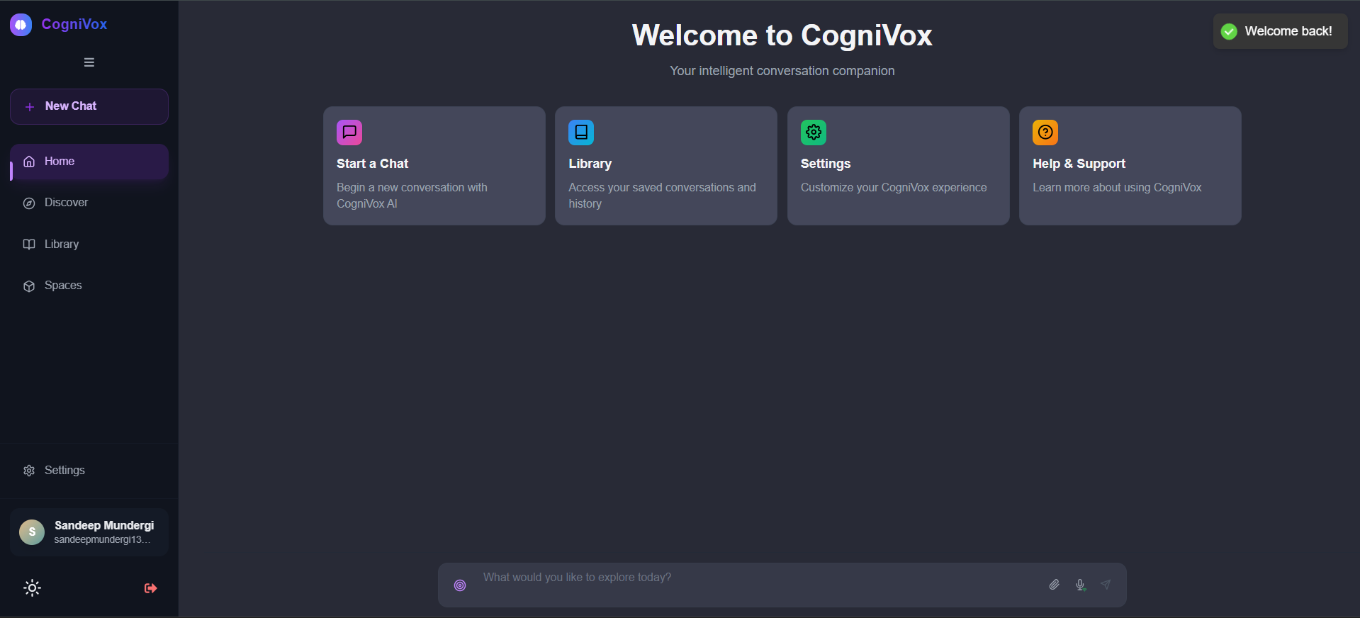
Home Page

Slide 6
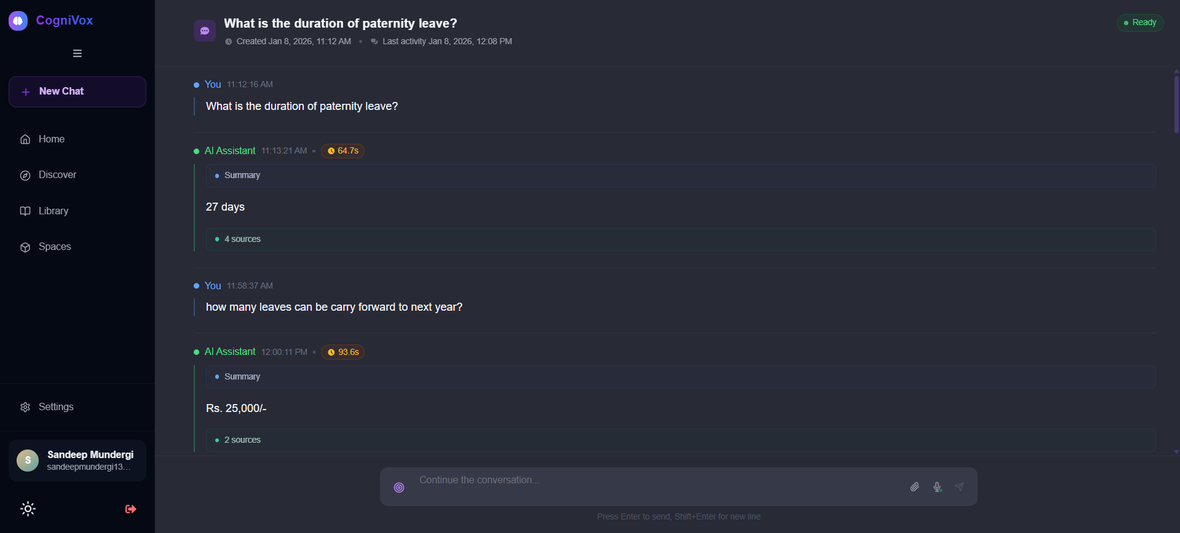
Chat Thread Page

Slide 7
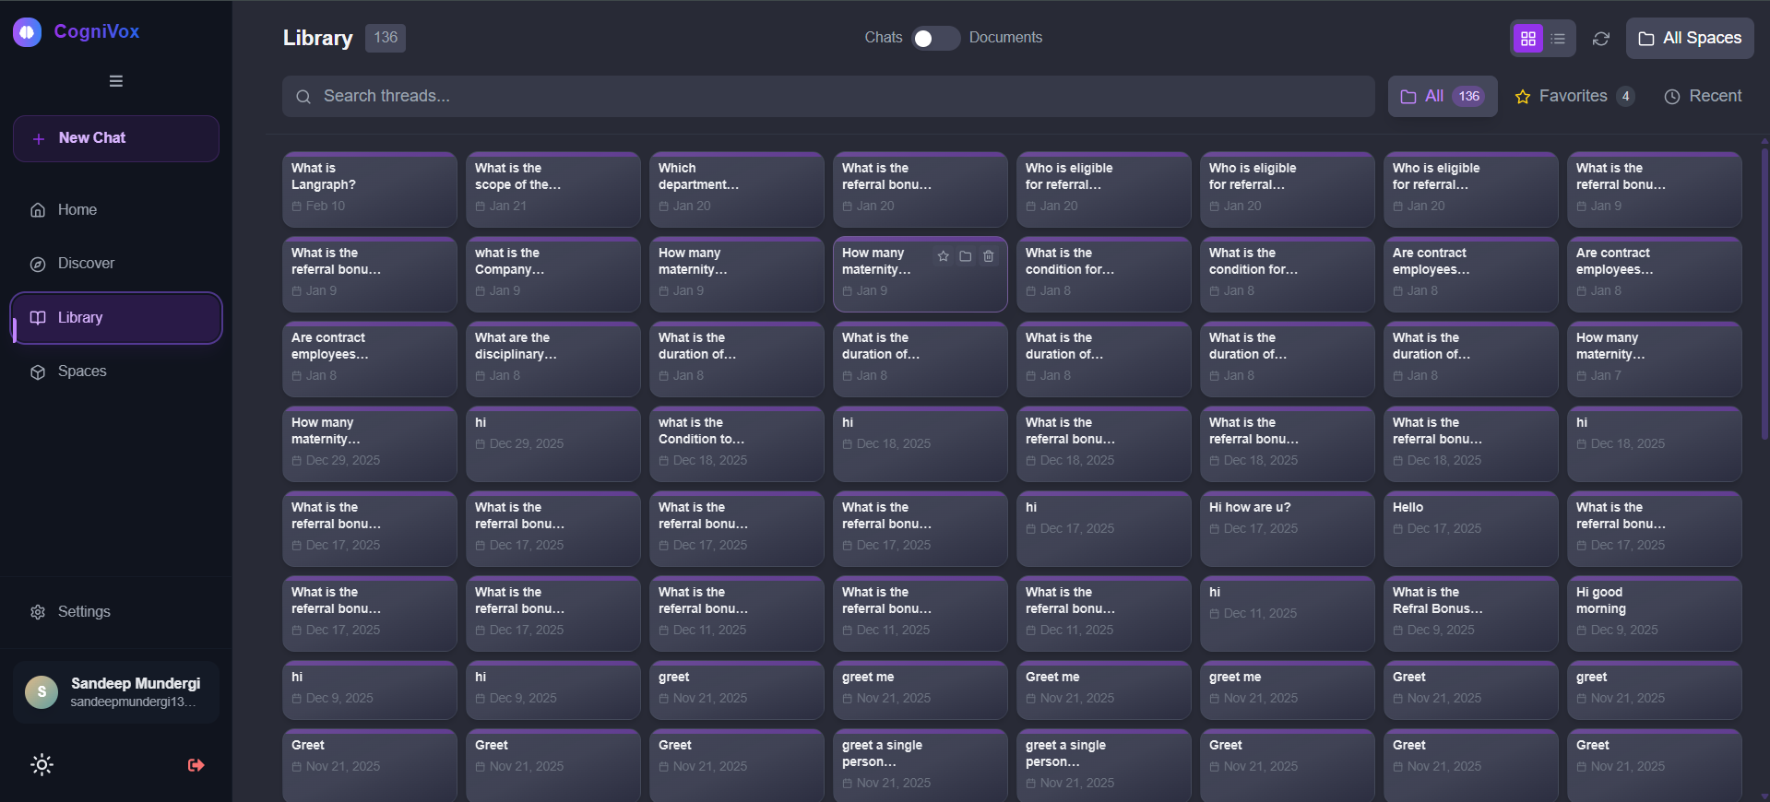
Library Chat Page

Slide 8
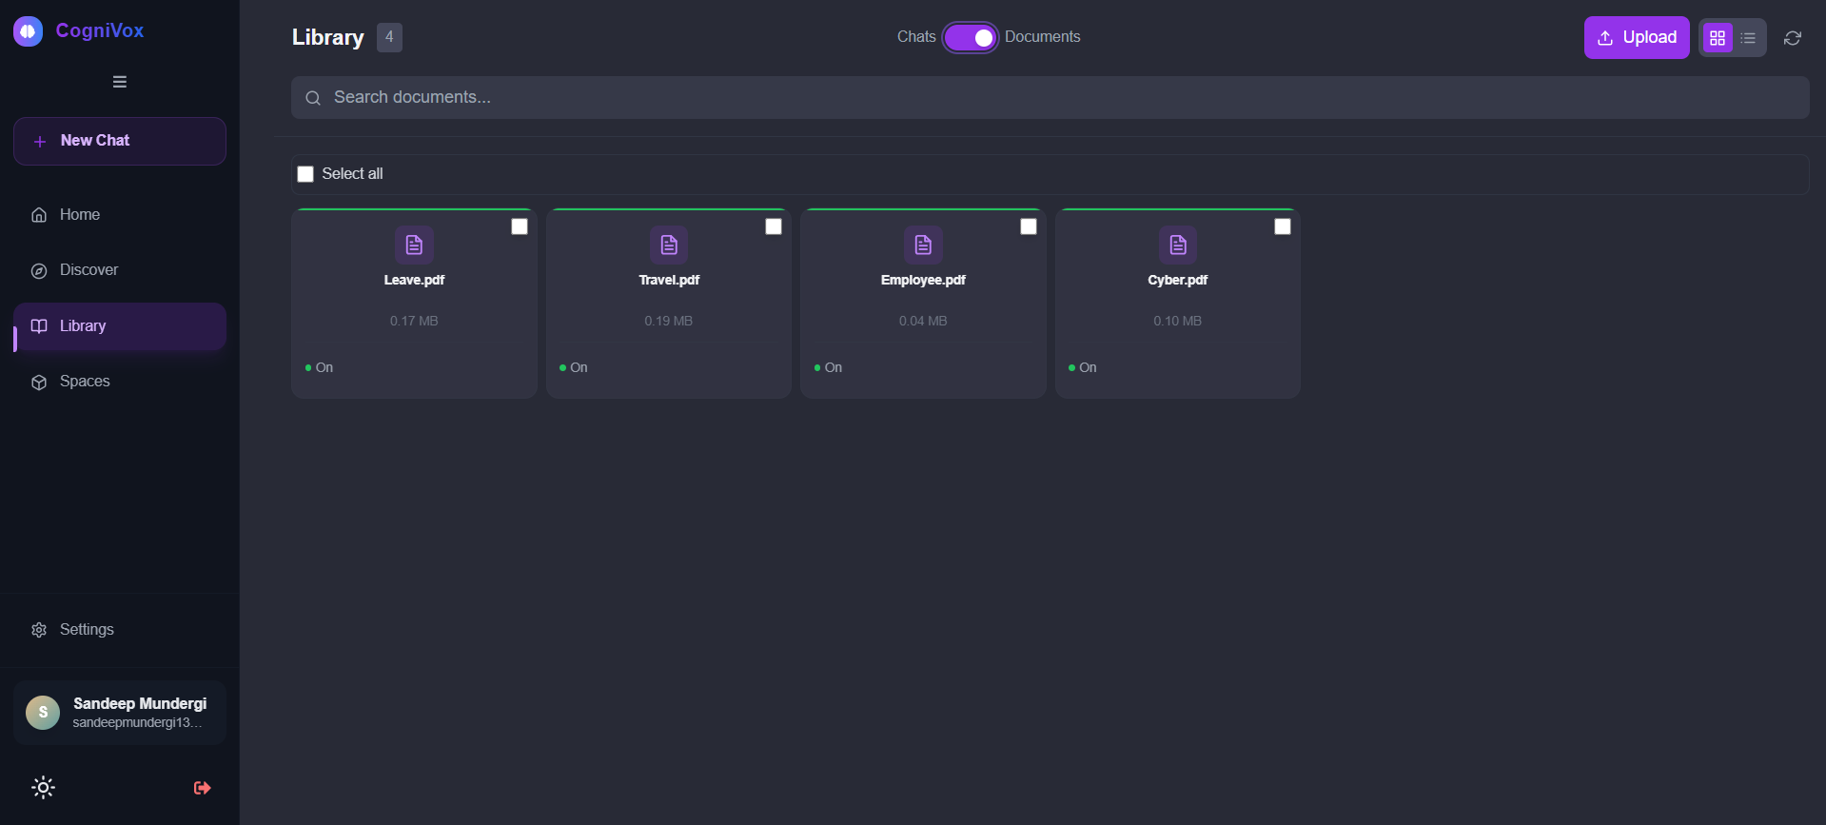
Library Document Page

Slide 9
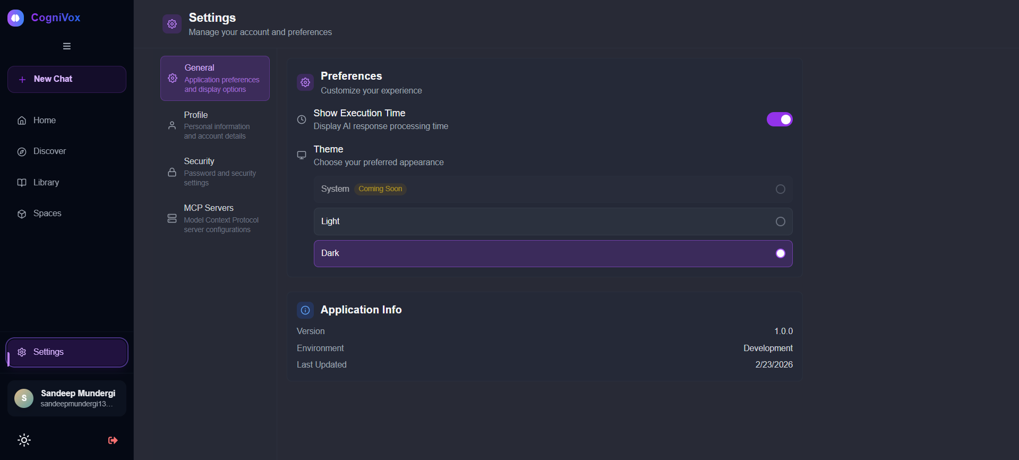
Settings General Page

Slide 10
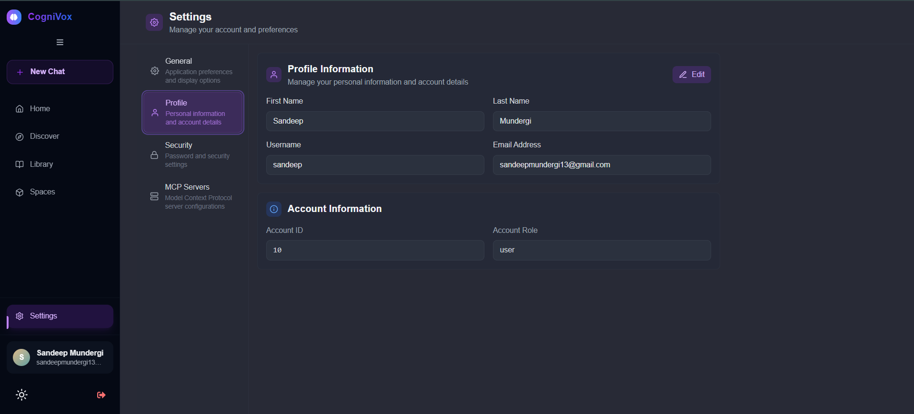
Settings Profile Page

Slide 11
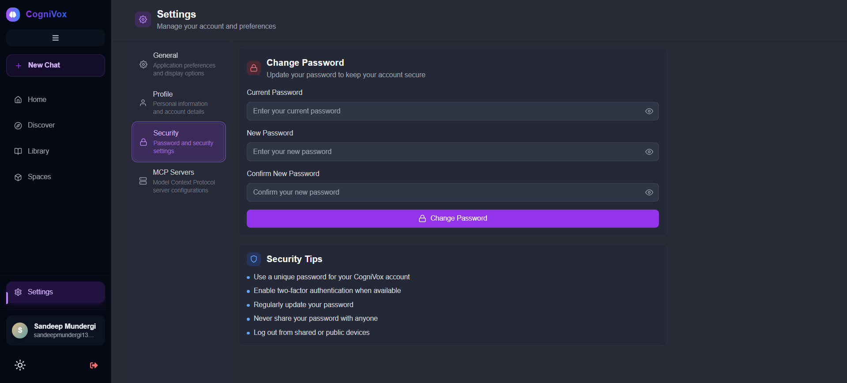
Settings Security Page

Slide 12
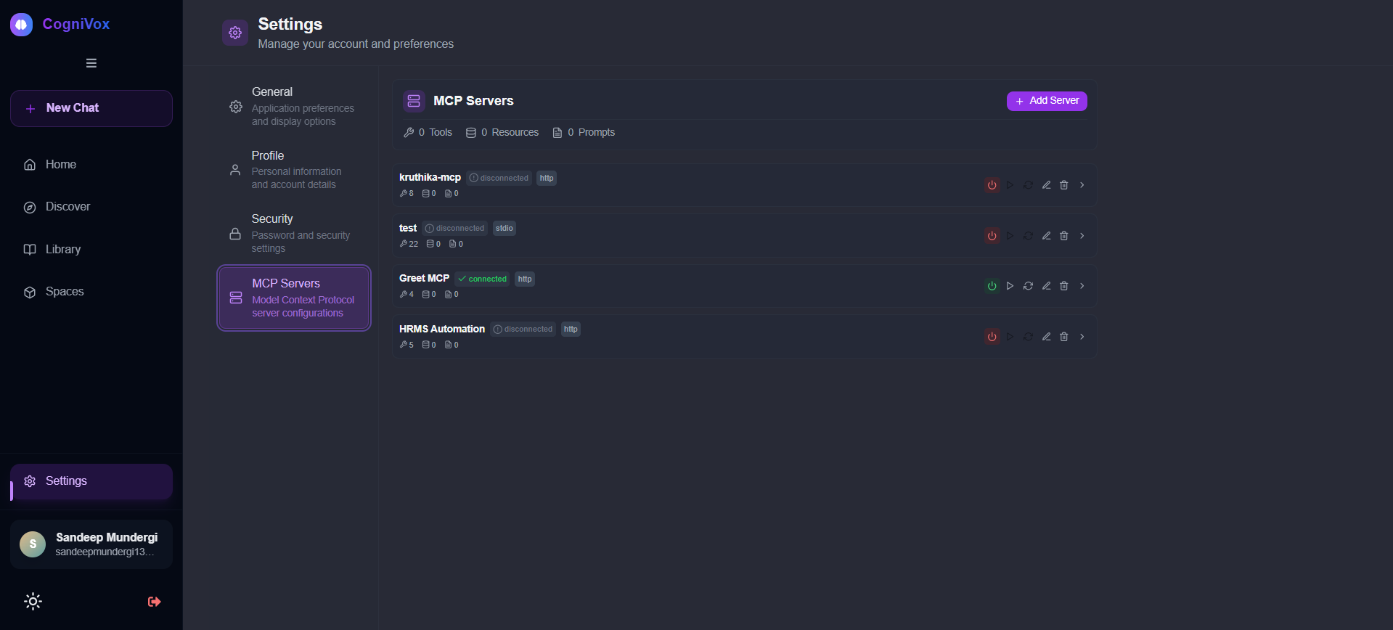
Settings MCP Server Page

