Slide 1

ParseQri
Text-to-SQL AI Tool for Human-Friendly Data Interaction
Powered by C2C Advanced Systems

Slide 2

Introduction
ParseQri is an advanced Text-to-SQL AI tool designed to seamlessly convert natural language queries into SQL queries. It integrates multiple intelligent agents to process, validate, and visualize data, bridging the gap between human language and database interactions.
Problem Statement
Text-to-SQL conversion is challenging due to:
Ambiguity in natural language queries
Complex database schemas
Need for human-friendly output and visualizations
Efficiency in handling large datasets

Slide 3
Solution - ParseQri
ParseQri leverages a multi-agent system to address these challenges. The key agents include:
Query Intent Classifier
SQL Generation Agent
SQL Validation Agent
Visualization Agent
ParseQri enhances accuracy, adaptability, and usability in
text-to-SQL applications.
System Workflow
ParseQri's architecture includes:
Collaborative Multi-Agent Framework
Data Integration from CSV to SQL
Query Processing and Validation
Response Formatting and Visualization

Slide 4
Key Features
Use Cases
Converts natural language to SQL queries
Supports CSV data integration to SQL
Connects to SQL Server and other databases seamlessly
Provides human-understandable answers
Generates SQL queries and visualizations
Multi-agent system for high accuracy and efficiency
Automated data querying for non-technical users
Medical data analysis and visualization
Real-time business intelligence reporting
Database management in educational and research settings

Slide 5
Performance Metrics
Interface Demonstration
High accuracy in SQL generation (Exact SQL Match Accuracy)
Efficient response time (Latency and Efficiency)
Human-friendly output (Response Formatting)
Dynamic chart generation for data presentation
showcasing the ParseQri with sample interface images demonstrating the core functionalities:
Natural language to SQL query conversion
Real-time data visualization
Query validation and error handling

Slide 6
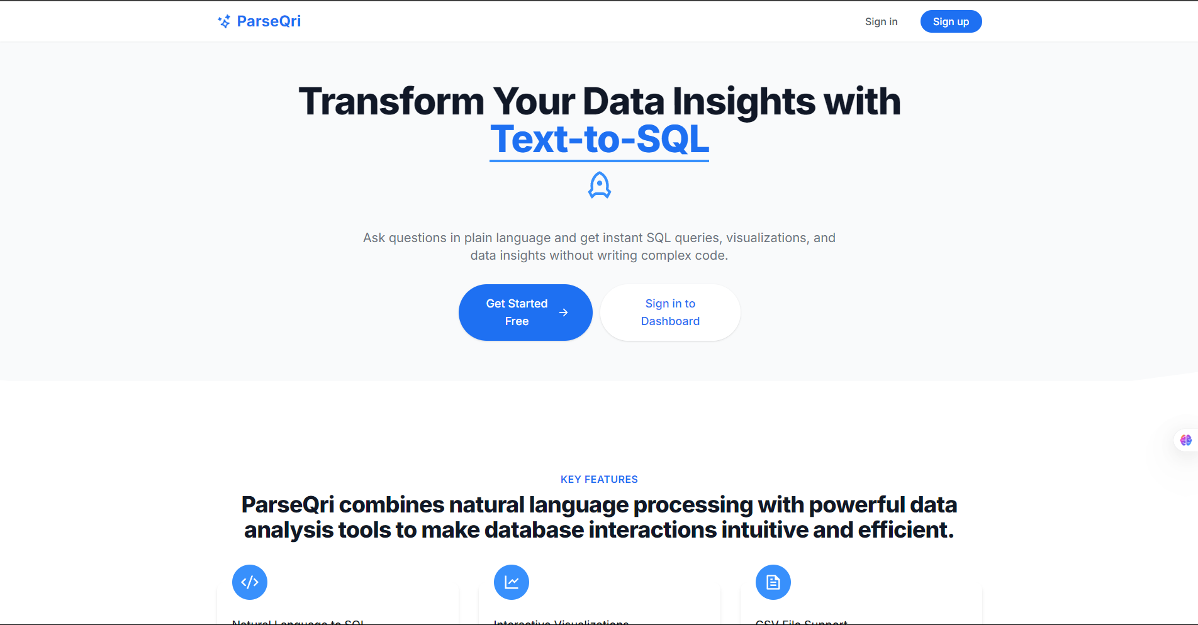
Landing Page

Slide 7
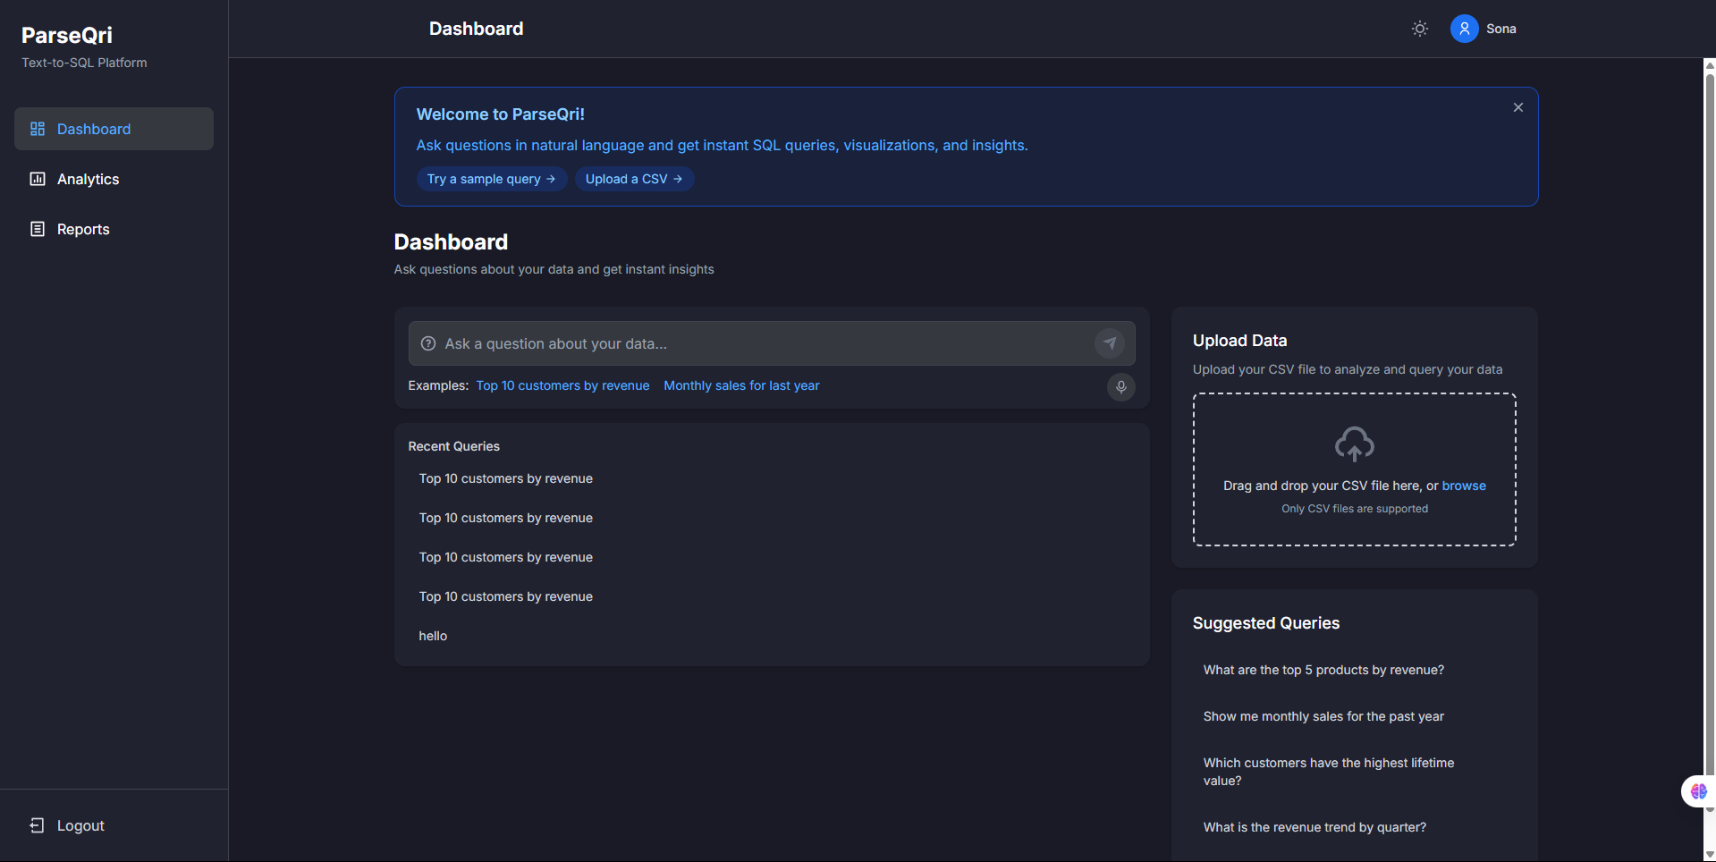
Dashboard (Dark theme)

Slide 8
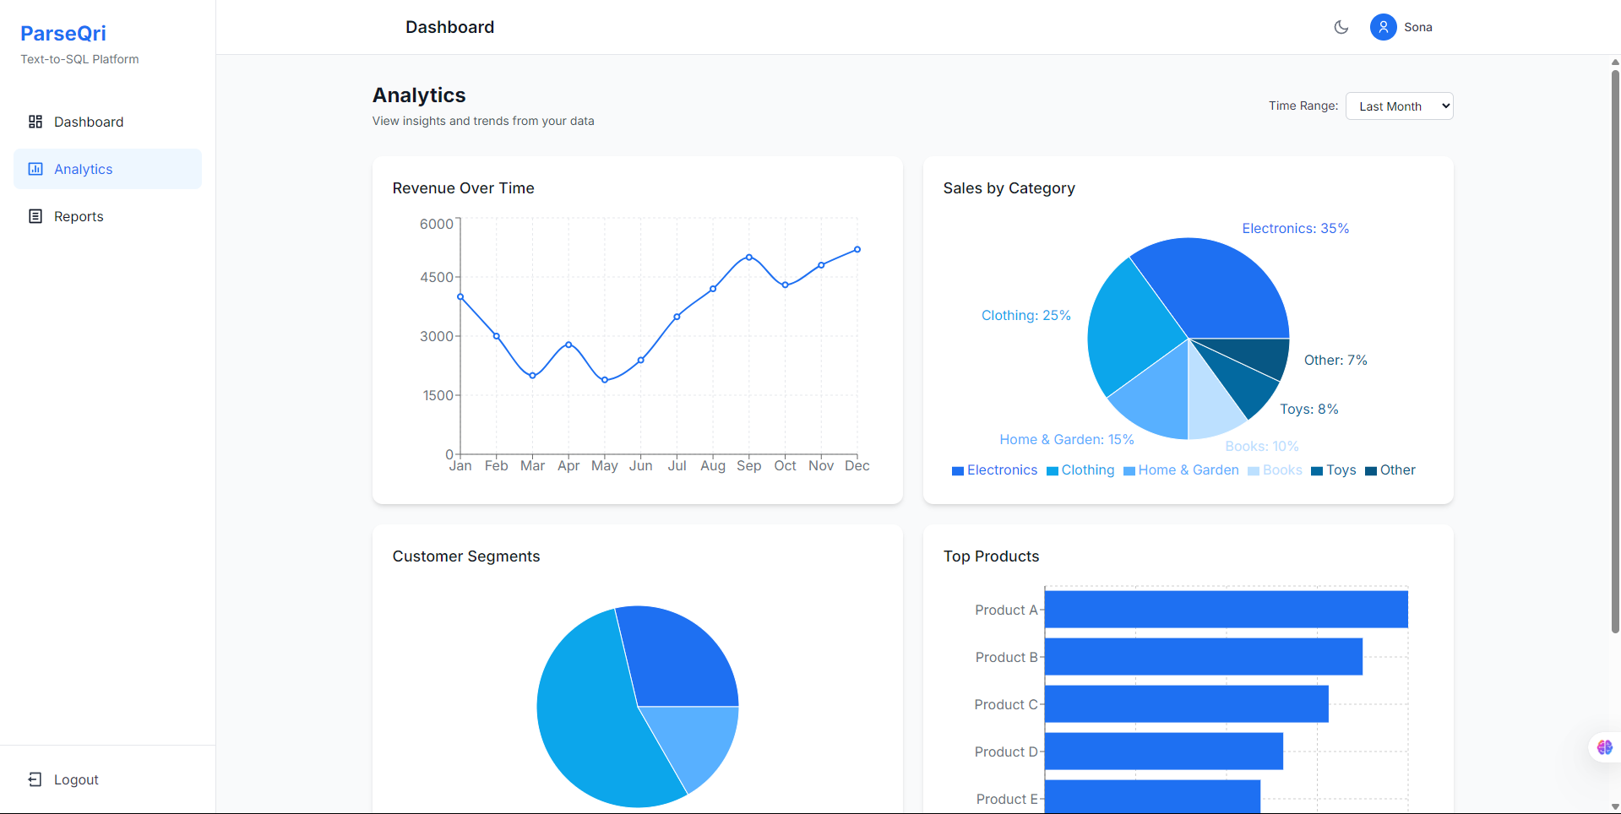
Analytics

Slide 9
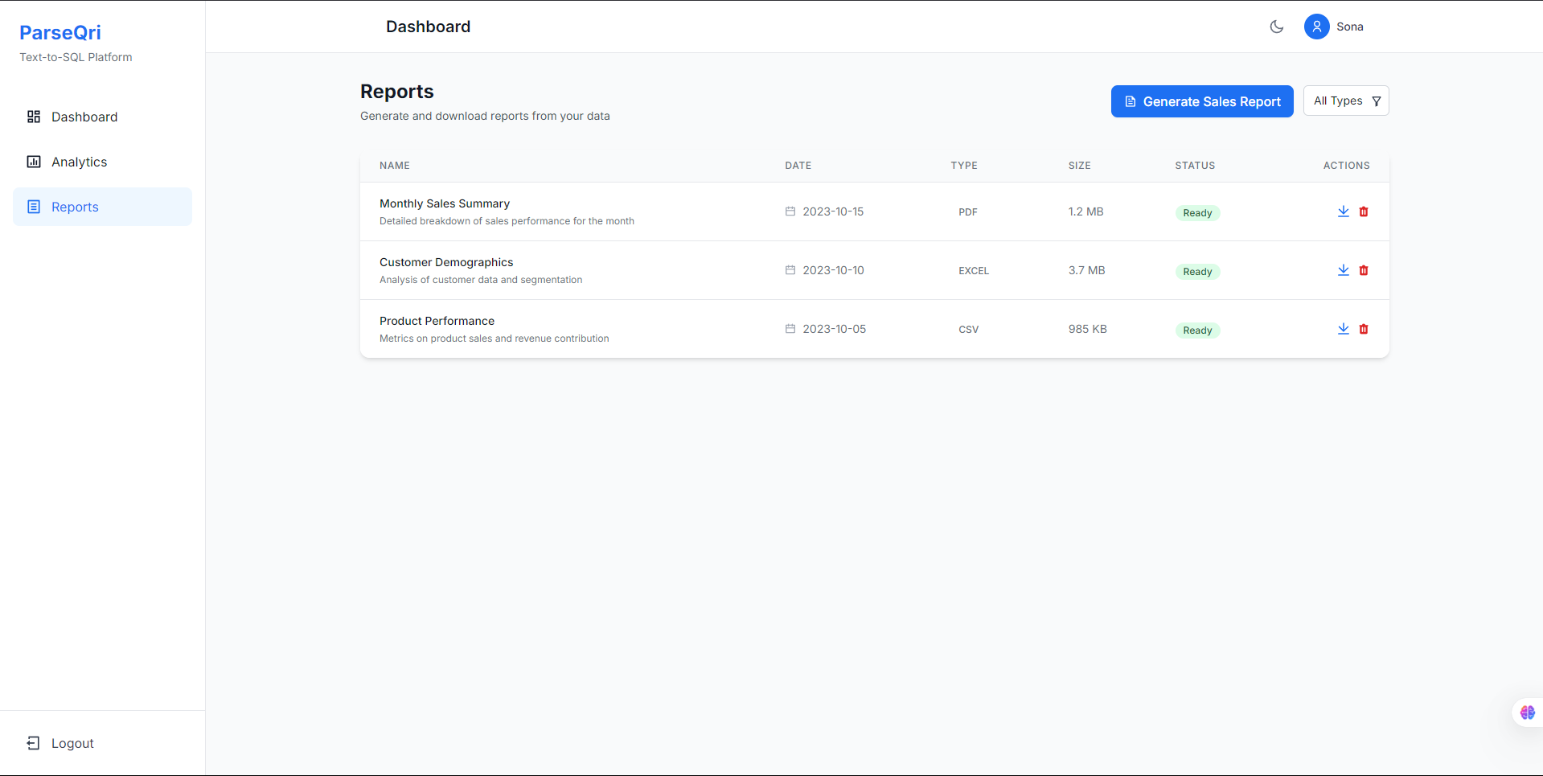
Report

Slide 10
Conclusion
ParseQri redefines text-to-SQL interactions with its multi-agent system. By providing accurate, human-friendly responses and visualizations, it empowers non-expert users to interact with complex databases efficiently.

Slide 11


THANK YOU FOR YOUR TIME
Q&A

