Slide 1
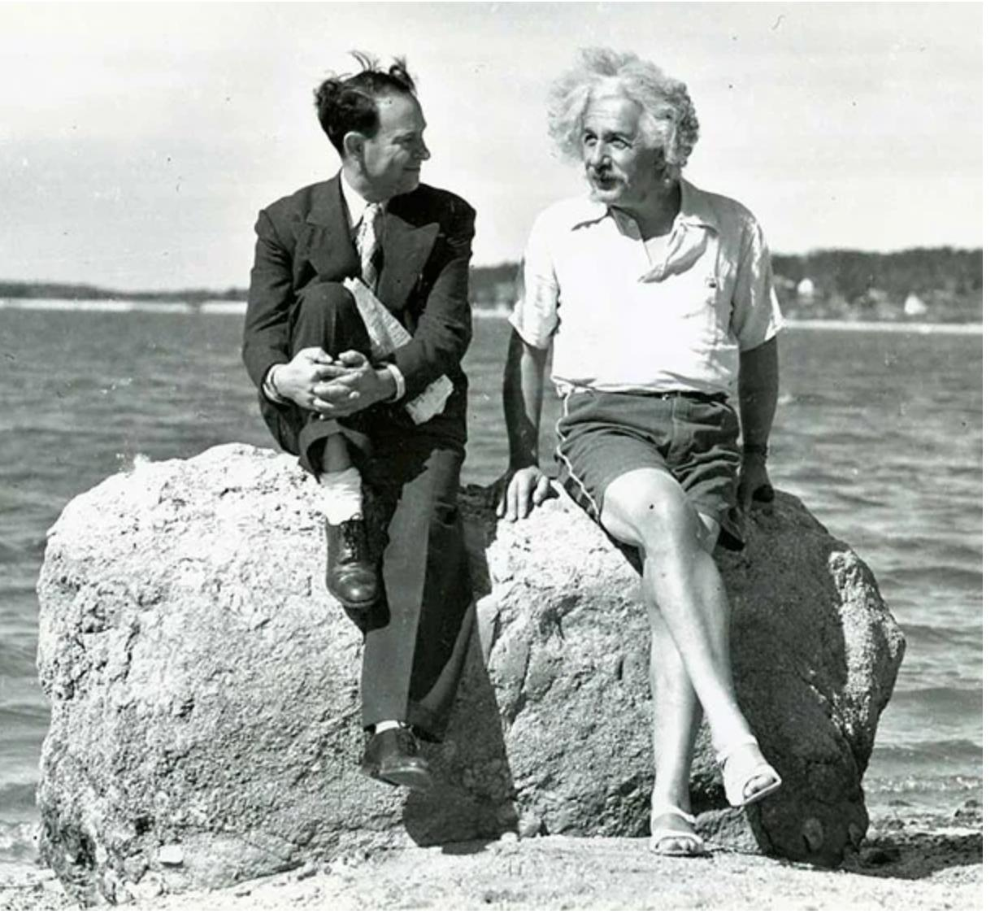

PAST FORWARD
TEAM – HELLO WORLD
Anubhab Rakshit
Bodhisatwa Dutta

Slide 2

INTRODUCTION
REIMAGINE HISTORY
THROUGH SOCIAL MEDIA
What if Instagram existed during the Indian Independence movement? Or Twitter during the Renaissance? Experience history through a modern lens.
Powered by Google's Gemini AI to create authentic historical content

Slide 3

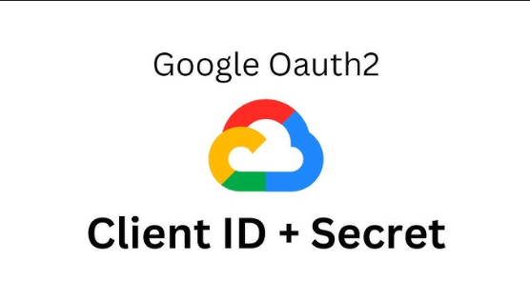


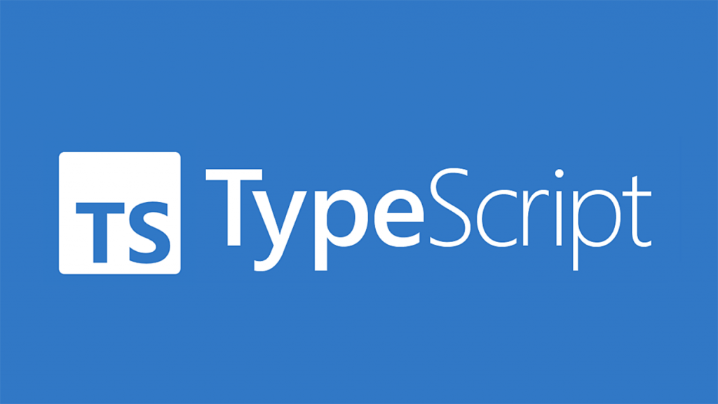


TECHNOLOGY STACK
PRISMA
npx prisma generate
npx prisma studio (localhost:5555)
NEON CLOUD POSTGRE SQL
FOR DATA STORAGE
GOOGLE CLOUD OAUTH/CLIENT
used to authenticate and authorize user
NODE.JS & TYPESCRIPT
FOR BACKEND
HUGGING FACE
datasets for building intelligent applications.
REACT.JS
For Frontend

Slide 4
HOW IT WORKS?
Input Your Parameters
Choose the historical era, location, and character type you want to explore.
AI Generates Content
Our advanced AI creates authentic posts based on historical context and language patterns.
Review & Customize
Edit the generated content or request variations until you're satisfied
Share Your Creation
Download or share your historical social media post with friends or for educational purposes.

Slide 5
FEATURES
Choose an Era:
Select any historical period from ancient civilizations to recent decades.
Specify the geographical context for more accurate historical representation.
Select Character Type
Choose from various social roles like poet, farmer, soldier, or royalty.
Pick a Location
Generate Visuals:
Optionally create AI-generated images that match the historical context.
Authentic Hashtags:
Get period-appropriate hashtags that blend history with modern social media.
Interactive Comments
See how contemporaries might have responded to the historical post.

Slide 6
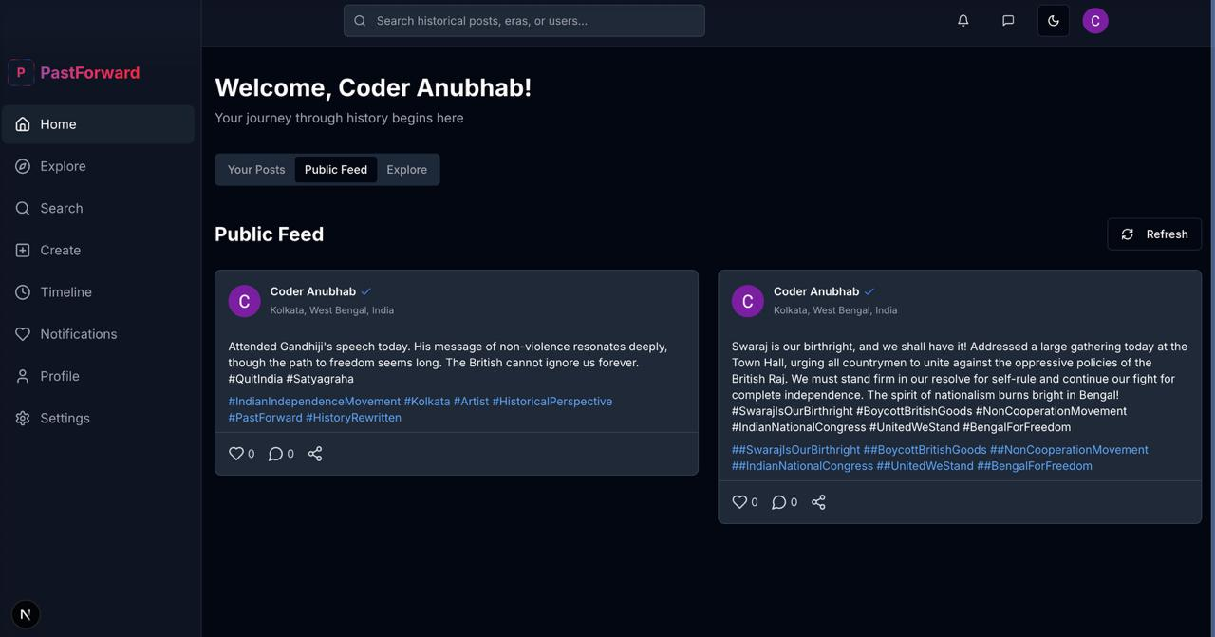
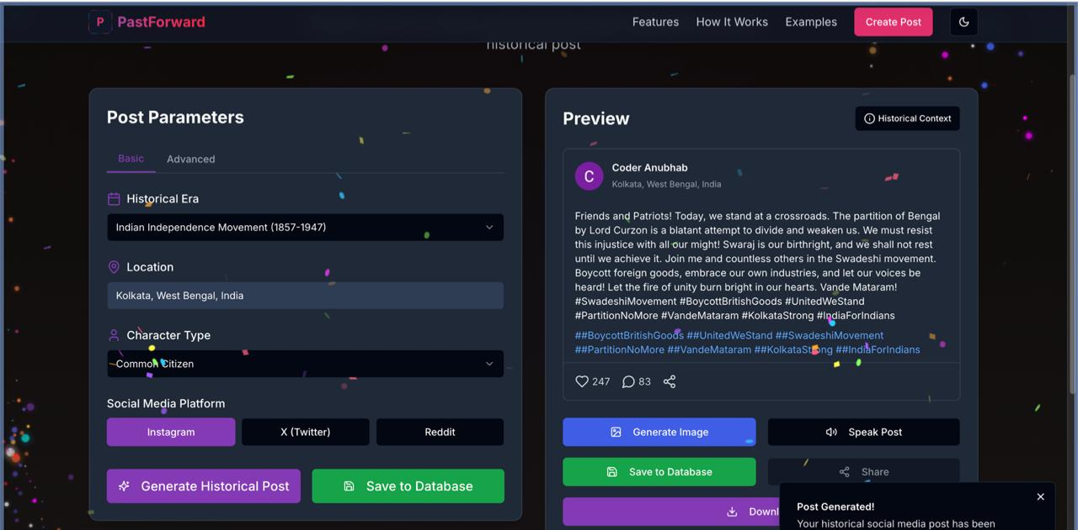
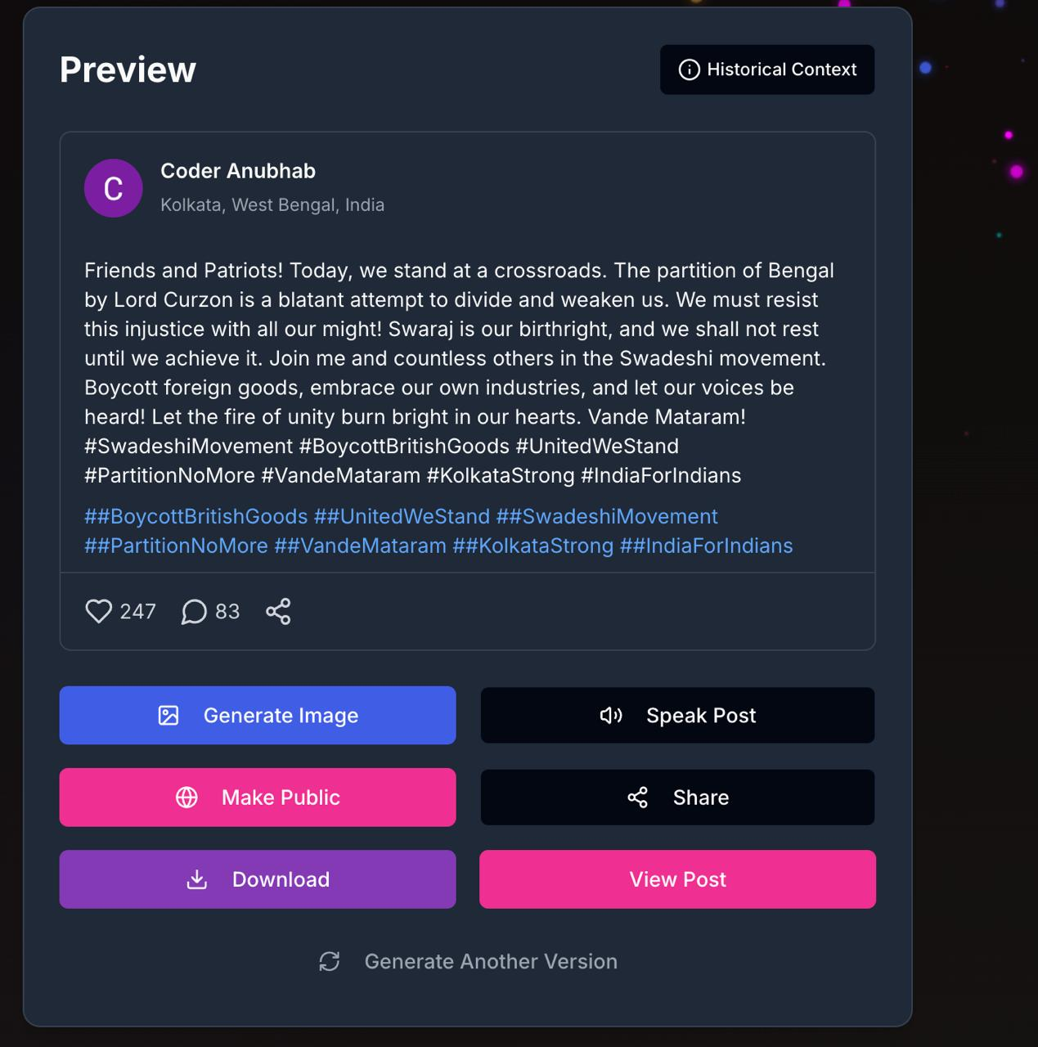
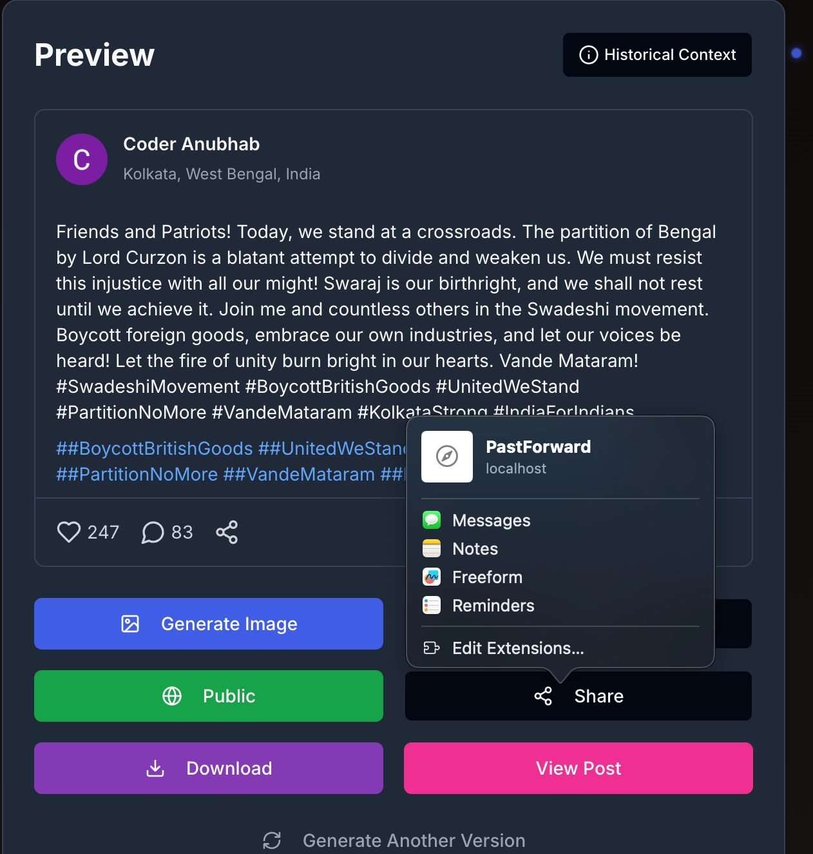
DASHBOARD

Slide 7
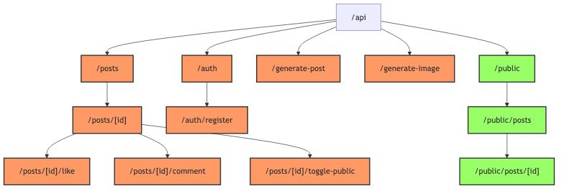
API Routes Structure
The authentication flow in this system starts at /api/auth, where users can log in or register via /auth/register. After successful authentication, users receive access tokens to interact with protected routes like creating posts, liking, commenting, or toggling post visibility. These routes are secured and only accessible to logged-in users. In contrast, unauthenticated users can only access public content through /api/public/posts and /public/posts/[id], ensuring secure and role-based access across the application.

Slide 8
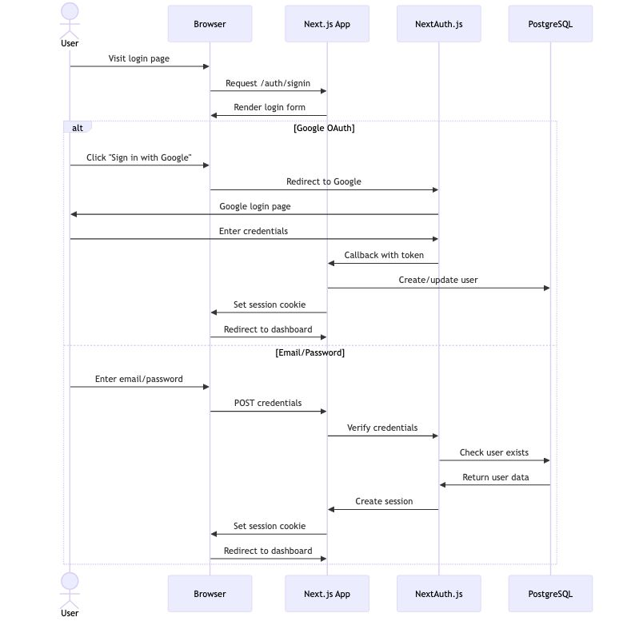
Authentication Flow
This diagram shows the authentication flow in a Next.js app using NextAuth.js with both Google OAuth and email/password login options. When a user visits the login page, they can either click "Sign in with Google" (redirects to Google, returns a token, creates/updates the user, and sets a session) or enter their email and password (credentials are verified, session is created, and the user is redirected to the dashboard). Both flows result in setting a secure session cookie for authenticated access.

Slide 9
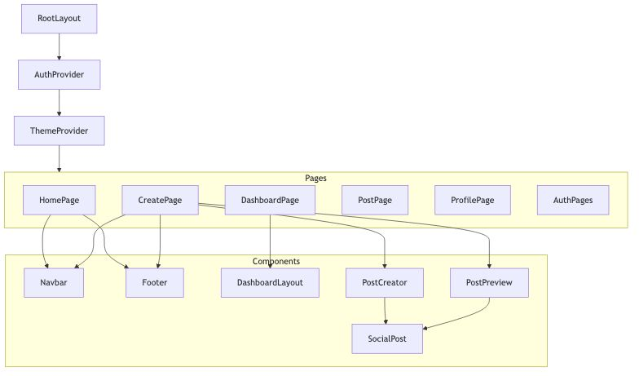
Component Hierarchy
This diagram represents the component hierarchy of a Next.js application. At the top level, the app is wrapped with RootLayout, followed by AuthProvider and ThemeProvider to manage authentication and styling globally. The main structure is divided into pages like HomePage, CreatePage, DashboardPage, PostPage, ProfilePage, and AuthPages. These pages use shared components such as Navbar, Footer, DashboardLayout, PostCreator, and PostPreview, promoting reusability. Components like SocialPost are nested deeper, showing how UI elements are composed and reused across different views.

Slide 10
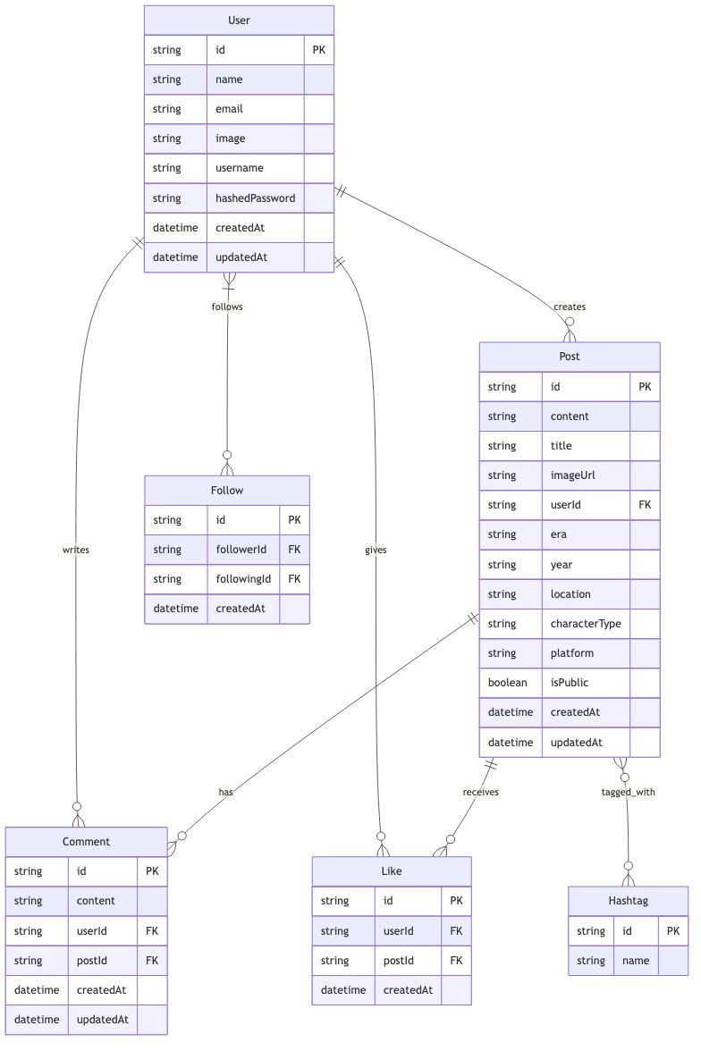
Data Model Relationships

Slide 11
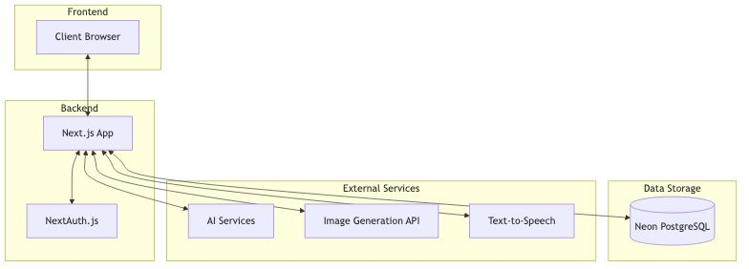
Overall Application Architecture
The overall architecture of a web application. The frontend is the client browser, which interacts with the backend, powered by a Next.js app. The backend handles authentication using NextAuth.js and connects to several external services for extended functionality—such as AI services, an Image Generation API, and Text-to-Speech features. All application data, including user info and generated content, is stored in a Neon PostgreSQL database. This architecture ensures seamless communication between frontend, backend, external APIs, and data storage, enabling a robust and dynamic user experience.

Slide 12
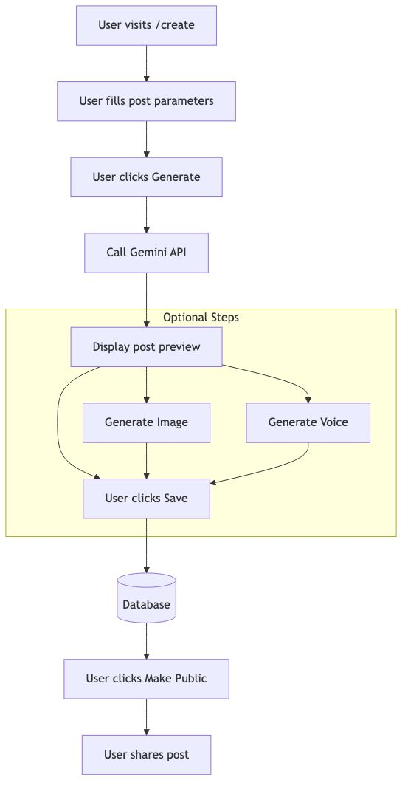
Post Creation Flow
The user starts by visiting the /create page and filling in post parameters. Upon clicking "Generate," the app calls the Gemini API to generate content. Next, a post preview is displayed, and the user has optional steps to generate an image and/or generate voice. Once satisfied, the user clicks "Save," and the post is stored in the database. Later, the user can choose to make the post public, enabling them to share it with others. This flow highlights a smooth and interactive content creation experience with optional AI-enhanced features.

Slide 13
Thank You

