Slide 1
Salary Prediction for Different Jobs USING Machine Learning Model.
Presented By:
Ramit Paul (C23022)

Slide 2
OBJECTIVE
Which features are the strongest for Salary Prediction?
Which model can predict better if a new dataset of similar kind is provided.

Slide 3
DATA DESCRIPTION
Target Variable:
Selling Price
Predictor Variables:
work_year
experience_level
employment_type
job_title
salary
salary_currency
salary_in_usd
employee_residence
remote_ratio
company_location
company_size

Slide 4
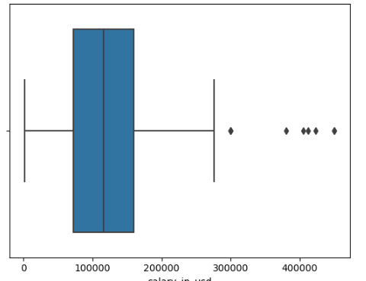
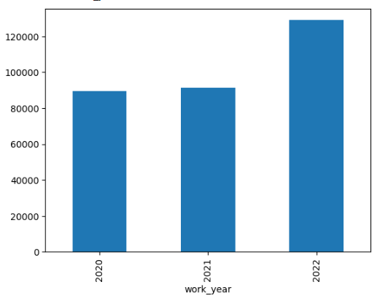
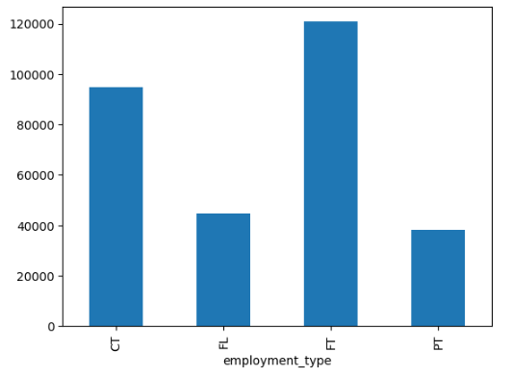
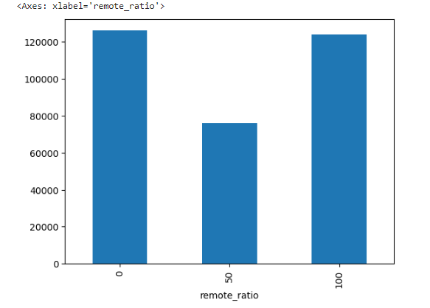
EXPLORATORY DATA ANALYSIS

Slide 5
FEATURE ENGINEERING
Indexing Categorical Variables
Encoding Categorical Variables.
Vectorising
Scaling

Slide 6
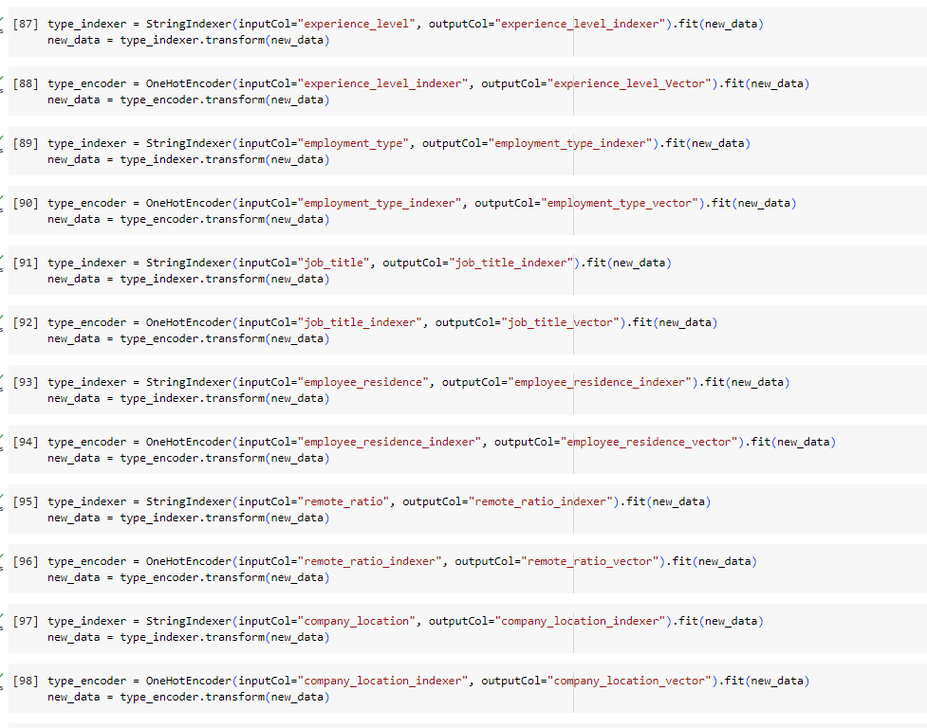
FEATURE ENGINEERING
Scaling of features has been done here after encoding and assembling.

Slide 7
MODELLING
Liner RegressionPipeline
Decision Tree Regression Pipeline

Slide 8
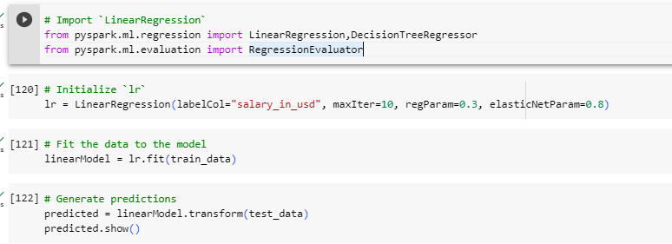
LINEAR REGRESSION

Slide 9
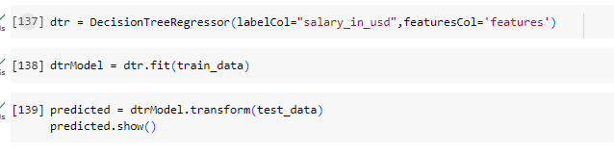
Decision Tree Regresion

Slide 10
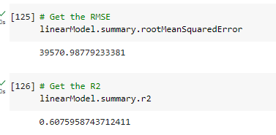
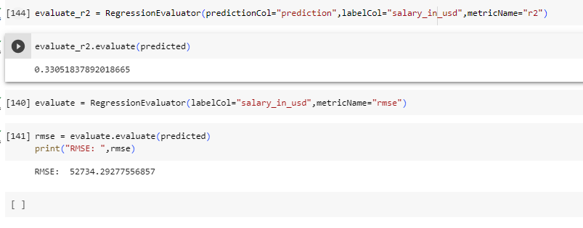
MODEL COMPARISON

Slide 11
CONCLUSION
Linear Regression Model has given the better result with R2 score: 0.60

