Slide 1
Project Presentation of Industry Oriented Hands on Experience (22CS422)
On
Digital Forgetting: Is Selective Memory Essential for Artificial Intelligence?
Anubha Khanna - 2210991313
Ansh Goyal - 2210991294
Anisha Singh - 2210991274
Abhijeet Sharma - 2210991150
Supervised By: Dr. Ajay Kumar
Department of Computer Science and Engineering,
Chitkara University, Punjab

Slide 2
Table of Contents
Introduction
Problem Statement
Software interaction
Objectives
SDLC Diagram
Data Flow Diagram
Challenges
Project Preview
Future scope
References/Links used

Slide 3
Introduction
Artificial Intelligence is one of the most important technologies in today’s digital world. It is used in many domains such as healthcare, finance, transportation, e-commerce, and education. Systems like recommendation engines, virtual assistants, fraud detection systems, and autonomous vehicles depend heavily on AI to process large amounts of data and make intelligent decisions.
Most AI systems are built on the assumption that more data leads to better performance. While this is true initially, continuous accumulation of data creates several long-term problems. As data grows, it increases storage requirements, slows down processing, and introduces outdated or irrelevant information into the system.
In contrast, human intelligence works differently. The human brain does not store everything permanently. It selectively retains useful information and gradually forgets less important details. This process reduces cognitive load and improves decision-making.
Inspired by this, our research introduces the concept of digital forgetting, where AI systems intelligently remove unnecessary or outdated data while retaining valuable information. This helps AI systems become more efficient, adaptive, and closer to human-like intelligence.

Slide 4
Problem Statement
Modern AI systems face several major challenges due to uncontrolled data storage.
First, there is data overload. AI systems continuously collect data from users, sensors, and applications. This leads to exponential growth in stored data, making systems difficult to manage.
Second, computational complexity increases. Larger datasets require more processing power, which slows down training and prediction.
Third, outdated data remains in the system. Old data may not represent current trends and can negatively affect predictions.
Fourth, there are privacy concerns. Storing personal data indefinitely can violate regulations such as GDPR, which includes the “right to be forgotten.”
Finally, resource consumption increases, leading to higher storage and operational costs.

Slide 5
Software Interaction
The ForgetAI system demonstrates how digital forgetting works in practice.
When a user inputs data (such as text or messages), the system stores it in a database along with metadata like importance, usage, and timestamp.
The system then processes this data using a mathematical model. It calculates a score based on:
Importance of the data
Frequency of usage
Time elapsed (decay factor)
Based on this score:
High-score data is retained
Low-score data is removed
The results are displayed on a dashboard where users can see:
Stored data
Forgotten data
Memory efficiency
Graphs and comparisons
=>This creates a clear comparison between:
Normal AI (stores everything)
ForgetAI (filters data intelligently)

Slide 6
Objectives
The main objectives of this research are:
To introduce the concept of digital forgetting in AI systems
To reduce memory overload and improve system efficiency
To remove outdated and irrelevant data automatically
To improve decision-making by retaining only useful information
To enhance privacy and comply with data protection laws
To develop AI systems that behave more like human memory

Slide 7
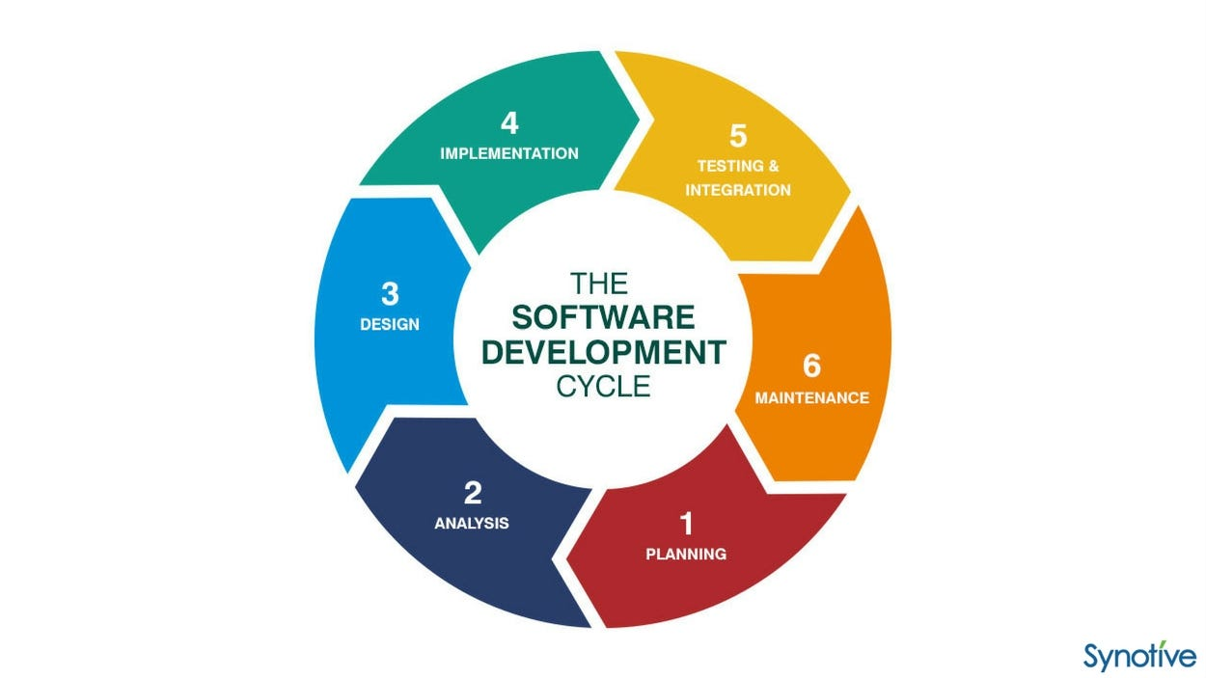
SDLC Diagram

Slide 8
SDLC Diagram
The development of the ForgetAI system follows the Software Development Life Cycle:
Requirement Analysis We identified the main problem: AI systems store too much data, leading to inefficiency.
System Design We designed a system architecture that includes input, storage, processing, decision, and output layers.
Development
Backend: Node.js, Express, MongoDB
Frontend: React dashboard
Testing We tested the system using sample data to evaluate memory reduction and performance.
Deployment The system was deployed with a user interface for real-time visualization.
Maintenance Future improvements include better algorithms and adaptive learning.

Slide 9
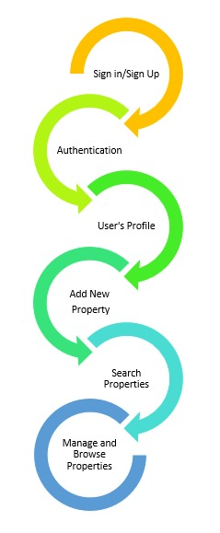
Data Flow Diagram
Sign In/Sign Up: User inputs credentials (username/email and password) in the sign-in form .Server verifies credentials against the database.
Authentication: Authenticated user makes a request to access protected routes or perform actions (e.g., add new property, view user profile).
User Profile: Authenticated user navigates to the profile page. React component sends a request to the server to fetch user data using the authentication token.
Add New Property: Authenticated user fills out the property details form (e.g., address, price, description, images). Server validates the token and inserts the new property information into the database.
Search Property: User interacts with the search bar or filters to specify search criteria (e.g., location, price range, property type). Server sends the list of matching properties back to the client.
Manage and Browse Property: Authenticated user navigates to the property management or browsing section.

Slide 10
Challenges
First, it is difficult to determine which data should be removed. If important data is deleted, it may reduce system accuracy.
Second, removing data can affect model performance. Some machine learning models depend heavily on training data, so deleting data may impact stability.
Third, designing efficient algorithms for safe and reliable forgetting is still a research challenge.
In simple terms:
Choosing the right threshold is difficult
Avoiding loss of important data is critical
Maintaining system stability is challenging

Slide 11
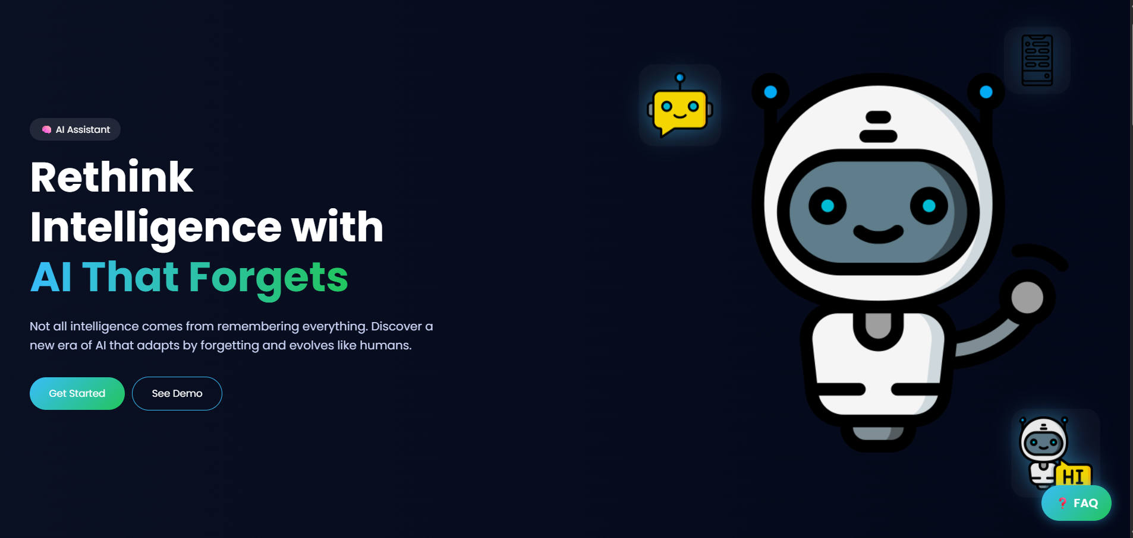
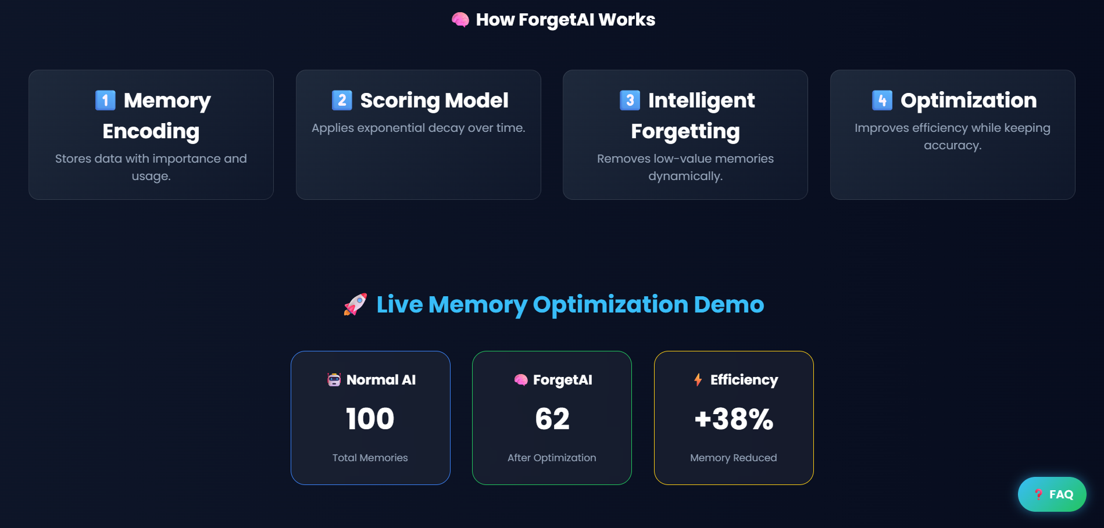

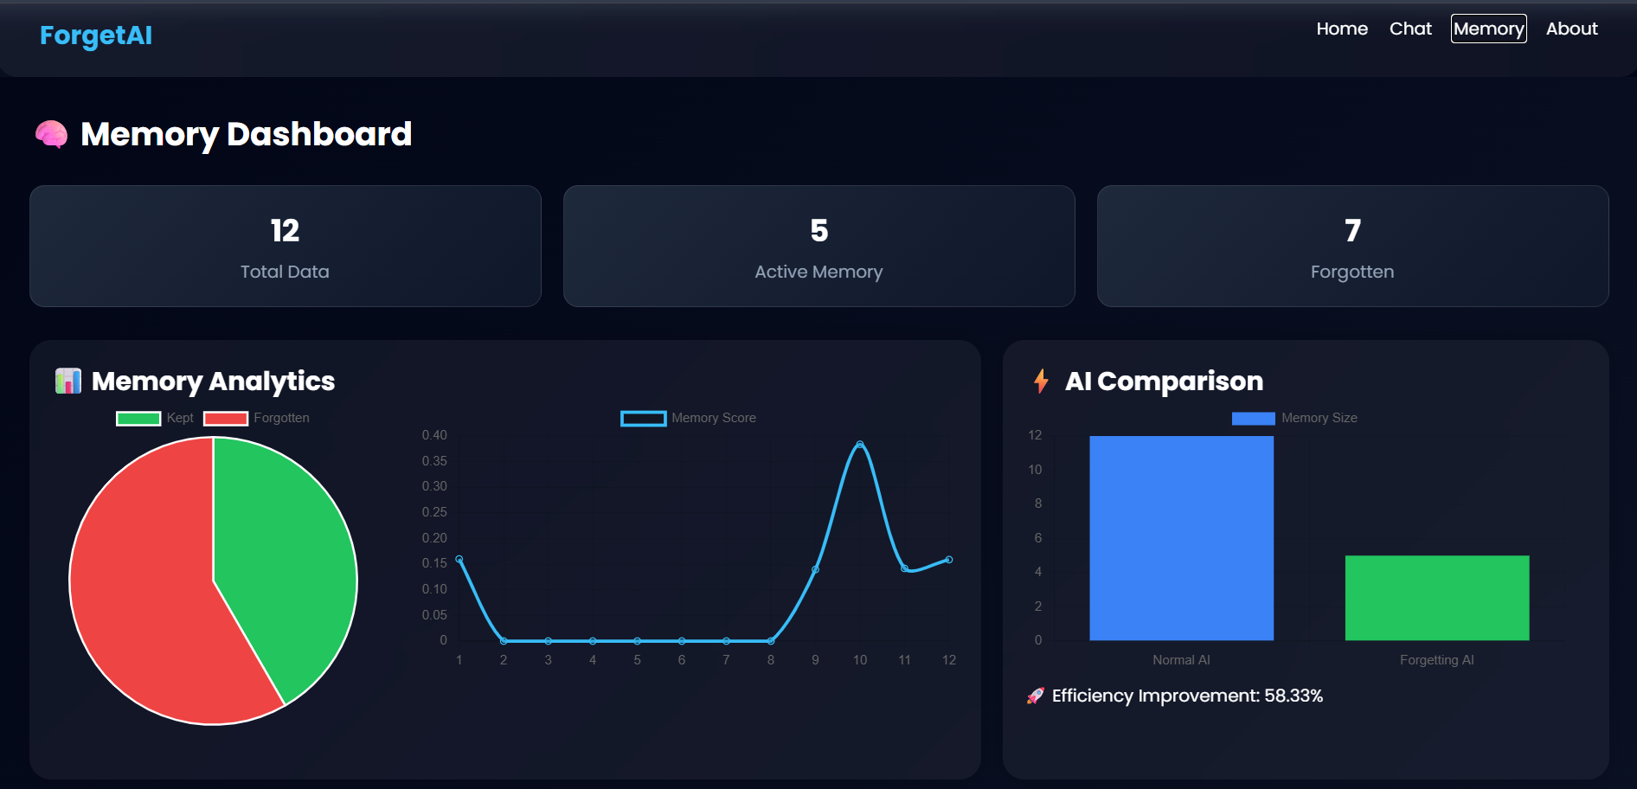
Project Preview

Slide 12
Future Scope
AI systems can be made more intelligent by automatically deciding what to keep and what to forget without manual control.
Integration with reinforcement learning can allow systems to improve forgetting decisions over time.
Better machine unlearning techniques will ensure that removing data does not affect performance.
Digital forgetting will also play a key role in privacy protection as data regulations become stricter.

Slide 13
References/Links used
https://www.youtube.com/watch?v=HFj5FMb0jwY&t=958s&ab_channel=LamaDev
https://www.youtube.com/watch?v=eJ3YysWaP_A&t=0s&ab_channel=LamaDev
www.google.com
www.chatgpt.com
This research is supported by multiple studies in the field of machine unlearning and AI memory management, including:
Cao & Yang (2015) – Machine Unlearning
Bourtoule et al. (2021)
Ma et al. (2023)
Wang et al. (2024)
Papernot et al. – Privacy-preserving AI

Slide 14
Thank You

