Slide 1

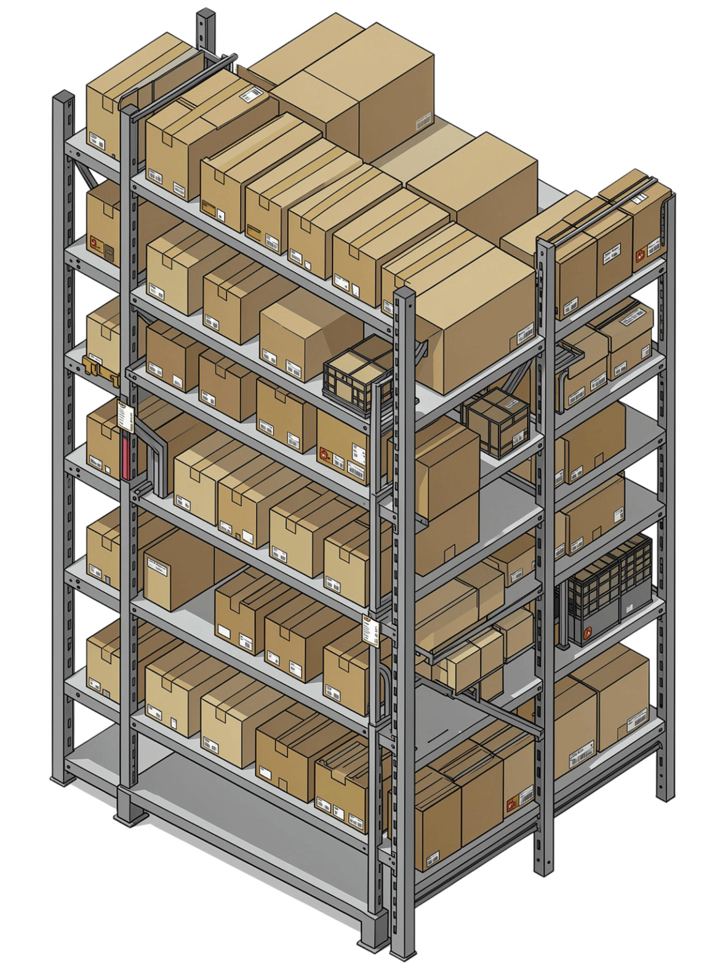
Inventory & Supply Chain
Tracker with Reorder Alerts
Real-time visibility, zero stockouts

Slide 2

Retail businesses need to maintain sufficient inventory to meet customer demand while avoiding excessive stock that increases holding costs and ties up working capital. Traditional inventory monitoring mainly focuses on current stock levels and may not fully utilize historical sales, demand patterns, regional performance and seasonality. The objective of this project is to develop an Inventory & Supply Chain Tracker with Reorder Alerts that transforms historical sales and inventory data into actionable insights. The solution identifies inventory risks, highlights reorder requirements and supports data-driven inventory planning. The system aims to help businesses reduce stockout risk, control overstocking, improve inventory allocation and make better replenishment decisions.
PROBLEM STATEMENT:

Slide 3
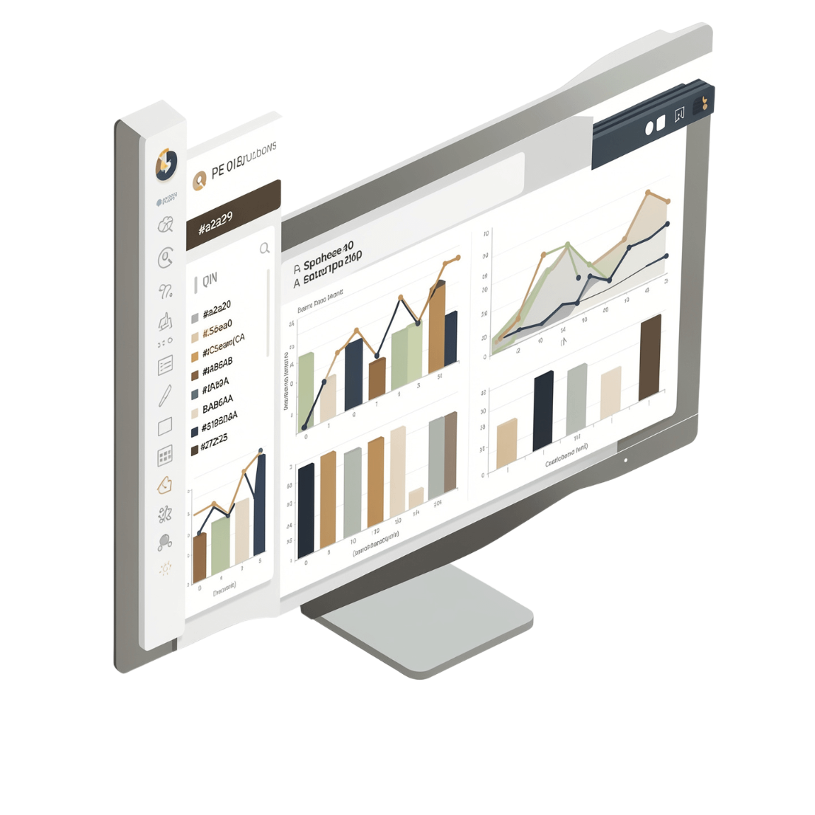
Project Objective:
The objective of this project is to develop an Inventory & Supply Chain Tracker with Reorder Alerts using historical retail sales and inventory data. The project analyses sales, inventory levels, demand forecasts, product categories and regional performance to identify inventory risks and replenishment requirements.
The solution provides interactive dashboards and KPIs that help users monitor inventory health, understand demand patterns and prioritize reorder decisions.
The overall goal is to support data-driven inventory planning, reduce stockout and overstocking risks, and improve operational efficiency.

Slide 4
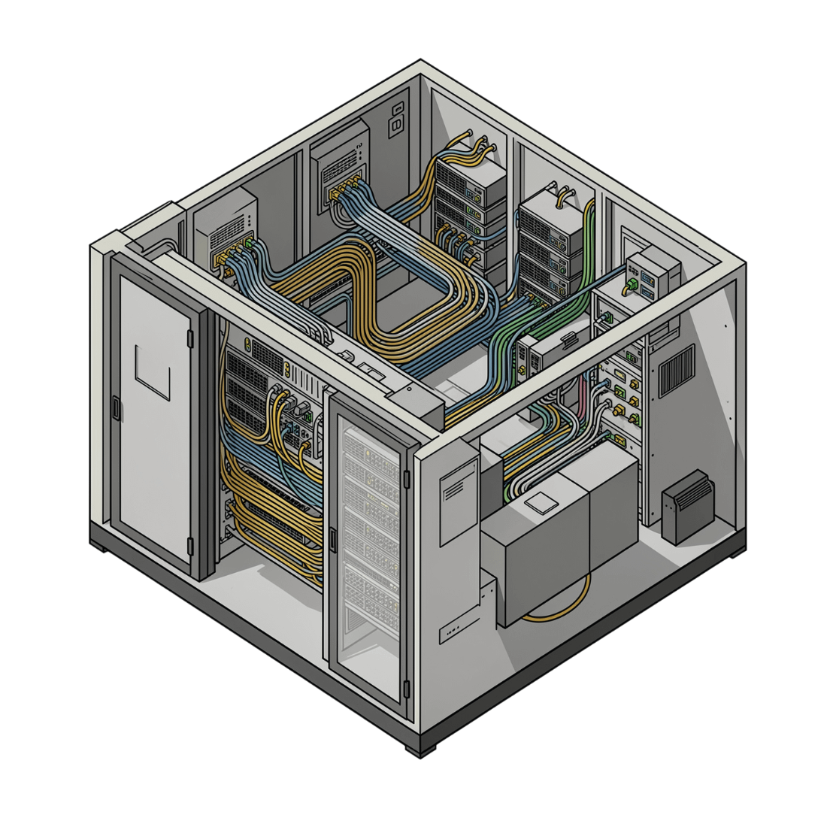
DATASET DESCRIPTION:
The project uses a historical retail inventory and sales dataset obtained from Kaggle. The dataset contains information related to products, stores, categories, dates, sales, inventory levels, units ordered, pricing, discounts, promotions, seasonality, weather conditions and demand forecasting. The dataset was cleaned and transformed before analysis. Additional calculated fields were created to support sales analysis, inventory risk classification, reorder alerts and forecast evaluation. The historical nature of the dataset allows the project to identify patterns that can support better future inventory and replenishment decisions.
Expected Business Impact
Higher Stock Availability
Reduced Excess Inventory
Better Revenue
Improved Operational Efficiency

Slide 5

Data Cleaning
& Methodology:
Data Cleaning
Data Transformation
Checked and standardized data types, especially date and numerical fields.
Identified and handled missing/invalid values.
Checked for duplicate and inconsistent records.
Standardized categorical values for consistent analysis.
Validated numerical fields such as sales, inventory, units sold and units ordered.
Created calculated fields required for business analysis:
Gross Sales
Discount Amount
Net Sales
Reorder Quantity
Reorder Alert
Inventory Status
Absolute Forecast Error
Data Collection
Historical retail inventory and sales dataset obtained from Kaggle.
Dataset contains information related to products, sales, inventory, orders, pricing, discounts, promotions, region, seasonality, weather and demand forecasting.
Decision Framework
Historical Sales & Inventory Data
↓
Data Cleaning
↓
Data Transformation
↓
KPI & Pivot Analysis
↓
Inventory Risk Analysis
↓
Reorder Identification
↓
Business Insights & Decisions
Analysis Methodology
Used Excel Tables for structured data management.
Used formulas for KPI and calculated-field generation.
Used PivotTables and Pivot Charts for aggregation and analysis.
Used Slicers for interactive filtering.
Classified inventory into Critical, Low, Healthy and Overstocked categories.
Calculated forecast performance using MAE and a WMAPE-style accuracy metric.

Slide 6
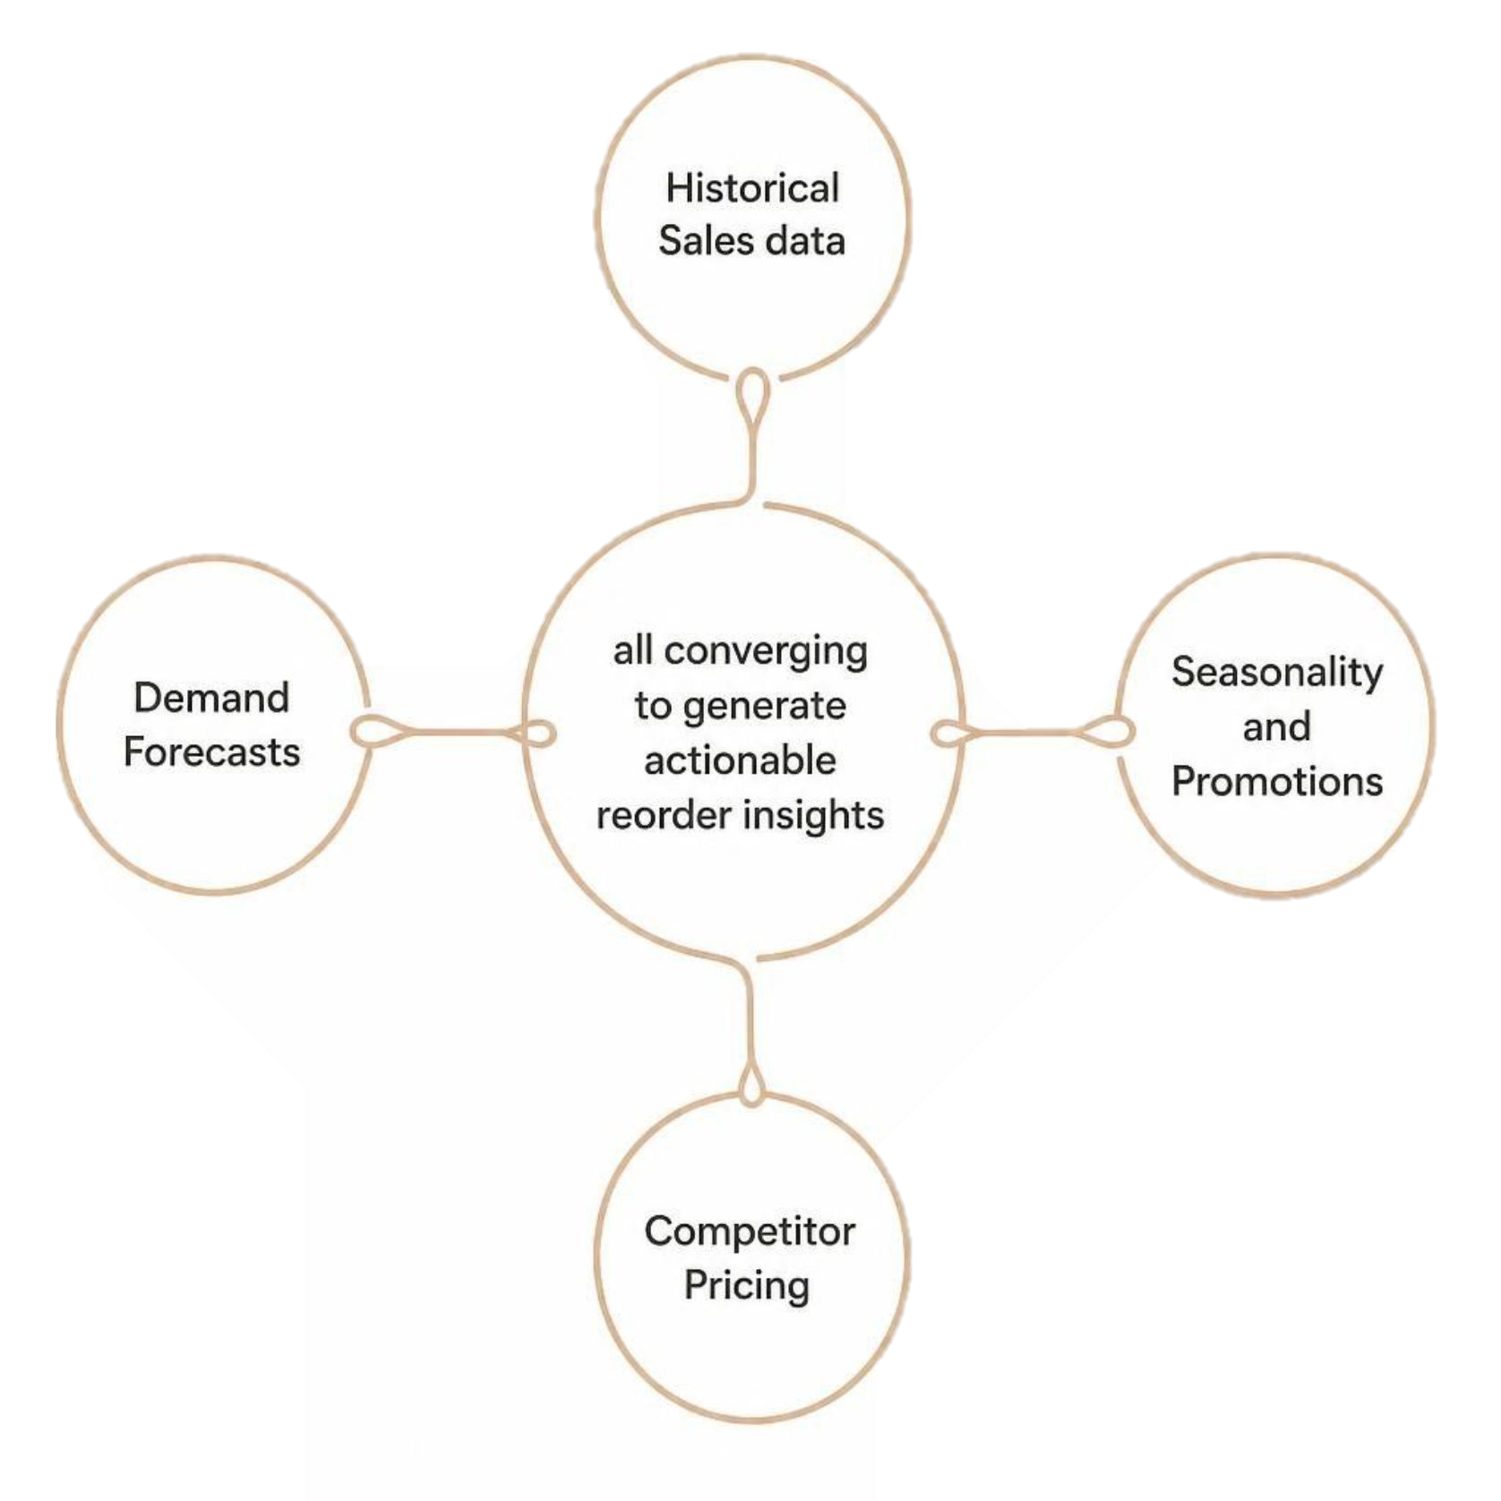
Key Insights
Critical & Low inventory exists
Overstocked inventory exists
Inventory imbalance exists
High-performing products drive revenue
Regional sales vary
Historical demand patterns exist
Forecast accuracy ≈ 94%
Discounts represent significant sales value

Slide 7

Business Decision
The Risk of Inaction
The Opportunity
Prioritize replenishment
Review and control future ordering
Optimize allocation rather than simply increasing stock
Protect their availability
Allocate inventory based on regional demand
Use them for inventory planning
Incorporate forecast demand into replenishment
Evaluate promotions against net sales and units sold
Manual processes cannot scale. Demand volatility will only increase.
An intelligent system pays for itself through stockout prevention alone.
The Decision
Automate, integrate, and gain full supply chain visibility — now.
Right Product + Right Quantity + Right Location + Right Time = Better Inventory Decisions

Slide 8
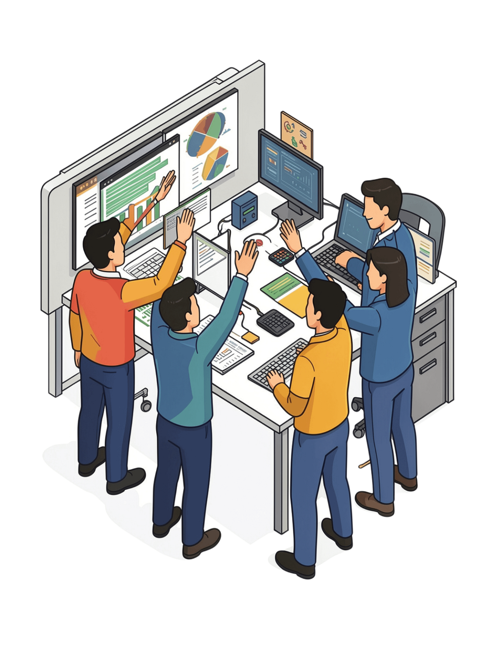
Thank You

