Slide 1

Covid-19 : An Era of Info-cum-Pandemic

Slide 2
To Minimise The current Infodemic condition in india
Our Government can make a high authority team and an trusted organization which can notify and update the myths going in india in an app or a trusted website .

Slide 3
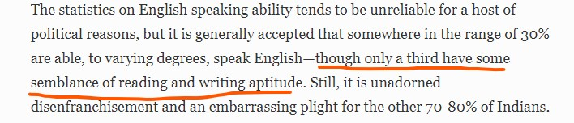
Statistics of Englishly-abled people

Slide 4
Solution to all the deeds
A Web/Mobile Application
Trusted Resources
Handful of Volunteers
Regular Updation
That’s it !!!

Slide 5
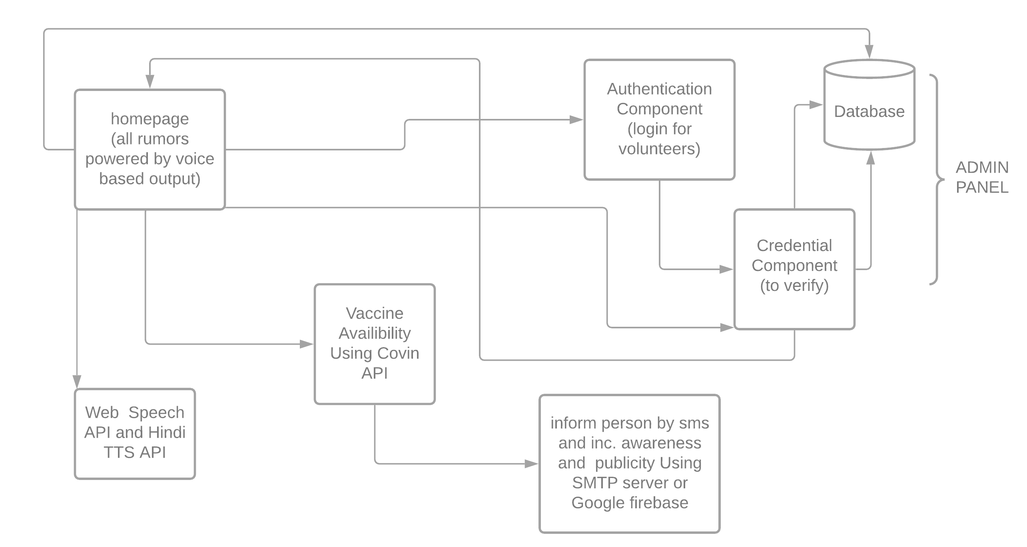
Working Overview

Slide 6
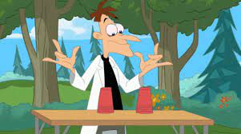
Fortunately I am Working on it !!

Slide 7
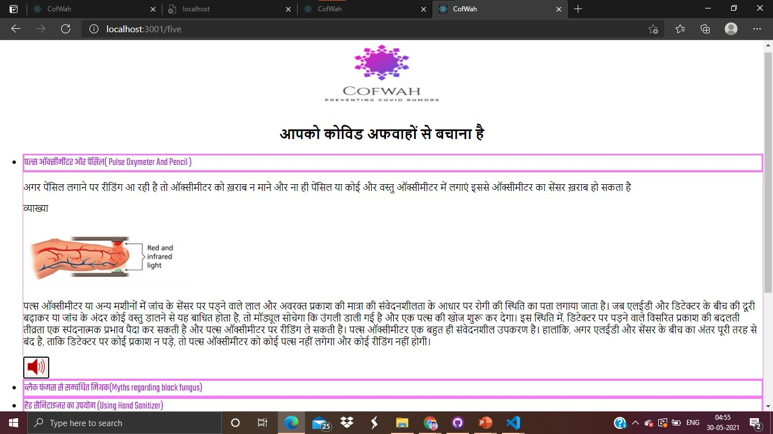

Slide 8
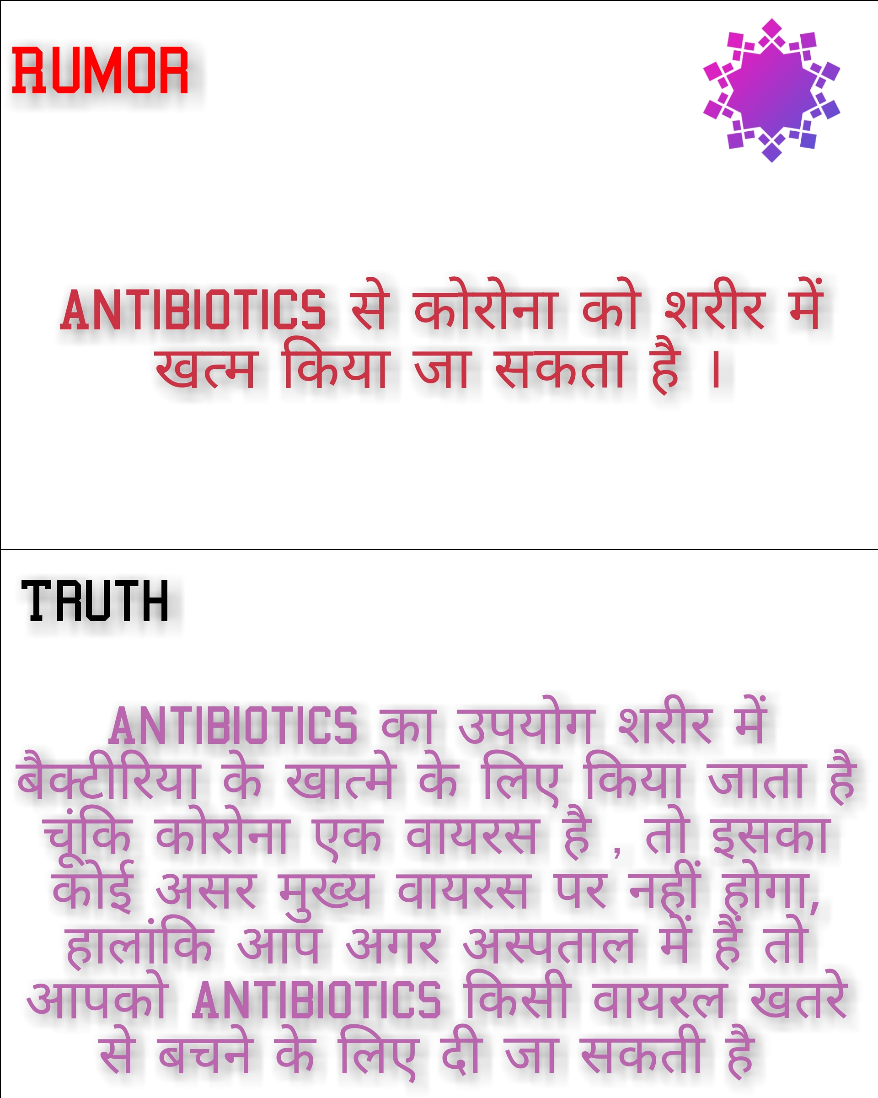

Slide 9
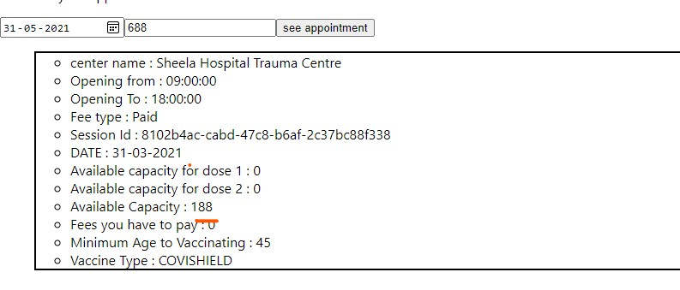

Slide 10
Thank you

