Slide 1

Soar to Uppaal Translation
Siddhartha Bhattacharyya, Thomas C. Eskridge and Marco Carvalho

Slide 2
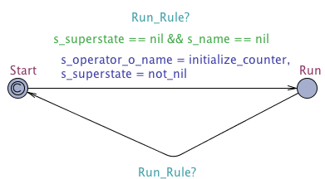
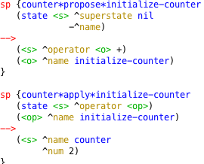
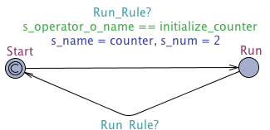
Soar rules in Uppaal

Slide 3
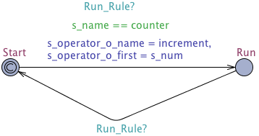
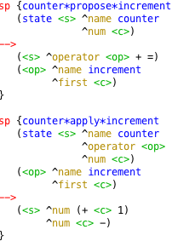
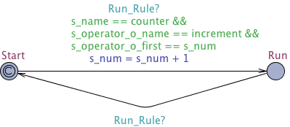
Soar rules in Uppaal (contd.)

Slide 4
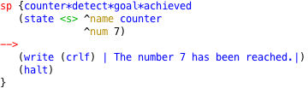

Goal rule

Slide 5
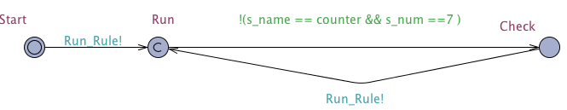
Scheduler

Slide 6
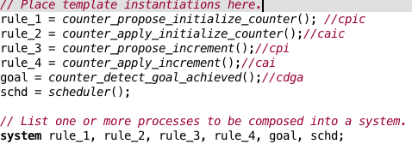
System instantiation

Slide 7
Uppaal xml
<?xml version="1.0" encoding="utf-8"?>
<!DOCTYPE nta PUBLIC '-//Uppaal Team//DTD Flat System 1.1//EN' 'http://www.it.uu.se/research/group/darts/uppaal/flat-1_2.dtd'>
<nta>
<declaration>// Place global declarations here.
const int nil = 0;
const int not_nil = 1;
const int initialize_counter = 1;
const int counter = 2;
const int increment = 3;
int s_name;
int s_num;
int s_superstate;
int s_operator_o_name;
int s_operator_o_first;
broadcast chan Run_Rule;
</declaration>

Slide 8
xml
<template>
<name x="5" y="5">counter_apply_initialize_counter</name>
<declaration>// Place local declarations here.
</declaration>
<location id="id0" x="-2346" y="-2312">
<name x="-2356" y="-2342">Run</name>
</location>
<location id="id1" x="-2627" y="-2311">
<name x="-2637" y="-2341">Start</name>
<committed/>
</location>
<init ref="id1"/>
<transition>
<source ref="id0"/>
<target ref="id1"/>
<label kind="synchronisation" x="-2524" y="-2252">Run_Rule?</label>
<nail x="-2490" y="-2252"/>
</transition>
<transition>
<source ref="id1"/>
<target ref="id0"/>
<label kind="guard" x="-2618" y="-2371">s_operator_o_name == initialize_counter</label>
<label kind="synchronisation" x="-2533" y="-2388">Run_Rule?</label>
<label kind="assignment" x="-2584" y="-2354">s_name = counter, s_num = 2</label>
</transition>
</template>

Slide 9
Translator Code
import java.io.File;
import java.io.InputStream;
import java.io.OutputStream;
import java.io.StringWriter;
import java.util.ArrayList;
import java.util.Hashtable;
import java.util.List;
import java.util.Map;
import java.util.HashMap;
import javax.xml.parsers.DocumentBuilder;
import javax.xml.parsers.DocumentBuilderFactory;
import javax.xml.parsers.ParserConfigurationException;
import javax.xml.transform.Transformer;
import javax.xml.transform.TransformerException;
import javax.xml.transform.TransformerFactory;
import javax.xml.transform.dom.DOMSource;
import javax.xml.transform.stream.StreamResult;
import org.eclipse.core.resources.IFile;
import org.eclipse.core.resources.IFolder;
import org.eclipse.core.runtime.CoreException;
import org.eclipse.xtext.util.StringInputStream;
import org.w3c.dom.Attr;
import org.w3c.dom.Document;

Slide 10
Translator Code (contd.)
try {
DocumentBuilderFactory docFactory = DocumentBuilderFactory.newInstance();
DocumentBuilder docBuilder = docFactory.newDocumentBuilder();
// root elements
Document doc = docBuilder.newDocument();
Element rootElement = doc.createElement("nta");
doc.appendChild(rootElement);
// Global Declaration elements
Element globalDeclaration = doc.createElement("declaration");
rootElement.appendChild(globalDeclaration);
printGlobalDeclarations(doc, globalDeclaration, componentImplementationList);
printParameters(doc, rootElement, UppaalXmlTranslator.sortedmapPortToCT, componentImplementationList);
Element system = doc.createElement("system");
rootElement.appendChild(system);
instantiateProcesses(doc, system, componentImplementationList);
system.appendChild(doc.createTextNode("system "));
printSystemDeclarations(doc, system, UppaalXmlTranslator.sortedinstanceAndCT, componentImplementationList);
system.appendChild(doc.createTextNode(";" + "\n"));

Slide 11
Translator Code (contd.)
Element template = doc.createElement("template");
rootElement.appendChild(template);
Element templateName = doc.createElement("name");
templateName.appendChild(doc.createTextNode(SOAR DATA RULE NAME));
template.appendChild(templateName);
Element localDeclaration = doc.createElement("declaration");
localDeclaration.appendChild(doc.createTextNode(SOAR DATA DECLR.));
template.appendChild(localDeclaration);
String strLocationId = "id" + 0;
Element location = doc.createElement("location");
location.setAttribute("id", strLocationId);
location.setAttribute("x", "-100");
location.setAttribute("y", "-100");
Element locationName = doc.createElement("name");
locationName.appendChild(doc.createTextNode(STATE NAME));
location.appendChild(locationName);
Element labelInv = doc.createElement("label");
labelInv.setAttribute("kind", "invariant");
labelInv.appendChild(doc.createTextNode(SOAR PRE-CONDITION));
location.appendChild(labelInv);
template.appendChild(location);
Element initialState = doc.createElement("init");
initialState.setAttribute("ref", strLocationId);
template.appendChild(initialState);
Element transition = doc.createElement("transition");
Element source = doc.createElement("source");
source.setAttribute("ref", strLocationId);
transition.appendChild(source);
Element target = doc.createElement("target");
target.setAttribute("ref", strLocationId);
transition.appendChild(target);
Element labelSync = doc.createElement("label");
labelSync.setAttribute("kind", "synchronisation");
labelSync.appendChild(doc.createTextNode("tp!"));
transition.appendChild(labelSync);
Element labelGuard = doc.createElement("label");
labelGuard.setAttribute("kind", "guard");
labelGuard.appendChild(doc.createTextNode("t==1"));
transition.appendChild(labelGuard);
Element labelAssgn = doc.createElement("label");
labelAssgn.setAttribute("kind", "assignment");
labelAssgn.appendChild(doc.createTextNode("t=0"));
transition.appendChild(labelAssgn);
template.appendChild(transition);

Slide 12
Translator Code (contd.)
// Create the Eclipse file to hold the translation in the uppaal directory
StringInputStream init = new StringInputStream("Failure occurred during translation.");
IFile file = folder.getFile(name + ".xml");
if (file.exists()) file.delete(true, null);
file.create(init, true, null);
// Get access to the Eclipse file as a regular Java xml file
StreamResult result = new StreamResult(new File(file.getRawLocationURI()));
// Output to console for testing
// StreamResult result = new StreamResult(System.out);
// Write the content into xml file
TransformerFactory transformerFactory = TransformerFactory.newInstance();
Transformer transformer = transformerFactory.newTransformer();
DOMSource source = new DOMSource(doc);
transformer.transform(source, result);
} catch (ParserConfigurationException pce) {
pce.printStackTrace();
} catch (TransformerException tfe) {
tfe.printStackTrace();
} catch (CoreException cex) {
cex.printStackTrace();
}

