Slide 1

Team Number : 30
- ANUBHAV BHATTACHARYA
- HARSH SHUKLA
-TOUHID MOHAMMED
- SAGAR RAJPUT

Slide 2

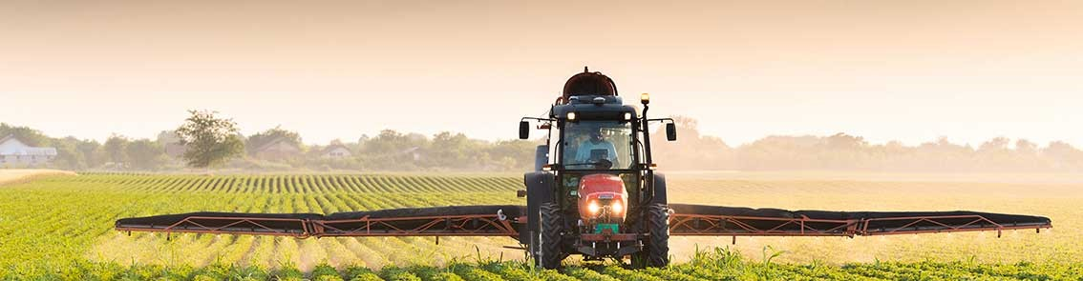
AGRICULTURE
A SOCIAL-RELIEF SOLUTION

Slide 3
AGRICULTURE:
Importance On
Employment
GDP / Economy
Other Sectors agriculture’s

Slide 4
STATISTICS :
Employment
261.63 million Indians are farmworkers.
Agricultural Land GDP
180 million hectares.
Cultivable Land
158.65 million hectares.
Total Production Agricultural Sector
366.92 billion USD.
GDP
Agriculture Sector holds 15.4% share.
40% exports are related to agriculture.

Slide 5
PROBLEMS :
Unsold Produce
Worth of Rs. 58000 Crore and 40% of the produce.
Excess Produce
Middle-men
Crop Value

Slide 6
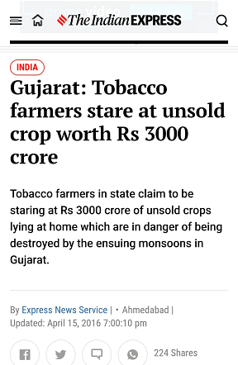
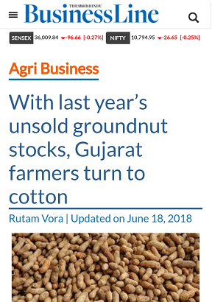
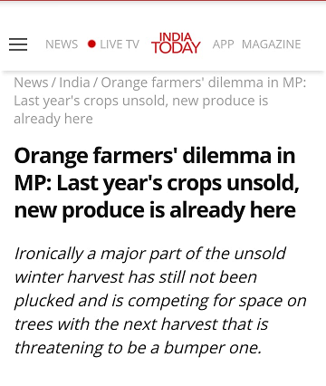
And This Leads To Debts, which eventually leads to :

Slide 7
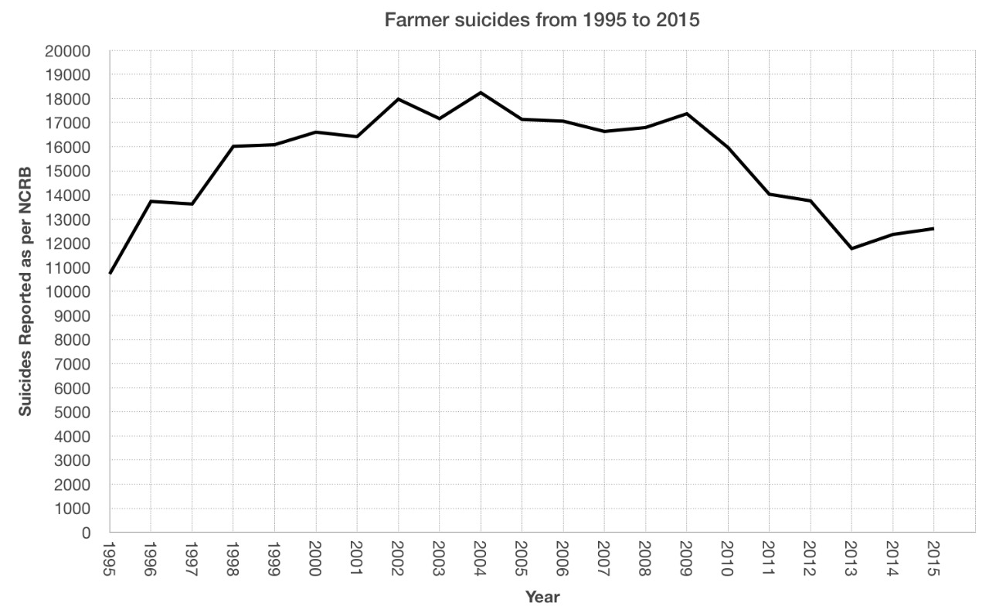
Farmer Deaths In India :

Slide 8
So This Was The Story Till Now, And Here Is Where We Enter..

Slide 9
Chronic Hunger In and Around India :
In the world, there are about 780 million people facing chronic hunger.
1/3rd of World’s hunger victims live in India.
14.9% of our population is undernourished.
195.9 million go hungry everyday.
21.0% of children under 5 are underweight.
34.8% of children under 5 are stunted.
1 in 4 children is malnourished.

Slide 10
Solution :

Slide 11
Buying The Unsold Produce At MSP
Building Canteens/Mess
Feeding the Needy

Slide 12
Services Offered In The Portal
Reporting the unused/excess produce.
Collection.
Distribution.
Preparation of the Food.
Cheap & Affordable Food

Slide 13
Post Effects Of This Solution
Employment
Customer Care
Collection
Distribution
Preparation
Survey
Increased Production In Crops
Economical condition of the country receives a great boost.

Slide 14
THANK YOU

