Slide 1

SOI Implementation of Spiking Equilibrium Propagation for Real-Time Learning
Amruta Parulekar (20d070009)
Anubhav Bhatla (200070008)
Tanmay Joshi (200070027)

Slide 2
Introduction
Backpropagation is a neural network training method involving calculation of the gradients of the loss function while moving backwards through the layers.
EP mimics the way neurons reach equilibrium while learning and spiking EP employs spiking neural networks (SNNs), using spike-based transmission, proving suitable for tasks requiring precise timing
EP finds stable equilibrium states of minimum energy by using feedback connections that iteratively update the network activations based on input data, current state and target state.
It is computationally intensive, requires labelled training data and treats artificial neural networks (ANNs) as static systems, disadvantages which are countered by Equilibrium propagation (EP)
Notes:
In deep learning tasks, input data undergoes a feed-forward pass through an artificial neural network (ANN) for initial prediction, followed by a backpropagation training algorithm that computes gradients of the loss with respect to network weights and biases, enabling iterative adjustments to minimize the loss, but this process is computationally intensive and reliant on labeled training data, making it less suitable for real-time or unsupervised learning applications.
Equilibrium Propagation (EP) is an alternative training algorithm to backpropagation, treating artificial neural networks as dynamic systems evolving over time, focusing on energy-based objectives to improve generalization performance and adaptability to unsupervised learning, mimicking principles of neural information processing in the brain by leveraging energy functions for learning and inference through iterative updates of network activations and feedback connections.
In this project, we implemented spiking equilibrium propagation using 45nm CMOS Technology, an extension of the Equilibrium Propagation (EP) learning algorithm that incorporates spiking neural network (SNN) architectures, leveraging discrete, spike-based communication between neurons for biologically inspired neural computation, retaining the energy-based modeling concept, and proving well-suited for tasks emphasizing precise timing and spike-based encoding.

Slide 3
Background
Energy-based models (EBMs)
Widely used for integrated circuit design
Real-time learning
Assign energy scores to different model configurations for the observed and generated data.
45nm CMOS Technology
Training: Minimize energy function
Involves a system that adapts its parameters instantaneously as input data changes with time
Is recognized for its energy efficiency, low power consumption, and high integration capabilities.
Testing: Find configuration with lowest energy function

Slide 4
Objectives
SOI Implementation of Spiking Equilibrium Propagation for Real-Time Learning
Higher energy efficiency and low power consumption
A more biologically plausible learning system
Rapidly adapting system capable of real-time learning

Slide 5
Experimentation flow
Literature Survey
Used default LTspice MOS models to make the five subcircuits
Replaced the default models with 45nm CMOS models and adjusted values
Combined subcircuits to simulate two neurons connected by a synapse

Slide 6
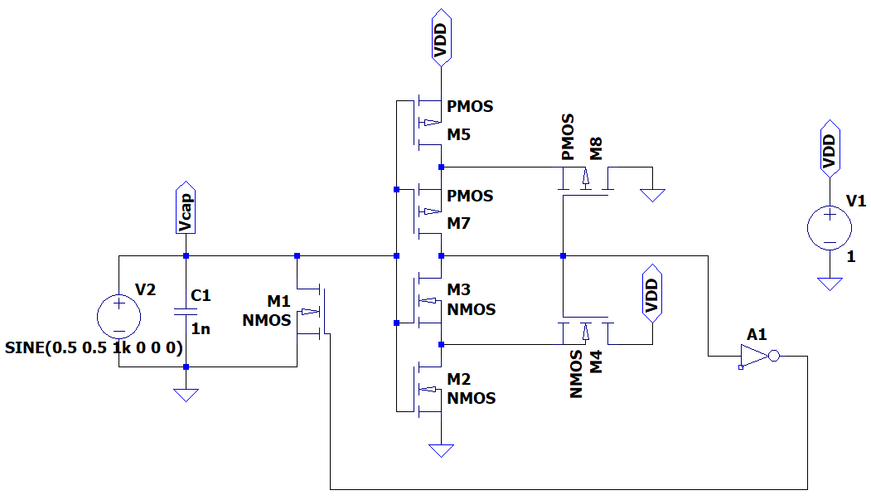
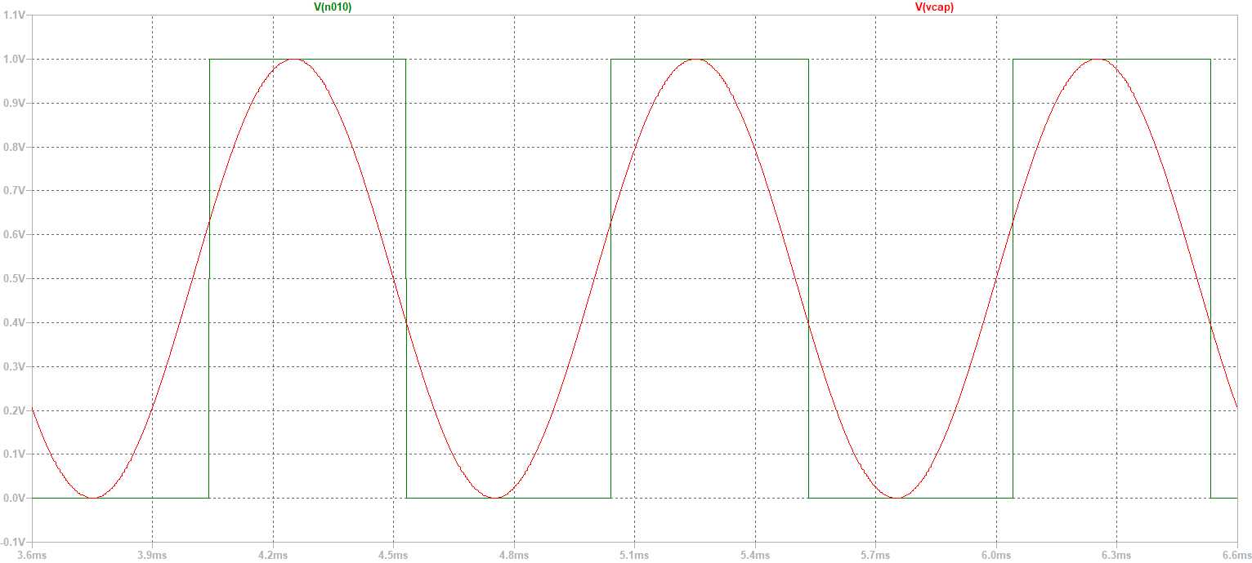
Integrate-and-Fire circuit
This circuit simulates the spiking behavior of a LIF post-synaptic neuron
It employs a Schmitt trigger generating spikes through rapid switching when the input voltage reaches a threshold

Slide 7
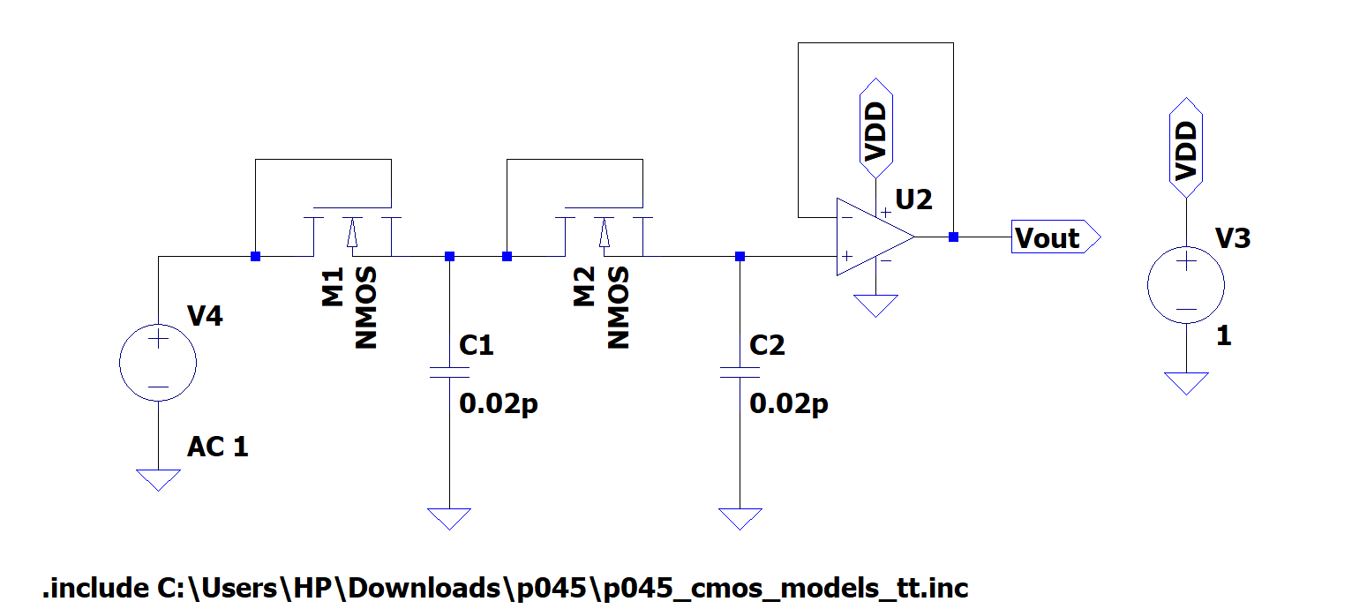
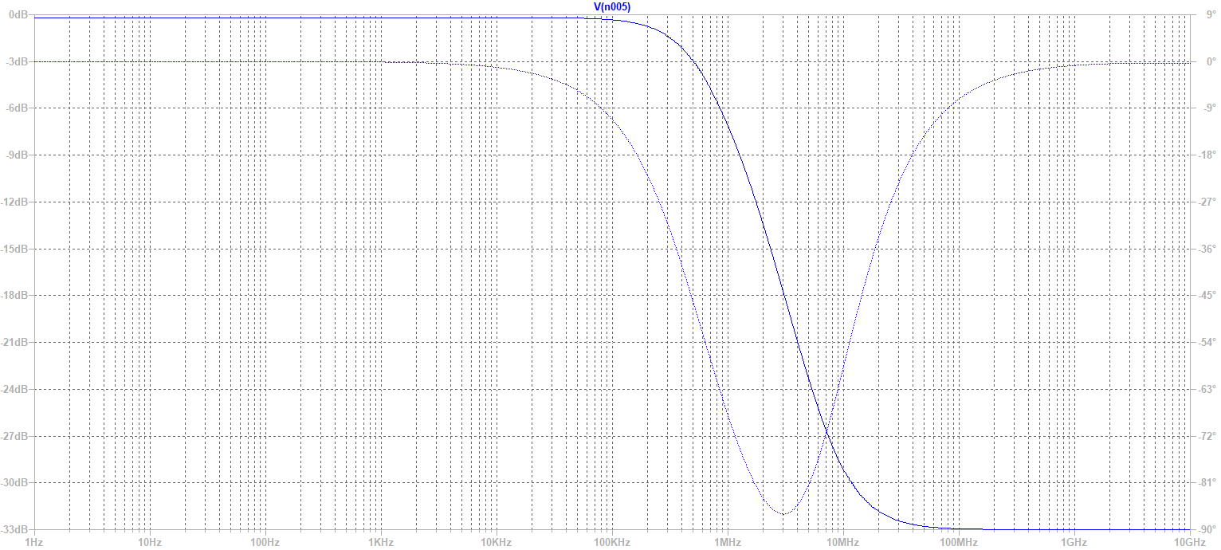
Two-stage Low-pass filter
This circuit ensures rapid voltage increase with each spike and slow decay between spikes
It uses two diode-connected nMOS devices in series with capacitors from each diode's output to ground to leaky-integrate the IFC output

Slide 8
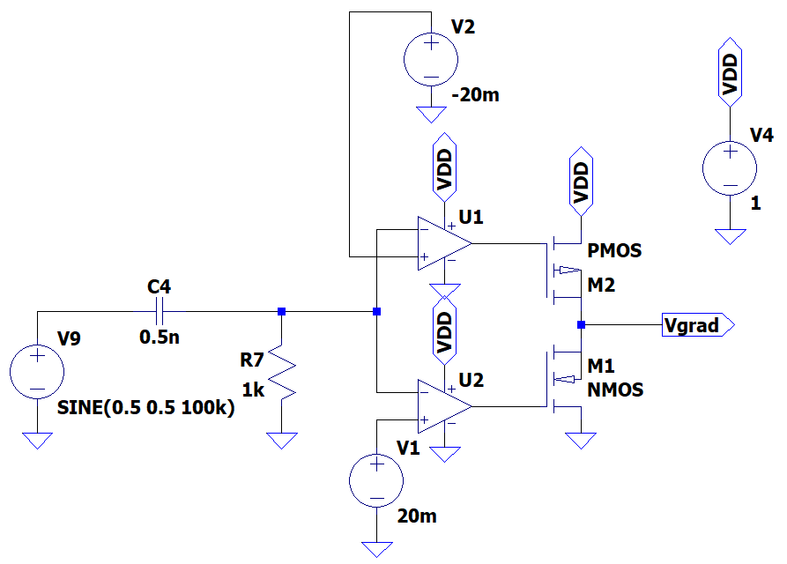
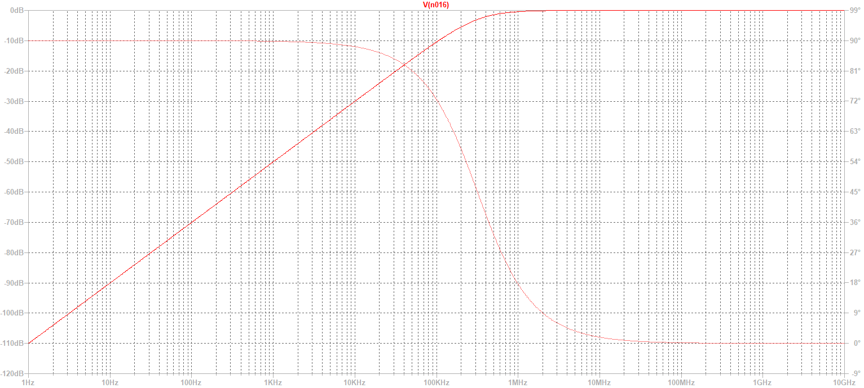
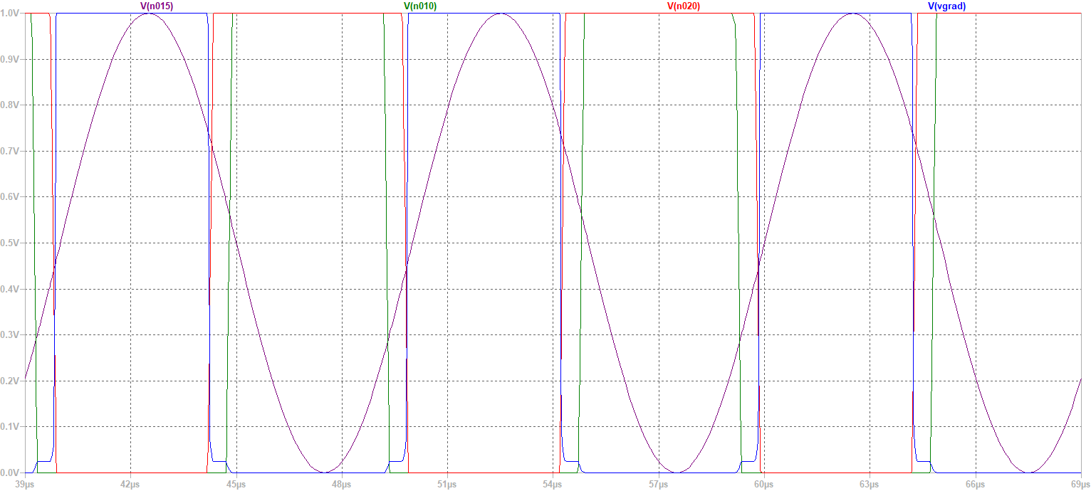
Derivative circuit
This circuit produces an output signal proportional to the derivative of the input signal
It is constructed using a differential amplifier connected in an RC feedback

Slide 9
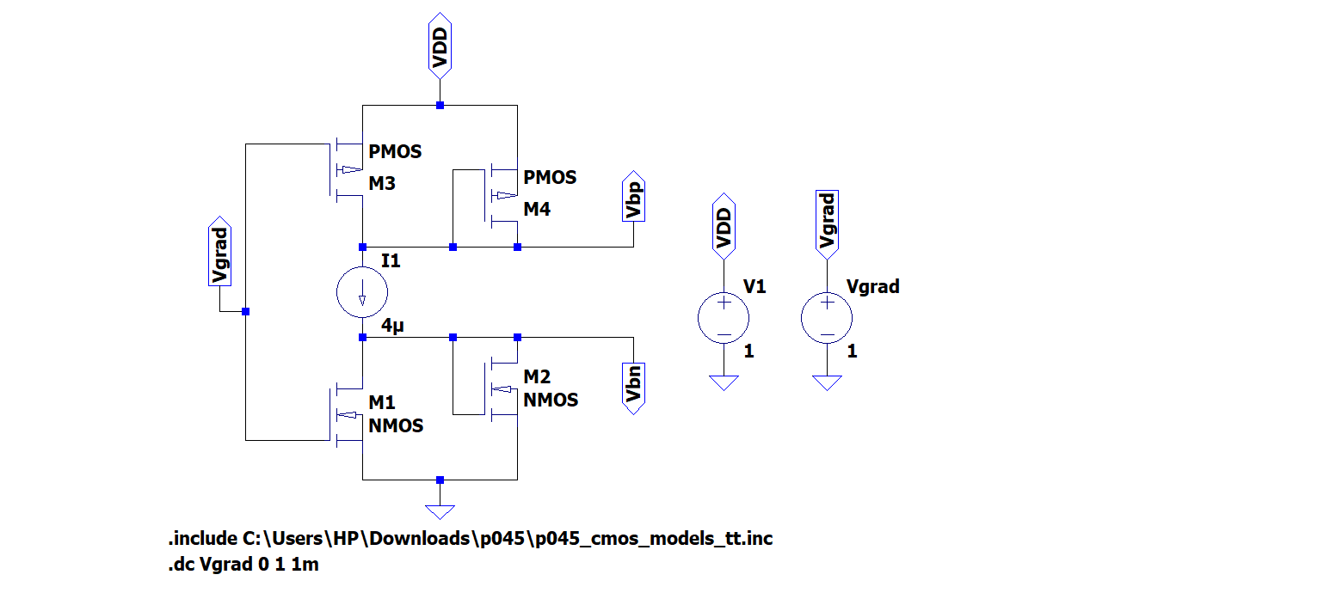
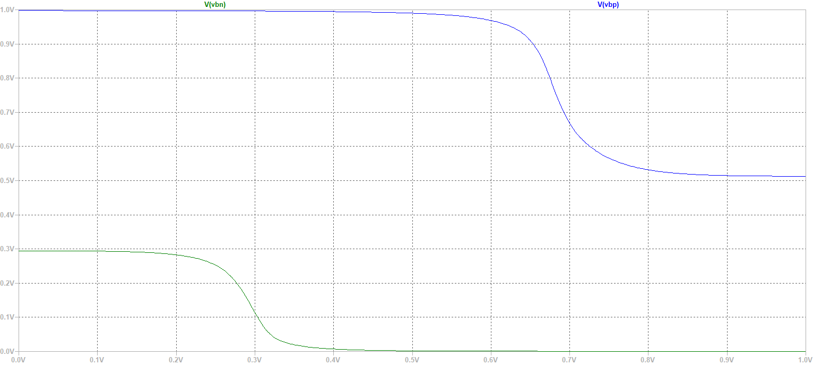
Bias circuit
This circuit takes the gradient of the spike rate as input and outputs bias voltages (Vbp and Vbn) to the synapse circuit.
Based on the gradient values, M3 & M4 control Vbp and M2 & M1 control Vbn

Slide 10
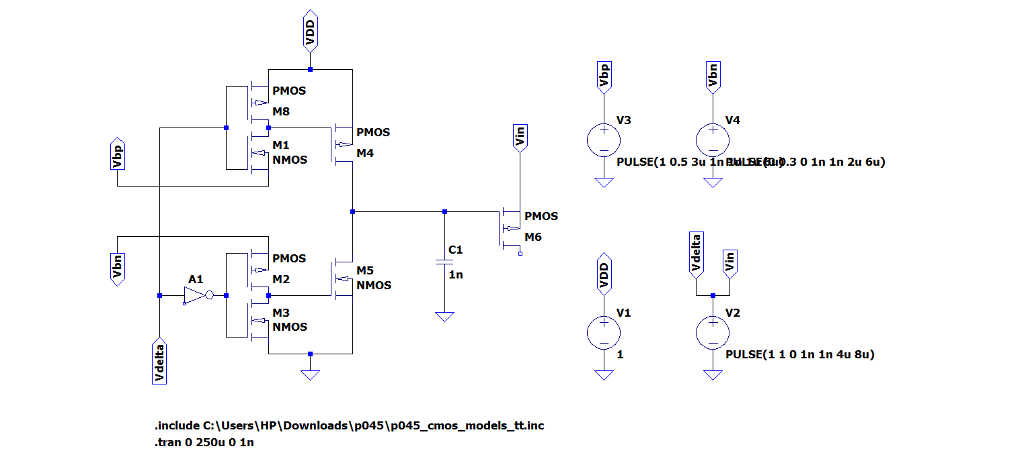
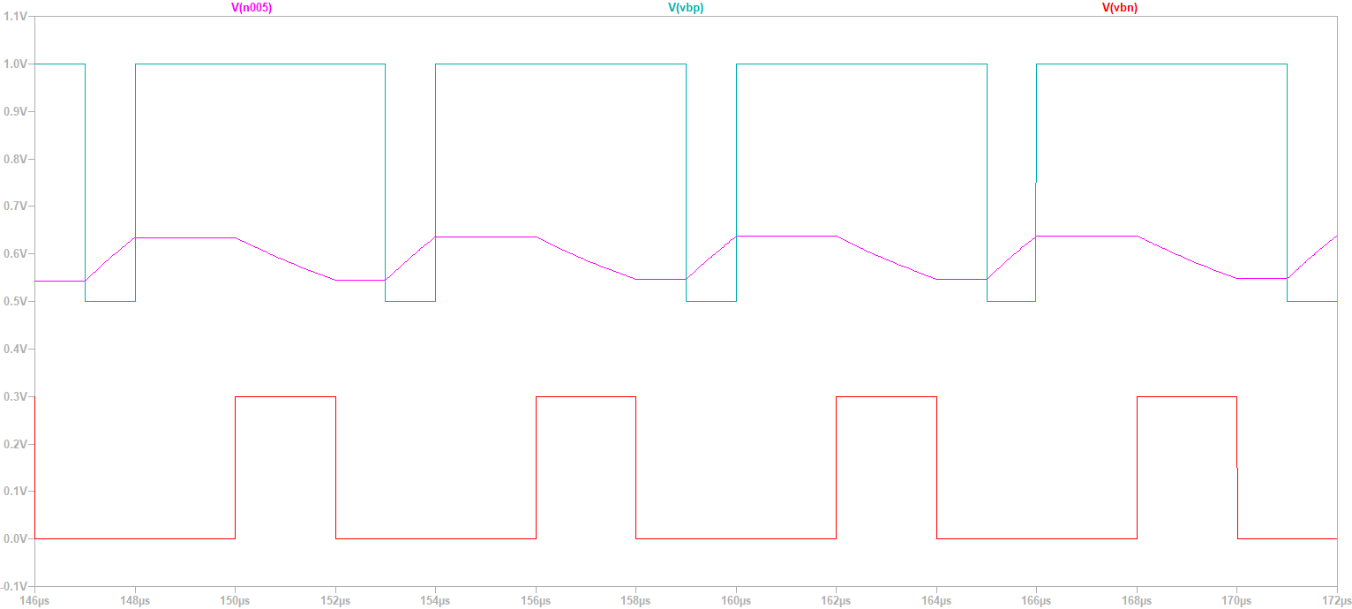
Synapse circuit
This circuit processes inputs from the presynaptic and post-synaptic neurons to generate an output fed back to the post synaptic IFC.
It involves a capacitor that charges, discharges or remains steady based on different input conditions

Slide 11
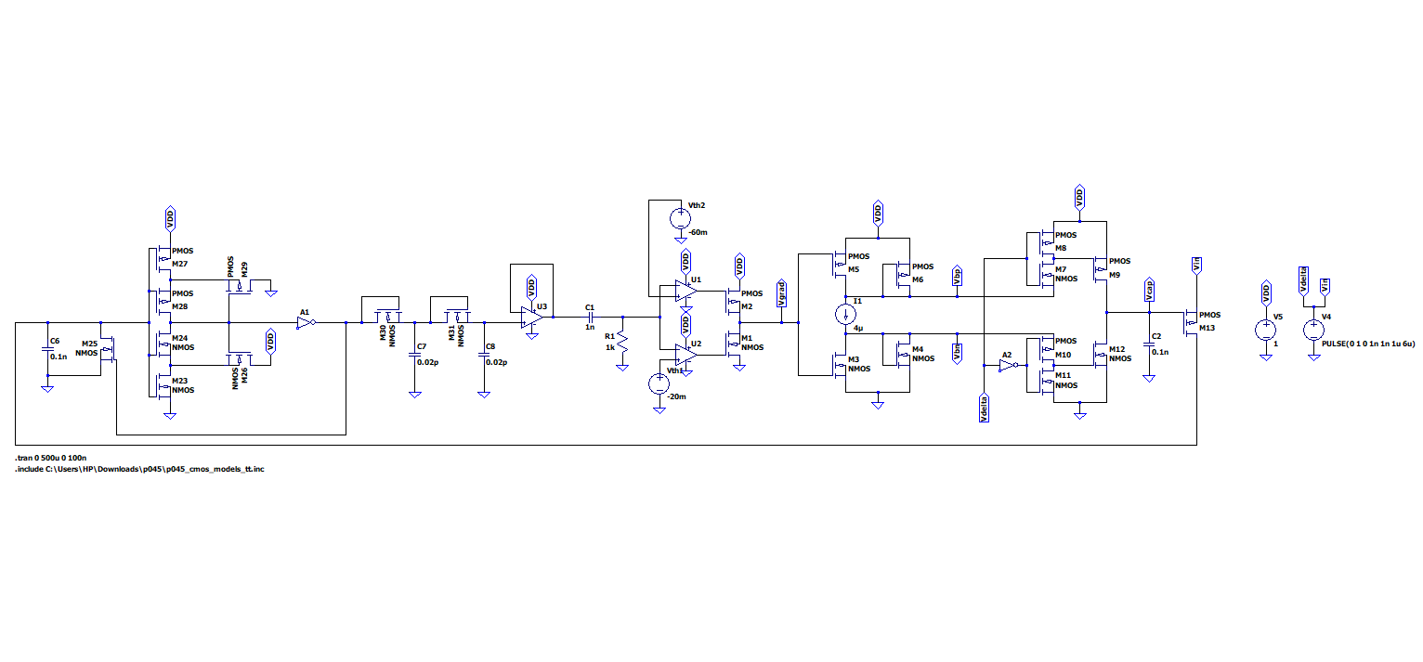
The complete circuit

Slide 12
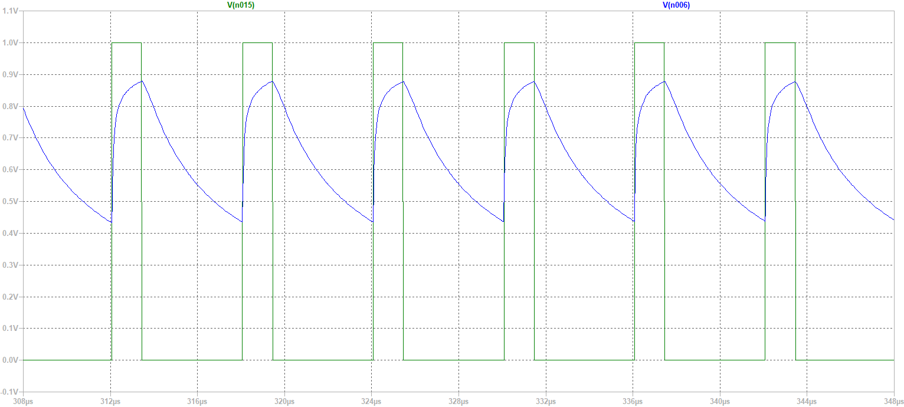
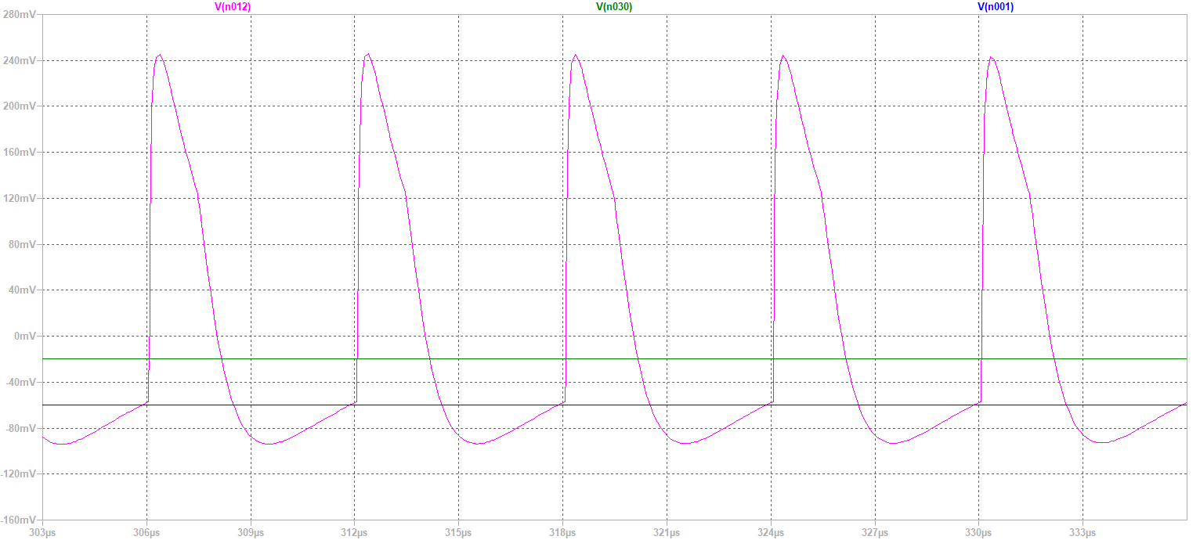
Results
Post-synaptic neuron spikes
Analog spike rate for post-synaptic neuron
Threshold voltages
Post-synaptic neuron Spike-rate derivative

Slide 13
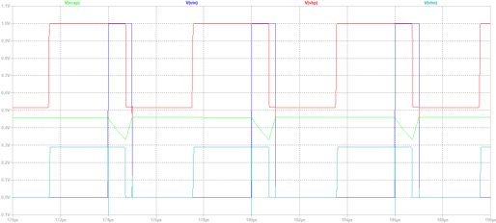
Results
Power values:
Total power consumption=82.65uW
Power consumed by synapse circuit=8.79uW
Output capacitor voltage
Presynaptic neuron spikes
Bias voltages

Slide 14
Conclusion
We have successfully simulated the neuron and synaptic circuit of the spike equilibrium propagation hardware using 45nm CMOS technology.
We have cascaded the five circuit blocks such that each operates within its required region of operation. They are working as intended.
This combined circuit gives us a low-power and energy efficient, biologically inspired algorithm for real time learning tasks.

Slide 15
References
[1] B. Scellier and Y. Bengio, “Equilibrium propagation: Bridging the gap between energy-based models and backpropagation,” Frontiers in Computational Neuroscience, vol. 11, 2017. [Online]. Available: https://www.frontiersin.org/articles/10.3389/fncom.2017.00024
[2] B. Taylor, N. Ramos, E. Yeats, and H. Li, “CMOS implementation of spiking equilibrium propagation for real-time learning,” in 2022 IEEE 4th International Conference on Artificial Intelligence Circuits and Systems (AICAS), 2022, pp. 283–286.

Slide 16
THANK YOU

