Slide 1
Freeflow Core
Team-1
EE748: Advanced Topics in Computer Architecture

Slide 2
Motivation: OoO vs InO
OoO help extract both the inherent memory-level parallelism (MLP) and the instruction-level parallelism (ILP)
Therefore, OoO have much higher performance than InO
High power and area budgets
Need an energy-efficient core for extracting MLP
sOoO add just enough OoO functionality to extract MLP

Slide 3
Sliced-Out-of-Order (sOoO) Core
Create slices of address-generating instructions (AGIs) leading up to loads/stores
Slices are executed out-of-order
bypass potentially stalled instructions
Manage to bridge most of the OoO-Ino performance gap
Small hardware overhead
High energy-efficiency

Slide 4
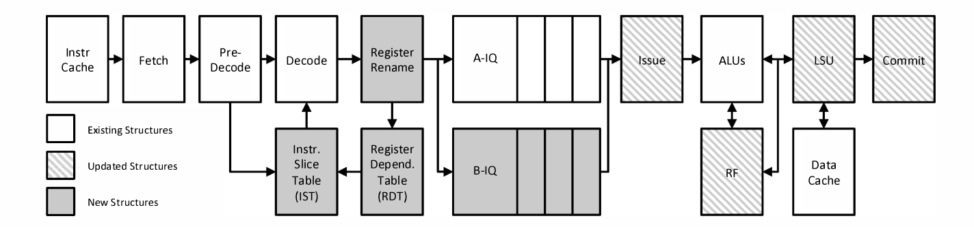
Load-Slice Core [1]
Different queues: compute (A-IQ) and memory-access (B-IQ)
Identify AGIs: Backward dependency analysis technique
Execute slices out-of-order using memory-access queue
[1] “The load slice core microarchitecture,” in International Symposium on Computer Architecture, 2015

Slide 5
Limitations of sOoO
Suffer from frequent stalls:
Inter-slice dependence
Head of memory-access stalled due to dependency on instruction in another slice
Blocks younger, independent-slice instructions
Tackled by Freeway Core [2]
Stalls at the head of the compute pipeline
Dependency on a long-latency instruction in the compute pipeline
Blocks younger, ready-to-execute instructions
Tackled by Freeflow Core [3]
[2] “Freeway: Maximizing MLP for slice-out-of-order execution,” in International Symposium on High Performance Computer Architecture, 2019
[3] “Freeflow core: Enhancing performance of in-order cores with energy efficiency,” in International Conference on Computer Design (ICCD), 2019

Slide 6
Freeflow Core
Bypass blocking instructions in the compute pipeline to another queue (bypass queue)
Need to detect such high-latency instructions
Set-Counter: count stall cycles at the head of the compute pipeline
> 6 cycles: registered in the Freeflow Instruction Slice Table (FIST)
Reset-Counter: count stall cycles at the head of the bypass queue
< 6 cycles: remove the FIST entry for the instruction as it is no longer a high-latency instruction

Slide 7
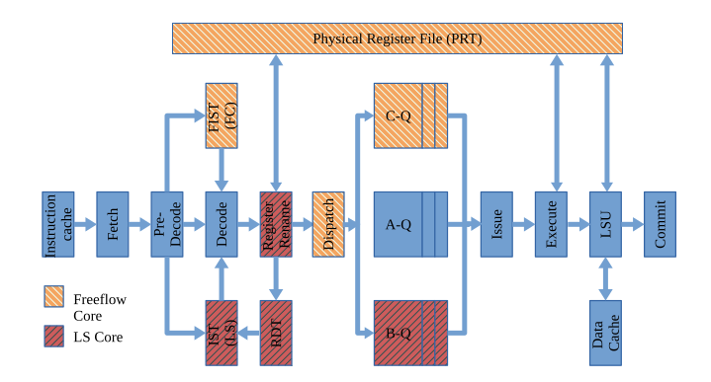
Freeflow Core Microarchitecture

Slide 8
Implementation
Implement Load-Slice Core and Freeflow Core using Gem5
Baselines:
In-order: gem5 MinorCPU
Out-of-order: gem5 O3CPU
Modify O3CPU to implement LSC and Freeflow
Evaluate LSC and Freeflow on SPEC2006 benchmarks

Slide 9
O3 to In-Order
Instruction list stores every instruction that is fetched by the CPU till it has been retired -> fills up in program order
Find oldest instruction that has not been issued
Head of the ready queue must match oldest instruction
Check for squashed instructions in ready queue

Slide 10
Instruction Queues
Check incoming instruction and add to appropriate instruction list
If instruction is of memory access type (load, store or memory reference) then add to 2nd list
Follow the same procedure as previous but keep 2 oldest instruction sequence numbers and compare them with the head of the ready queue

Slide 11
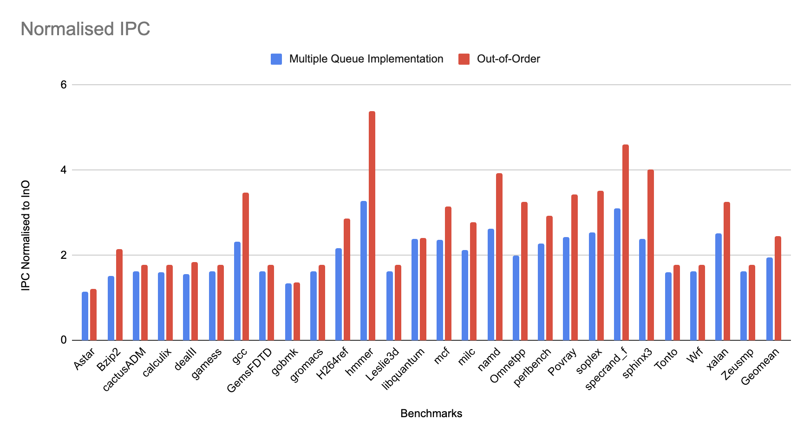
Results

Slide 12
Work Distribution
Converting O3CPU to In-order with register renaming: Both
Implementation of additional queues: Neeraj

