Slide 1
EE724 Nanoelectronics Course Projects Collaborator: Synopsys
Optimum Device Design for NIPIN Selector
Anubhav Bhatla, Hemant Hajare and Nikhileshsing Rajput
Mentored by Hemant Kumar and Shubham Patil

Slide 2
Outline
Understand Impact Ionization
Analyse
PIN device
NIPIN device
Uniform charge distribution
Delta charge distribution
Experiment NIPIN device for
Effect of varying lengths of i1 and i2 regions
Effect of temperature on IV characteristics
Effect of proportion of Germanium in p-region
5 May 2024
EE724 Nanoelectronics Course Projects, 2024

Slide 3
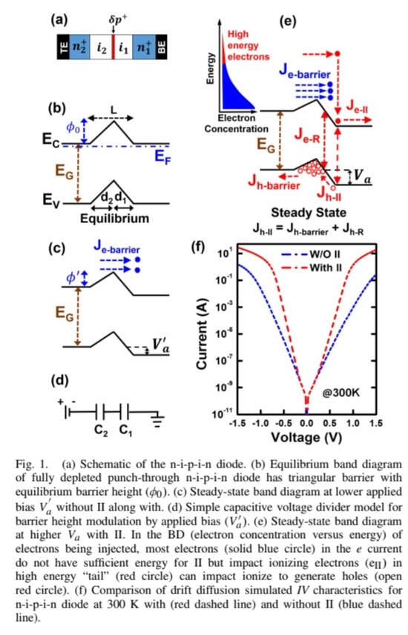
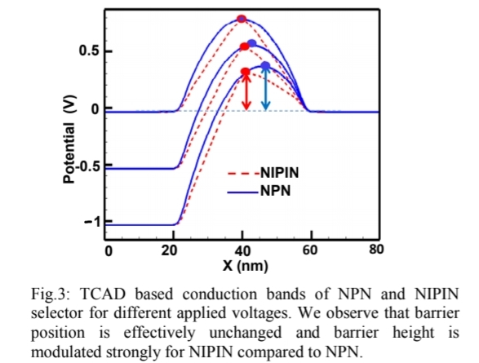
Motivation
Advantages of NIPIN selector over NPN selector
NIPIN : linear band diagram, NPN : non-linear band diagram
NIPIN : ideal subthreshold slope and negligible degradation, NPN : subthreshold slope degradation at high V
Experimental demonstration of impact ionization
High current, sub ±2V operation, voltage asymmetry
5 May 2024
EE724 Nanoelectronics Course Projects, 2024

Slide 4
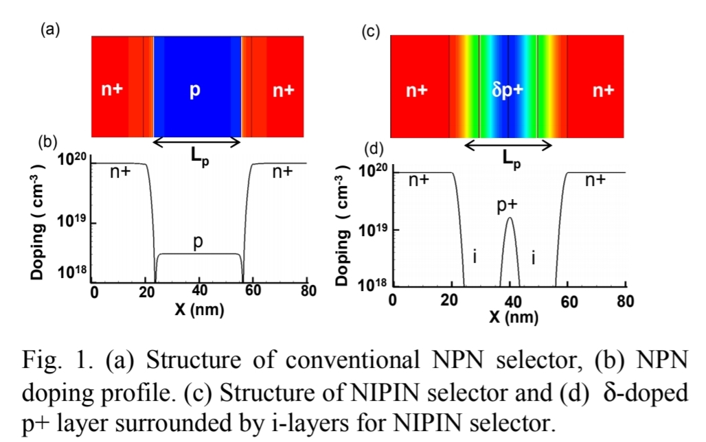
Device Details
10¹⁶ cm⁻¹
δp+
10¹⁶ cm⁻¹
N+
i/p-
i/p-
N+
10²⁰ cm⁻¹
10¹⁹ cm⁻¹
10²⁰ cm⁻¹
Device consists of 5 regions : n+, i1, p+, i2, n+
i1 are i2 are p-regions but relatively intrinsic w.r.t n+ and p+
Device is symmetric/asymmetric based on if i1 and i2 have equal lengths and doping concentration
Length of p region is very small (~1 nm) as compared to other regions (~10nm)
p-region is delta-doped
Highly p- doped intrinsic region and δ-doped p+ region
5 May 2024
EE724 Nanoelectronics Course Projects, 2024

Slide 5
TCAD calibration
Si-Ge in p-region:
(sdegeo:create-rectangle
(position xminp yminp 0) (position xmaxp ymaxp 0)
"SiliconGermanium" "p"
)
HeteroInterface
MoleFraction( RegionName = ["p"]
xFraction = 1.00)
Impact Ionization:
eAvalanche
hAvalanche
5 May 2024
EE724 Nanoelectronics Course Projects, 2024

Slide 6
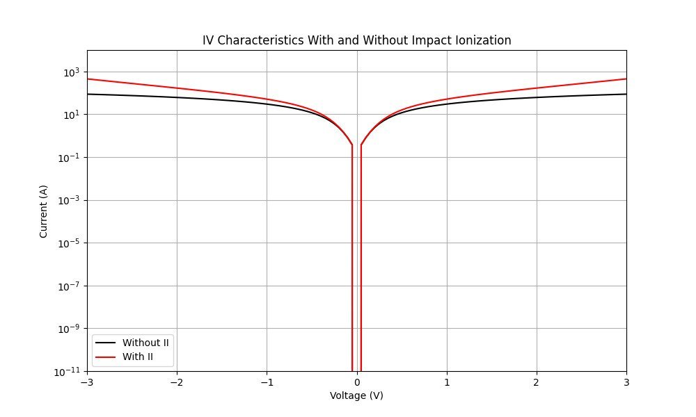
Impact Ionization
5 May 2024
EE724 Nanoelectronics Course Projects, 2024

Slide 7
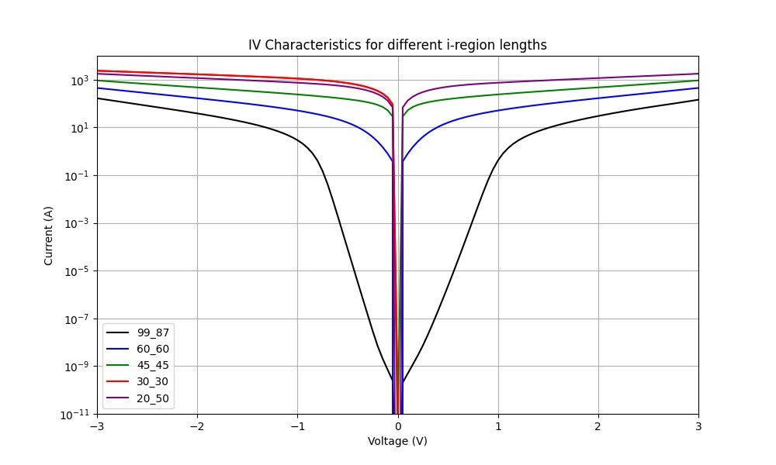
Impact of parameter variation
Length of i1 and i2 regions
Device is symmetric/asymmetric if length of i1, i2 are equal/unequal respectively
IV characteristics/Band diagram are symmetric/asymmetric likewise
Symmetric and asymmetric IV characteristics
5 May 2024
EE724 Nanoelectronics Course Projects, 2024

Slide 8
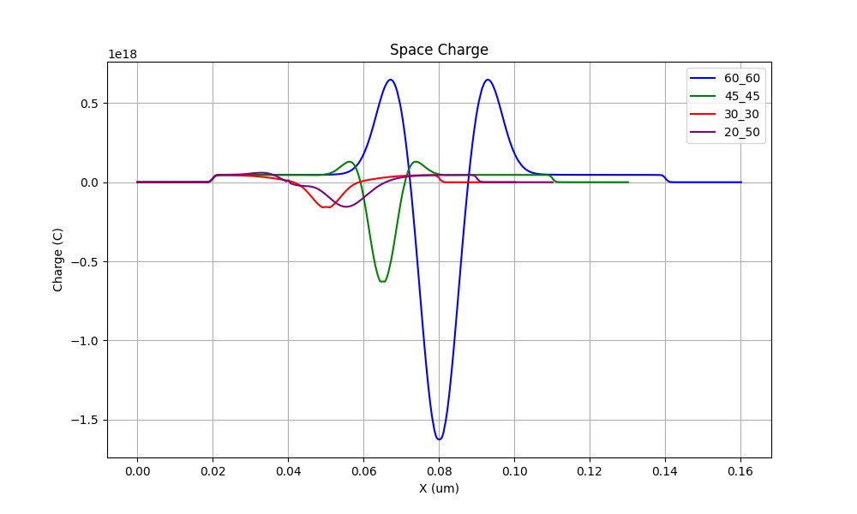
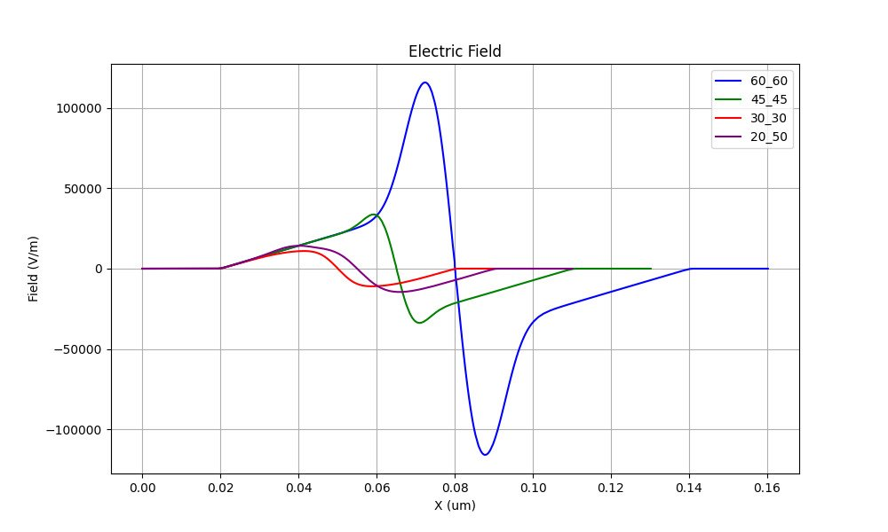
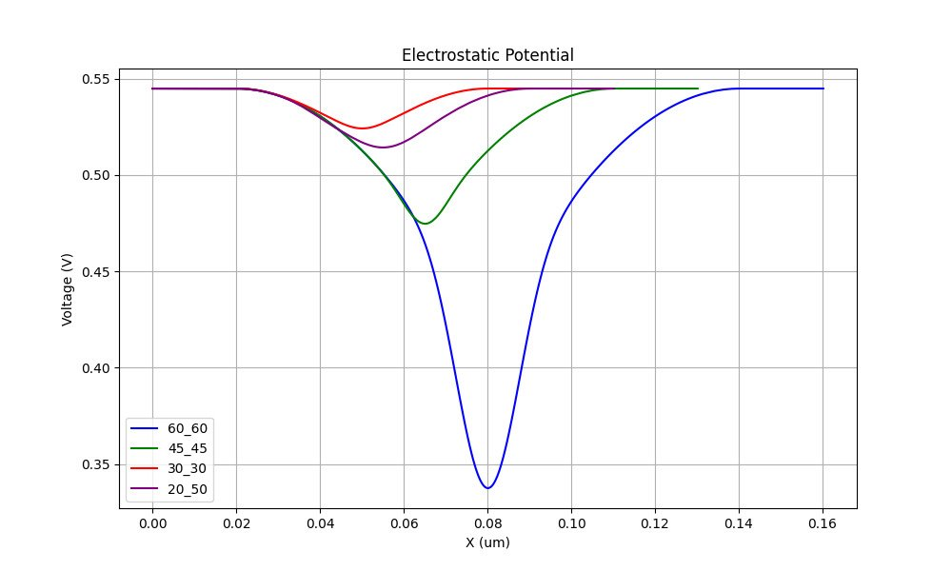
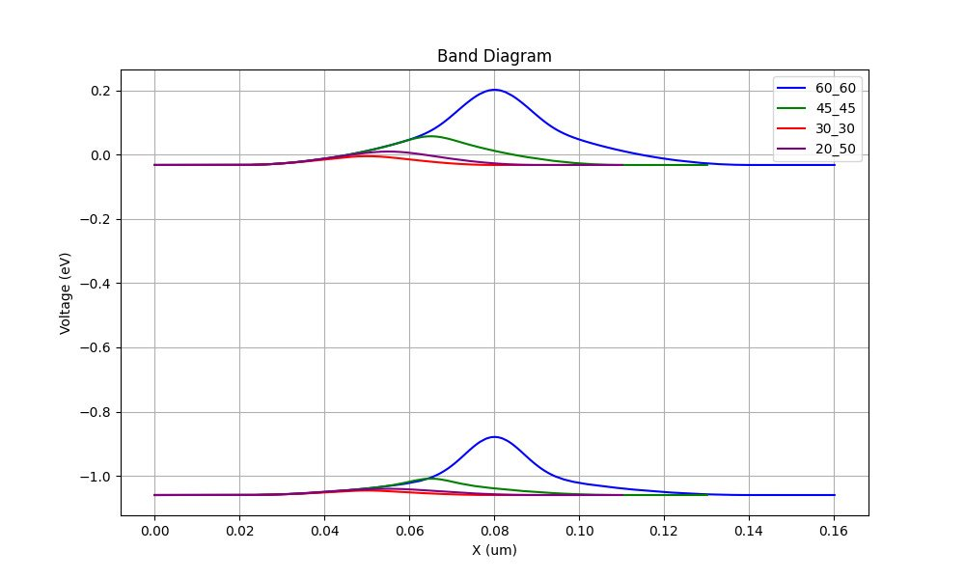
5 May 2024
EE724 Nanoelectronics Course Projects, 2024

Slide 9
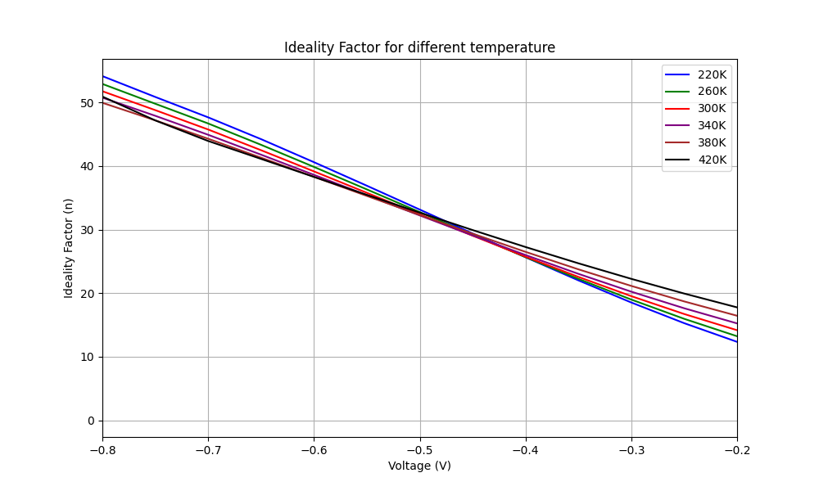
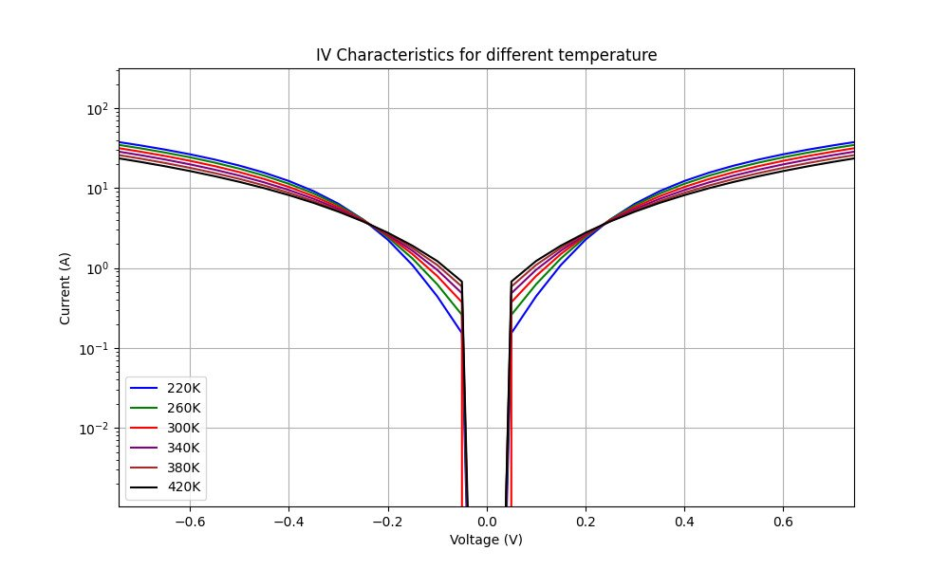
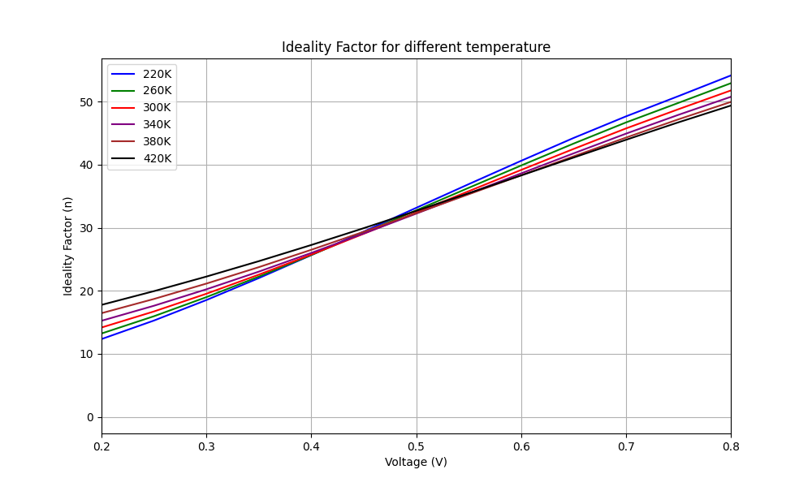
Impact of parameter variation
Temperature of operation
Existence of cross over point
5 May 2024
EE724 Nanoelectronics Course Projects, 2024

Slide 10
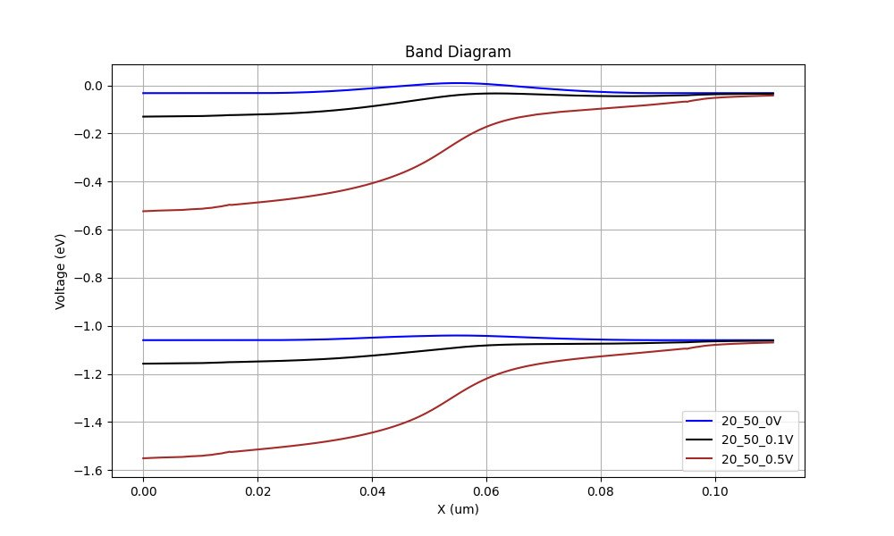
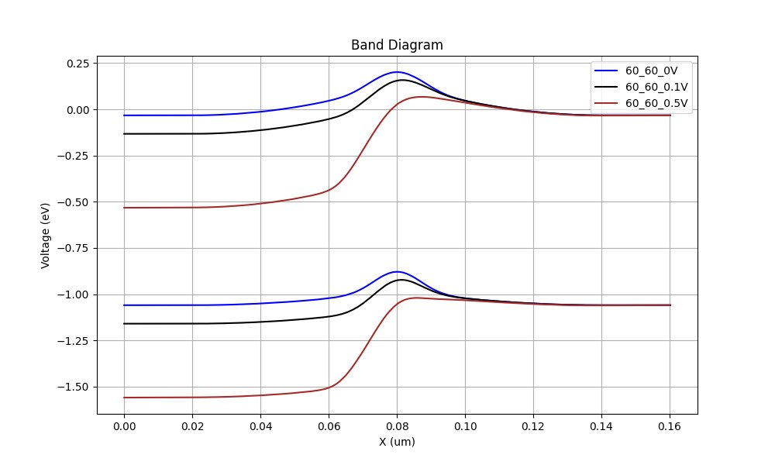
Impact of parameter variation
Bias voltages
Barrier height increases with positive bias
5 May 2024
EE724 Nanoelectronics Course Projects, 2024

Slide 11
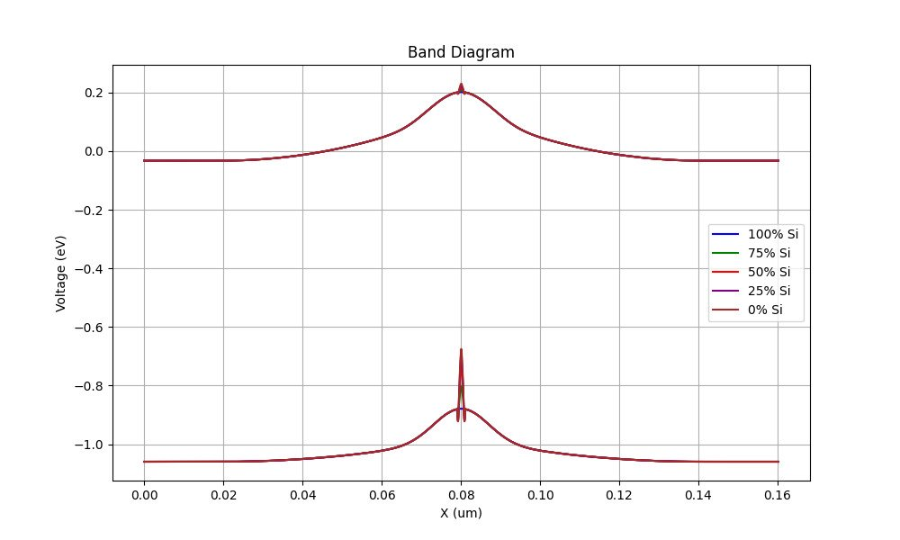
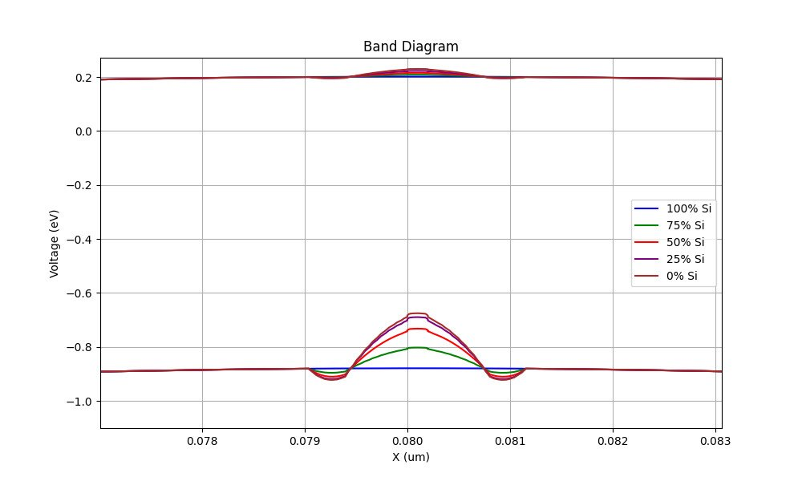
Impact of parameter variation
Proportion of Germanium in p-region
The hole well can be modified without modifying the electron barrier
5 May 2024
EE724 Nanoelectronics Course Projects, 2024

Slide 12
Conclusion and future work
NIPIN device
Symmetric and asymmetric properties
Number of controllable parameters
Width of regions
Doping concentration
Impact ionization
Effect of using Si-Ge in i-regions
5 May 2024
EE724 Nanoelectronics Course Projects, 2024

Slide 13
Reference
B. Das, S. Sushama, J. Schulze and U. Ganguly, "Sub-0.2 V Impact Ionization in Si n-i-p-i-n Diode," in IEEE Transactions on Electron Devices
R. Meshram et al., "High performance triangular barrier engineered NIPIN selector for bipolar RRAM," 2014 IEEE 6th International Memory Workshop (IMW)
5 May 2024
EE724 Nanoelectronics Course Projects, 2024

Slide 14
Appendix – Physics of Impact Ionization
5 May 2024
EE724 Nanoelectronics Course Projects, 2024

Slide 15
E<E_{g}
5 May 2024
EE724 Nanoelectronics Course Projects, 2024

Slide 16
5 May 2024
EE724 Nanoelectronics Course Projects, 2024

Slide 17
E>E_{g}
5 May 2024
EE724 Nanoelectronics Course Projects, 2024

Slide 18
5 May 2024
EE724 Nanoelectronics Course Projects, 2024

Slide 19
5 May 2024
EE724 Nanoelectronics Course Projects, 2024

Slide 20
5 May 2024
EE724 Nanoelectronics Course Projects, 2024

Slide 21

5 May 2024
EE724 Nanoelectronics Course Projects, 2024

Slide 22
5 May 2024
EE724 Nanoelectronics Course Projects, 2024

Slide 23

5 May 2024
EE724 Nanoelectronics Course Projects, 2024

